Slide 1

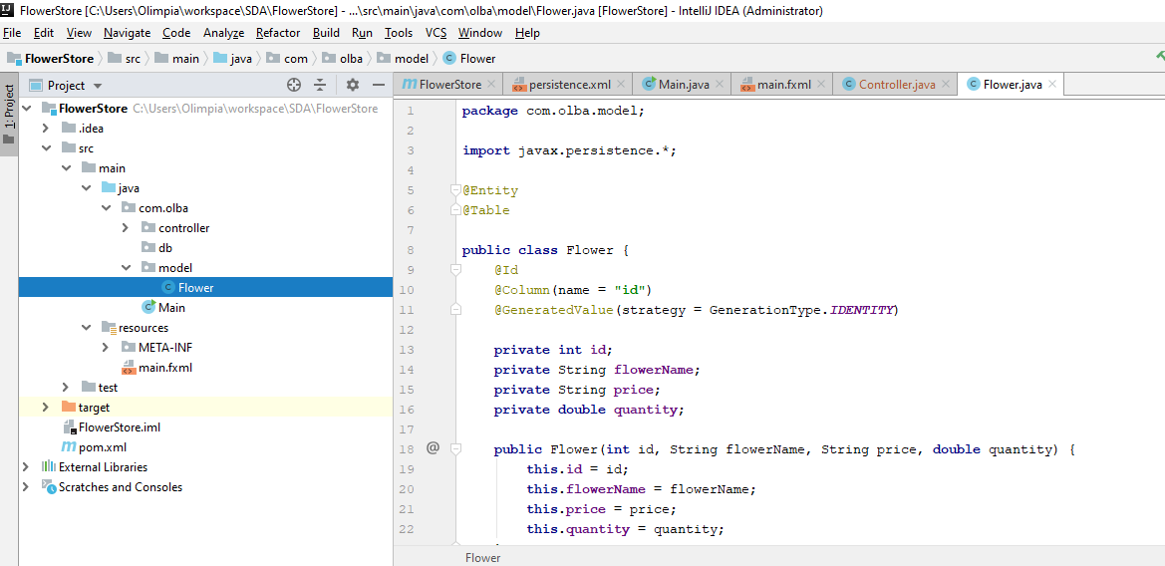
Application Name: FlowerStore
Create model package and first class Flower

Slide 2
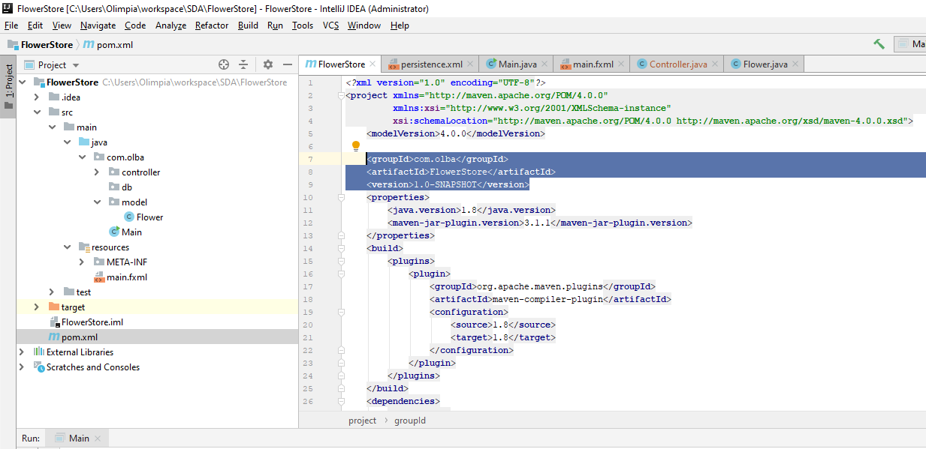
Add properties to pom.xml file

Slide 3
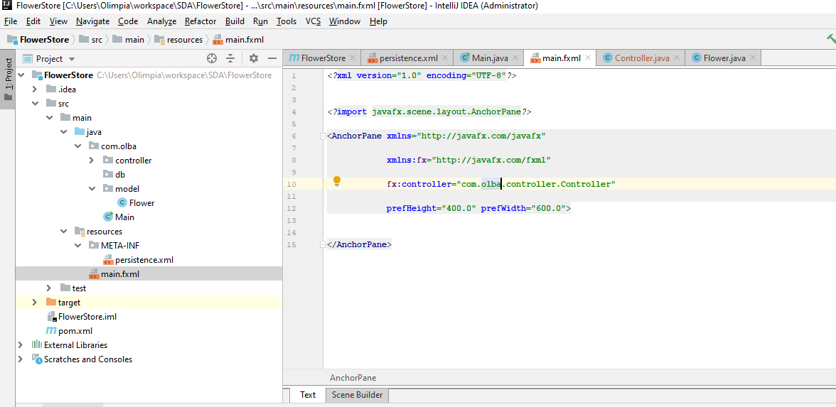
Create resources package and main.fxml file

Slide 4
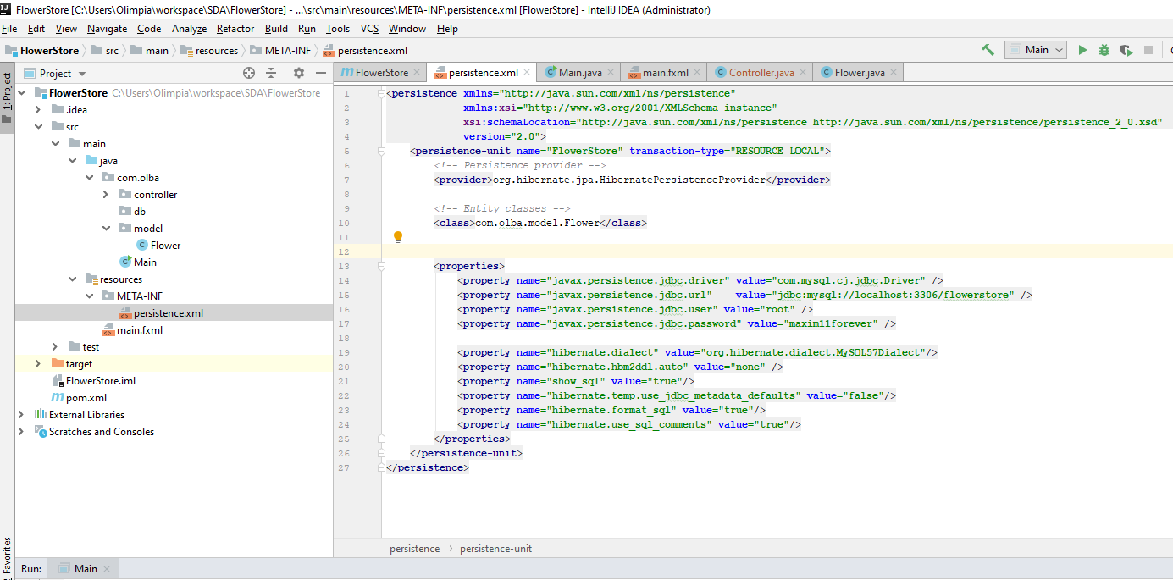
Create persistence.xml file in resources/META-INF

Slide 5
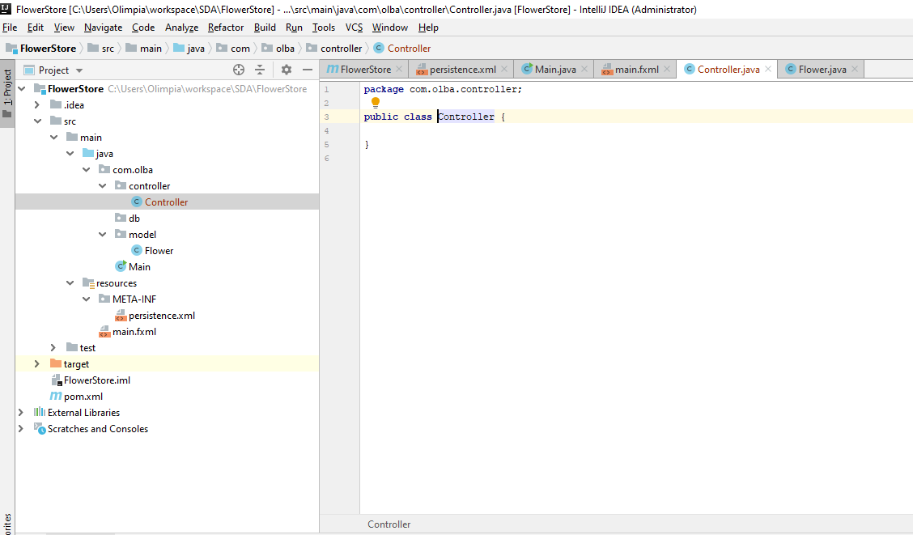
Create package controller and class Controller

Slide 6
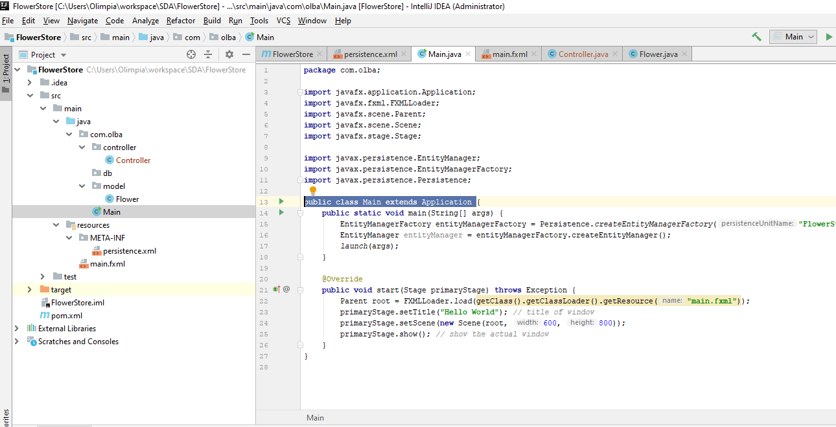
Create Main class

Slide 7
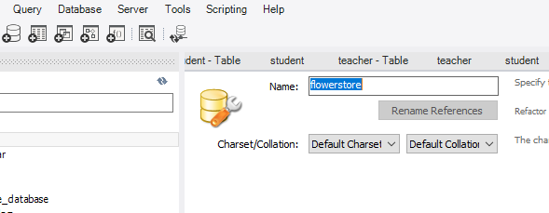
Create flowerstore database in MySql server

Slide 8
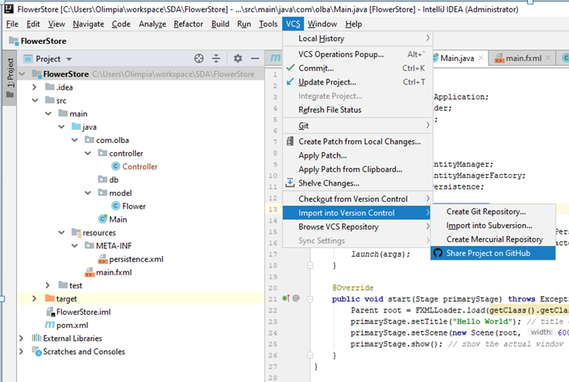
Share your project on GitHub

Slide 9

Good luck with your first setup application! ;-)

