Slide 1
Update 12/10/2018
Amanda Lewis

Slide 2
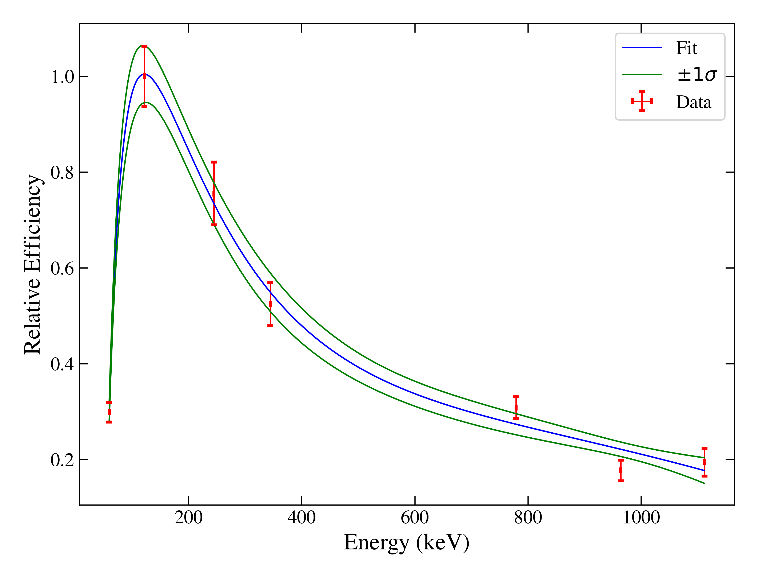
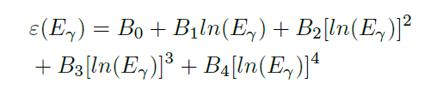
HPGe detector efficiency calibration
A logarithmic polynomial model is often used
This is a simple, linear model – easy to do regression and get uncertainties
But isn’t a physical model
1

Slide 3
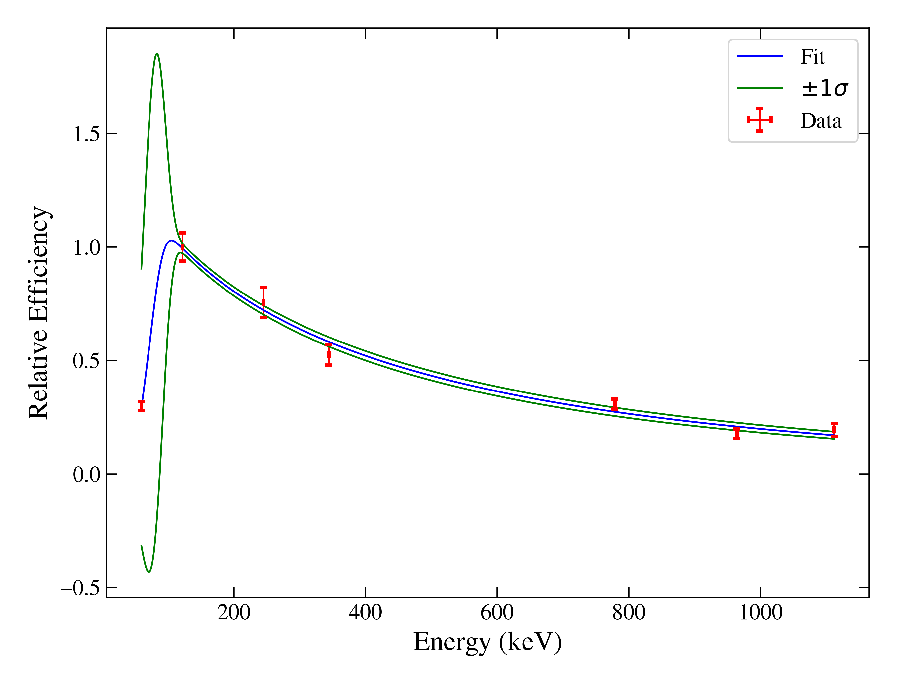

A physically-informed model would be better
This model is still simple, but is derived from physics
Based on Gallagher, W. J., & Cipolla, S. J. (1974). A model-based efficiency calibration of a Si(Li) detector in the energy region from 3 to 140 keV. Nuclear Instruments and Methods, 122, 405–414. https://doi.org/10.1016/0029-554X(74)90508-4
Geometric eff
Prob of getting through dead layer
Prob of interacting in detector volume
2

Slide 4
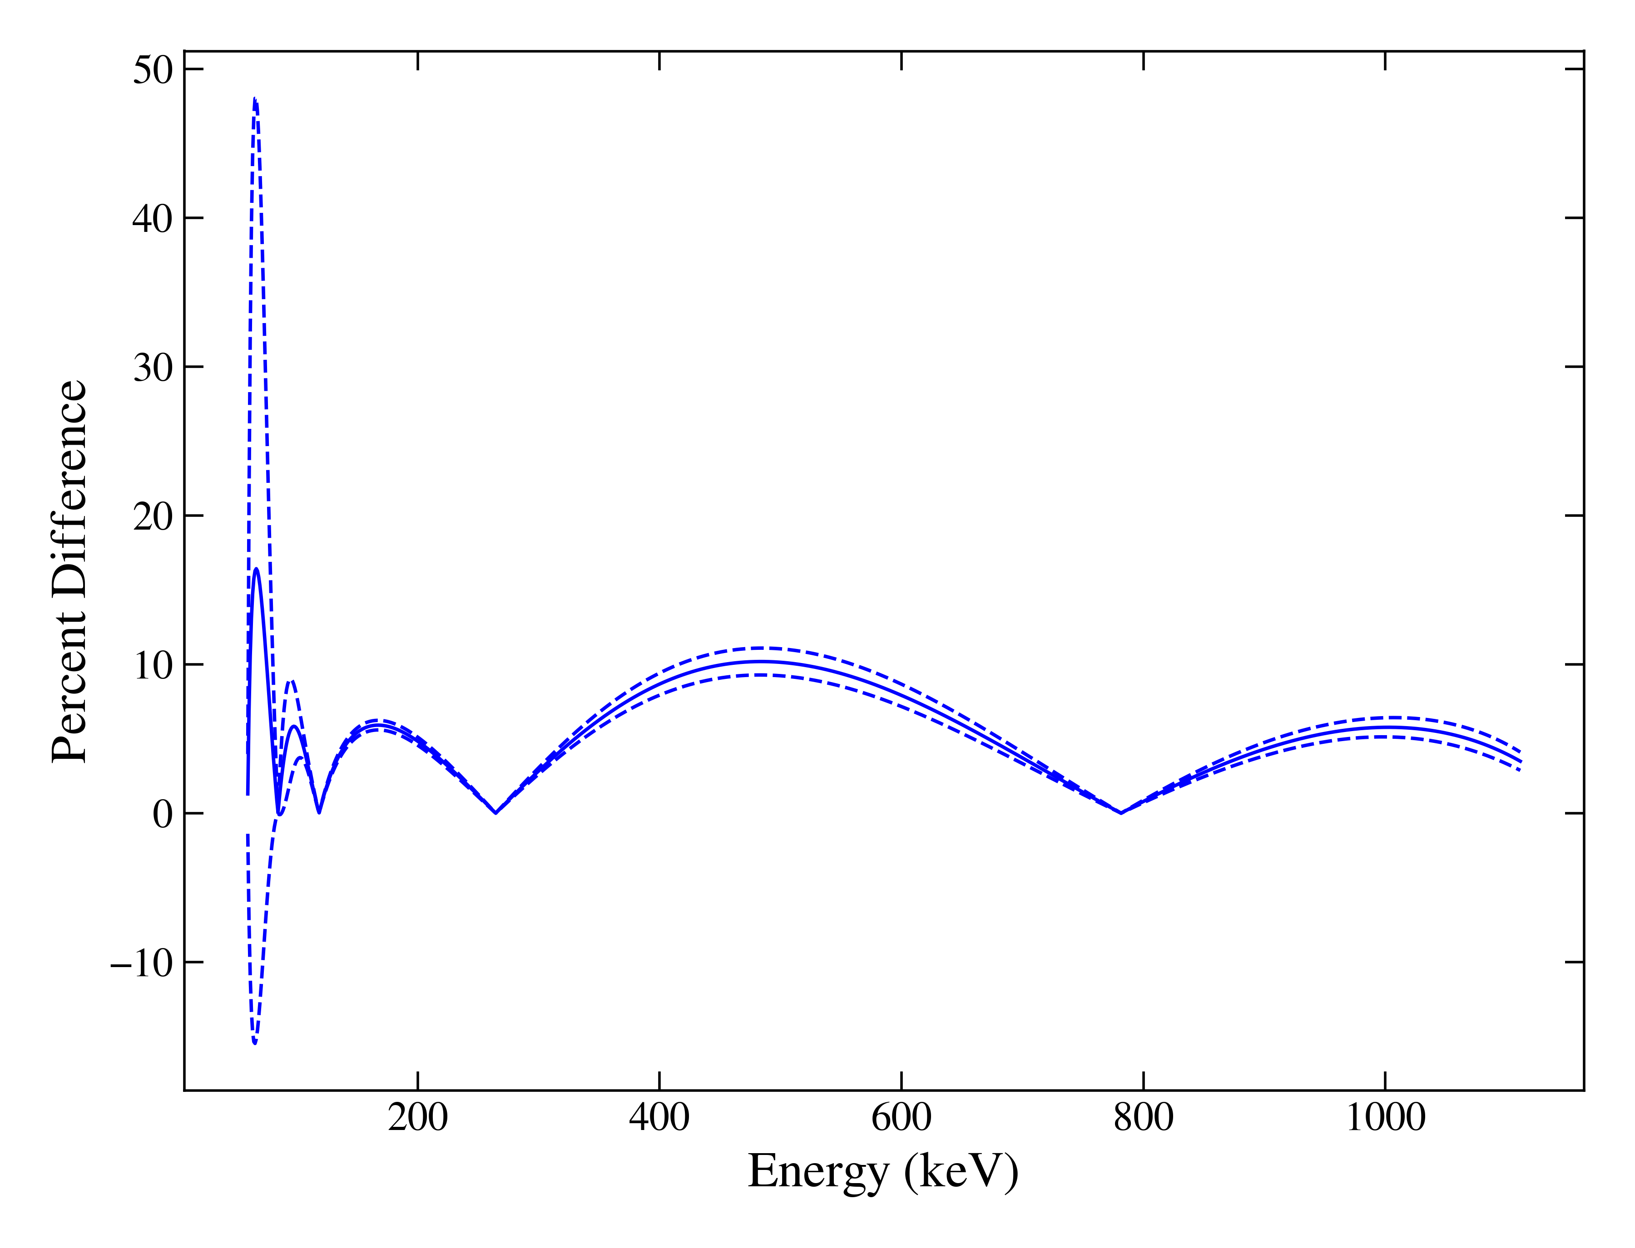
Eric showed that the curves based on these two models are different
3

Slide 5
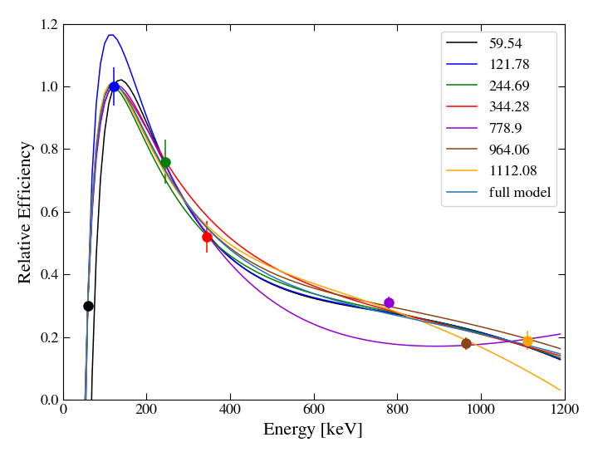
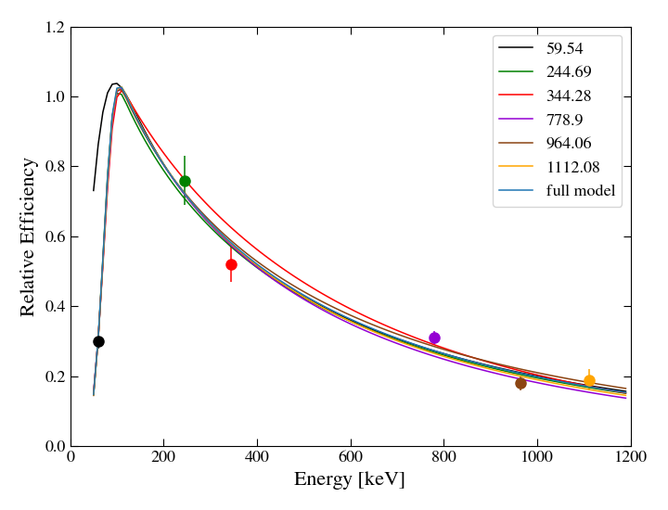
Predicted residual analysis shows that beyond different, the physical model is more stable
4

Slide 6
Future work on efficiency calibration
Add more gamma lines (sit and take data for longer)
See how many data points the log poly form needs to be as stable
See if it will ever not peak at a data point
Do a better job of uncertainty propagation
5

Slide 7
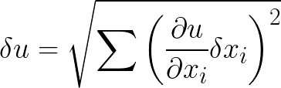
The assumptions behind uncertainty propagation
The Knoll uncertainty propagation equation for uncorrelated uncertainties comes from a Taylor expansion of function u – so all of the assumptions that requires
Small uncertainties
Function is linear in the variables
6

Slide 8
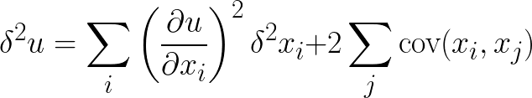
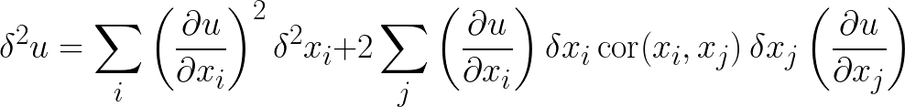
The sandwich formula allows for correlations
Accounting for correlations:
Which expands out to:
7

Slide 9



The uncertainties in linear regression are different
They are analytically derived
Assumptions behind this:
Gaussian, uncorrelated uncertainties
All Y’s come from the same distribution with common variance
8

Slide 10



Generalized Least Squares
Allows for the Y uncertainties to be correlated and non-identical by using data covariance matrix V
Assumptions:
Gaussian Uncertainties
Data uncertainty
Measure of fit
9

Slide 11
Where does Monte Carlo propagation come in?
By sampling and refitting, it allows easy propagation of non-Gaussian and correlated uncertainties – no analytic equation needed
Right now, Eric has this up and running, but just the second part
This takes time – he does 1000 trials for every fit
An alternative is to use MC once to calculate the covariance matrix V, then use scipy, using analytical GLS equations, to do the final fit
Still requires gaussian errors
But analytical equation for V would be very difficult (and likely not solvable)
10

Slide 12
A Monte Carlo Iteration for Efficiency Calibration covariance matrix
Choose source activities based on uncertainties
For each source
Choose branching ratios in a consistent manner
For each data point
Calculate counts by the initial fit of the efficiency curve
Pick statistical uncertainty based on the counts
Create matrix of counts for each gamma line, and store
Now, with a series of “observations” of the different counts, we can easily construct a data covariance matrix, V
11

