Slide 1
WhiskedAway
A Relational Database for Wedding Catering Operations
Business Concept • Database Schema • CRUD • Business Intelligence
Final Project Presentation
Notes:
Introduce WhiskedAway: a boutique wedding catering business, and this project as the relational database that runs both its public website and internal operations.

Slide 2
BUSINESS OVERVIEW
What is WhiskedAway?
WhiskedAway is a boutique wedding catering company. Its web application lets engaged couples browse menu photos, compare package pricing, and request a quote — while the same database runs internal operations behind the scenes.
Customer-Facing
Filterable food gallery, live per-guest pricing, and a quote-request contact form.
Operations
Book events, assign staff, and attach optional add-on services per wedding.
Finance
Generate invoices and track partial/installment payments to full settlement.
2
Notes:
Explain the purpose: couples use the site to browse packages and request quotes; staff use the same database to run bookings, staffing, and billing.

Slide 3
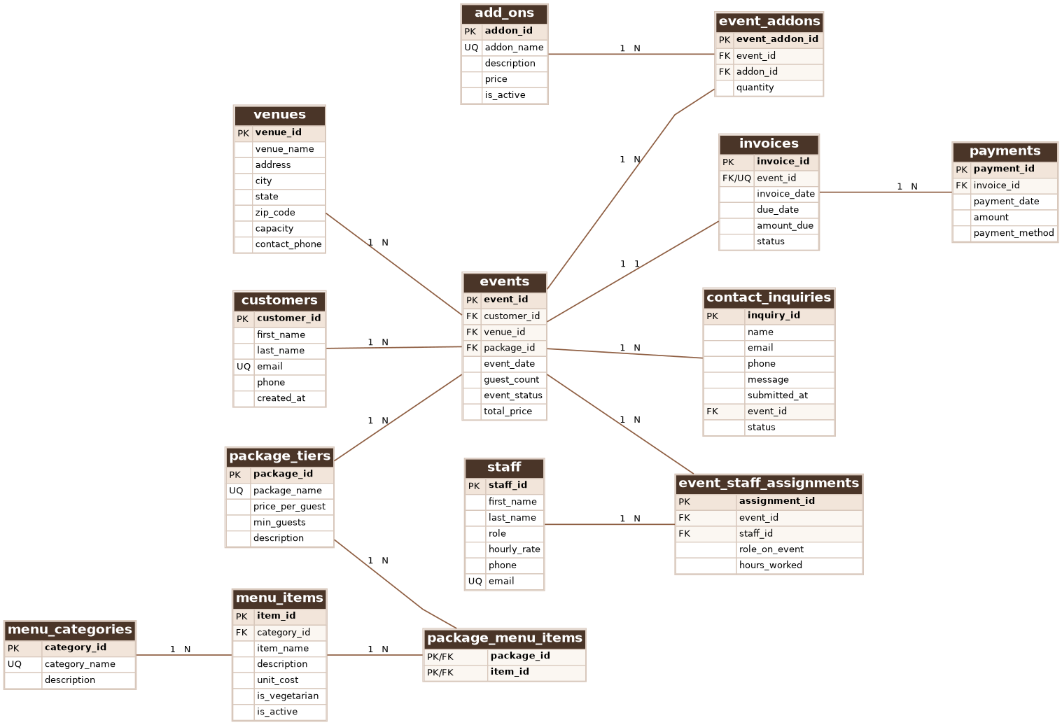
DATABASE STRUCTURE
Entity Relationship Diagram
14 tables — customer, catalog, operational, and financial data, linked by foreign keys.
3
Notes:
Walk through the ERD at a high level: point out the events table as the hub, and the junction tables resolving many-to-many relationships.

Slide 4
DATABASE STRUCTURE
Key Relationships & Design Rationale
events is the hub
Every booking joins one customer, one venue, and one package_tier — the center of the schema.
Junction tables for M:N
package_menu_items, event_addons, and event_staff_assignments resolve many-to-many relationships (a package has many dishes; a dish appears in many packages) without duplicate data.
1:1 invoices
Each event has exactly one invoice (enforced with a UNIQUE foreign key), while an invoice can receive many payments — supporting installment billing.
Referential integrity
Every join uses an explicit FOREIGN KEY constraint with ON UPDATE/DELETE rules, so an event can never point to a deleted customer or venue.
4
Notes:
Explain design rationale: why junction tables were used, why invoices are 1:1 with events but 1:N with payments, and how foreign keys enforce referential integrity.

Slide 5
FUNCTIONALITY DEMO
CRUD Operations
CREATE
READ
UPDATE
DELETE
Register a new customer profile the moment they inquire.
Pull every event booked by one customer, joined across venue and package.
Mark an invoice "Paid" once a balance is settled in full.
Remove a canceled add-on selection from an event.
5
Notes:
Demo or describe one CRUD example per operation, referencing the business task each one solves (e.g., marking an invoice Paid).

Slide 6
FUNCTIONALITY DEMO
Business Cases & Views
Which package tiers earn the most confirmed revenue?
Aggregate SUM/COUNT grouped by package, filtered to real bookings.
Which customers have an outstanding balance?
Correlated subquery nets payments against each invoice.
Which dishes appear across the most packages?
Join + GROUP BY ranks menu items by cross-package reach.
vw_event_dashboard
vw_monthly_revenue_report
One row per event combining customer, venue, package, invoice status, and balance — a front-desk-ready view.
Monthly rollup of confirmed events, guests, and revenue — a leadership reporting dashboard.
6
Notes:
Walk through one advanced query result (e.g., revenue by package) and both views, explaining why a view was the right tool for repeated reporting needs.

Slide 7
CHALLENGES & SOLUTIONS
Challenges & Solutions
Challenge: Packages and menu items are both reusable and share a many-to-many relationship.
Solution: Introduced a package_menu_items junction table instead of duplicating dish data inside each package row.
Challenge: Installment payments meant an invoice's "amount paid" isn't a single stored column.
Solution: Kept payments as its own table and computed running totals with a correlated subquery / view instead of a fragile cached field.
7
Notes:
Share two real challenges faced while designing the schema and how they were solved, e.g. modeling many-to-many relationships and installment payments.

Slide 8
Thank You
WhiskedAway — SQL scripts, sample data, and the ERD are included in the accompanying submission files.
Notes:
Thank the audience and note that all SQL scripts, sample data, and the ERD are included as separate submission files.

