Slide 1
Developing a Resume

Slide 2
Edible Resumes
Edible Resumes & Business Cards!
http://video.foxbusiness.com/v/4114803/edible-resumes-business-cards/#sp=show-clips

Slide 3
What did you think?
Turn to your neighbor and discuss the following questions:
What is your reaction to using edible resumes?
When do you think it would be appropriate to
send an edible resume?

Slide 4
What does a resume do?
Your résumé is a chance for you to highlight your skills, accomplishments, and qualifications to your potential employer.
Tailor your résumé to each job or internship to which you apply.

Slide 5
Methods of Delivery
Electronic forms = fast delivery, some companies prefer email
Email résumé
Electronic form
YouTube video résumé
Paper forms (hard copies) = traditional method of delivery, more commonly used
Mail
Hand delivered

Slide 6
Electronic Resumes
Four popular methods for sending résumés online
Email attachment
Electronic form
Webpage
Hardcopy resume employers scan into data

Slide 7
Electronic Resumes
E-mail attachment
Send as an attachment to an e-mail message
Test e-mail a copy of your resume by sending an e-mail to yourself before you send it to a potential employer
Allows you to check your formatting after being e-mailed
Check to ensure your resume doesn’t get blocked as spam

Slide 8
Electronic Resumes
Electronic forms
Use when posting your resume directly to an online job board
Fill out the electronic form the database provides
No formatting to follow since you are simply filling in their form
Allows text to be compatible with all computers searching job board

Slide 9
Electronic Resumes
Webpage résumés
Advantages
Can include photographs, links to other Websites, design/layout graphics
Are compatible with all computers with access to Internet
Disadvantages
Need web design software (Dreamweaver, Frontpage, etc.)
Can’t post Web resume on an online job

Slide 10
Paper (Hard Copy) Resumes
Chronological Résumés = most common type
Presents your experience in reverse chronological order
Most recent employment and education is feature

Slide 11
Chronological Resumes
Conditions for using a chronological résumé:
If you are a traditional job applicant (recent high school or college grad)
If you entered a profession in which you received college training
If you want to show increasing promotions or responsibilities in work experience
If you have impressive qualifications, job titles, or honors

Slide 12
Chronological Resume Example

Slide 13
Types of Resumes
Functional Résumés
Showcase what you can do/did rather than where or when you did it
Focuses on your professional skills by grouping credentials, accomplishments, qualifications, and experiences together over the course of all jobs you’ve held
Emphasizes your specialty areas, rather than straight work experience
Useful when you desire to change careers

Slide 14
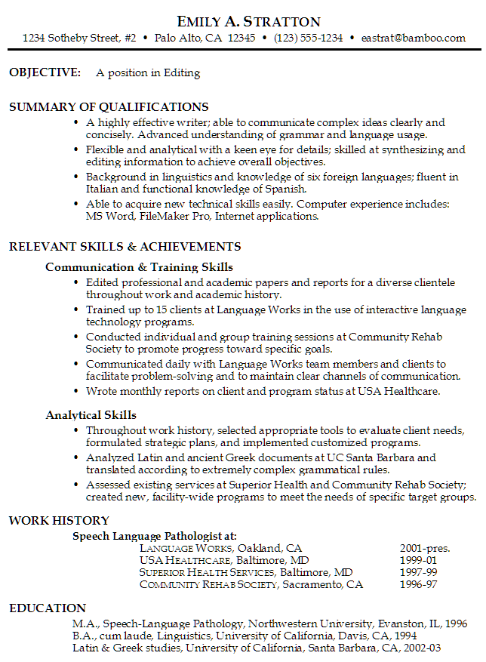

Slide 15
Types of Resumes
Combined Résumé
Highlights skills that are relevant to the job you are applying for & provides work history
Weaves the best from the chronological and functional formats together by classifying positions and responsibilities under functional headings
The focus is on skills and accomplishments emphasizing the environments in which they were developed.

Slide 16
Combined Resumes
Conditions for using a combined résumé:
When you want to highlight capabilities not used in your recent work experience.
When your greatest strengths are when and where you developed specific skills
When much of your work has been freelance, consulting or temporary.

Slide 17
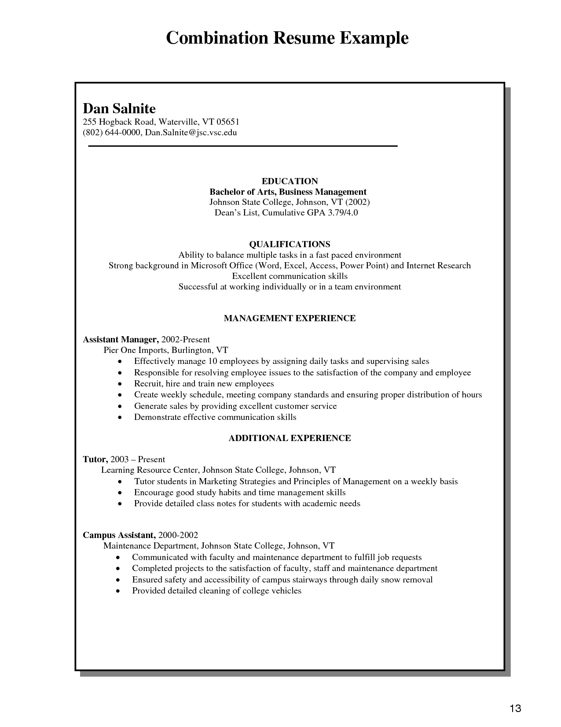

Slide 18
Basic Elements of a Resume
Identifying Information in header/letterhead (this is your contact information)
Your name
Full first name, middle initial, & last name
In boldface and printed in larger type size (14 or 16 point)
Address
Use the format: comma after city name & two letter postal abbreviation for state
In regular typeface and in your normal type size (10 0r 12 point)
Example: 123 University Ave., Lubbock, TX 79409
Home or cell phone number with area code
In regular typeface and in your normal type size (10 0r 12 point)
Examples: (806) 7422816 or 8067422816
Limit to two phone numbers, never more
E-mail address
In regular typeface and in your normal type size (10 0r 12 point)
Example: corey.clem@ttu.edu
Website address (optional)
In regular typeface and in your normal type size (10

Slide 19
Resume Headings
Objective
Career Objective, Job Objective, Career Interest
Education
Academic Background, Educational History
Work Experience
Experience, Employment, Professional Background
Honors & Awards
Awards, Distinctions, College Awards, Scholarships
Activities
Campus Involvement, Community Activities, Community Service

Slide 20
Basic Elements of Resume
Career Objective (optional, but suggested)
A brief statement to identify goals for the next few years
12 sentences
Write specifically for the job for which you are applying
Use specific language of the job description if possible
Bad example: Seeking employment in a business environment offering an opportunity for professional growth.
Good example: To market financial planning programs and provide financial counseling to ensure positive client relations.

Slide 21
Basic Elements of Resume
What comes first – education or work experience?
In general, educational information follows the job experience section.
However there are three situations in which education should precede work experience:
You are currently in school or a recent graduate.
You are changing careers and your education is more pertinent to the new career than your job experience.
You are seeking a position where specialized education is a prerequisite for employment.

Slide 22
Basic Elements of a Resume
Remember that whatever information is first will be what catches the employer’s attention.
This is why it is suggested that you put your greatest asset first – whether that is education or experience.

Slide 23
Education
List educational experience in reverse chronological order (most recent listed first)
List all schools from which you have earned degrees (community colleges, two-year colleges four-year universities, graduate programs)
Do NOT list high school for professional jobs!

Slide 24
Education Essential Elements:
Degree you received or will receive
Example : Bachelor of Science in Agricultural Communication
Date you graduated or will graduate
Examples: December 2006 or Degree expected in 2013
Complete name of school
Example: Texas Tech University
City and state where school is located
Example: Lubbock, TX
Additional Elements:
Overall GPA or major GPA (above 3.0 on 4.0 scale)
Minors
Specific courses related to position

Slide 25
Word Experience
List employment experience since high school
part-time jobs
full-time jobs
summer employment
military experience
workstudy
Internships
volunteer positions
Can come before or after education section

Slide 26
Work Experience Essential Elements:
Your job title
Example: Social Studies Department Chair and Instructor
Name of company you worked for
Example: Harmony School of Innovation
City and state where company is located
Example: Houston, TX
Dates you worked there
Example: August2007 – June 2011
Bulleted items describing activities completed in position
Indent list
Use action verbs
Use parallel structure in each

Slide 27
Honors and Awards
Honors & Awards
Change heading to fit whatever you list
Include the following kinds of information:
Scholarships
Academic or service awards
Nominations for awards
Organizational leadership positions
Academic honor societies

Slide 28
Honors and Awards Essential Elements:
Name of honor/award
Date received
Honors Who’s Who Among America’s College Students
Inducted Spring 2005 & Texas Tech University President’s List Fall 2005, 2006
Awards
Spring 2003, 2006
Houston Livestock Show and Rodeo Scholarship

Slide 29
Activities:
Include activities you participated in on a regular basis
Include the following kinds of information:
Membership in professional organizations
Volunteer work
Membership in campus clubs, fraternities, or sororities
Activities highlighting special skills, abilities, & responsibility
Membership in community organ

Slide 30
Activities Essential Elements:
Name of organization
Dates involved
Leadership roles you held
Accomplishments
Activities Texas Tech Equestrian Team - Fall 2002Spring 2004
Showed at collegiate horse shows, planned and helped conduct clinics, horse shows, lessons, and community service projects for the team and the local community and assisted younger teammates during training and shows. Participated in Texas Tech Arbor Day, Lubbock area Special Olympics equestrian events, assisting in local community clean up and construction of Legacy Play Village

Slide 31
Additional Elements
Languages
Foreign language skills
Indicate your level of fluency
Foreign studies and/or travel
Example:
International Experience
1 year of British studies
Attended Royal Agricultural College , Cirencester, Gloucestershire, United Kingdom , August 19992000
Earned British studies certificate
Studied 6 months as a Rotary International Student Ambassador
Spoke to community organizations about differences in culture, education and lifestyle

Slide 32
Additional Elements
Skills
If you have a varied work experience, you may want to include a skills summary
Example:
Technical Skills
MoraeUsability Testing Software
Mplus statistical modeling software
SPSS statistical software
Adobe Dreamweaver CS4
Adobe Photoshop CS4
Adobe InDesign CS4
Social Media Application (Twitter, Facebook, Blogger, WordPress)

Slide 33
Resume Formatting
Best fonts are Times New Roman, Calibri, or Arial
Limit to no more than 2 font types
Use a 14 or 16point font for headings
Use a 10 or 12point font for text
Use white space, bullets, & indentations
Use extra line of white space between sections
Use bold font to emphasize your name, section names, job titles you’ve held

Slide 34
Resume Formatting
Avoid underlining text
Use short phrases or sentence fragments with no punctuation
Avoid I, me, or my if possible
Use gerunds (ing endings) to describe actions
Use present or past tense verbs when gerunds are too long

Slide 35
Resume Formatting
Your résumé can include the following, but don’t over design!
Bullets
Boldface
Horizontal rules
Indentations
Different font sizes
Avoid the following:
Clip art
Borders
Photos
Unusual colors (salmon, baby blue, tangerine, or yellow)

Slide 36
Be Unique to Stand Out!
Templates are available for Word, but how unique will you be if you simply follow a template??

Slide 37
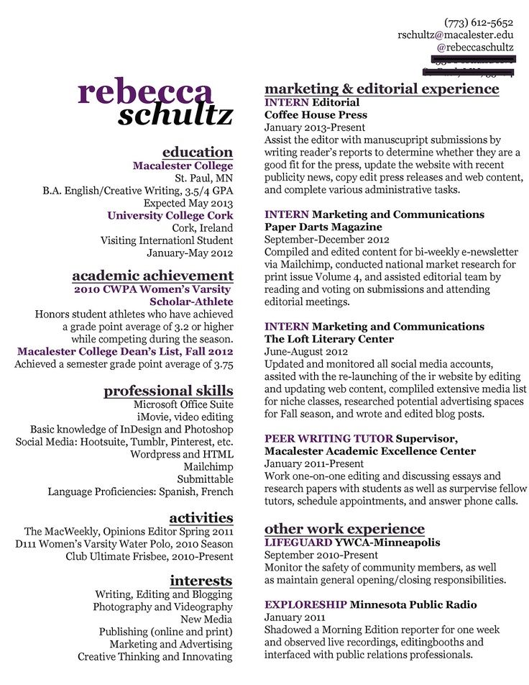

Slide 38
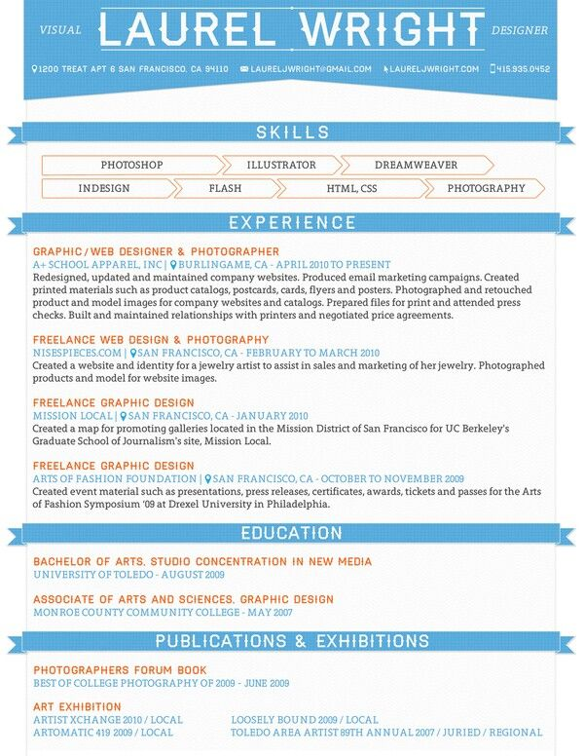

Slide 39
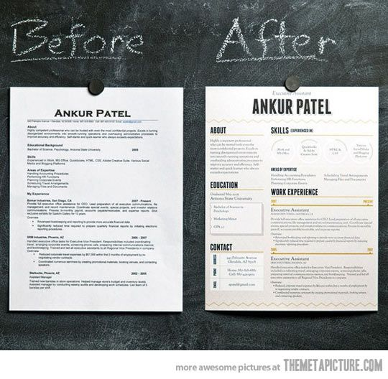

Slide 40
