Slide 1
Project Report [PA3] Clustering based Data Analysis
CMPS 451/551 Data Mining
Team NeNai
Team Members: Olisemeka Nmarkwe [W0762669]
Sujana Mehta. [W0757459]

Slide 2
DESCRIPTION
Goal: Exploration of EEG hand-crafted feature space for identification of individuals.
Tasks:
Visualize signals
Preprocess signals
Design representation
Extract features
Explore feature distributions

Slide 3
Problem Definition
The objective of this project is to develop a modular and reusable pipeline for preprocessing and extracting meaningful features from EEG data. The pipeline will include advanced signal processing techniques (e.g., notch filtering, impedance filtering, bandpass filtering, and re-referencing) and statistical feature extraction (e.g., mean, standard deviation, skewness, kurtosis). These features will be used to enable exploratory data analysis, visualization, and preparation for machine learning tasks.

Slide 4
Preprocessing
Notch Filtering: Removes powerline interference (60 Hz and harmonics).
Impedance Filtering: Filters noise caused by impedance mismatch.
Bandpass Filtering: Retains frequencies between 0.5 Hz and 32 Hz.
Re-referencing: Centers the signals to remove bias.

Slide 5
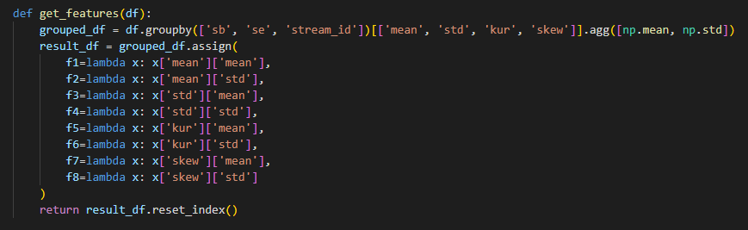
Generate Features
Feature Extraction:
Extracts statistical features (mean, std, kurtosis, skewness) for each signal window.
Aggregates these features to produce higher-level statistics (f1 through f8).

Slide 6
Data Description
ATTRIBUTE NAME | TYPE
sb | Categorical (Subject Identifier)
se | Categorical (Session Identifier)
stream_id | Integer
f1 | Continuous (Mean of Means)
f2 | Continuous (Standard Deviation of Means)
f3 | Continuous (Mean of Standard Deviations)
f4 | Continuous (Standard Deviation of Standard Deviations)
f5 | Continuous (Mean of Kurtosis)
f6 | Continuous (Standard Deviation of Kurtosis)
f7 | Continuous (Mean of Skewness)
f8 | Continuous (Standard Deviation of Skewness)
target | Categorical (Class Label: Sb1 or Sb2)

Slide 7
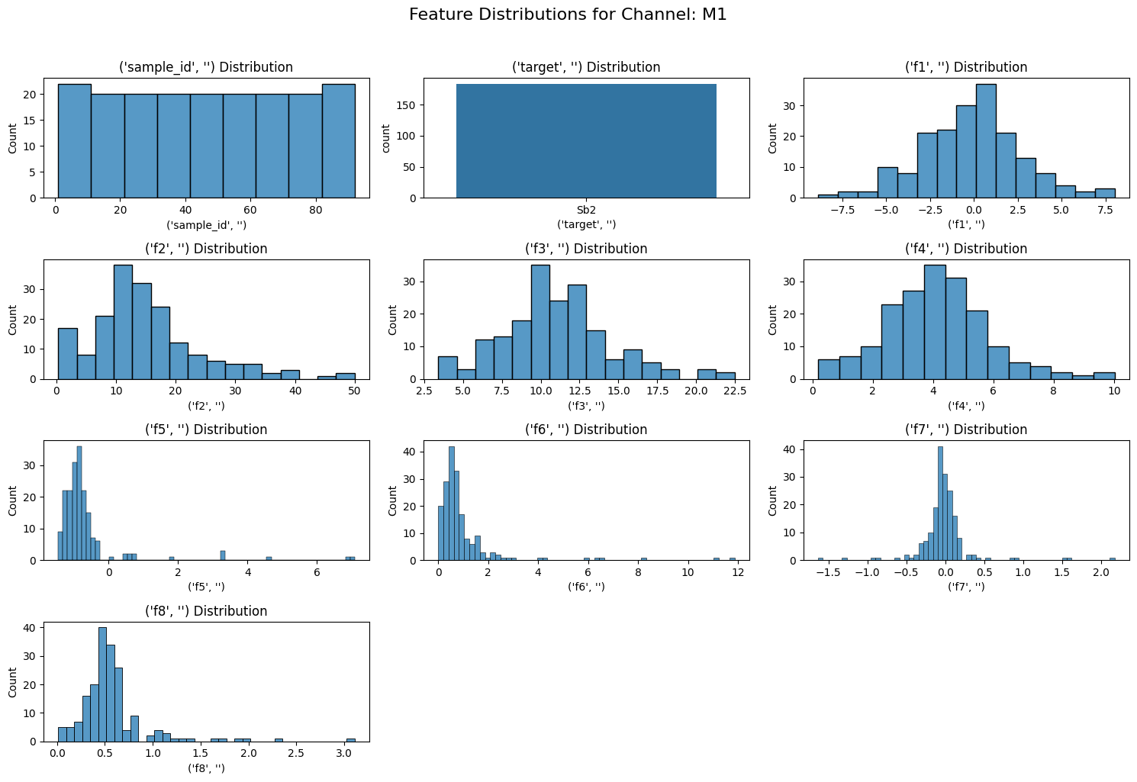
Histograms

Slide 8
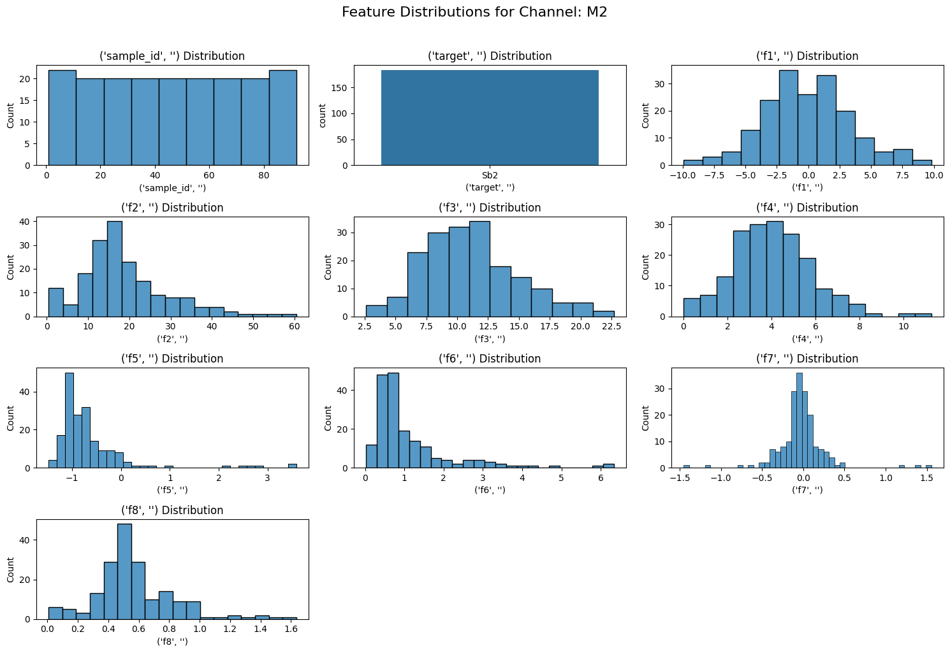
Histograms

Slide 9
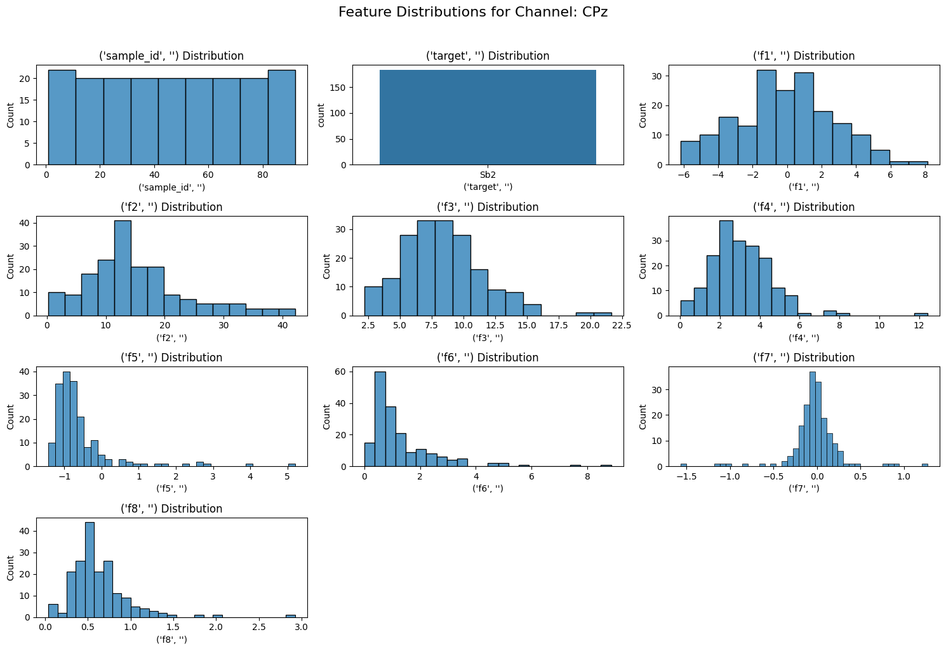
Histograms

Slide 10
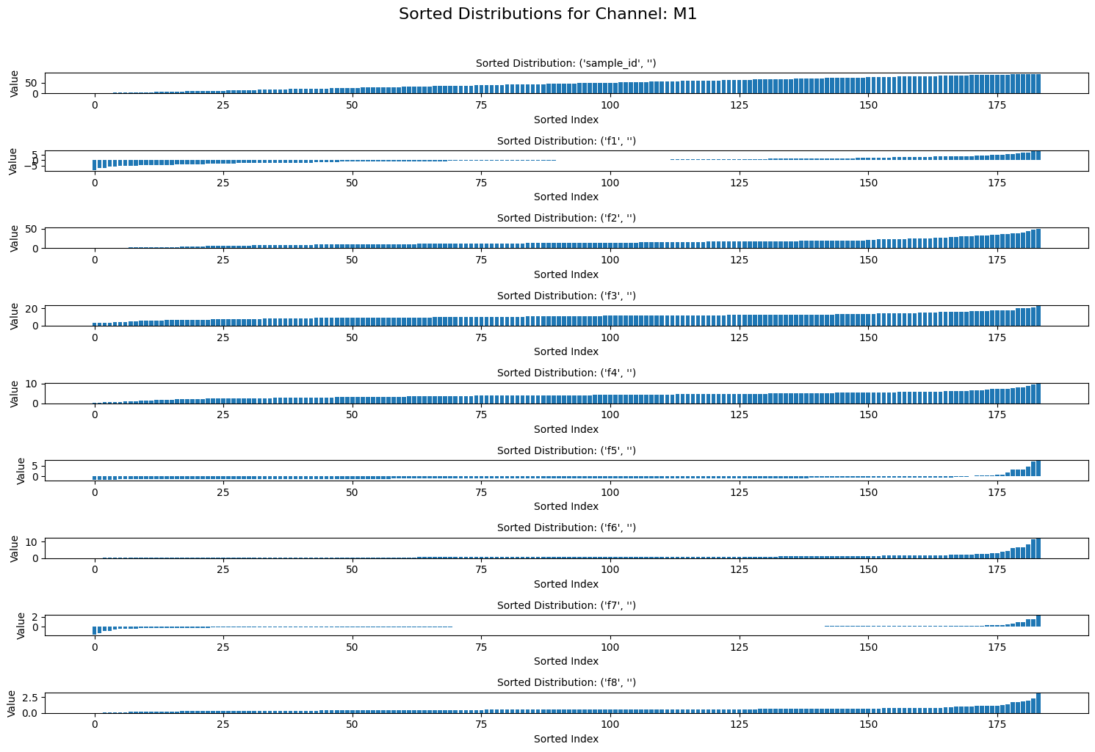
Distributions

Slide 11
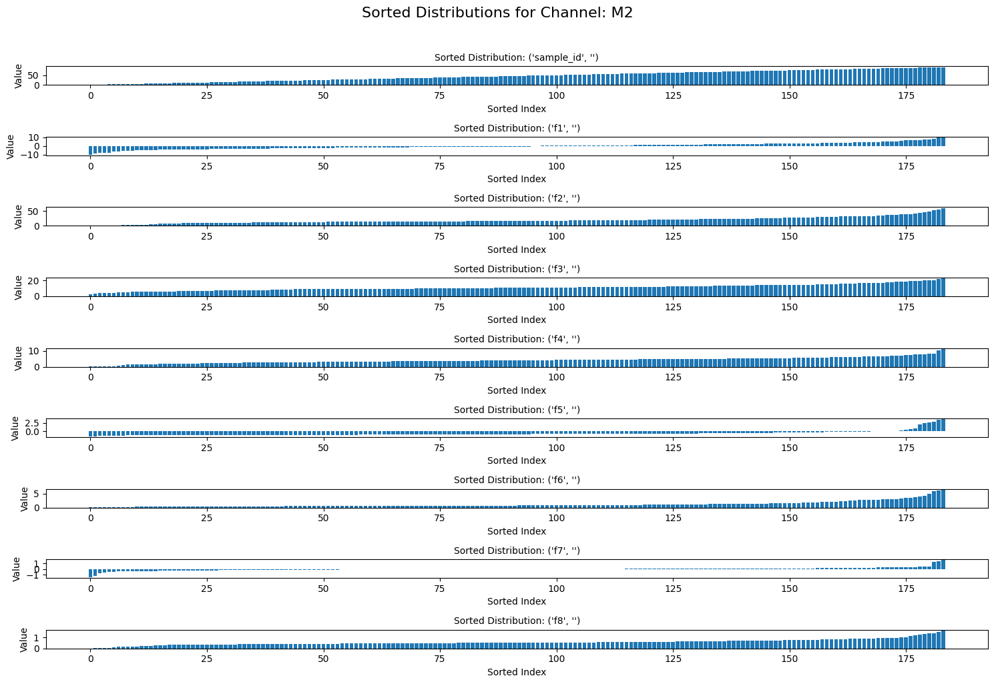
Distributions

Slide 12
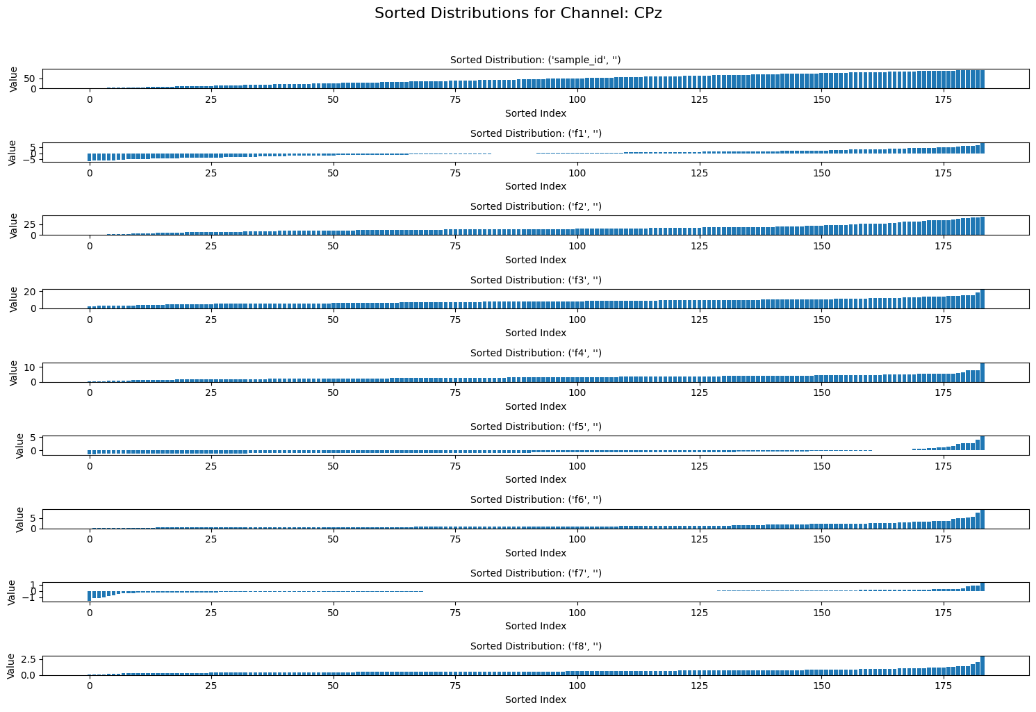
Distributions

Slide 13
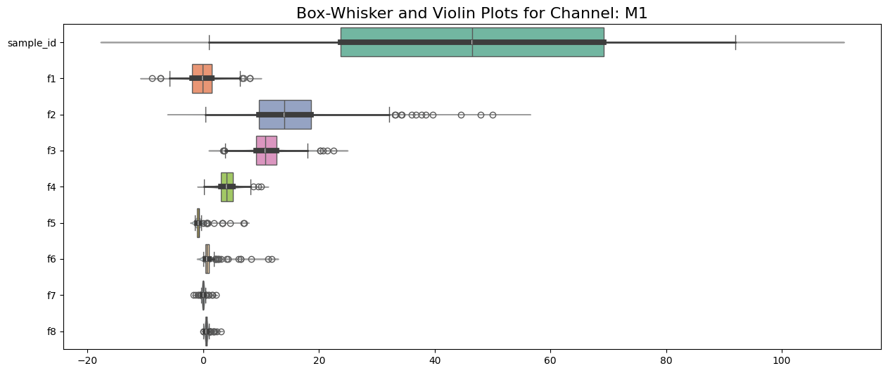
Box-Whisker & Violin Plots

Slide 14
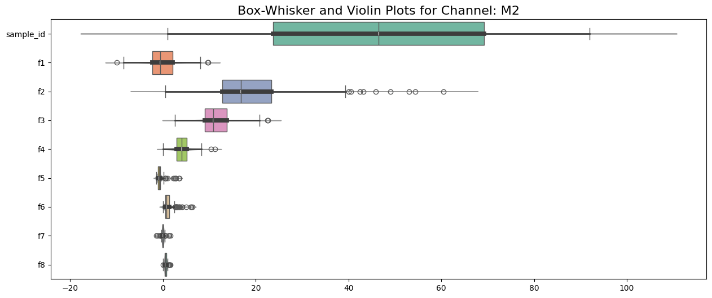
Box-Whisker & Violin Plots

Slide 15
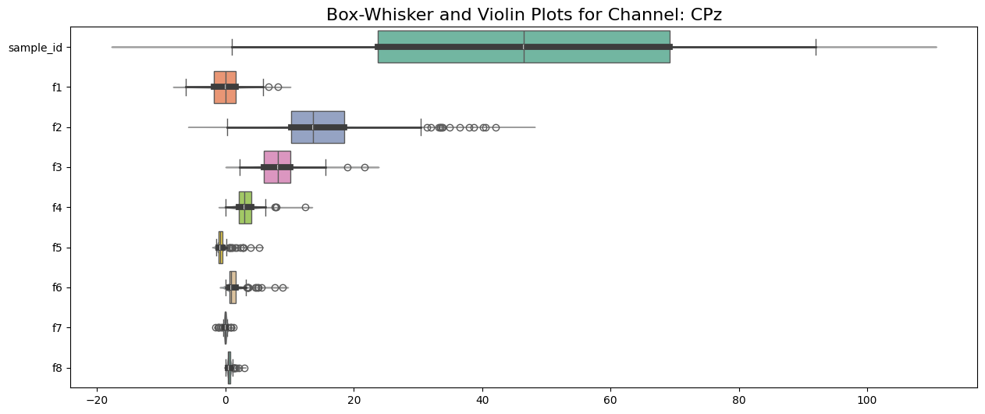
Box-Whisker & Violin Plots

