Slide 1
Chapter 8.1 - 8.4 incl.
May, 2nd 2022
Tassilo Henninger

Slide 2
Agenda:
sequence models and sequence data
text preprocessing
language model (as the inspiration for the design of RNNs)
RNN
Notes:
As recurrent networks are often based on text data. The book starts by introducing basics of language models

Slide 3
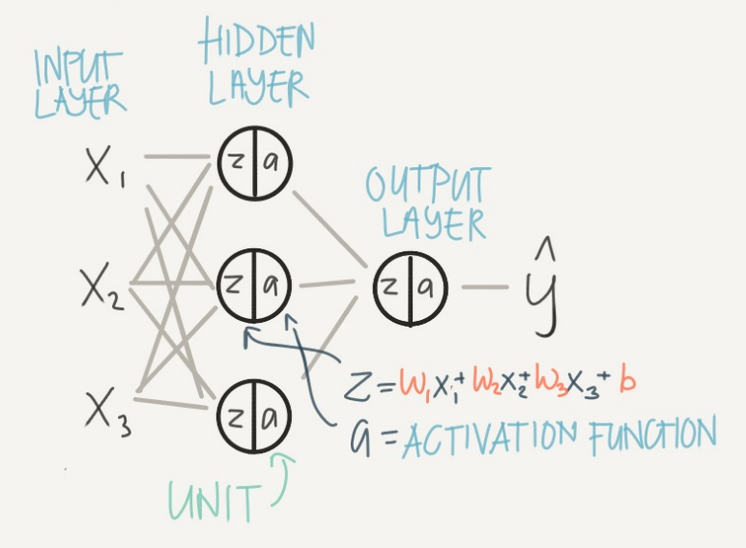
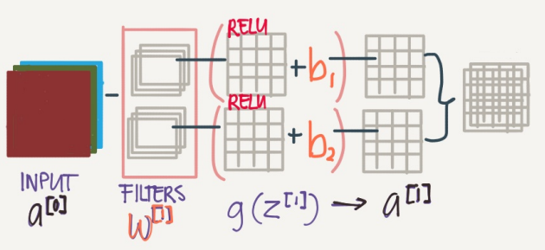
What we had so far…
How can we handle sequence data?
Notes:
so far we assumed that our data are all drawn from some distribution,
and all the examples are independently and identically distributed (i.i.d.).
Unfortunately, this is not true for most data.

Slide 4


How can „sequence data” look like?
data is not stationary:
sequence matters:
Music, speech, text, and videos are all sequential in nature
”dog bites man” vs “man bites dog”
stock prices (interpolation vs extrapolation)
6.5
8.5
Notes:
People’s opinions on movies can change quite significantly over time.
Seasonality, anchoring

Slide 5
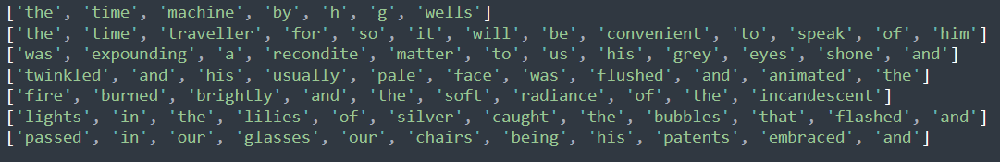
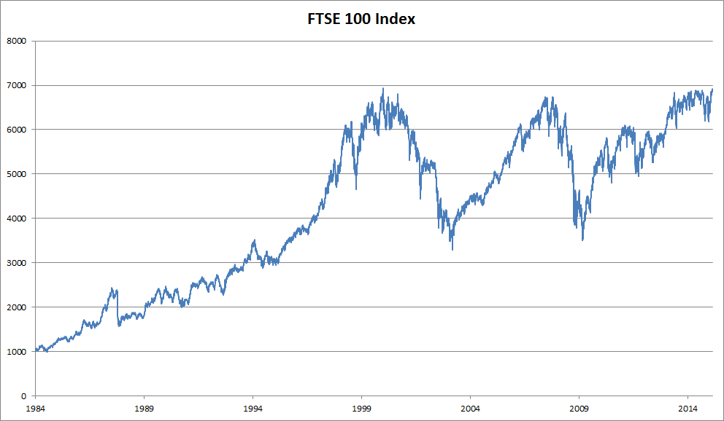
Prediction challenges with „sequence data”:
variate input length
?
to continue the sequence
?

Slide 6

Statistical Tools for overcoming those problems:
Autoregressive Models:
assume that the potentially rather long sequence xt−1,…,x1 is not really necessary
Use timespan of length σ and only use xt−1,…,xt− σ observations
→ input has always same length
t1
t2
t3
Whenever this approximation is accurate,
we say that the sequence satisfies a
Markov condition
Notes:
We need statistical tools and
new deep neural network architectures to deal with sequence data
Autoregressive Models
Problem 1: the number of inputs, xt−1,…,x1 varies, depending on t.
First, assume that the potentially rather long sequence xt−1,…,x1 is not really necessary. In this case we might content ourselves with some timespan of length τ and only use xt−1,…,xt−τ observations.
the number of arguments is always the same
whenever this approximation is accurate we say that the sequence satisfies a Markov condition. In particular, if τ=1, we have a first-order Markov model and

Slide 7
Statistical Tools for overcoming those problems:
Autoregressive Models:
assume that the potentially rather long sequence xt−1,…,x1 is not really necessary
Use timespan of length σ and only use xt−1,…,xt− σ observations
→ input has always same length
t1
t2
t3
Whenever this approximation is accurate,
we say that the sequence satisfies a
Markov condition
Notes:
Autoregressive Models
Problem 1: the number of inputs, xt−1,…,x1 varies, depending on t.
First, assume that the potentially rather long sequence xt−1,…,x1 is not really necessary. In this case we might content ourselves with some timespan of length τ and only use xt−1,…,xt−τ observations.
the number of arguments is always the same
whenever this approximation is accurate we say that the sequence satisfies a Markov condition.
In particular, if τ=1, we have a first-order Markov model and

Slide 8
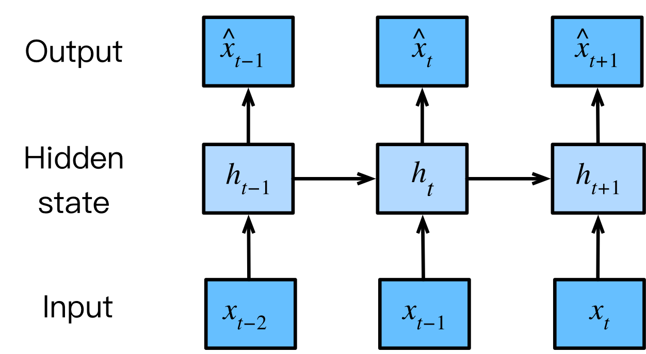
Statistical Tools for overcoming those problems:
latent autoregressive models:
The second strategy, is to keep some summary ht of the past observations
Use summary in addition to the input for prediction

Slide 9
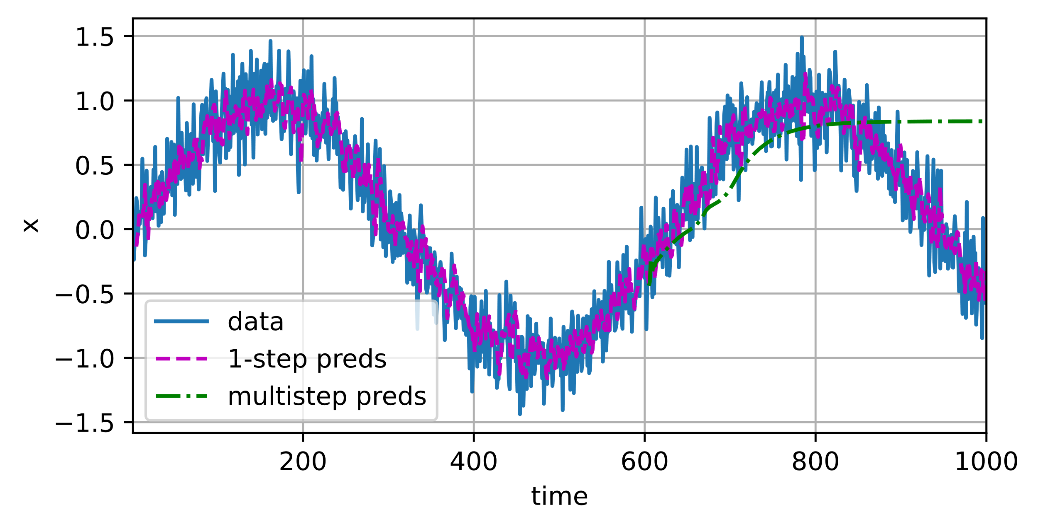
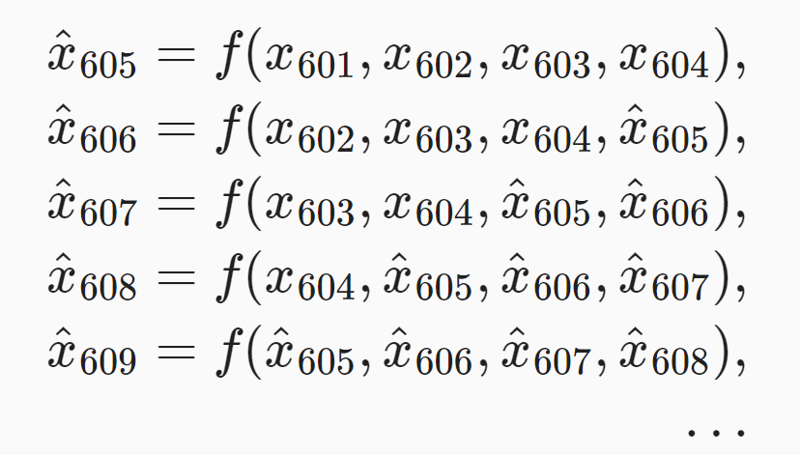
Concept in action!
Notes:
However, there is just one little problem to this: if we observe sequence data only until time step 604,
we cannot hope to receive the inputs for all the future one-step-ahead predictions. Instead, we need to work our way forward one step at a time:
he predictions decay to a constant pretty quickly after a few prediction steps.
due to the fact that the errors build up
weather forcast

Slide 10
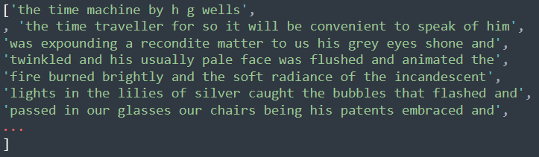
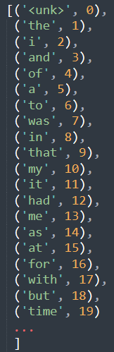
Text Preprocessing:
1. Load text as strings into memory.
3. Build a vocabulary map
2. Split strings into tokens
4. Convert text into sequences of numerical indices
Notes:
Load text as strings into memory.
Split strings into tokens (e.g., words and characters).
Build a table of vocabulary to map the split tokens to numerical indices.
first count the unique tokens in all the documents from the training set, namely a corpus, and then assign a numerical index to each unique token according to its frequency
Rarely appeared tokens are often removed to reduce the complexity
Special tokens: <unk>, <pad>, <bos>, <eos>
Convert text into sequences of numerical indices so they can be manipulated by models easily.

Slide 11


Language Models and the Dataset:
goal of a language model is to estimate the joint probability of a sequence
['the', 'time', 'traveller', 'for', 'so', 'it', 'will', 'be', 'convenient', 'to', 'speak’]
ideal language model would be able to generate natural text just on its own
…'of', 'him'
language models are of great service even in their limited form
In speech recognition or text summary: what is more likely
e.g. “to recognize speech” and “to wreck a nice beach”

Slide 12

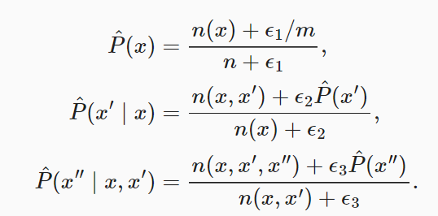

How to calculate probability of a sequence?
Calculate probabilities based on relative word frequency:
This works fairly well, but only for frequent words…
Possible solution: Laplace smoothing adds a small constant to all counts
Notes:
assume that the training dataset is a large text corpus, such as all Wikipedia entries
hen ϵ1=0, no smoothing is applied; when ϵ1 approaches positive infinity, P^(x) approaches the uniform probability 1/m.

Slide 13
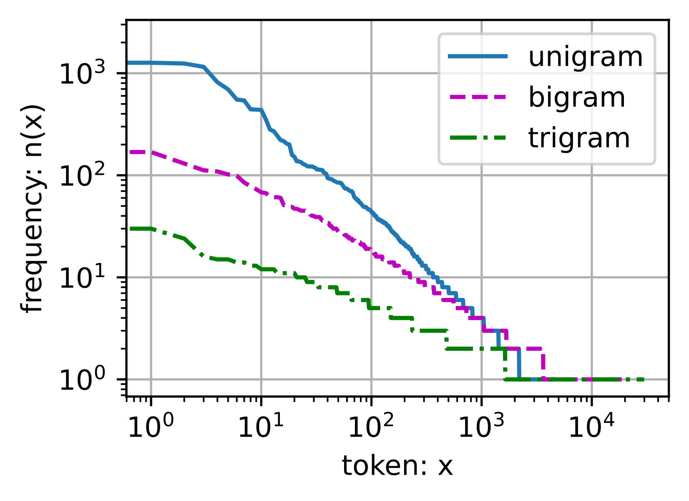
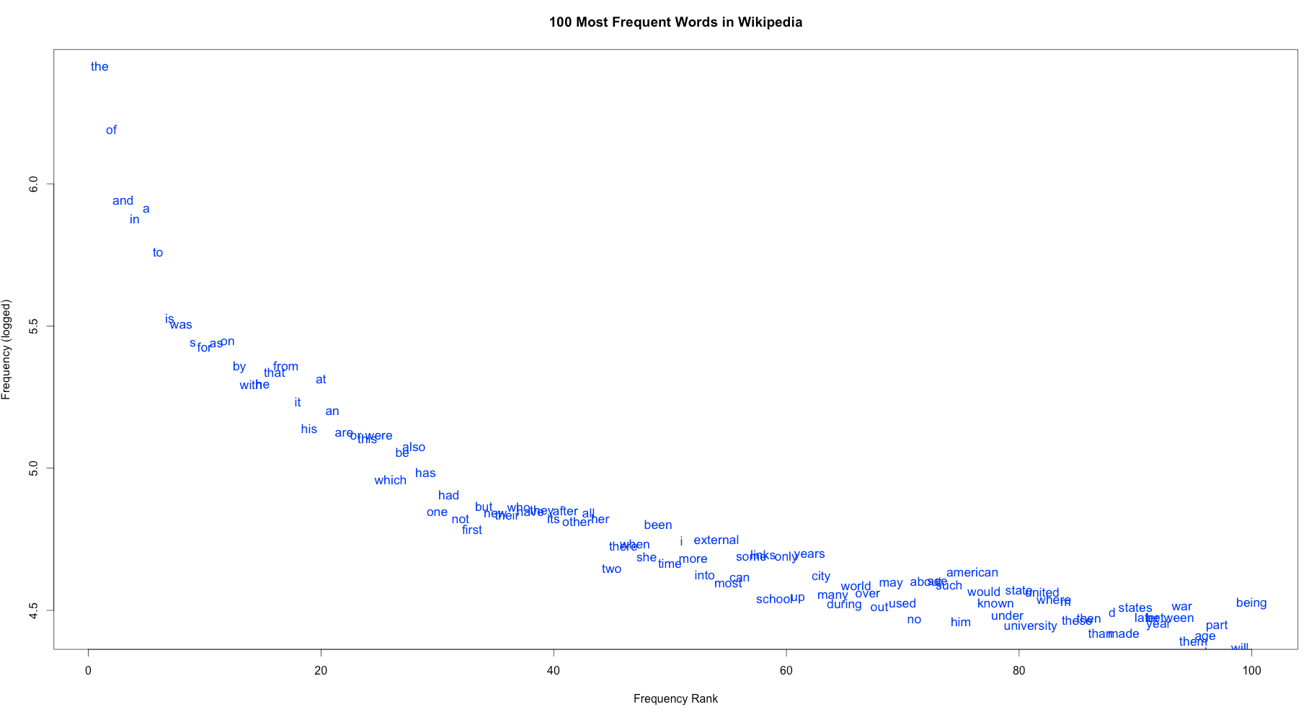
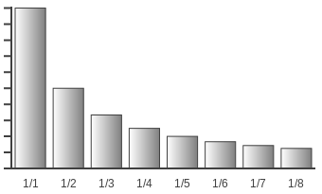
Natural Language Statistics - Zipf’s law:
probability formulae that involve one, two, and three variables are typically referred to as unigram, bigram, and trigram models
Notes:
Follows the paretro distribution
The most frequent word occurse two times as often as the 2nd most frequent word
The 3rd frequent word occurse a third as often as the most frequent word
There is a lot of structure but not enough frequency to deal with infrequent word combinations efficiently via Laplace smoothing
Instead, we will use deep learning based models.

Slide 14
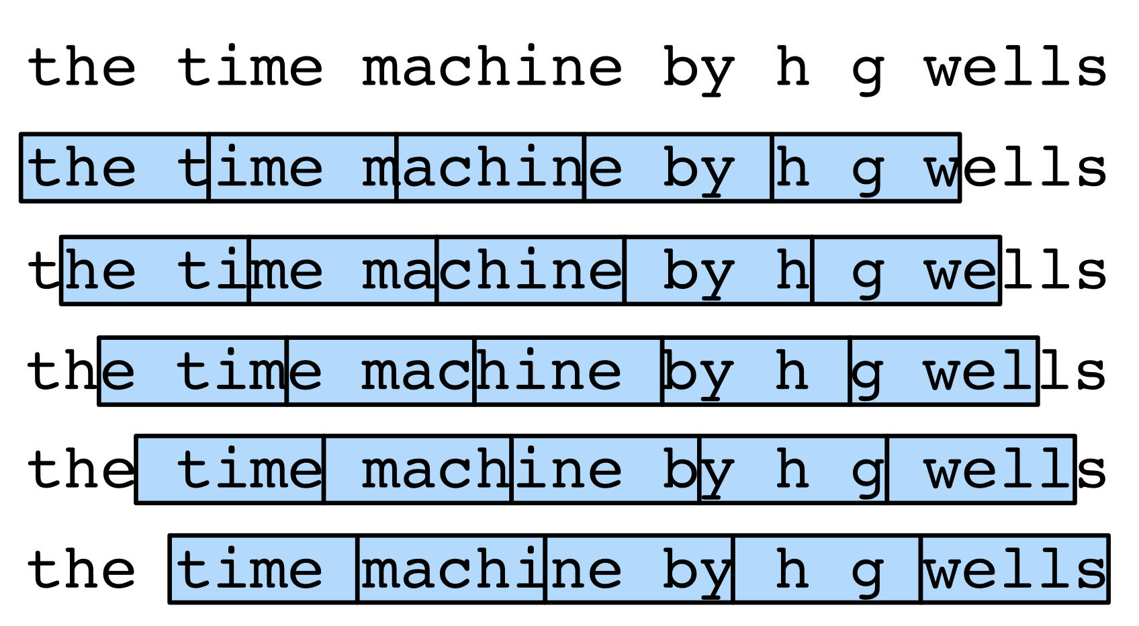
How to process sequence data for NN?
n = 5
Notes:
assume that we will use a neural network to train a language model
l, where the network processes a minibatch of sequences with predefined length, say n time steps, at a time.
How to read minibatches of features and labels at random?
partition such a long sequence into subsequences with the same number of time steps
subsequence of n time steps at a time
shows all the different ways to obtain subsequences from an original text sequence, where n=5 and a token at each time step corresponds to a character
Which to pick?
Therefore, we can start with a random offset to partition a sequence to get both coverage and randomness
his strategy preserves the order of split subsequences when iterating over minibatche

Slide 15








How to process sequence data for NN?
minibatch 1
minibatch 2
X
n 1
n 1
Y
Random sampling
X
n 2
n 1
Y
Notes:
assume that we will use a neural network to train a language model
l, where the network processes a minibatch of sequences with predefined length, say n time steps, at a time.
How to read minibatches of features and labels at random?
partition such a long sequence into subsequences with the same number of time steps
subsequence of n time steps at a time
shows all the different ways to obtain subsequences from an original text sequence, where n=5 and a token at each time step corresponds to a character
Which to pick?
Therefore, we can start with a random offset to partition a sequence to get both coverage and randomness

Slide 16




How to process sequence data for NN?
minibatch 1
minibatch 2
n 1
X
n 1
Y
Random sampling
X
n 2
Y
minibatch 1
minibatch 2
X
n 1
n 1
Y
Sequential Partitioning
X
n 2
Y
Notes:
assume that we will use a neural network to train a language model
l, where the network processes a minibatch of sequences with predefined length, say n time steps, at a time.
How to read minibatches of features and labels at random?
partition such a long sequence into subsequences with the same number of time steps
subsequence of n time steps at a time
shows all the different ways to obtain subsequences from an original text sequence, where n=5 and a token at each time step corresponds to a character
Which to pick?
Therefore, we can start with a random offset to partition a sequence to get both coverage and randomness
his strategy preserves the order of split subsequences when iterating over minibatche

Slide 17

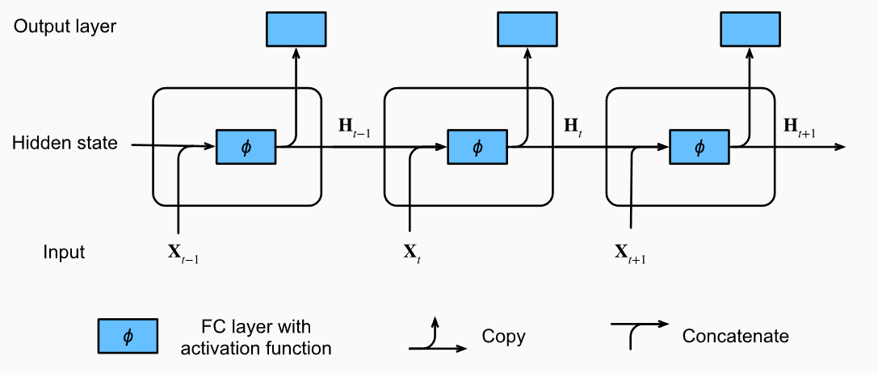
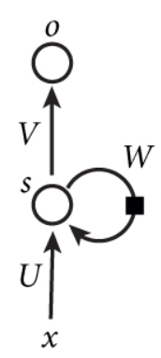
Recurrent Neural Networks:
hidden states:
Notes:
Hidden states are technically speaking inputs to whatever we do at a given step, and they can only be computed by looking at data at previous time steps
Not layers
Since the hidden state uses the same definition of the previous time step in the current time step, the computation of (8.4.5) is recurrent.

Slide 18
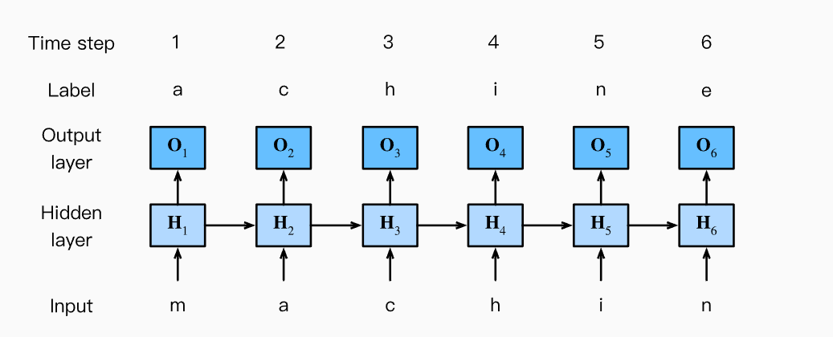
RNN-based Character-Level Language Models:

Slide 19
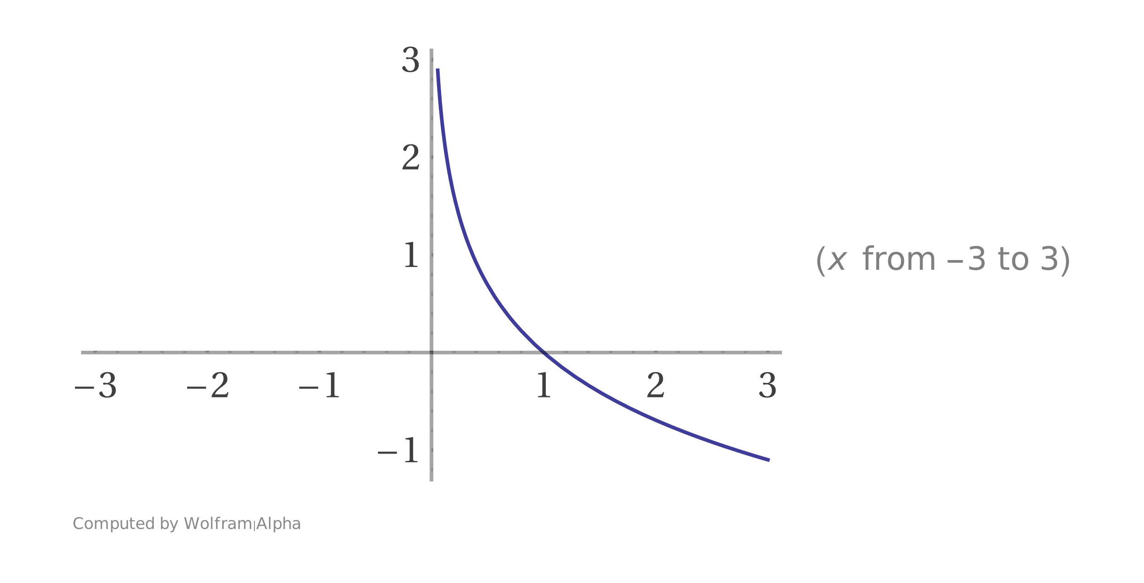
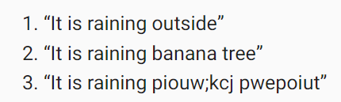
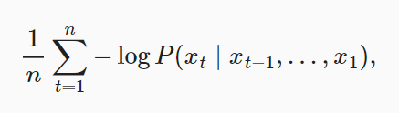
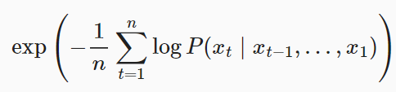
Perplexity and cross-entropy loss:
What is the best quality? How surprising is the text?
So we can measure it by the cross-entropy loss averaged over all the n tokens of a sequence.
Or the complexity
Notes:
Perplexity can be best understood as the harmonic mean of the number of real choices that we have when deciding which token to pick next

Slide 20
Any Questions?

