Slide 1
UK Government d Use-Case: Explanation of Accident Severity
12.01.2023
Tassilo Henninger

Slide 2
Project Setup:
Function​ | ​
Owner​ | Nicklas Prochazka​
Sponsor​ | Denis Baskan
Data Scientist​ | Tassilo Henninger
Owning unit​ | Department for Transport​
Affected units​ | Department for Towns and Cities​, Department for Health, Department for Mapping​
Steering Committee​ | Denis Baskan (Sponsor)​ Felix Bießmann (XAI)​ Alexander Löser (Head of Transport)​

Slide 3
Project Goal:
Business Question:
„How can we further reduce the serious traffic accidents in London? -
We did already simple data analysis but couldn’t find interesting insights.“
Dataset:
Detailed information about traffic accidents in London. This information includes, but is not limited to, geographical locations, weather conditions, type of vehicles, number of casualties and vehicle manoeuvres.

Slide 4
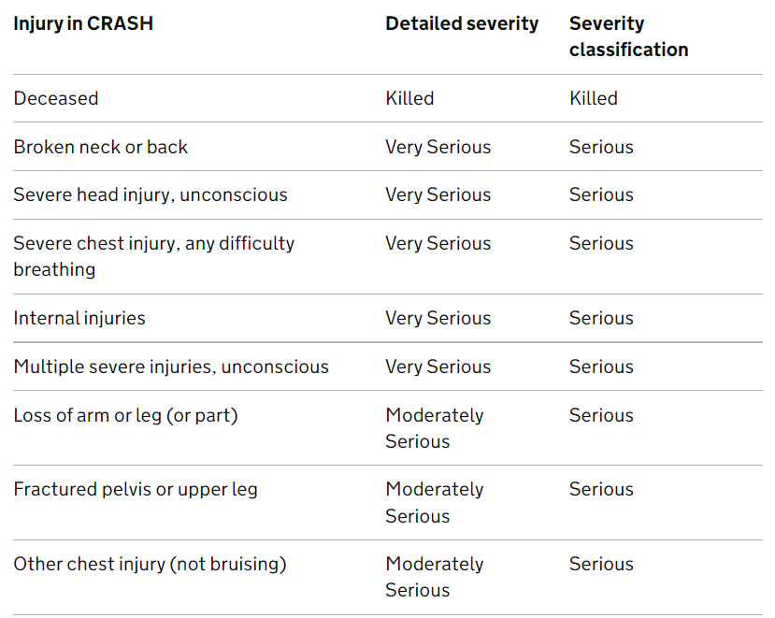

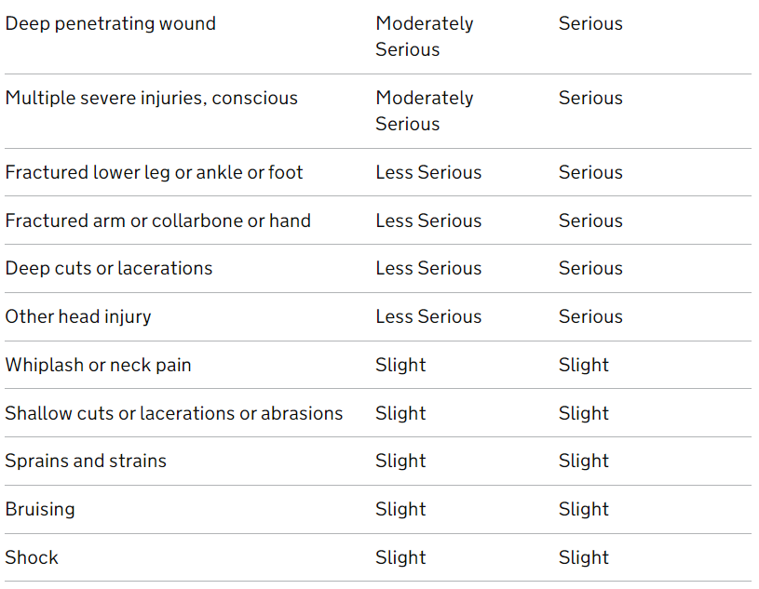
Dataset
standardised reporting tool (called CRASH - Collision Recording and SHaring) which is designed to provide a common way for police forces to collate and submit data.
CRASH is an injury-based reporting system - that is, police officers record the most serious injury from a list rather than coding an overall severity

Slide 5
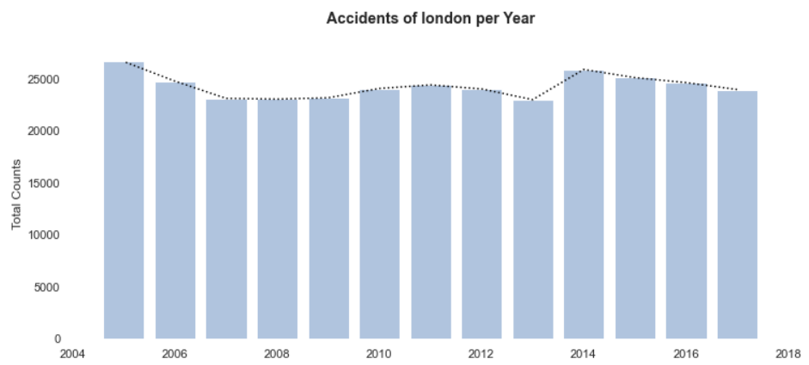
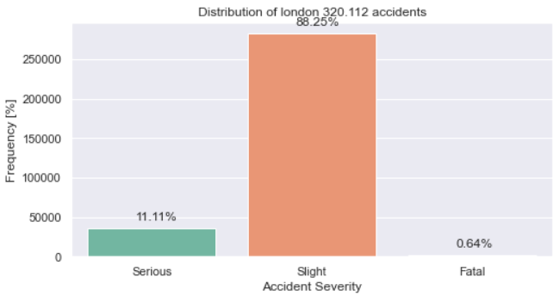
Dataset - Features
53 Features:
LSOA_of_Accident_Location
Number_of_Vehicles
Date
Model
Vehicle_Manoeuvre
Accident_Severity
Weather_Conditions
Speed_limit
Light_Conditions
Age_Band_of_Driver
Sex_of_Driver
Age_of_Vehicle
Engine_Capacity_.CC.
Journey_Purpose_of_Driver …
Around 320.000 accidents:

Slide 6

Project Goal: Rephrasing
Business Question:
„How can we further reduce the serious traffic accidents in London?“
Question to Answer via ML approach:
„What features are important to classify a traffic accident as serious?“
X1
X2
…
Xn
Prediction
1. Goal
Severity
ML Model
Data

Slide 7


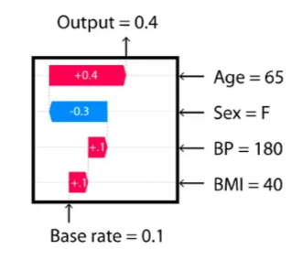
Project Goal: Rephrasing
Business Question:
„How can we further reduce the serious traffic accidents in London?“
Question to Answer via ML approach:
„What features are important to classify a traffic accident as serious?“
X1
X2
…
Xn
Prediction
2. Goal
Severity
ML Model
Data
Explanation
Further Insights

Slide 8
Project Work: Goal 1
Binary Classification results:
train weighted avg f1 score is: 0.88
test weighted avg f1 score is: 0.80
Up- and Down-Sampling via SMOTENC
ML Model
Prediction
X1
X2
…
Xn
X1
X2
…
Xn
X1
X2
…
Xn
Severity
Use Class Weights
ML Model
Data
Data Cleaning
(Handling Missing values)
Feature Engineering
ML Model

Slide 9

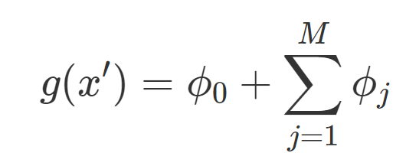
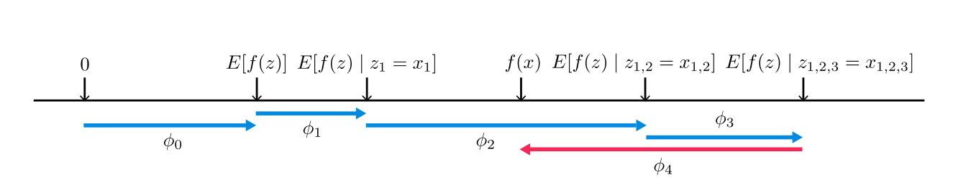
Project Work: Goal 2
SHAP – a unified approach to interpreting model predictions
Explanation
Class 1 = Serious or Fatal
Class 0 = Slight
Local Feature Importance
Transform SHAP Values for Categorical Features
Density Plot without a common norm
ML Model
Global Feature Importance

Slide 10
Results:
Further investigation with experts:
Look into Geomap and feature „LSOA_of_Accident_Location“
Number_of_Vehicles: 1 has a positive impact
Day_of_Week: no impact
Daytime: no impact
Vehicle_Type: motorcycle, Goods 7.5 tonnes
Vehicle_Manoeuvre: Overtaking
Light_Conditions: no impact
Weather_Conditions: Snowing → Slight

Slide 11
Backup

Slide 12
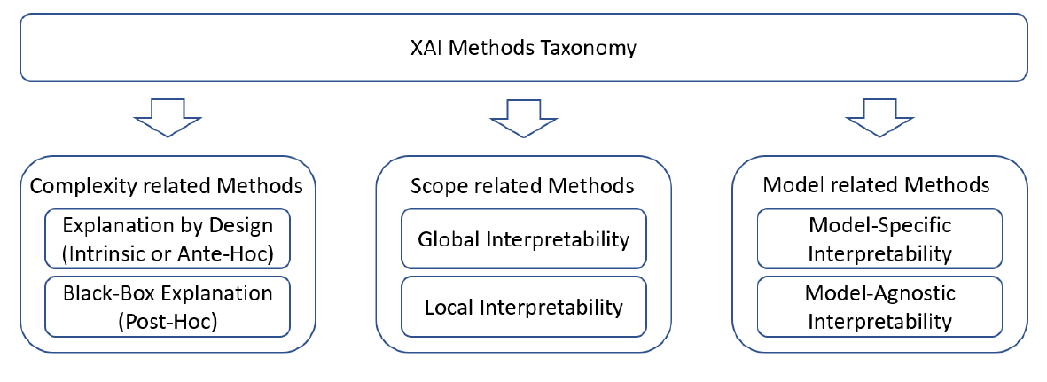
Overview of XAI
https://arxiv.org/abs/2107.02295

Slide 13
SHAP - Shapley Additive exPlanations - unified approach to interpreting model predictions
The best explanation of a simple model is the model itself; it perfectly represents itself and is easy to understand. For complex models, such as ensemble methods or deep networks, we cannot use the original model as its own best explanation because it is not easy to understand. Instead, we must use a simpler explanation model, which we define as any interpretable approximation of the original model. We show below that six current explanation methods from the literature all use the same explanation model.
We introduce the perspective of viewing any explanation of a model’s prediction as a model itself, which we term the explanation model. This lets us define the class of additive feature attribution methods (Section 2), which unifies six current methods.
We then show that game theory results guaranteeing a unique solution apply to the entire class of additive feature attribution methods (Section 3) and propose SHAP values as a unified measure of feature importance that various methods approximate (Section 4).
We propose new SHAP value estimation methods and demonstrate that they are better aligned with human intuition as measured by user studies and more effectually discriminate among model output classes than several existing methods (Section 5).
One innovation that SHAP brings to the table is that the Shapley value explanation is represented as an additive feature attribution method, a linear model

Slide 14
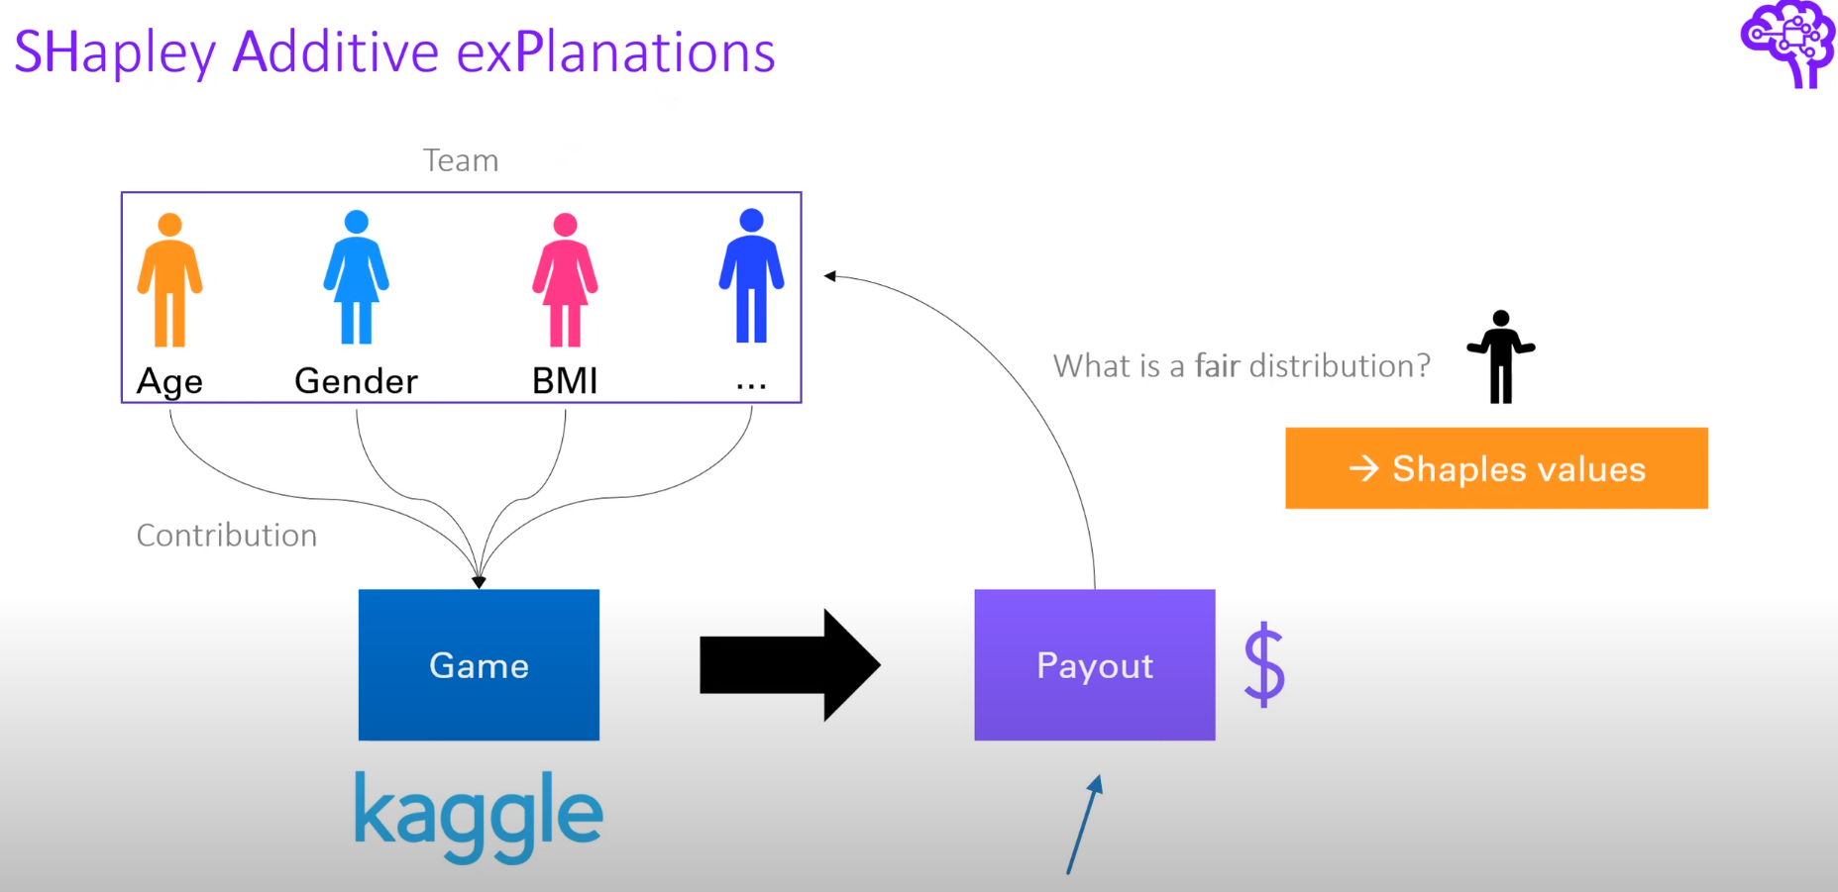
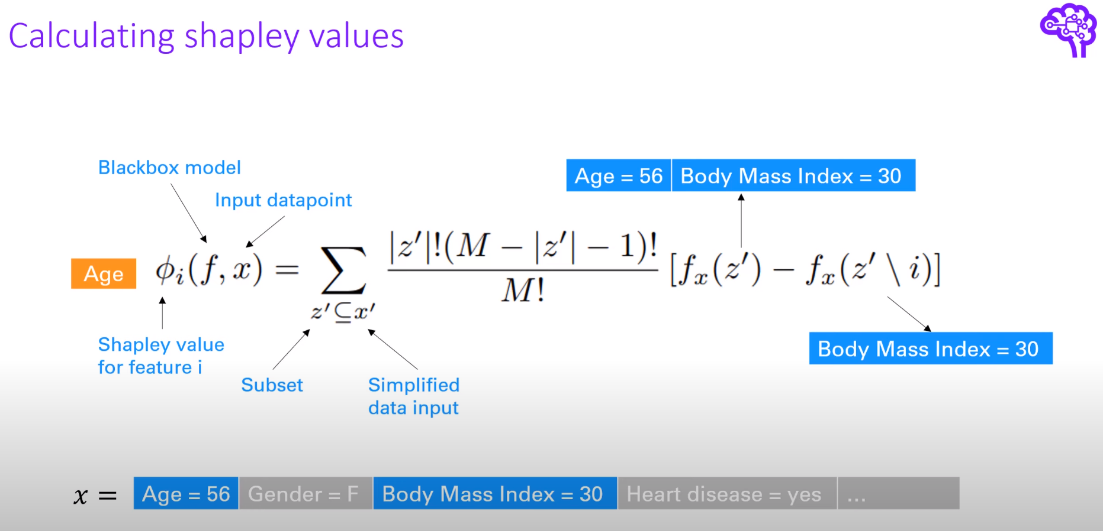
SHAP

