Slide 1
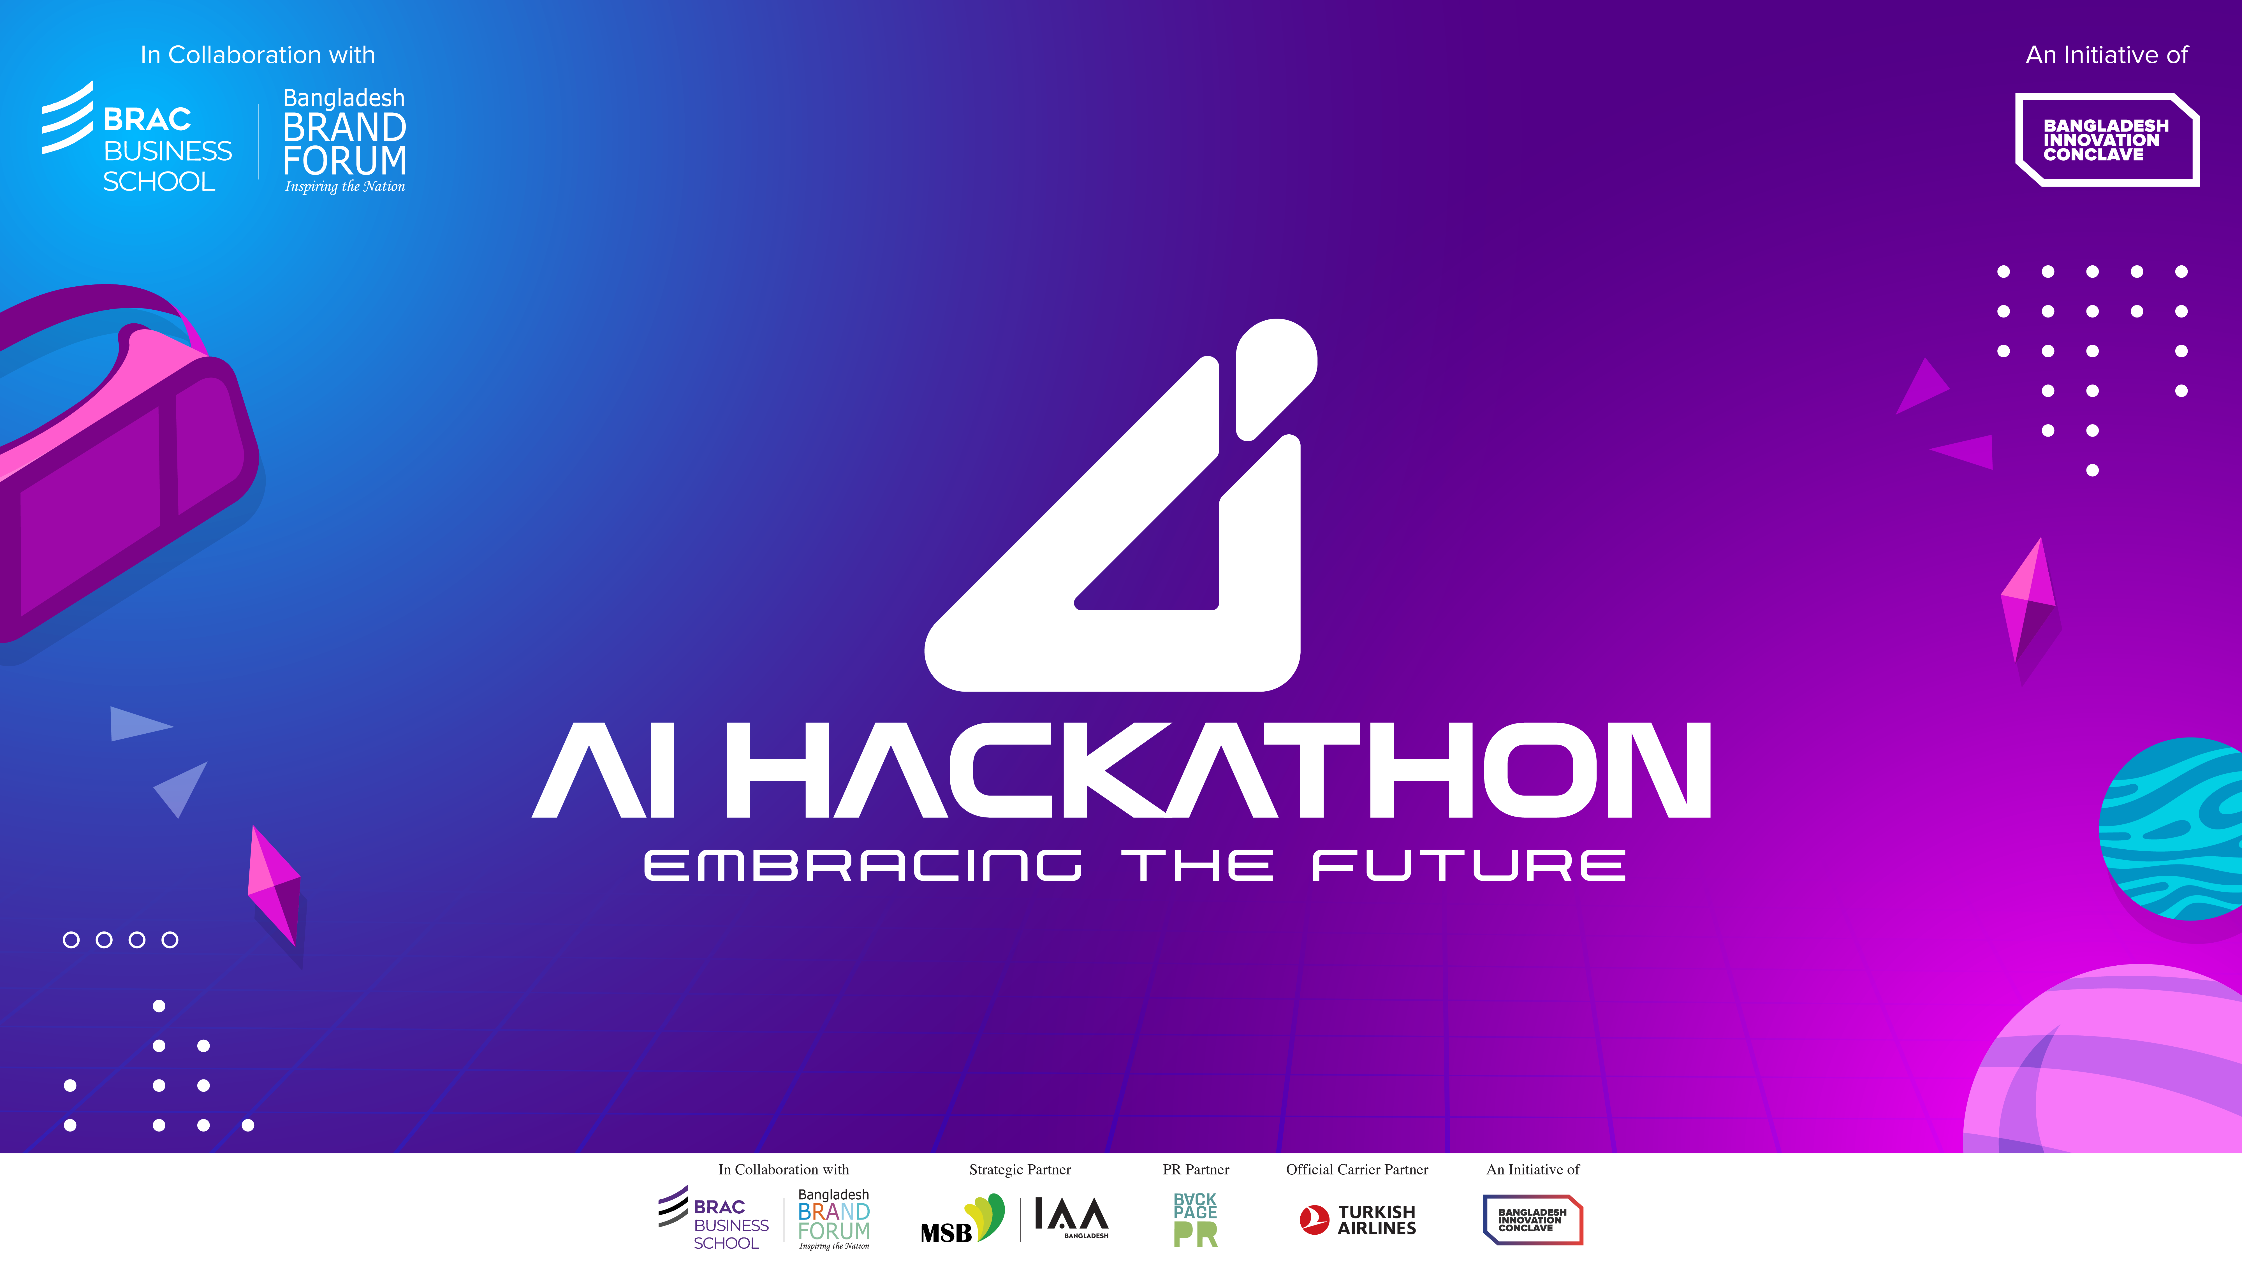

Slide 2

INITIATIVE NAME
Category Name: Education -AI Driven Personalized Solution
Group Name: Buraq
Project Name: QASIM (Quality Assesment of Simulation)
Team Members:
Mohammad Kawsar
Safius Sifat
Md. Morakib Hossain
Mir Oliul Pasha Taj

Slide 3
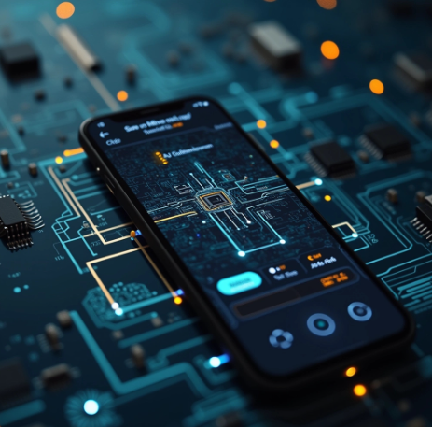
PROBLEM STATMENT
Solving engineering mathematical problems like complex hand-drawn electrical circuits can be confusing and time consuming, which we intend to solve.
Challenges in Circuit Solving:
Existing circuit simulators require installations and workstations.
Students face difficulty in recognizing hand-drawn circuits.
Traditional tools demand extensive training data for accuracy.

Slide 4
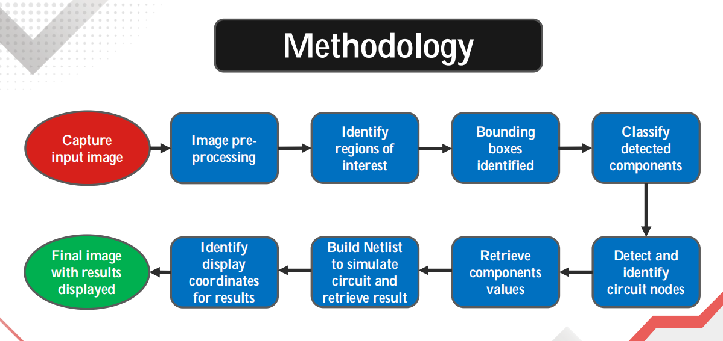
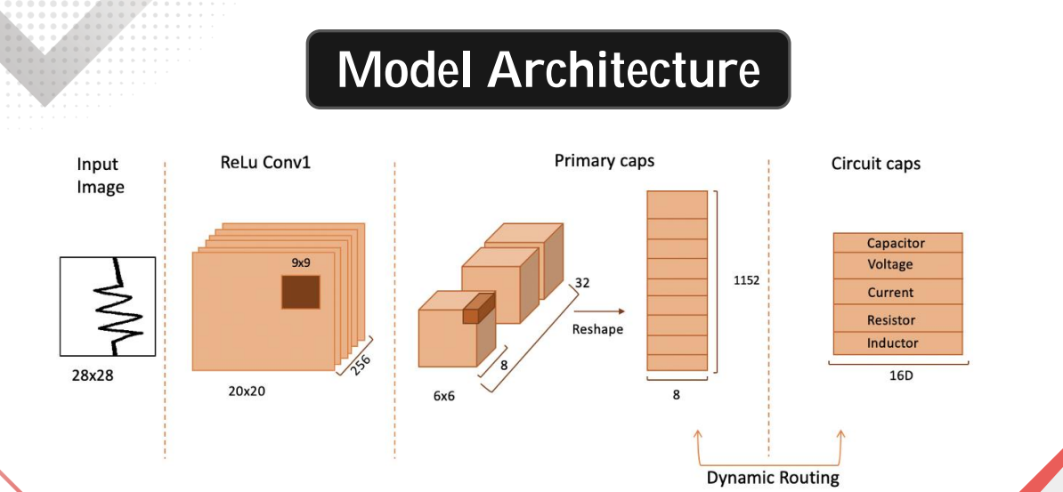
AI-BASED SOLUTION BRIEF
Uses Capsule Networks to recognize and interpret hand-drawn circuits.
Integrates Augmented Reality (AR) for real-time feedback.
Requires less training data while improving recognition accuracy.
Mobile-based solution to make circuit analysis accessible anytime, anywhere

Slide 5
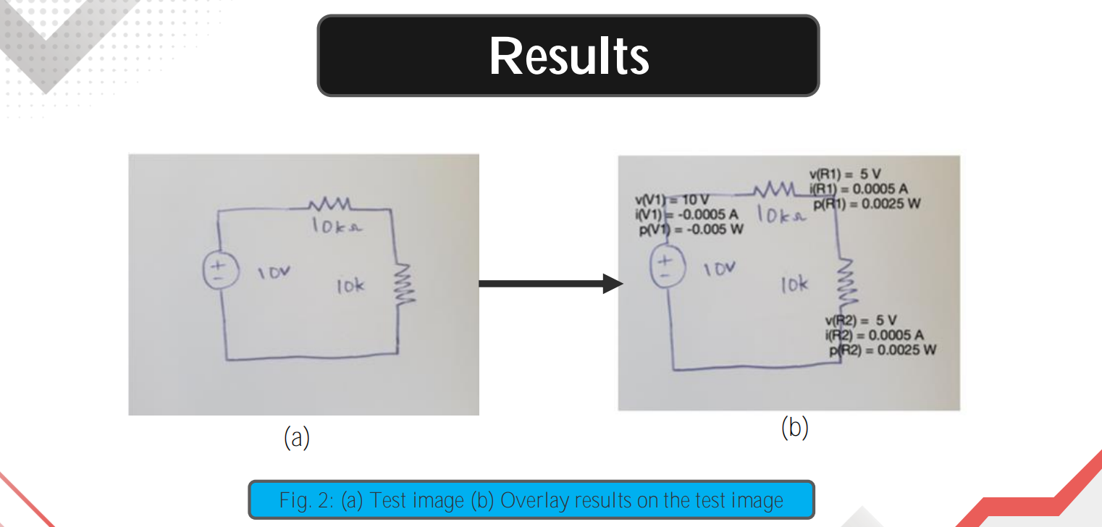
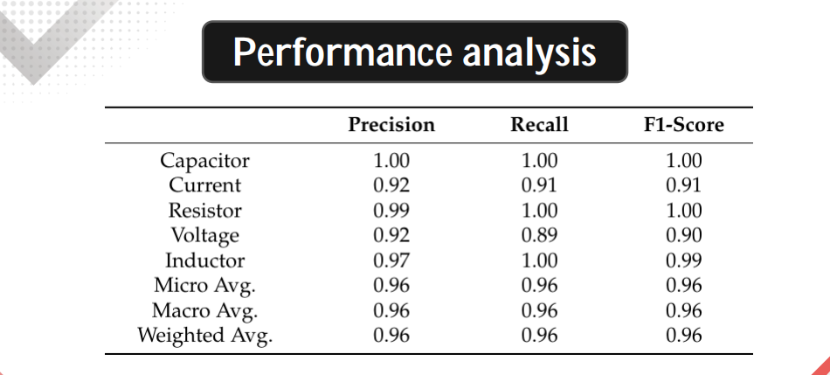
EXPECTED IMPACTS
Integration of machine learning techniques, particularly capsule networks, to recognize and detect circuit elements from images captured by smartphones.
Introduction of capsule networks as a novel technique in deep learning to significantly reduce the training data requirement for circuit recognition.
Development of a smartphone application for real-time analysis of hand-drawn circuits.

Slide 6
RESPONSIBLE AI USAGE STATEMENT
Ethical Considerations: In this segment there AI can only support mankind.
Limitations: Our system currently can solve electrical circuits only but we are working on adding different sectors.
Bias and Accuracy: System is being trained to generalize different handwritten styles.
References:
❖ [1] Rehmat, A.; Hartley, K. Building Engineering Awareness: Problem Based Learning Approach for STEM Integration. Interdiscip. J. Probl.-Based Learn. 2020, 14, n1.
❖ [2] Sabour, S.; Frosst, N.; Hinton, G.E. Dynamic Routing Between Capsules. In Advances in Neural Information Processing Systems Curran Associates, Inc.: NewYork, NY, USA, 2017; pp. 3859–3869.
❖ [3] Rabbani, M.; Khoshkangini, R.; Nagendraswamy, H.; Conti, M. Hand Drawn Optical Circuit Recognition. Procedia Comput. Sci. 2016, 84, 41–48.

Slide 7
Thank you

