Slide 1


AI Hackation - Education
Team
BURAQ
We Trust, We Grow

Slide 2



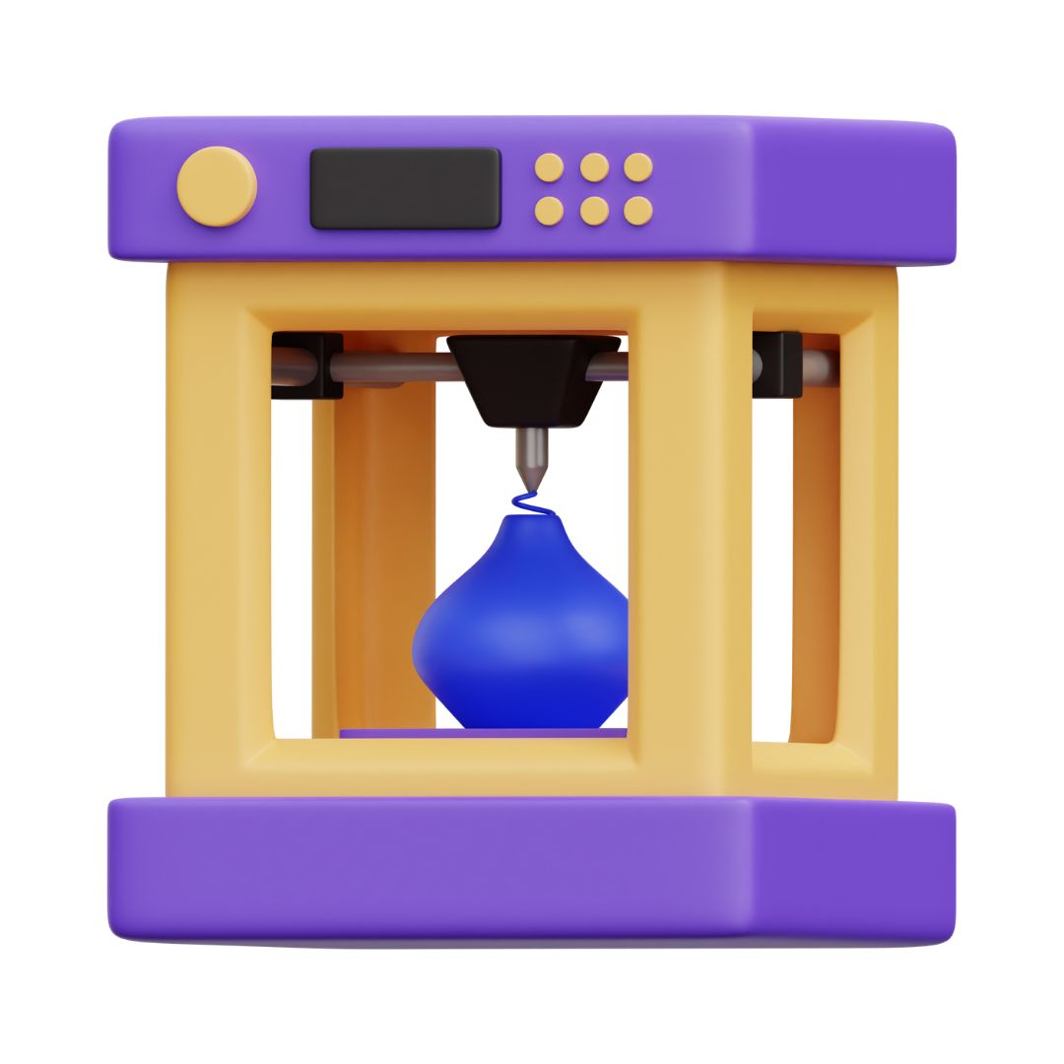

Problem Statement
In developing nations like Bangladesh, 65% of engineering students lose motivation due to outdated, theory-heavy curriculam (RUET Survey 2023).
Issues:
Inability to visualize complex problems.
Overwhelming syllabus + lack of accessible tools.
Existing circuit simulators require installations and workstations
Traditional tools demand extensive training data for accuracy
Expensive hardware/software dependencies.

Slide 3
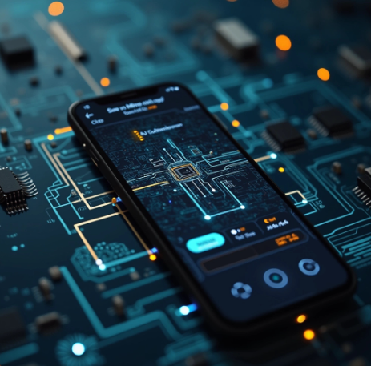
Our Solution
We turn images into Digital. In RUET we have found 92% of 150 students reported reduced pre-exam stress.
Why is this a game-changer?
One Stop Solution for Multi Discipline
Solve via text prompts or handwritten image uploads
Real Time Simulation
No Extra Hardware Required

Slide 4
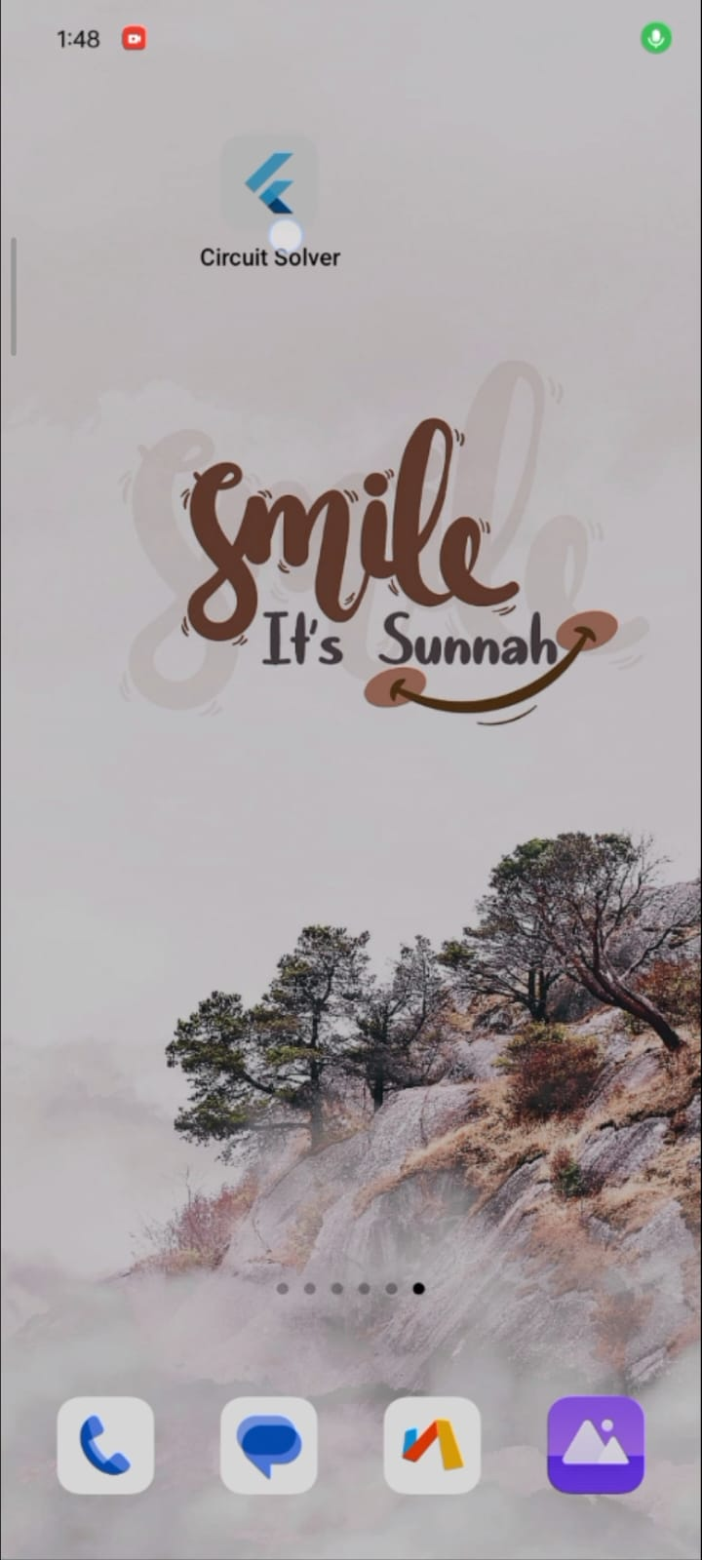
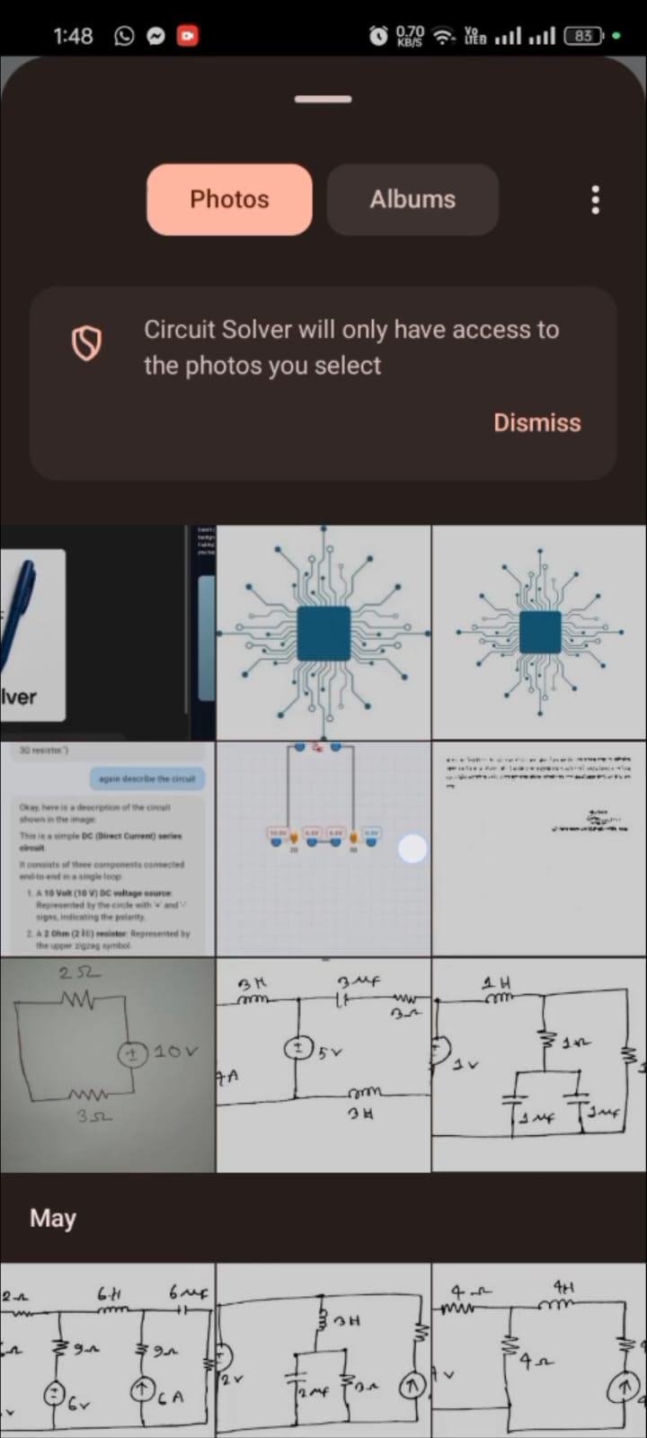
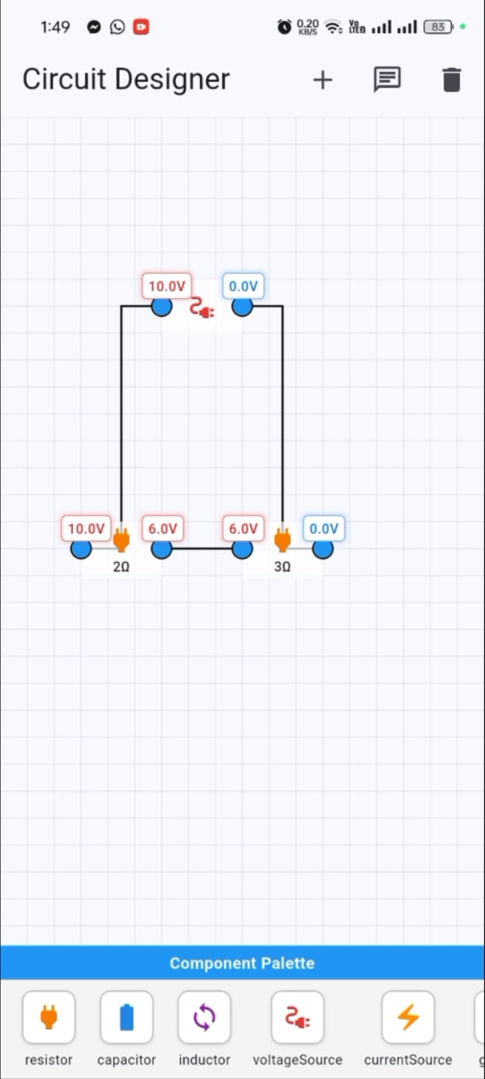
Product Demo
1. Open the app
2. Take Photo
3. Get Solve

Slide 5
Product Demo

Slide 6
Technical Details & Capacity
Chat Option
Technical Details
Image Upload Option
App Specification | Parameters
APP Name | QASIM
Technology | Flutter
App Size | 25 MB
Platform Support | Cross (Web,Android, IoS)
Category | Scalable
808333.3
Circuits
Canvas
Component
Palette

Slide 7
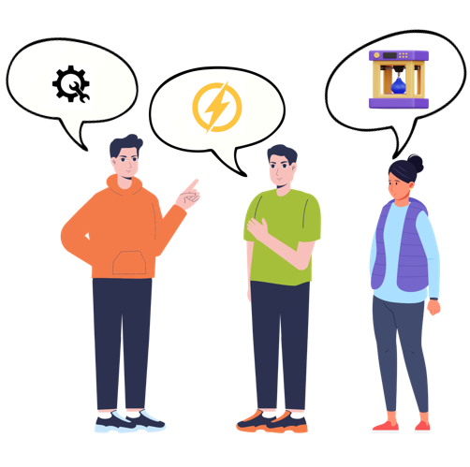
Market Survey
Fixed cost
For piloting, We Conducted direct market research with four Departmental Students (CSE, EEE, ETE, ECE) from RUET, Rajshahi.
No. of Engineering Students:
Dhaka: Nearly 30K
Rajshahi: Nearly 8K
Bangladesh: Nearly 1.5 lac
Global: 2.5 to 3 Millon students gradute per anum
Globally STEM Students: In South Asia 40 M out of 250 M
Total Startup Requirements
Market Response: Strong interest in our solution for hassel free solution

Slide 8
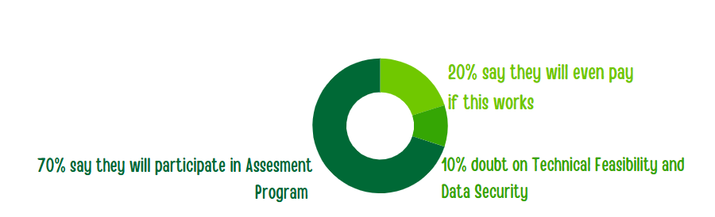
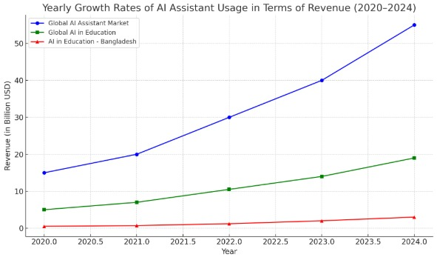
Market Validation
Market Size and Demand
Growing need for AI Assistant in Bangladesh
TAM- $ 2.5 B
SAM – $ 240 M
SOM – $ 1.2 M

Slide 9




Competition
Feature | Proto | PhotoMath | Chegg | Qasim
Multi Disciplinary | ❌ | ❌ | ❌ | ✅
Image to Solution | ❌ | ✅ | ❌ | ✅
Affordable | ✅ | ❌ | ❌ | ✅
Offline Access | ❌ | ❌ | ❌ | ✅
Affordable
Limited Features
Versatile and Updated Features
Expensive

Slide 10




Unique Features & Impacts
Cost Effectiveness
Fast and Efficient
Versatile
Secure

Slide 11
Business Model & Commercialization
Lean Canvas Model
Problem:
Bangladesh's Education System is not up to dated with advanced Technologies and it leds students to boredom and Time waste
Solution:
Our App is time saving virtual simulator for different principles
Customer Segments
Engineering students
Researchers
Educational institutions
Engineers for Real Life Problem Solving
Unique Value Proposition:
Our App is easy to use versatile solution
Existing Alternatives
Proto
Every Circuit Simulator
Photo math
Early Adapters:
Students of Electrical Faculty
Enthusiasts
Cost structure:
DataSet Collection & MAnagement
Research & Development
Web Hosting
API
Channels:
Play Store
Apple App Store
Direct Sales
Revenue Streams:
Primary Model
Freemium Model
Institutional Licensing
Unfair Advantage:
Large Engineering Community
MoU with startups

Slide 12
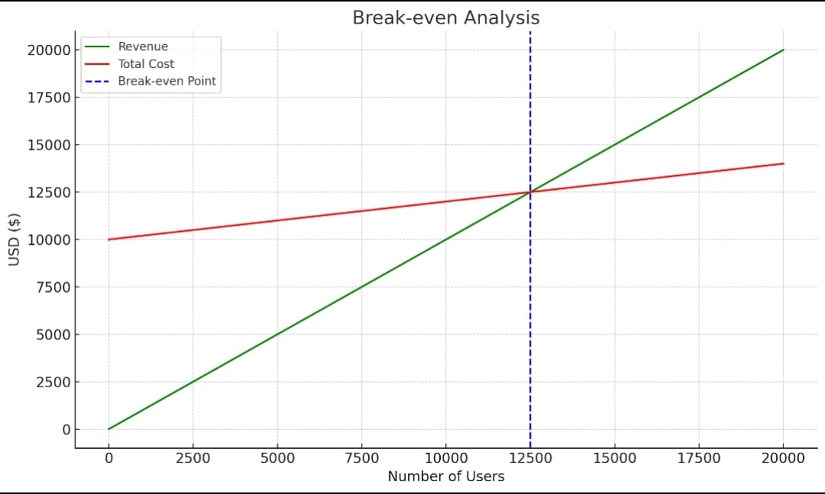
Cost BreakDown
Fixed cost
Break Even Analysis
Cost and Revenue BreakDown (USD)
Fixed cost
Development Team (2 Developer, 1 Designer) | 8000
Cloud Services (Firebase, storage, API Processing) | 1200
Marketing (Capus Drive, Online Marketing) | 2000
Maintainence (Updates, Bug Fixing) | 1200
Legal / Compliance (Licensing, App Store Fees) | 600
Miscellanous (Admin Customer Support) | 1000
Total Yearly Cost | 14,000 /year
Spend Per Lead | 0.50
Conversion rate | 2.50 /user
Total Startup Requirements
808333.3
CAC 20%

Slide 13
Strategy & Promises
Go to Market Strategy
Our Promises
Campus Piloting
Ambassador Program
Institution Deals
Freemium Launch
Social Proof
A social media page with 1k like
Database of 300 potential customers
R&D in scalability
Will Tune Affiliate Program
Revenue generation 12K BDT
Total Startup Requirements
808333.3
We want you with Us in the journey Towards Our Goal

Slide 14
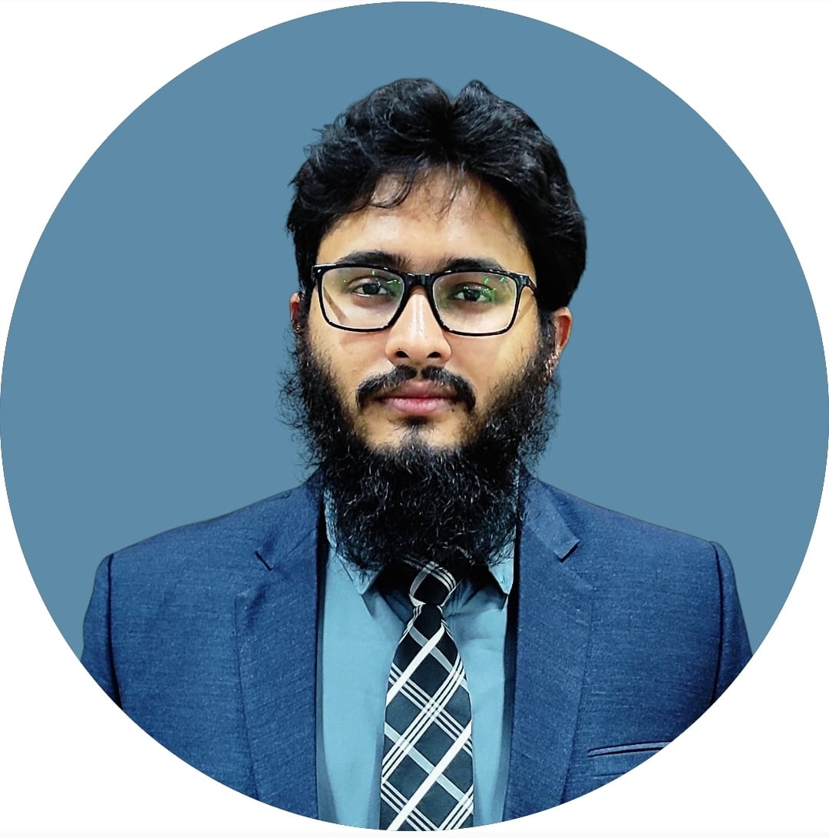
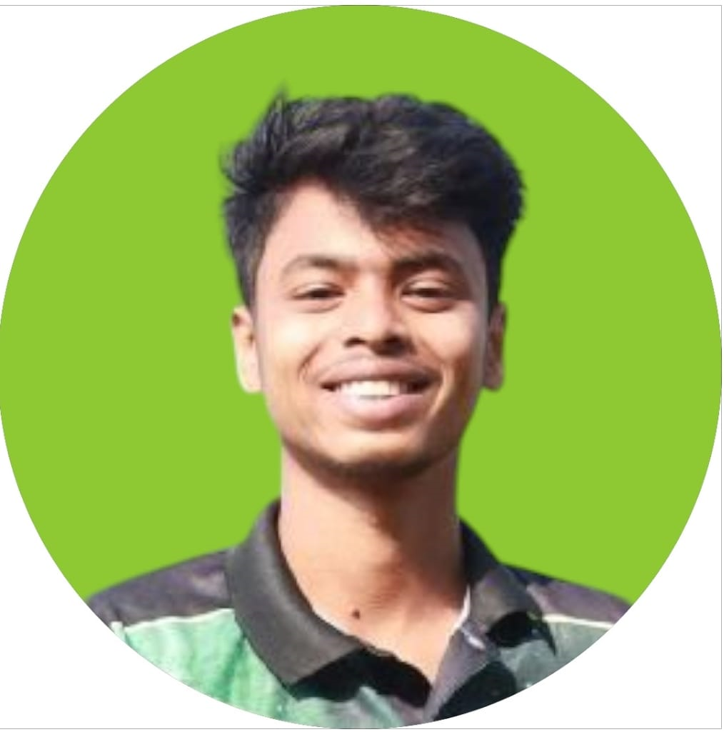
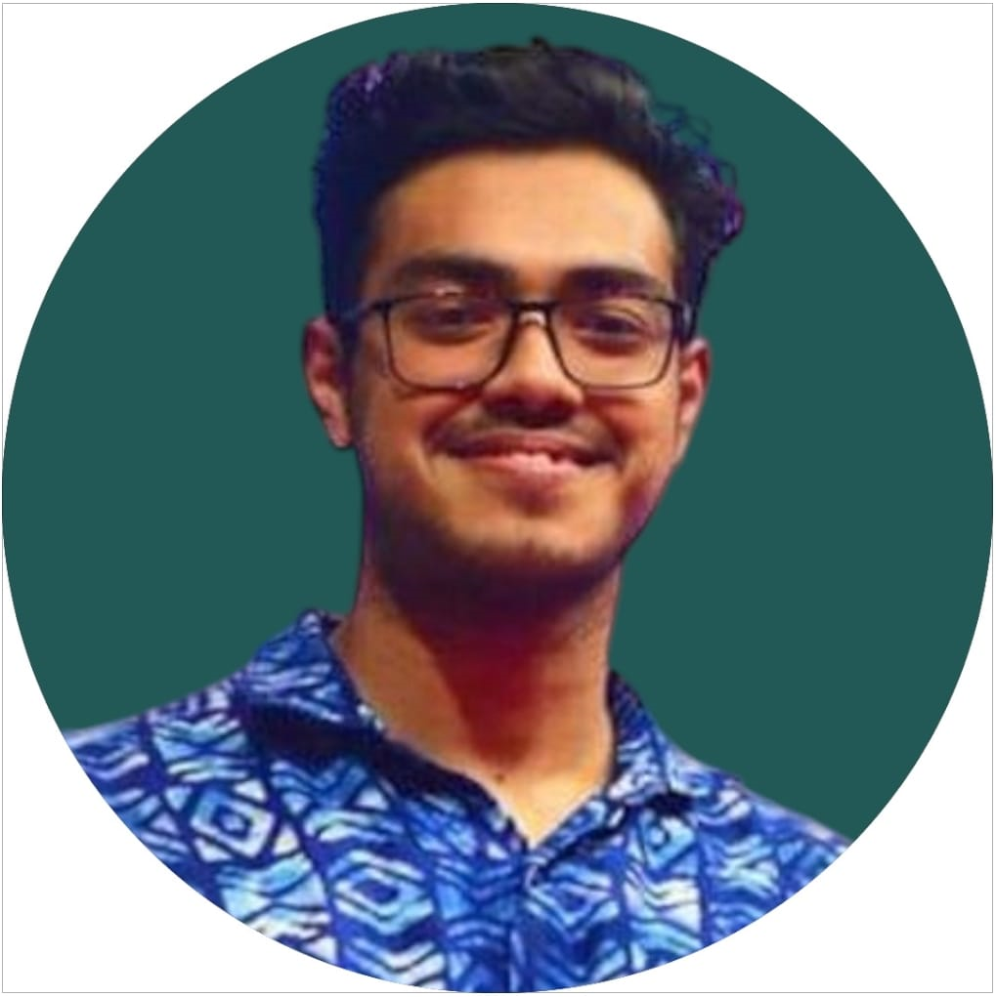
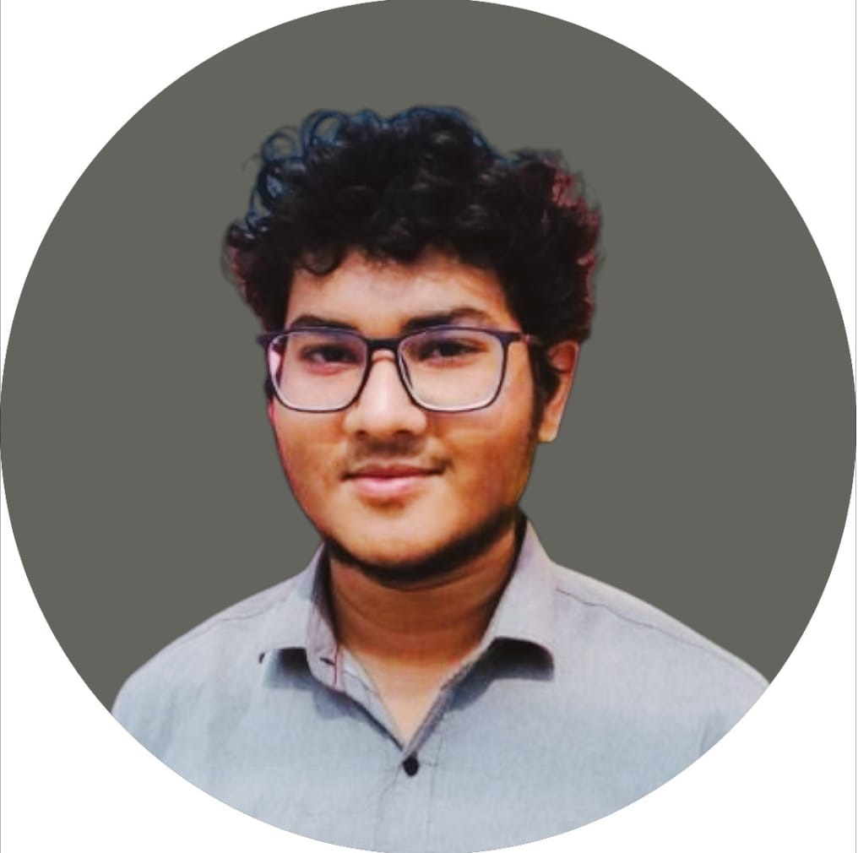
Team Introduction
MD. Kawsar Ahmed
MD. Morakib Hossain
MD. Safius Sifat
Mir Oliul Pasha Taj
Team Lead
AI Developer
Backend Developer
Software Engineer
Expertise: Hands on Expertise in Robotics, AI. Aspiring Business Strategist
Expertise: Hands on Expertise in Image Processing, Dataset Management and AI Development
Expertise: Hands on Expertise in API Integration, Backend Development, Compettitive Programming
Expertise: Hands on Expertise in Cross Platform App Development, Cyber Security

Slide 15
Thank You

