Slide 1
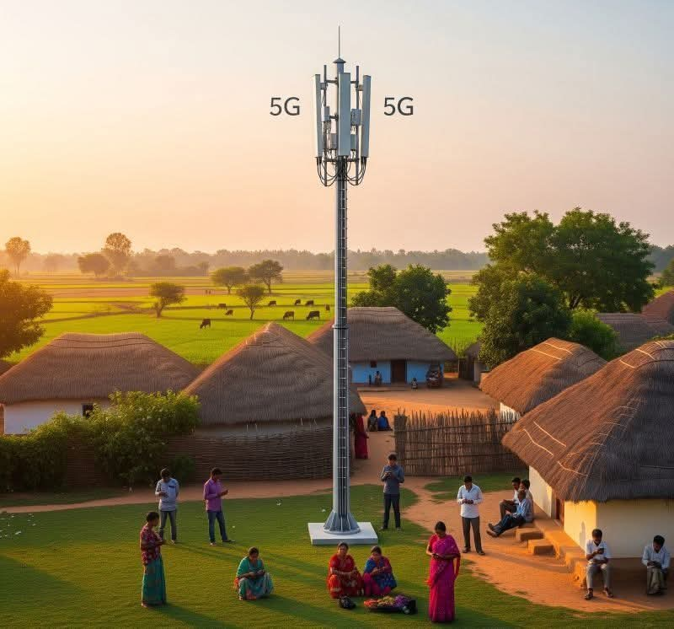
Understanding Customer Churn
A Business Perspective on Retaining Customers
Presented by: Olive Njeri

Slide 2
Overview
- Every business wants to grow — but keeping current customers is just as important as acquiring new ones.
- This project explores the factors that cause customers to leave (churn) and how we can reduce it.
- Using customer data, we analyzed patterns and built a model to help predict and prevent churn.

Slide 3
Business Understanding
What is Customer Churn?
- Churn happens when a customer stops using our service.
- High churn means lost revenue and higher marketing costs.
Business Goal:
- Identify which customers are likely to leave.
- Take action before they do.

Slide 4

Data Understanding
We worked with a dataset of over 7,000 customers, covering:
Customer information: Age, gender, contract type
Services used: Internet, phone, streaming
Billing and payments: Monthly charges, tenure
Churn status: Whether the customer stayed or left
Key Insight:
Some groups of customers are more likely to churn than others.

Slide 5
Modeling Approach
We used a machine learning model to predict churn.
Don't worry about the technicalities — here's what you need to know:
- The model learned from customer behavior patterns.
- It gives a likelihood score of a customer churning.
- The model helps us prioritize who needs attention first.

Slide 6
Evaluation
We tested the model to make sure it works well
It correctly predicted churn nearly 80% of the time.
The model is more accurate than guessing or using gut feeling.
Business value:
We now have a reliable way to identify at-risk customers before it's too late.

Slide 7

Key Recommendations
Based on our findings:
✅ Target customers with month-to-month contracts – they’re more likely to churn
✅ Offer personalized deals to high-paying, short-tenure customers
✅ Improve service quality for customers with tech or billing complaints

Slide 8
Next Steps
1. Integrate the model into customer service workflows
2. Train staff to act on churn alerts
3. Monitor results and adjust offers based on customer feedback
4. Expand analysis to new customer segments and products

Slide 9
Thank You
We appreciate your time and interest.
Let’s work together to reduce churn and grow smarter.
Questions? Let’s discuss.

