Slide 1
Tour Packages Sales Predicting Model
Ola Barradh

Slide 2
Problem Description
The travel agency is suffering from low number of sales despite the resources directed on pitch sales.
This presentation aims to:
Explore any patterns regarding the success or fail of a sale pitch
Build a predictive model for future customers

Slide 3
01
02
03
04
Tools
Dataset
Findings
Data Model

Slide 4
01
Tools

Slide 5
Tools
Jupyter Notebook
Data Processing
Numpy, Pandas
Vizualization
Modeling
Matplotlib and Seaborn
imblearn and sickit-learn

Slide 6
02
Dataset

Slide 7
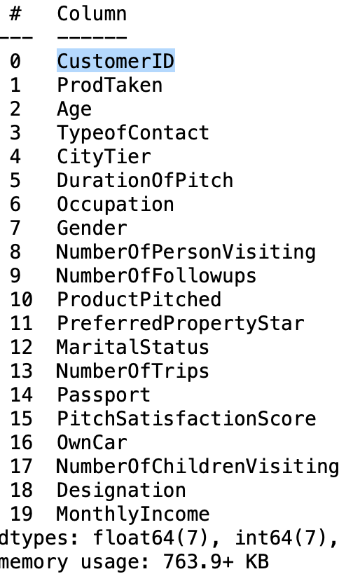
The data set is made of 4888 rows and 20 columns.
The dataset consists of different datatypes and is a mix of ordinal, categorical and numeric data
The data covers information both about the customer and the sale pitch interaction

Slide 8
03
Findings

Slide 9
Products Taken
We notice very low number of sales, indicating big amount of wasted time and resources

Slide 10
Products pitched vs. Products Bought

Slide 11
Personal Profile of Customers

Slide 12
Customer age and purchased product

Slide 13
Monthly Income and purchased product

Slide 14
04
Data Model

Slide 15
Testing Plan
Data
Over Sampling
Classification
Clean data
Clean data + Oversampling
Clean data +oversampling + feature selection
SMOTE
RandomOverSampler
Random Forest
Logistic Regression
XGBoost
AdaBoost

Slide 16
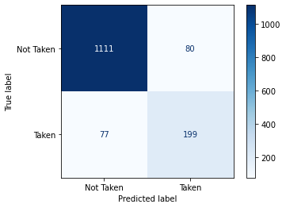
Testing (Clean Data)
Testing on Clean Data resulted in high accuracy 90% . The Recall was at 72%.

Slide 17
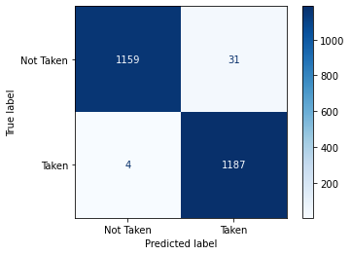
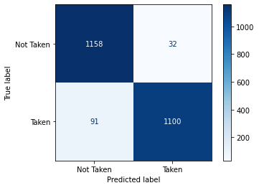
Testing (Over Sampling)
Mixed and matched Oversampling algorithms with different classification models
RandomOverSampler tends to cause overfitting of the data
RandomOverSampler + Random Forest
SMOTE+ Random Forest

Slide 18
RESULTS (SMOTE)
Model | Accuracy | Recall | Precision | F1
Decision Tree | 90% | 90% | 91% | 90%
Random Forest | 94% | 92% | 97% | 94%
XGBoost | 90% | 87% | 93% | 90%
AdaBoost | 88% | 85% | 90% | 87%
Logistic Regression | 87% | 83% | 91% | 87%
Data was skewed so we needed to Over Sample
Good results, leans toward overfitting
Random Forest produced the highest accuracy

Slide 19
RESULTS (RANDOM OVER SAMPLER)
Model | Accuracy | Recall | Precision | F1
Decision Tree | 96% | 98% | 93% | 95%
Random Forest | 98% | 99% | 97% | 98%
XGBoost | 82% | 82% | 81% | 82%
AdaBoost | 76% | 77% | 75% | 76%
Logistic Regression | 73% | 74% | 72% | 73%
Data was skewed so we needed to Over Sample
RandomOverSampler higher results thatn SMOTE
Random Forest produced too high of a result (Overfitting)

Slide 20
RESULTS (FEATURE SELECTION+SMOTE)
Model | Accuracy | Recall | Precision | F1
Decision Tree | 89% | 91% | 88% | 89%
Random Forest | 88% | 90% | 87% | 89%
XGBoost | 90% | 85% | 93% | 89%
AdaBoost | 89% | 85% | 93% | 89%
Logistic Regression | 86% | 83% | 88% | 86%
Selected features based on customer profile only
Numbers are lower >> more balanced
XGBoost produced the highest accuracy

Slide 21
RESULTS (FEATURE SELECTION+OverSampler)
Model | Accuracy | Recall | Precision | F1
Decision Tree | 95% | 99% | 91% | 95%
Random Forest | 95% | 99% | 91% | 95%
XGBoost | 79% | 78% | 80% | 79%
AdaBoost | 74% | 75% | 73% | 74%
Logistic Regression | 72% | 74% | 71% | 73%
Selected features based on customer profile only
Numbers are lower >> more balanced
XGBoost produced the highest accuracy

Slide 22
Thank you for Listening

