Slide 1
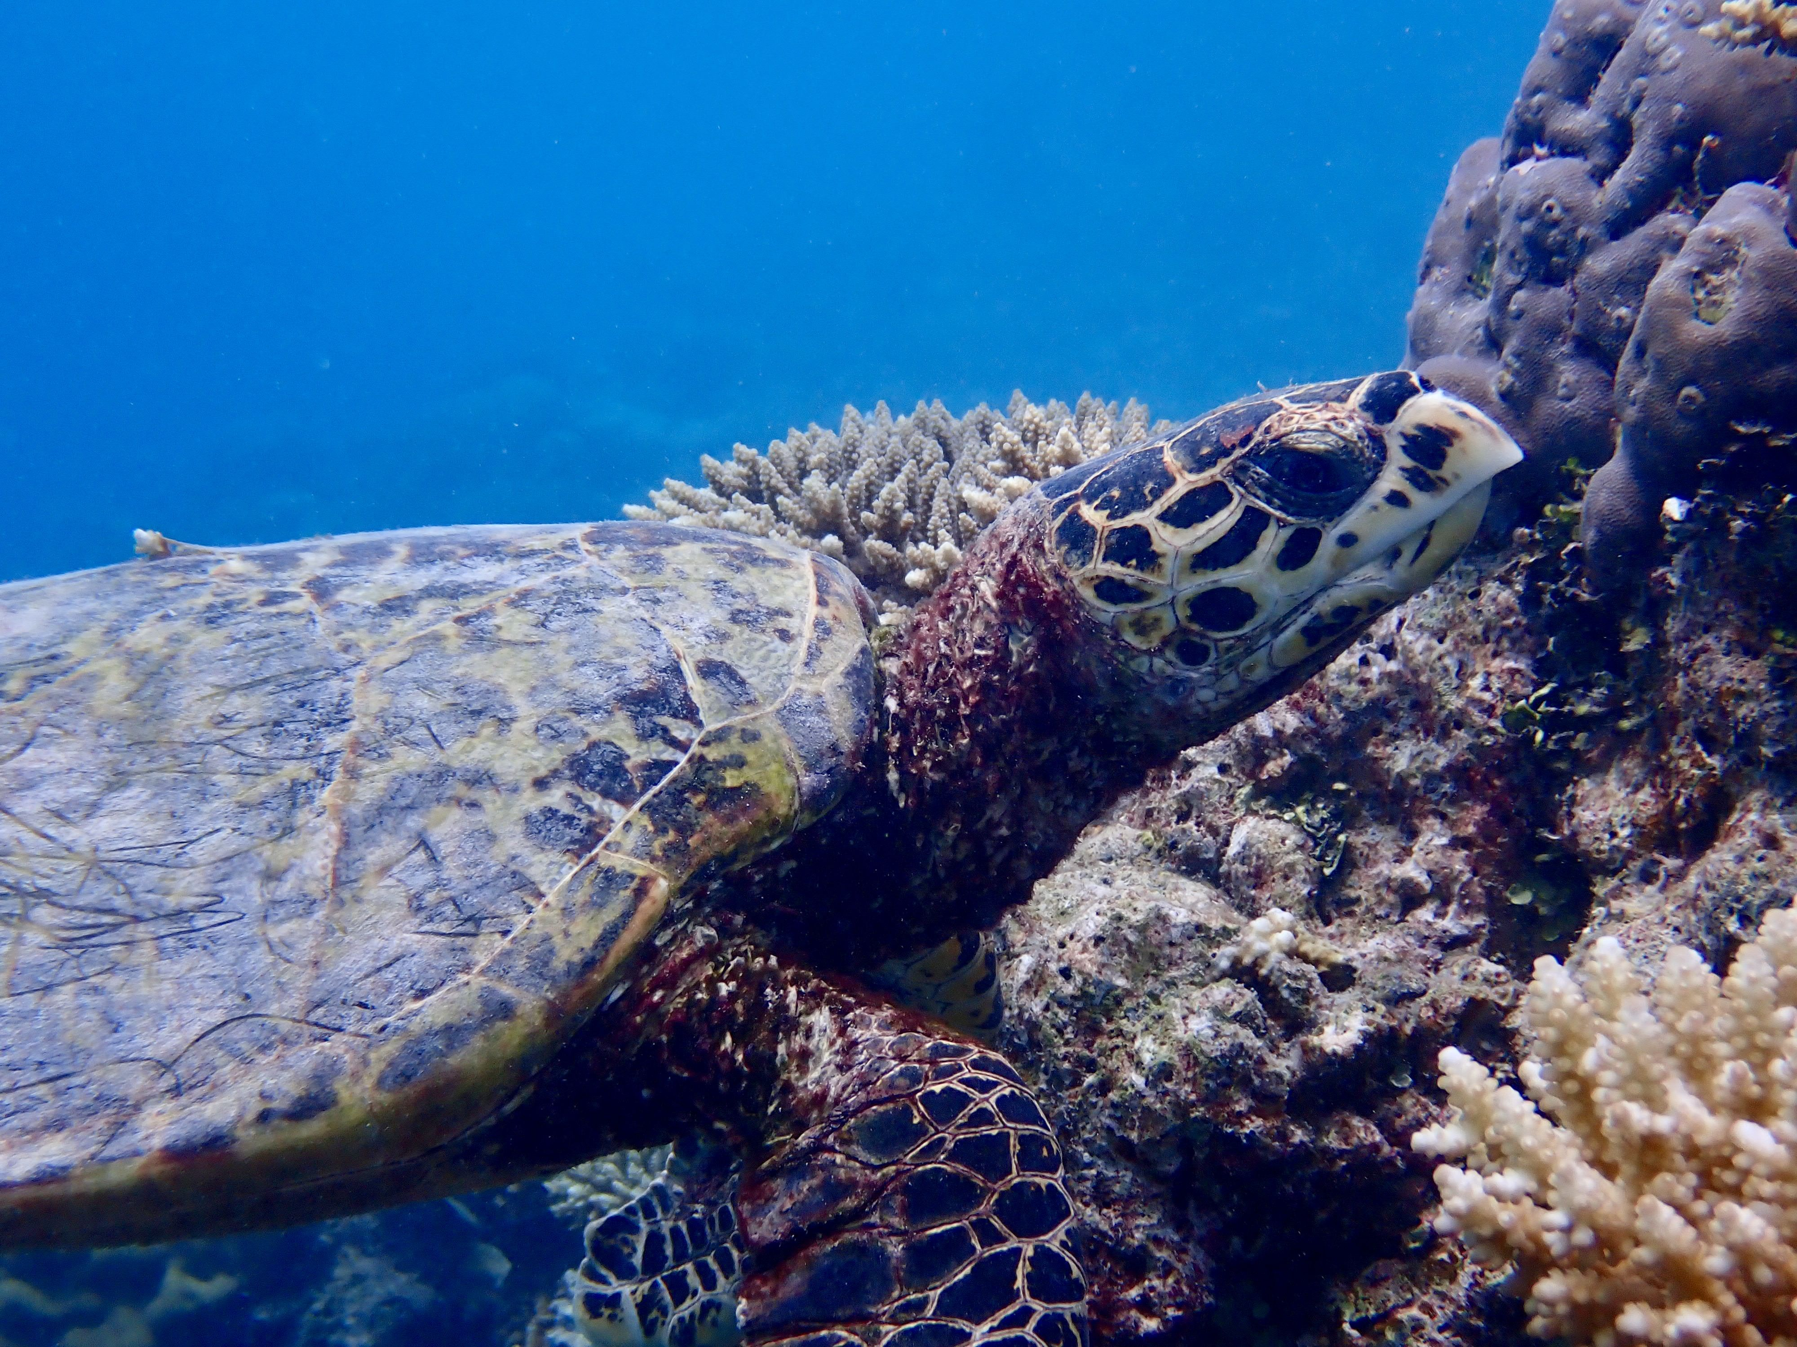
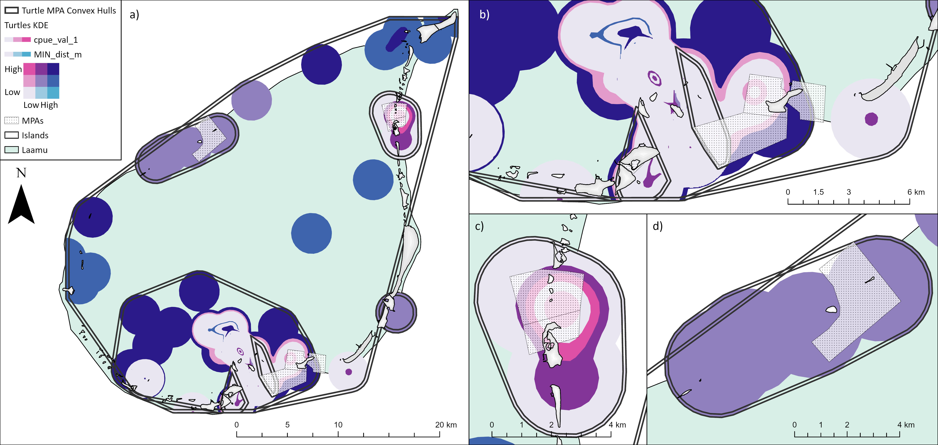
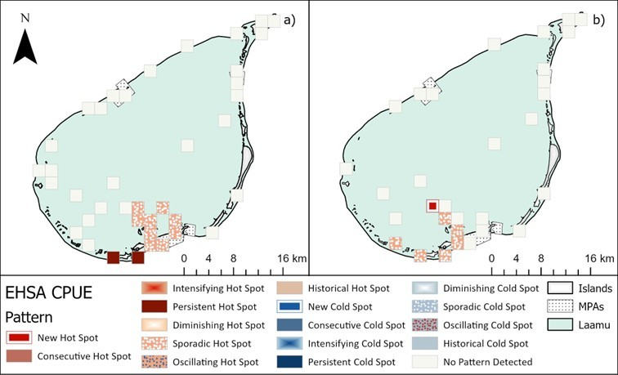


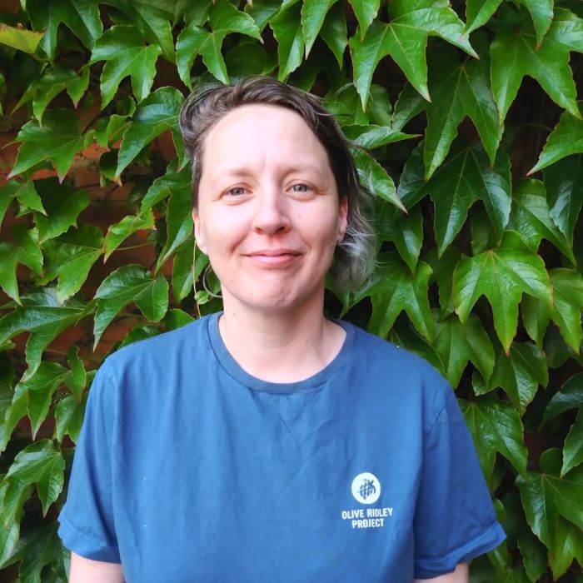
Scalable exploratory spatial analysis pipeline for sea turtle monitoring across Maldives: A case study in Laamu atoll
Jane R. Lloyd¹ʼ², Stephanie Köhnk² & Robert McNabb¹
Ulster University¹ & Olive Ridley Project²
HK4710 – Omi
1st Sept. 2023
Laamu, Olhuveli Reef
INTRODUCTION
This study uses spatial and temporal data from 1990-2024 of photo-identified green (n18131) and hawksbill (n31179) turtles from in-water encounters from ORP surveys and citizen scientist submissions (Hudgins et al 2023).
To create a repeatable plug and go Exploratory Spatial Data Analysis (ESDA) pipeline using Arc.py and ArcGIS Pro.
Focused on Laamu atoll as a case study because
of the consistent data quality including survey effort time.
The ESDA pipeline considers sea turtles in their primary habitat for informed conservation management decisions.
METHODS
The capture per unit effort (CPUE) was calculated daily for each site surveyed in Laamu atoll (total number of turtles / total survey time)*60).
This subset consists of 1416 green, 833 hawkbill turtles and 48 surveys with no turtle sightings.
Secondary datasets used include; Maldives OneMap Marine Protected Areas (MPAs) and Allen Corel Atlas Coral and seagrass extents.
Initial ESDA processing included: Hot Spot Analysis, Optimised Hotpots Analysis, Density Based Spatial Clustering of Applications with Noise and Kernal Density Extent (KDE) (Figure 1). ESDA parameters are editable within the developed Arc.py script.
Input datasets with statistically significant spatial results were further subjected to Space Time Cube (STC) bin calculations grouping by year/month for each site and Emerging HotSpot Analysis (Figure 2).
RESULTS
Figure 1. KDEs of all site CPUE sea turtle values vs secondary dataset MPAs
00
No sites have low dist. MPA & low CPUE.
Legend matrix colours marked with Ж
Same shade as in d), purple indicates a mid turtle CPUE, MPA is relatively low dist.
High CPUE indicated by dark blues, purple and pink hotspots. Spatially as a group the pale lilac / light pink boundary is primarily indicative of relatively low proximity to MPA & mid turtle CPUE compared to the brighter hotspot colours.
Ж
Ж
Darkness of blue colour reflects higher CPUE, because it’s further than 10km dist. to MPA – (applies to North East KDE sites)
CPUE sites of interest
d) Purple indicates a mid turtle CPUE, because the MPA is low distance
Consider outer convex hull boundary for consolidated MPA
c) Distance to MPAs is low, therefore the bright pink & purple indicate high to medium turtle CPUE
Figure 2. Emerging HotSpot analysis
Green & Hawksbill turtles
Hawksbill turtles only
Hawksbill KDE secondary benthic data analysis conducted with ACA coral & seagrass extents.
Figure 2a) Green & Hawksbill turtles
Widespread Sporadic Hotspots near a channel entrance *
Two Persistent Hotspots on the atolls outer southern rim.
Figure 2b) Hawksbill turtles only
The Persistent Hotspots from map a) become Sporadic Hotspots extending one site further west.
The New Hotspot is identified where previously no pattern was detectable when looking at both green & hawksbill turtles together.
All photo identified in-water sea turtle sightings Maldives 1990 - 2024.
*
CONCLUSION
To assess the efficacy of MPAs it is more useful to work with the turtle populations as a whole. All MPAs in Laamu have been captured by a multiple KDE convex hulls (Fig. 1).
Photo ID analysis shows high site fidelity, meaning turtles situated outside of MPAs have fewer protections and are unlikely to move, the longest Maldives residency period detected is 13 years 4 months within the study period. Therefore, MPAs should be expanded to reflect actual turtle distribution protecting foraging and shelter habitat connectivity.
Emerging Hotspot Spatial Analysis (Fig.2) considers the data temporally. The persistent, and new hotspots are outside of existing MPAs and most of the sporadic hotspots. This indicates the importance of south Laamu for turtles both historically and a New Hotspot for critically endangered hawksbills therefore; protections should be expanded in the future.
Using Capture per Unit Effort for each site is important to counter survey site sample bias. Repeat analysis for the remaining atolls in Maldives, may be more restrictive depending on turtle encounters and survey data availability. Additional life stage and turtle activity analyses are possible, by simply splitting the turtle data into different subgroups within the Arc.py workflow.
ESDA is an efficient pipeline for sea turtle monitoring photo ID data for rapid large scale detailed assessment providing spatial temporal evidence for the advocacy of expanded and well managed protective policies in Maldives.
KEY SOURCES
Maldives OneMap - https://readme.onemap.mv/
Allen Coral Atlas Team. 2026. The Allen Coral Atlas: A High Resolution Mapping and Monitoring Observatory for Global Shallow Coral Reefs. Arizona State University Center for Global Discovery and Conservation Science, Hilo HI USA. URL: https://allencoralatlas.org (accessed October 16th 2026 )
Hudgins JA, Hudgins EJ, Köhnk S, Mohamed Riyad E, Stelfox MR. 2023. A brighter future? Stable and growing sea turtle populations in the Republic of Maldives. PLoS One. 18(4):e0283973. doi:10.1371/journal.pone.0283973
Chat GPT4 was used in the Arc.py script development, all generated outputs were subjected to rigorous review, validation and refined under the lead author's oversight.
Jane Lloyd
jane.lloyd@oliveridleyproject.org
https://github.com/OliveRidleyProject/ESDA/tree/IMCC8-Posterorg

