Slide 1
Regular Expressions

Slide 2
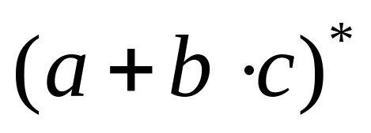
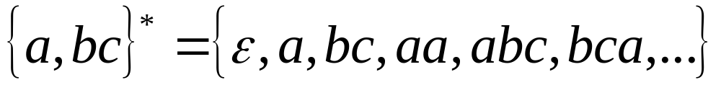
Regular Expressions
Regular expressions
describe regular languages
Example:
describes the language

Slide 3
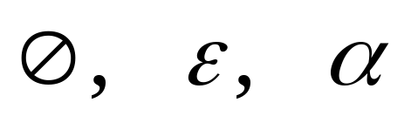


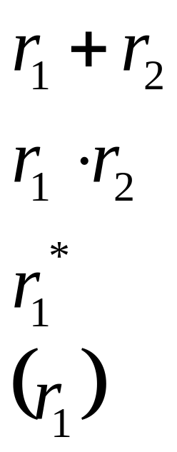
Recursive Definition
Primitive regular expressions:
Given regular expressions and
Are regular expressions

Slide 4
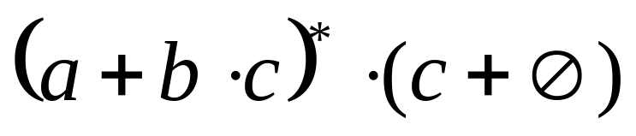
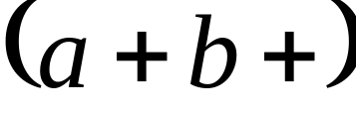
Examples
A regular expression:
Not a regular expression:

Slide 5
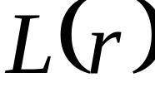

Languages of Regular Expressions
: language of regular expression
Example

Slide 6
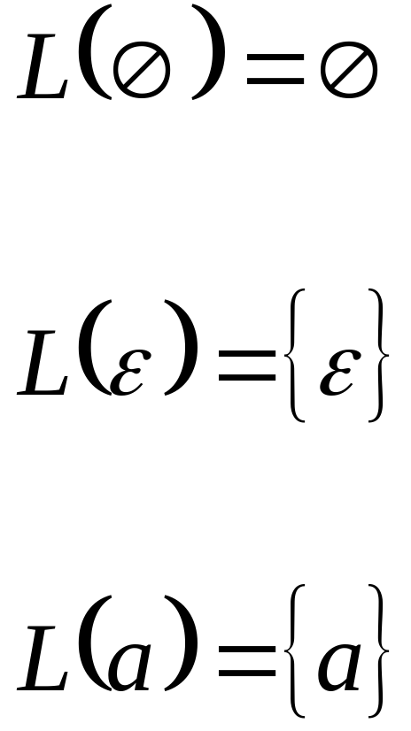
Definition
For primitive regular expressions:

Slide 7


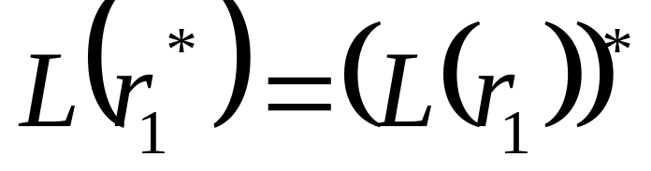

Definition (continued)
For regular expressions and

Slide 8
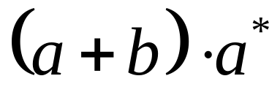
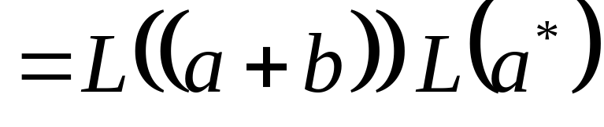
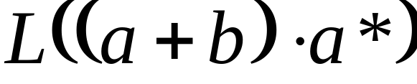
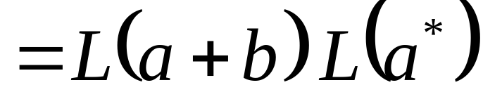
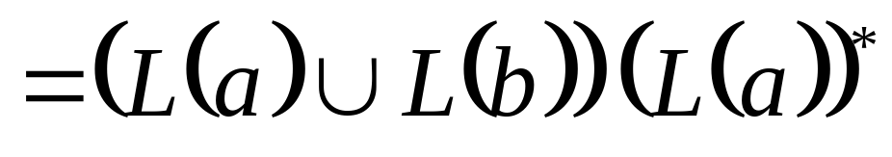
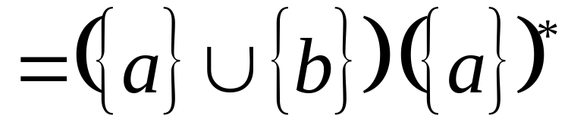
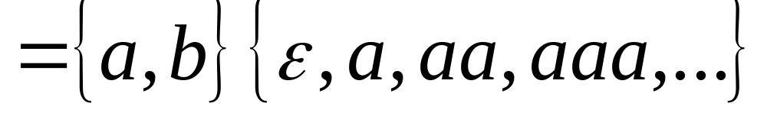
Example
Regular expression:

Slide 9
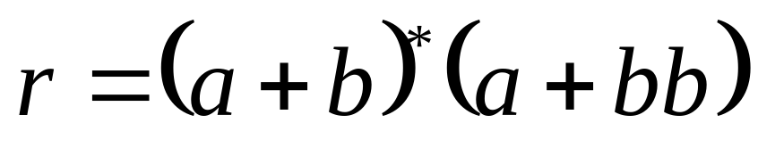
Example
Regular expression

Slide 10
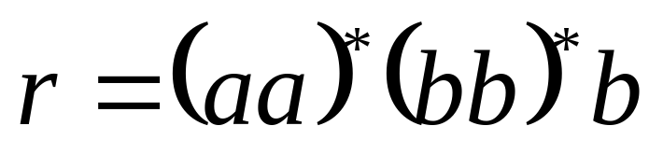

Example
Regular expression

Slide 11
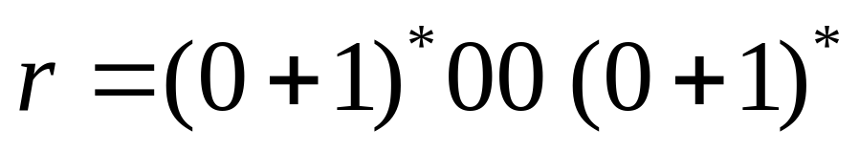

Example
Regular expression
= { all strings containing substring 00 }

Slide 12
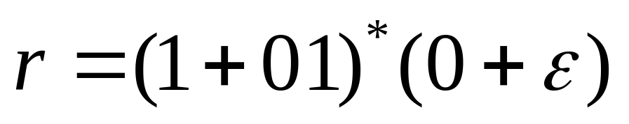
Example
Regular expression
= { all strings without substring 00 }

Slide 13

Equivalent Regular Expressions
Definition:
Regular expressions and
are equivalent if

Slide 14

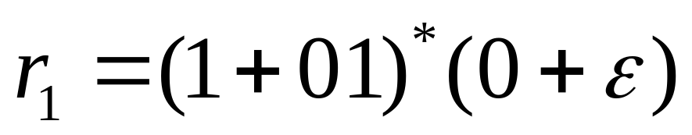
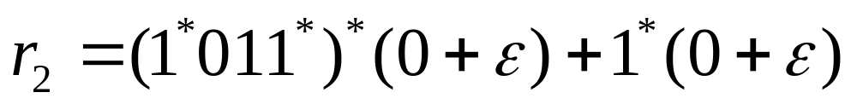

Example
= { all strings without substring 00 }
and
are equivalent
regular expressions

Slide 15
Regular Expressions and
Regular Languages

Slide 16
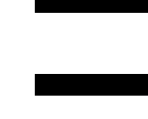
Theorem
Languages
Generated by
Regular Expressions
Regular
Languages

Slide 17
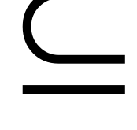

Proof:
Languages
Generated by
Regular Expressions
Regular
Languages
Languages
Generated by
Regular Expressions
Regular
Languages

Slide 18
Proof - Part 1
Languages
Generated by
Regular Expressions
Regular
Languages
For any regular expression
the language is regular
Proof by induction on the size of

Slide 19

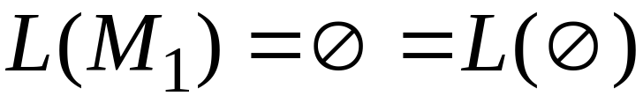
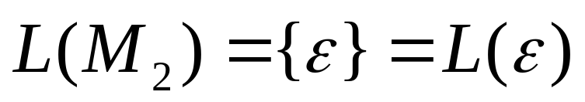

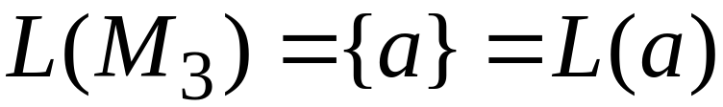
Induction Basis
Primitive Regular Expressions:
Corresponding
NFAs
regular
languages

Slide 20
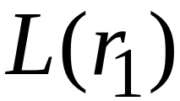
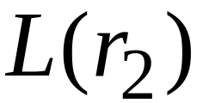
Inductive Hypothesis
Suppose
that for regular expressions and ,
and are regular languages

Slide 21
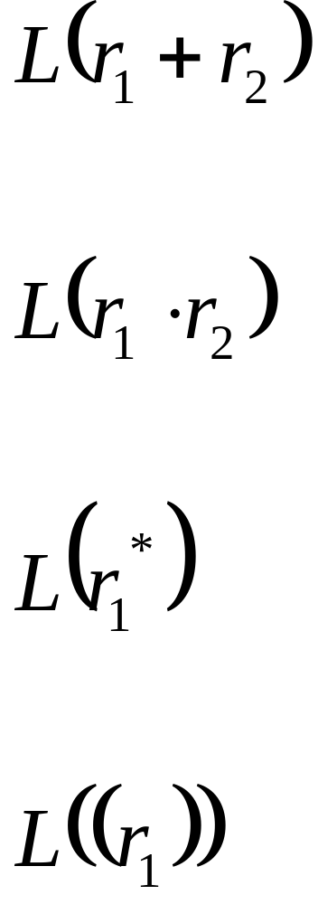
Inductive Step
We will prove:
Are regular
Languages

Slide 22
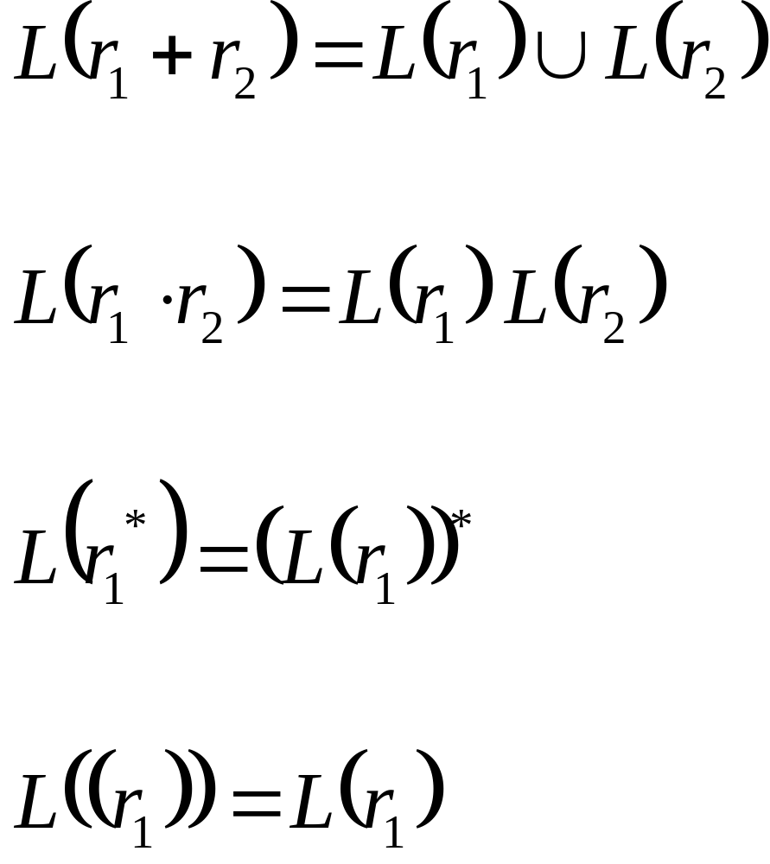
By definition of regular expressions:

Slide 23
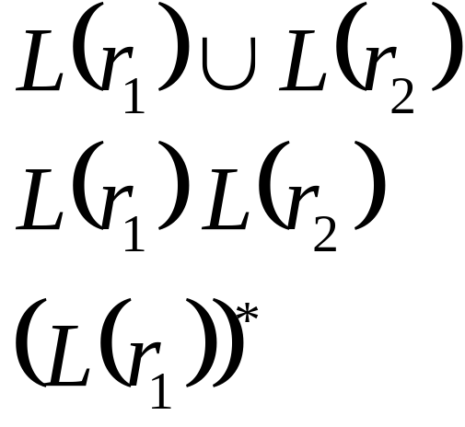
By inductive hypothesis we know:
and are regular languages
We also know:
Regular languages are closed under:
Union
Concatenation
Star

Slide 24
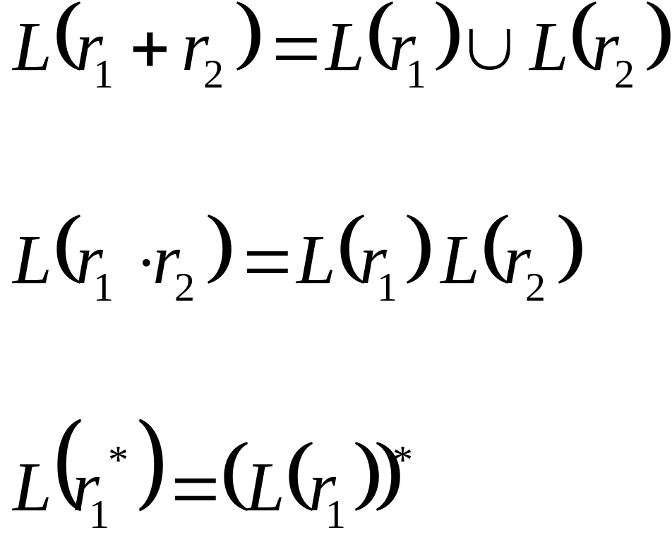
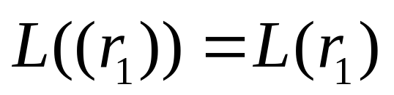
Therefore:
Are regular
languages
is trivially a regular language
(by induction hypothesis)
End of Proof-Part 1

Slide 25
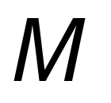
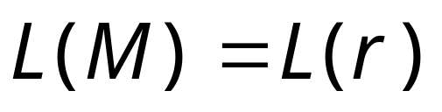
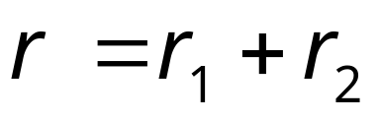



Using the regular closure of operations,
we can construct recursively the NFA
that accepts
Example:

Slide 26
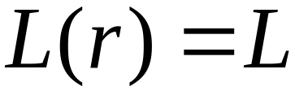
Proof - Part 2
Languages
Generated by
Regular Expressions
Regular
Languages
For any regular language there is
a regular expression with
We will convert an NFA that accepts
to a regular expression

Slide 27

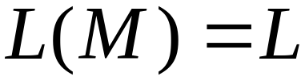
Since is regular, there is a
NFA that accepts it
Take it with a single accept state

Slide 28




From construct the equivalent
Generalized Transition Graph
in which transition labels are regular expressions
Example:
Corresponding
Generalized transition graph

Slide 29




Another Example:
Transition labels
are regular
expressions

Slide 30
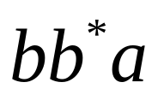
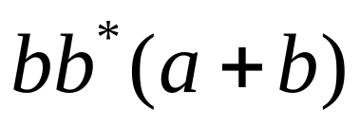
Reducing the states:
Transition labels
are regular
expressions

Slide 31

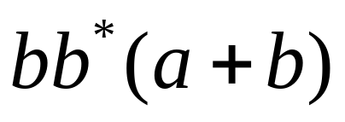
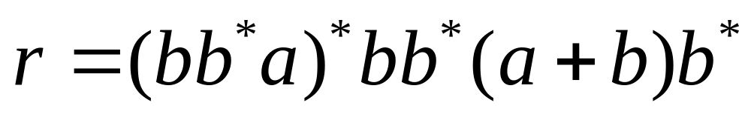
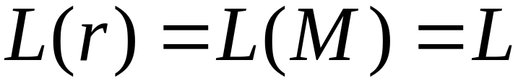
Resulting Regular Expression:

Slide 32





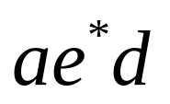
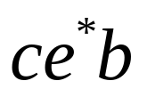
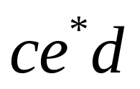
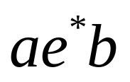
In General
Removing a state:
2-neighbors

Slide 33












This can be generalized
to arbitrary number
of neighbors to q
3-neighbors

Slide 34





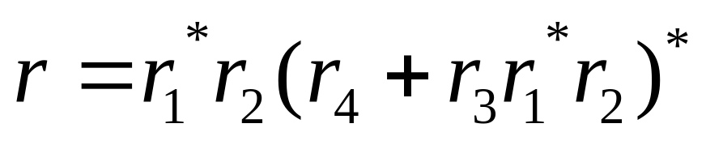
By repeating the process until
two states are left, the resulting graph is
Initial graph
Resulting graph
The resulting regular expression:
End of Proof-Part 2

Slide 35
Standard Representations of Regular Languages
Regular Languages
DFAs
Regular
Expressions
NFAs

Slide 36
When we say:
We are given
a Regular Language
We mean:
Language is in a standard
representation
(DFA, NFA, or Regular Expression)

