Slide 1
Context-Free Languages

Slide 2




Context-Free Languages
Regular Languages

Slide 3
Context-Free Languages
Context-Free
Grammars
Pushdown
Automata
stack
automaton

Slide 4
Context-Free Grammars

Slide 5

Formal Definitions
Grammar:
Set of
variables
Set of
terminal
symbols
Start
variable
Set of
productions

Slide 6


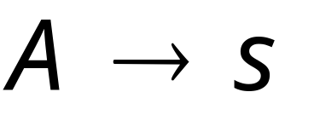
Context-Free Grammar:
All productions in are of the form
Variable
String of
variables and
terminals

Slide 7
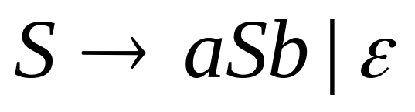
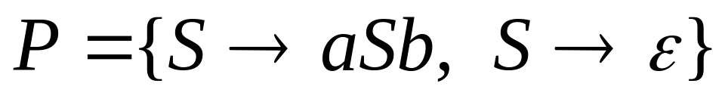


Example of Context-Free Grammar
productions
start variable
variables
terminals

Slide 8




Language of a Grammar:
For a grammar with start variable
String of terminals or

Slide 9
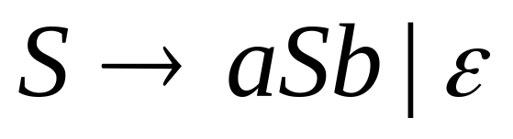
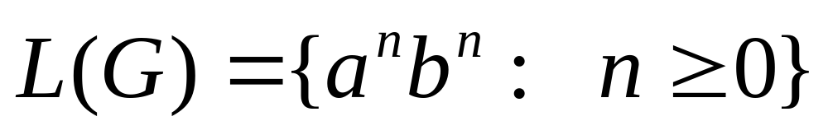
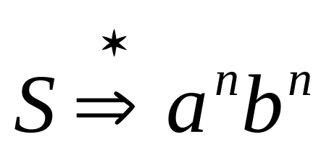
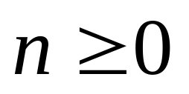
Example:
context-free grammar :
Since, there is derivation
for any

Slide 10

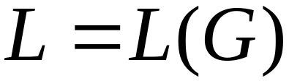
Context-Free Language definition:
A language is context-free
if there is a context-free grammar
with

Slide 11
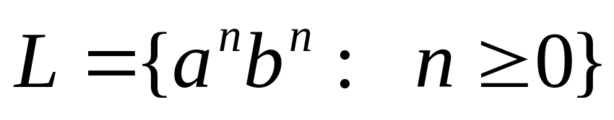
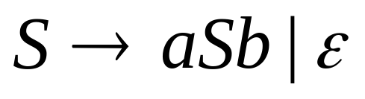
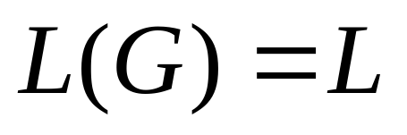
Example:
is a context-free language
since context-free grammar :
generates

Slide 12
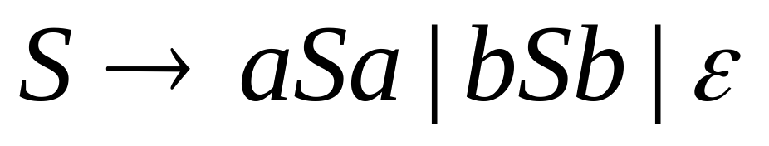


Another Example
Context-free grammar :
Example derivations:
Palindromes of even length

Slide 13
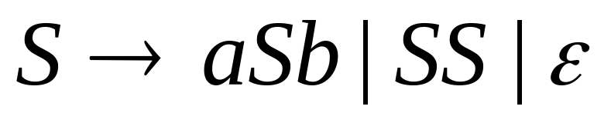
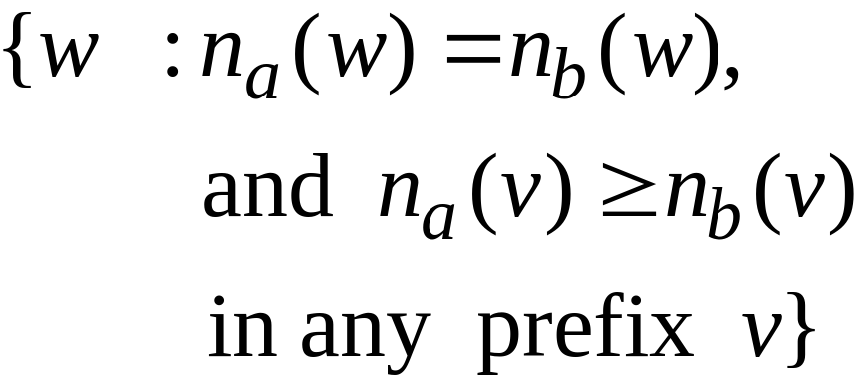

Another Example
Context-free grammar :
Example derivations:
Describes
matched
parentheses:
() ((( ))) (( ))

Slide 14
Derivation Order and
Derivation Trees

Slide 15
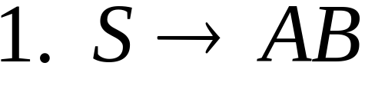
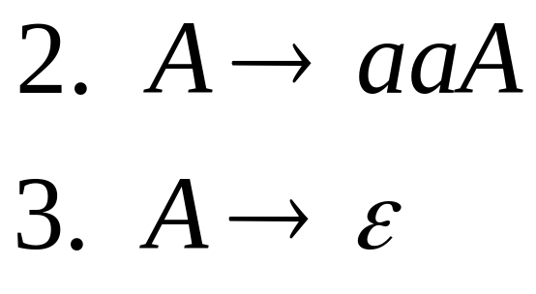
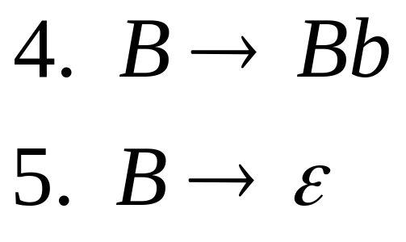
Derivation Order
Consider the following example grammar
with 5 productions:

Slide 16

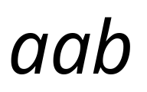

Leftmost derivation order of string :
At each step, we substitute the
leftmost variable

Slide 17

Rightmost derivation order of string :
At each step, we substitute the
rightmost variable

Slide 18
Leftmost derivation of :
Rightmost derivation of :

Slide 19

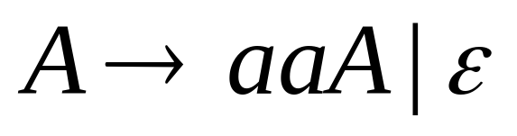
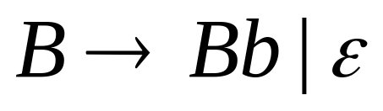
Derivation Trees
Consider the same example grammar:
And a derivation of :

Slide 20




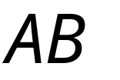
yield

Slide 21

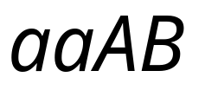

yield

Slide 22

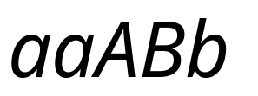
yield

Slide 23

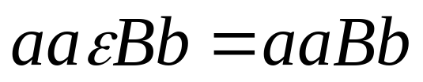
yield

Slide 24
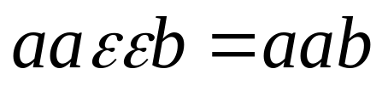
Derivation Tree
(parse tree)
yield

Slide 25
Sometimes, derivation order doesn’t matter
Leftmost derivation:
Rightmost derivation:
Give same
derivation tree

Slide 26
Ambiguity

Slide 27
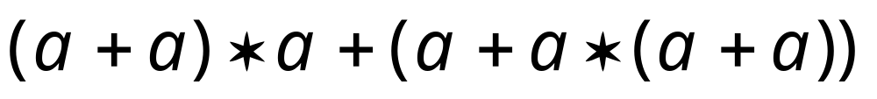
Grammar for mathematical expressions
Example strings:
Denotes any number

Slide 28





A leftmost derivation
for

Slide 29

Another
leftmost derivation
for

Slide 30
Two derivation trees
for

Slide 31

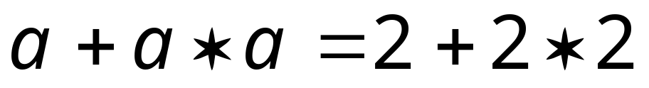

take

Slide 32





Good Tree
Bad Tree
Compute expression result
using the tree

Slide 33
Two different derivation trees
may cause problems in applications which
use the derivation trees:
Evaluating expressions
In general, in compilers
for programming languages

Slide 34

Ambiguous Grammar:
A context-free grammar is ambiguous
if there is a string which has:
two different derivation trees
or
two leftmost derivations
(Two different derivation trees give two
different leftmost derivations and vice-versa)

Slide 35
Example:
this grammar is ambiguous since
string
has two derivation trees

Slide 36
this grammar is ambiguous also because
string
has two leftmost derivations

Slide 37

Another ambiguous grammar:
STMT
if EXPR then STMT
if EXPR then STMT else STMT
Variables
Terminals
Very common piece of grammar
in programming languages

Slide 38
If expr1 then if expr2 then stmt1 else stmt2
STMT
this is the tree
used in languages
if
expr1
then
STMT
if
expr2
then
stmt1
else
stmt2
Two derivation trees
STMT
if
expr1
then
STMT
else
stmt2
if
expr2
then
stmt1

Slide 39
In general, ambiguity is bad
and we want to remove it
Sometimes it is possible to find
a non-ambiguous grammar for a language
But, in general ιt is difficult to achieve this

Slide 40
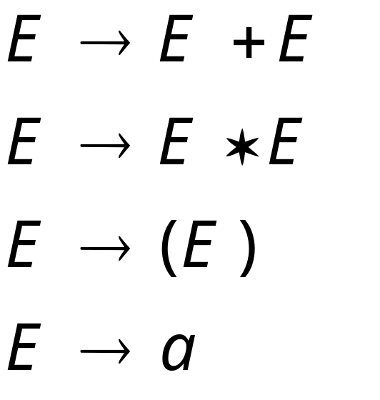
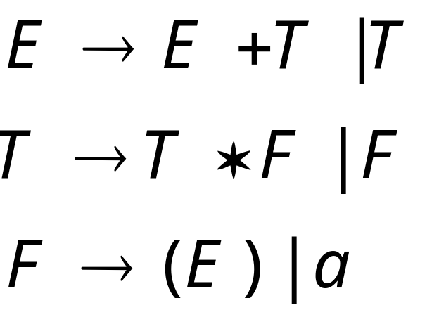
A successful example:
Equivalent
Ambiguous
Grammar
Non-Ambiguous
Grammar
generates the same
language

Slide 41

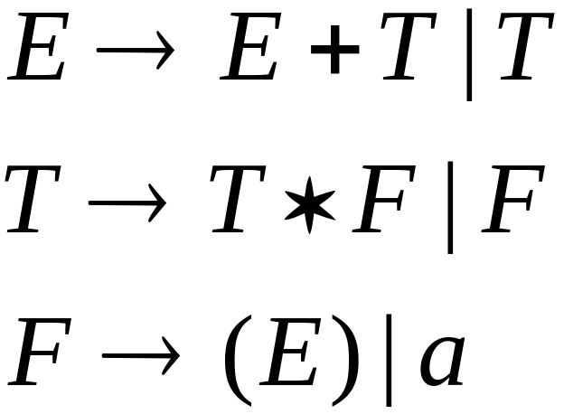


Unique
derivation tree
for

Slide 42
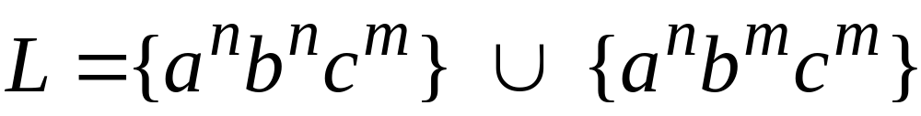


An un-successful example:
is inherently ambiguous:
every grammar that generates this
language is ambiguous

Slide 43


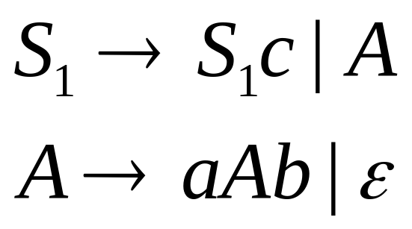
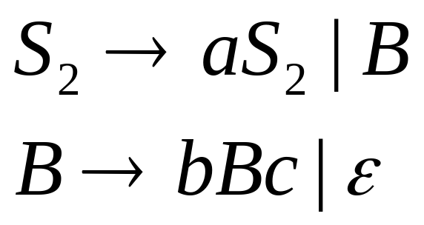
Example (ambiguous) grammar for :

Slide 44
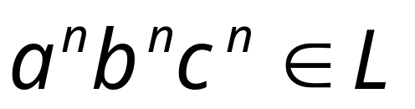



The string
has always two different derivation trees
(for any grammar)
For example

