Slide 1
Pumping Lemma for
Context-free Languages

Slide 2
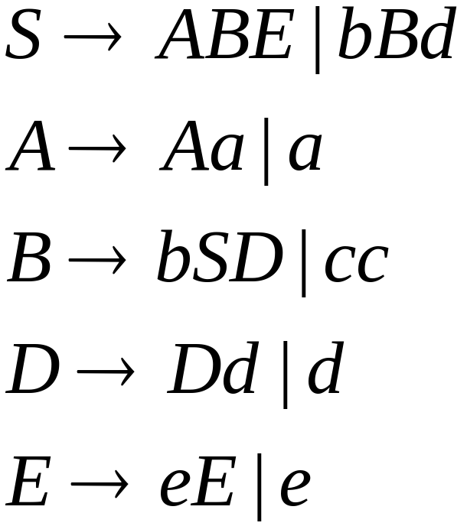
Take an infinite context-free language
Generates an infinite number
of different strings
Example:

Slide 3
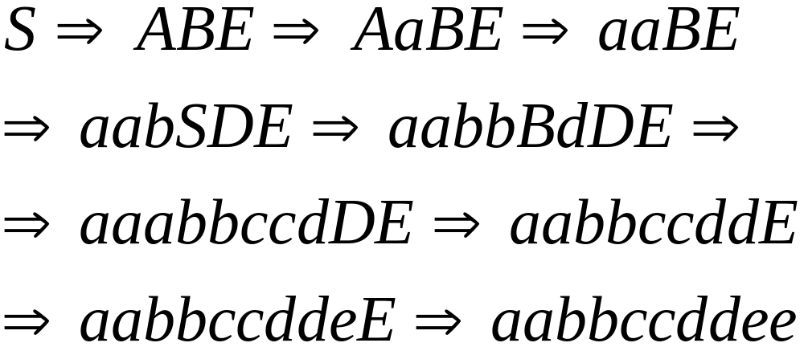
In a derivation of a “long” enough
string, variables are repeated
A possible derivation:

Slide 4
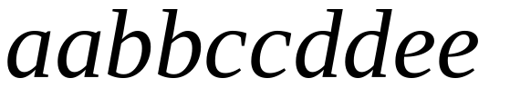











Derivation Tree
Repeated
variable

Slide 5
Derivation Tree
Repeated
variable

Slide 6
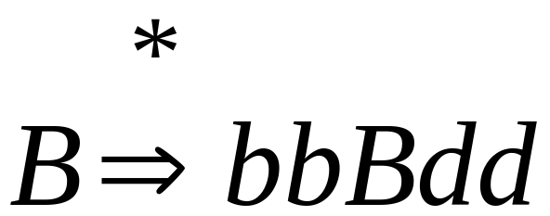

Slide 7
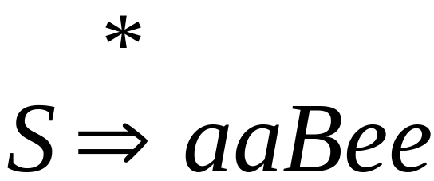

Slide 8
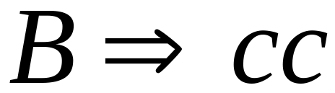

Slide 9

Putting all together

Slide 10
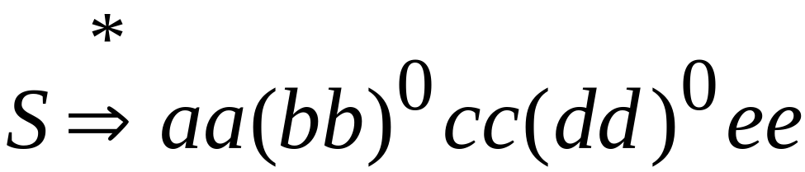
We can remove the middle part

Slide 11
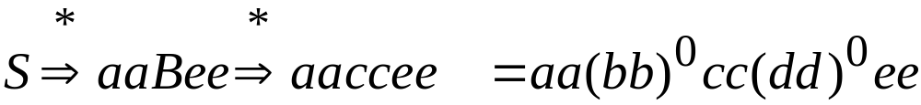
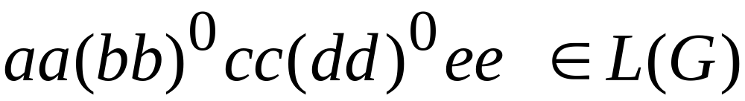

Slide 12
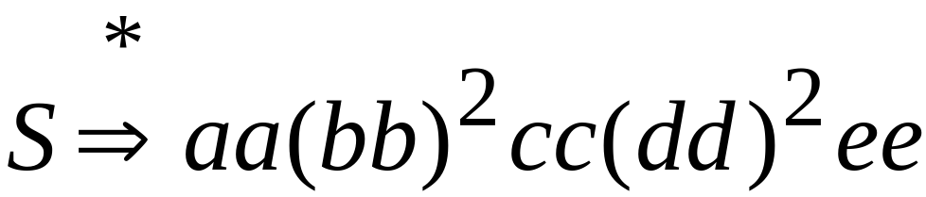
We can repeated middle part two times
1
2

Slide 13
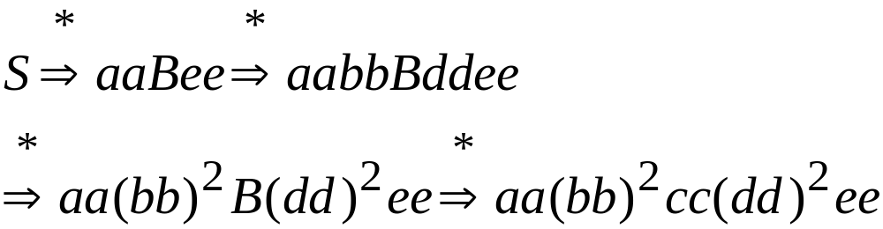
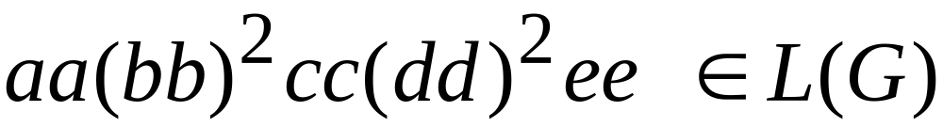

Slide 14

We can repeat middle part three times
1
2
3

Slide 15
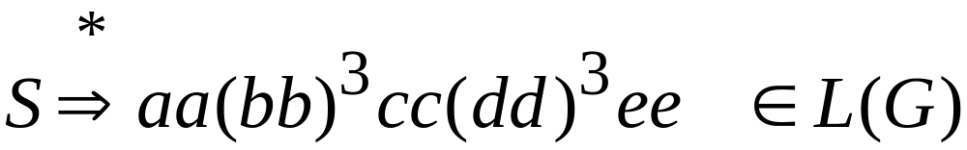

Slide 16

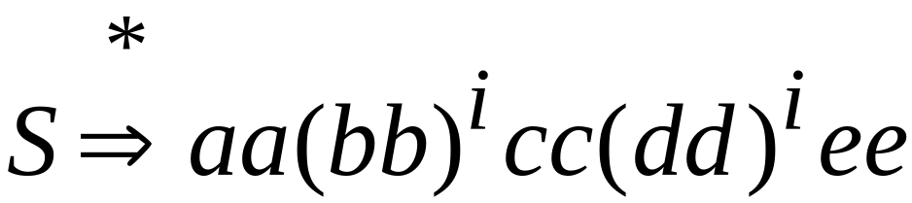
Repeat middle part times
1
i

Slide 17
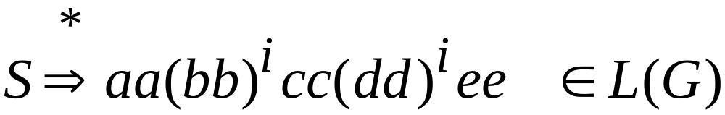
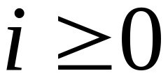
For any

Slide 18
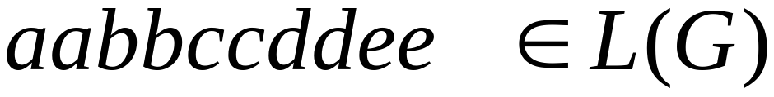

From Grammar
and given string
We inferred that a family of strings is in
for any

Slide 19


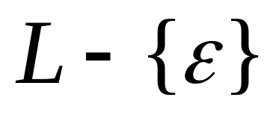

Arbitrary Grammars
Consider now an arbitrary infinite
context-free language
Let be the grammar of
Take so that it has no unit-productions
and no -productions
(remove them)

Slide 20


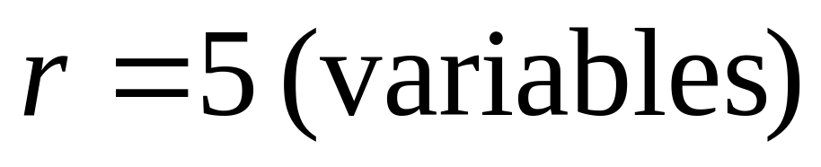
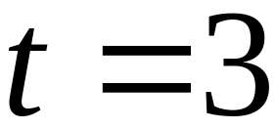
Let be the number of variables
Let be the maximum right-hand size
of any production
Example:

Slide 21
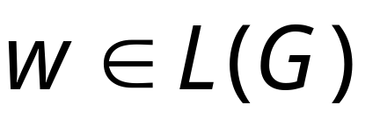
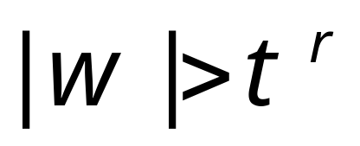
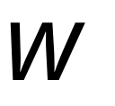
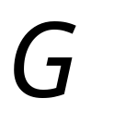
Claim:
Take string with .
Then in the derivation tree of
there is a path from the root to a leaf
where a variable of is repeated
Proof:
Proof by contradiction

Slide 22



Derivation tree of
We will show:
some variable
is repeated

Slide 23
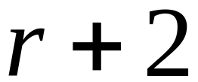
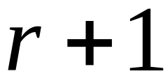
First we show that the tree of
has at least levels of nodes
Suppose the opposite:
At most
Levels

Slide 24

Maximum number of nodes per level
Level 0:
nodes
Level 1:
nodes
nodes
The maximum right-hand side of any production

Slide 25
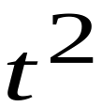
Maximum number of nodes per level
Level 0:
nodes
Level 1:
nodes
Level 2:
nodes
nodes
nodes
nodes

Slide 26


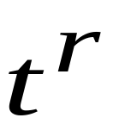
Maximum number of nodes per level
Level 0:
nodes
At most
Levels
Level :
nodes
Level :
nodes
Maximum possible string length
= max nodes at level =

Slide 27
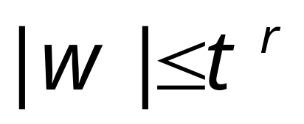

Therefore,
maximum length of string :
However we took,
Contradiction!!!
Therefore,
the tree must have at least levels

Slide 28



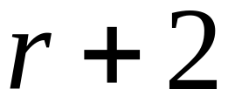


Thus, there is a path from the root
to a leaf with at least nodes
(root)
At least
Levels
Variables
symbol
(leaf)

Slide 29

Since there are at most different variables,
some variable is repeated
Pigeonhole
principle
END OF CLAIM PROOF

Slide 30

Take now a string
with
From claim:
some variable
is repeated
subtree of
Take to be the deepest, so that
only is repeated in subtree

Slide 31





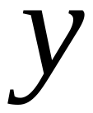


We can write
yield
yield
yield
yield
Strings of terminals
yield

Slide 32
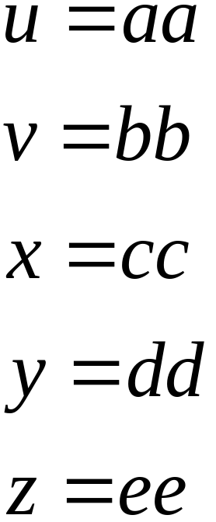

Example:

Slide 33
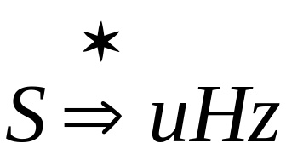
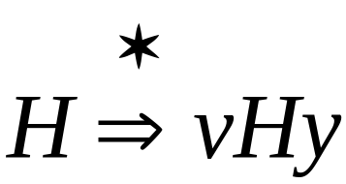
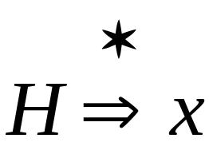
Possible derivations

Slide 34
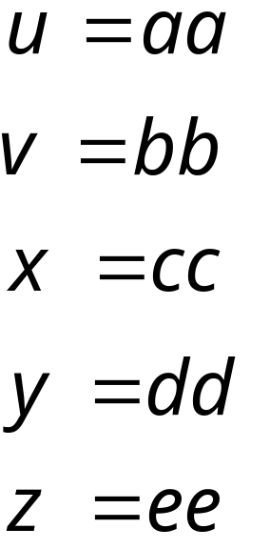
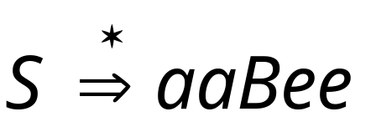
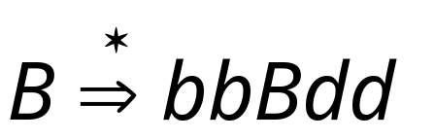
Example:

Slide 35
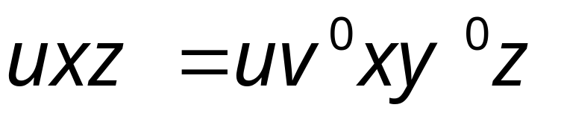
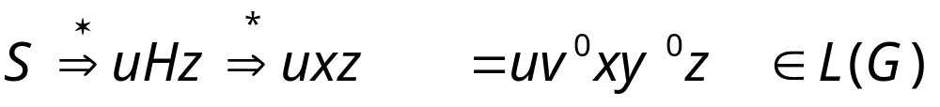
Remove Middle Part
Yield:

Slide 36
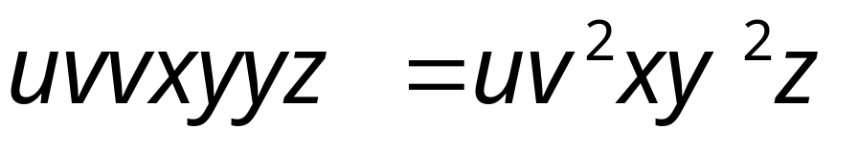
Repeat Middle part two times
1
2
Yield:

Slide 37
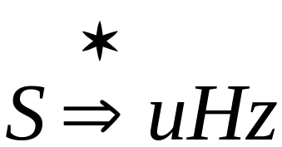
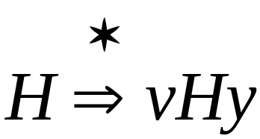
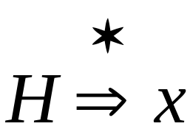
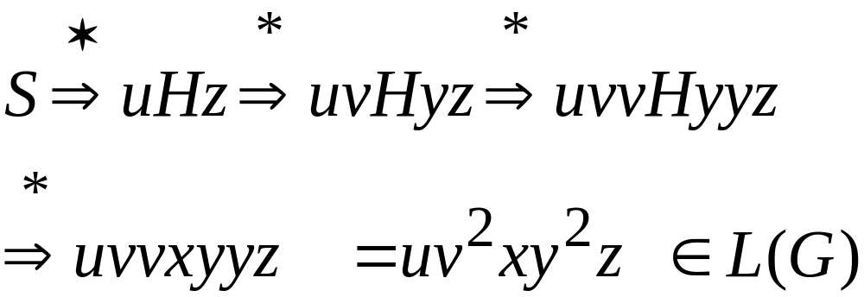

Slide 38

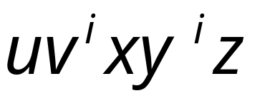
Repeat Middle part times
1
i
Yield:

Slide 39
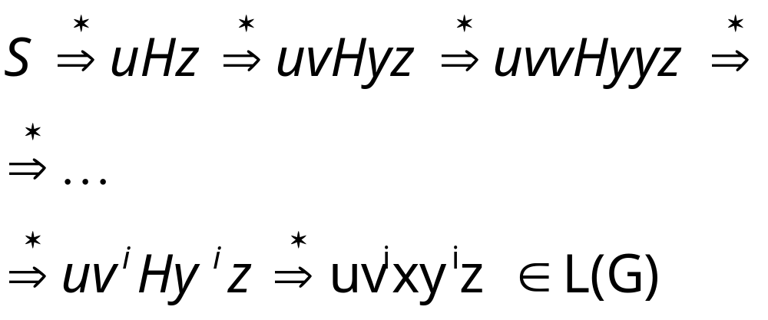

Slide 40
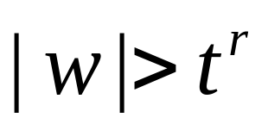
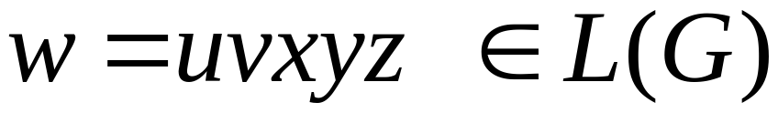
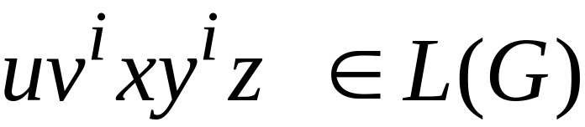



Therefore,
If we know that:
then we also know:
For all
since

Slide 41






Observation 1:
Since has no
unit and
-productions
At least one of or is not

Slide 42


Observation 2:
since in subtree
only variable
is repeated
subtree of
Explanation follows….

Slide 43










subtree of
Various yields
since no variable is repeated in
Maximum right-hand side of any production

Slide 44

Thus, if we choose critical length
then, we obtain the pumping lemma for
context-free languages

Slide 45





The Pumping Lemma:
For any infinite context-free language
there exists an integer such that
for any string
we can write
with lengths
and it must be that:

Slide 46
Applications of
The Pumping Lemma

Slide 47


Non-context free languages
Context-free languages

Slide 48

Theorem:
The language
is not context free
Proof:
Use the Pumping Lemma
for context-free languages

Slide 49
Assume for contradiction that
is context-free
Since is context-free and infinite
we can apply the pumping lemma

Slide 50




Let be the critical length
of the pumping lemma
Pick any string with length
We pick:

Slide 51


From pumping lemma:
we can write:
with lengths and

Slide 52



Pumping Lemma says:
for all

Slide 53


We examine all the possible locations
of string in

Slide 54






Case 1:
is in

Slide 55








Slide 56





Slide 57


From Pumping Lemma:
However:
Contradiction!!!

Slide 58


Case 2:
is in
Similar to case 1

Slide 59


Case 3:
is in
Similar to case 1

Slide 60



Case 4:
overlaps and

Slide 61




Sub-case 1:
contains only
contains only

Slide 62


Slide 63




Slide 64


From Pumping Lemma:
However:
Contradiction!!!

Slide 65

Sub-case 2:
contains and
contains only

Slide 66






By assumption

Slide 67






Slide 68

From Pumping Lemma:
However:
Contradiction!!!

Slide 69
Sub-case 3:
contains only
contains and
Similar to sub-case 2

Slide 70


Case 5:
overlaps and
Similar to case 4

Slide 71



Case 6:
overlaps , and
Impossible!

Slide 72
In all cases we obtained a contradiction
Therefore:
the original assumption that
is context-free must be wrong
Conclusion:
is not context-free

