Slide 1
Signals & Systems
Text: Communication Systems Principles using MATLAB®
Text, drawings and images copyright © John Wiley & Sons 2018

Slide 2
Book Chapter Overview Communication Systems Principles using MATLAB®
Chapter 1: Telecommunications Block Diagrams. How we build a “system” out of “blocks” .
Chapter 2: How information is sent using wired networks such as Ethernet, wireless (WiFi) and optical fiber.
Chapter3: How we modulate a signal for sending, and demodulate it when we receive it, to get back the original information.
Chapter 4: Internet protocols: how data is transferred in packets, how Internet addressing works.
Chapter 5: How we encode a signal such as audio or video, how we allocate bits to these signals for data transmission.
Chapter 6: How we check digital data for errors, and encrypt messages.

Slide 3
Communication Systems Principles using MATLAB® How to approach the book
Technical principles described. Mathematical derivations where needed.
MATLAB® code given. You should always try it!
End of chapter problems are important as review questions and to ensure you’ve learned the principles. Some are descriptive, some are mathematical, some require writing your own MATLAB code or modifying that given in the chapter.

Slide 4
Chapter Aims
Apply mathematical principles to waveforms.
Introduce terms and definitions used in telecommunications, such as root-mean-square (RMS) for voltage measurements and decibels (dB, dBm) for power.
Frequency domain and filters for telecommunications.
Telecommunication system building blocks.
Loads, impedance, power and noise.

Slide 5

Mathematical Conventions
Simple scalar: math-italic $x, y, z$
Constants: upper case $N, M$
A column vector: bold font, lower case $u, v$
A matrix: bold font, upper case $X, Y$

Slide 6
Code Conventions
Type at command prompt.
The variable ans shows the computation results.
Plotting can be done this way: try peaks to show a 3D function.
A random matrix and its inverse:
Note >> prompt of MATLAB command line.
m = rand(2,2)
m =
0.1576 0.9572
0.9706 0.4854
inv(m)
ans =
-0.5693 1.1228
1.1385 -0.1849

Slide 7
Code Conventions
% clear all variables
clear all
% close any open figure windows (plots/graphs)
close all
N = 3;
d = zeros(2*N+1, 1);
d(2*N+1) = 1;
d(1) = (1/j)^(2*N)
d =
-1
0
0
0
0
0
1
Type on command line, or put in a .m file, for example “mycode.m”
Click run, or type mycode at the command prompt. File should be in current folder (directory).
Anything without a semicolon ; is printed in the command window.
Help on a topic: for example, help zeros

Slide 8
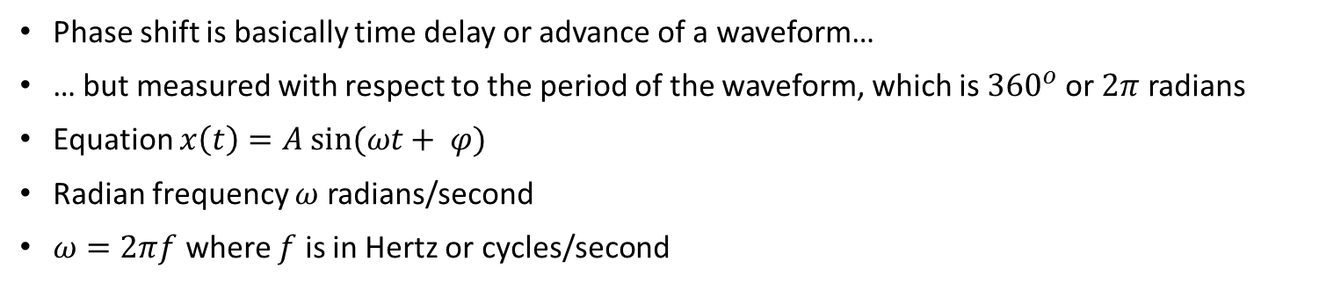
Phase Shift of a Waveform
Phase shift is basically time delay or advance of a waveform…
… but measured with respect to the period of the waveform, which is ${360}^{o}$or $2π$ radians
Equation $x\left(t\right)=A sin⁡(ωt+ φ)$
Radian frequency $ω$ radians/second
$ω=2πf$ where $f$ is in Hertz or cycles/second
N = 20;
n = 0:N-1;
w = 2*pi/N;
x = sin(n*w - pi/2);
stem(x, 'b');

Slide 9
Calculating & Plotting a Waveform
Two ways: one to approximate time by a very small step of time.
Pretend we have a smooth waveform.
N = 100;
tmax = 1;
f = 1;
phi = -pi/2;
A = 1;
t = linspace(0, tmax, N);
x = A*sin(2*pi*f*t + phi);
stem(t, x, 'b.');

Slide 10
Calculating & Plotting a Waveform
Two ways: second is to use steps as if the waveform is actually sampled.
Accept that algorithms calculate in small steps.
N = 20;
n = 0:N-1;
w = 2*pi/N;
phi = -pi/2;
x = sin(n*w + phi);
stem(x, 'b');

Slide 11
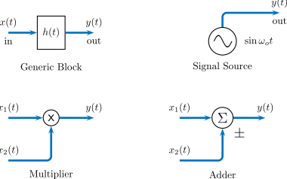
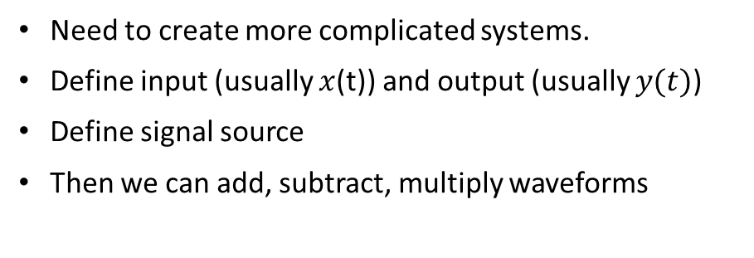
Doing things with Waveforms
Need to create more complicated systems.
Define input (usually $x$(t)) and output (usually $y(t)$)
Define signal source
Then we can add, subtract, multiply waveforms

Slide 12
Linear and Nonlinear Systems
Output could be linear in theory, but is usually nonlinear.

Slide 13
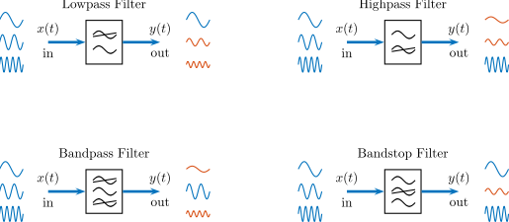
Important Building Block: a Filter
Magnitude of output depends on frequency of input.
Lots of filters in communication systems

Slide 14
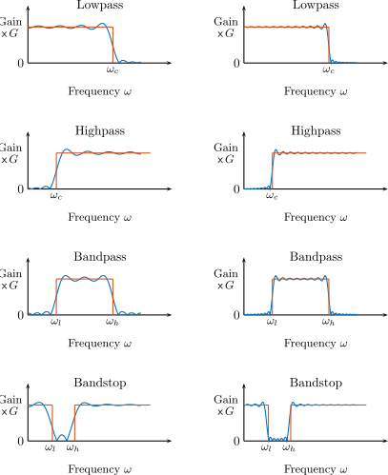
Important Building Block: a Filter
Lowpass: passes only lower frequencies to output
Highpass: passes only higher frequencies
Bandpass: only some defined range of frequencies
Bandstop: reject some range of frequencies

Slide 15
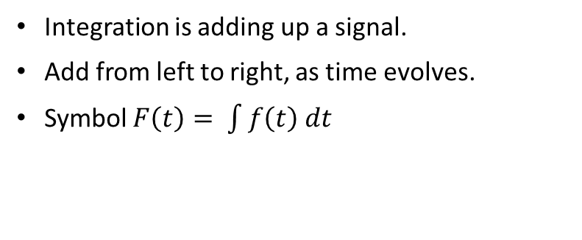
Important Building Blocks: Integration
Integration is adding up a signal.
Add from left to right, as time evolves.
Symbol $F\left(t\right)= \int{f\left(t\right) dt}$

Slide 16
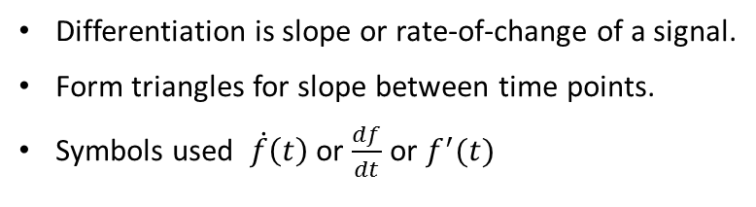
Important Building Blocks: Differentiation
Differentiation is slope or rate-of-change of a signal.
Form triangles for slope between time points.
Symbols used $\dot{f}\left(t\right)$ or $\frac{df}{dt}$ or $f^{′}(t)$

Slide 17
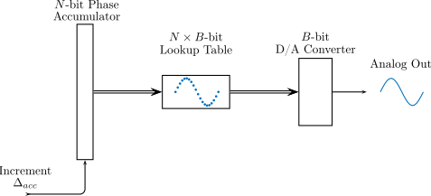
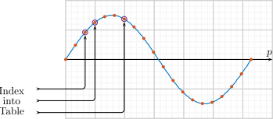
Generating a Waveform
Many, many ways of designing and building an oscillator.
Direct Digital Synthesis method (DDS) uses calculations and a table of values.
Key problem: how to change the frequency. Basically, step through the table faster.

Slide 18
Generating a Waveform
Problem: may have to skip samples in a non-even manner.
Leads to (slightly) distorted waveform.
Note nonlinear (logarithmic) vertical scale for frequency spectrum.

Slide 19
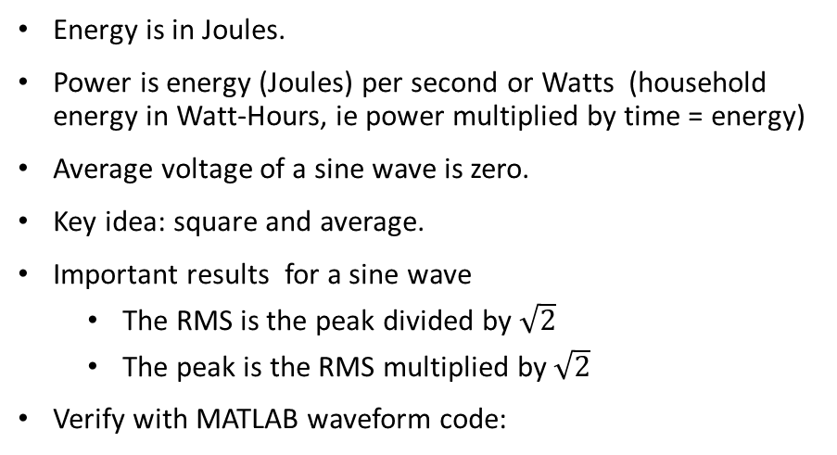
Power in a Waveform
Energy is in Joules.
Power is energy (Joules) per second or Watts (household energy in Watt-Hours, ie power multiplied by time = energy)
Average voltage of a sine wave is zero.
Key idea: square and average.
Important results for a sine wave
The RMS is the peak divided by $\sqrt{2}$
The peak is the RMS multiplied by $\sqrt{2}$
Verify with MATLAB waveform code:
sqrt((sum(x.*x)*dt)/tmax)
ans =
0.7071

Slide 20
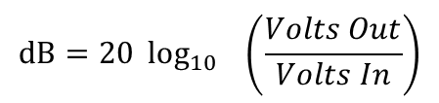
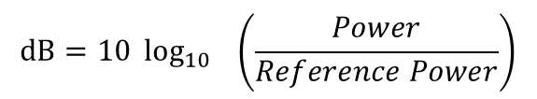
Power and the Decibel
Decibel (abbreviation: dB) is very commonly used in communication systems.
Relates two quantities.
Could define for a system as
Common figure: if Power (top line) is twice the Reference Power, then in decibels it is 3 dB
Similarly, if Power (top line) is half the Reference Power, then in decibels it is - 3 dB
If relating voltages, the formula becomes
Note the 20 factor. See text for explanation.
If reference power in milliWatts, then use symbol dBm
$$dB=10 \log_{10}{ \left(\frac{Power}{Reference Power}\right)}$$
$$dB=20 \log_{10}{ \left(\frac{Volts Out}{Volts In}\right)}$$

Slide 21
Why use Decibels
Easier to use when we combine systems.
Suppose two systems, one has a gain of 2.5 and the other a gain of 1/2
The 2.5 gain is 10*log10(2.5) or nearly 4 dB. The 2 gain is about -3 dB.
Overall gain would be 2.5 x ½ = 1.25.
In decibels, this is 4 dB – 3dB = 1 dB.
Check for yourself that 10*log10(1.25) is very close to 1 dB
Also: since decibel measure is based on logarithms, it permits easier working with very large or very small power levels.
Example: a wireless system receives a power of one nanowatt, in dBm this is -60 dBm
>> 10*log10((1e-9)/(1e-3))
ans =
-60

Slide 22
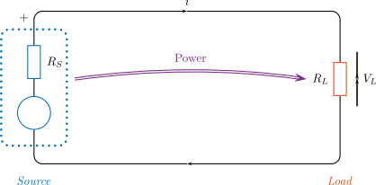
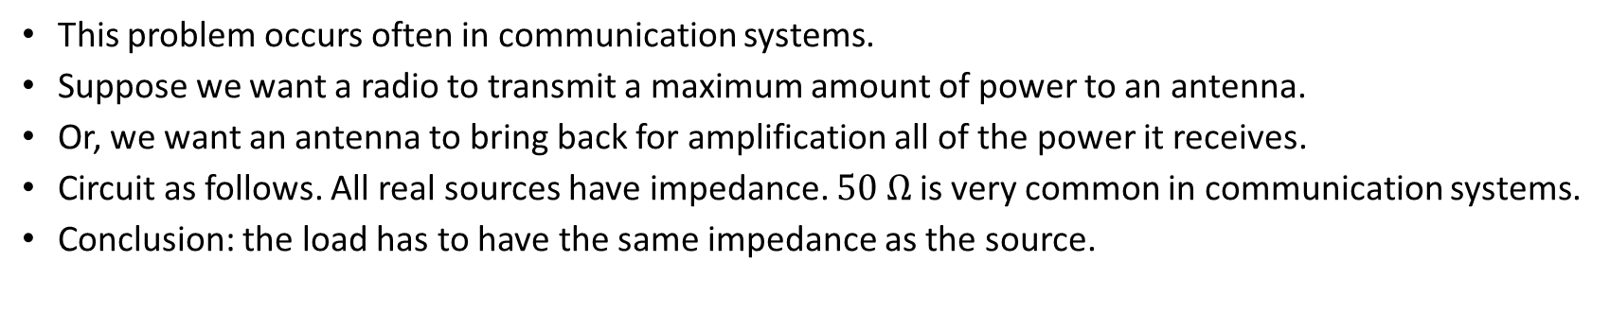
Transferring Power
This problem occurs often in communication systems.
Suppose we want a radio to transmit a maximum amount of power to an antenna.
Or, we want an antenna to bring back for amplification all of the power it receives.
Circuit as follows. All real sources have impedance. $50 Ω$ is very common in communication systems.
Conclusion: the load has to have the same impedance as the source.

Slide 23
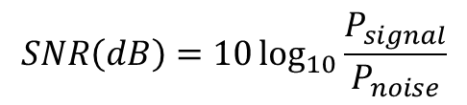
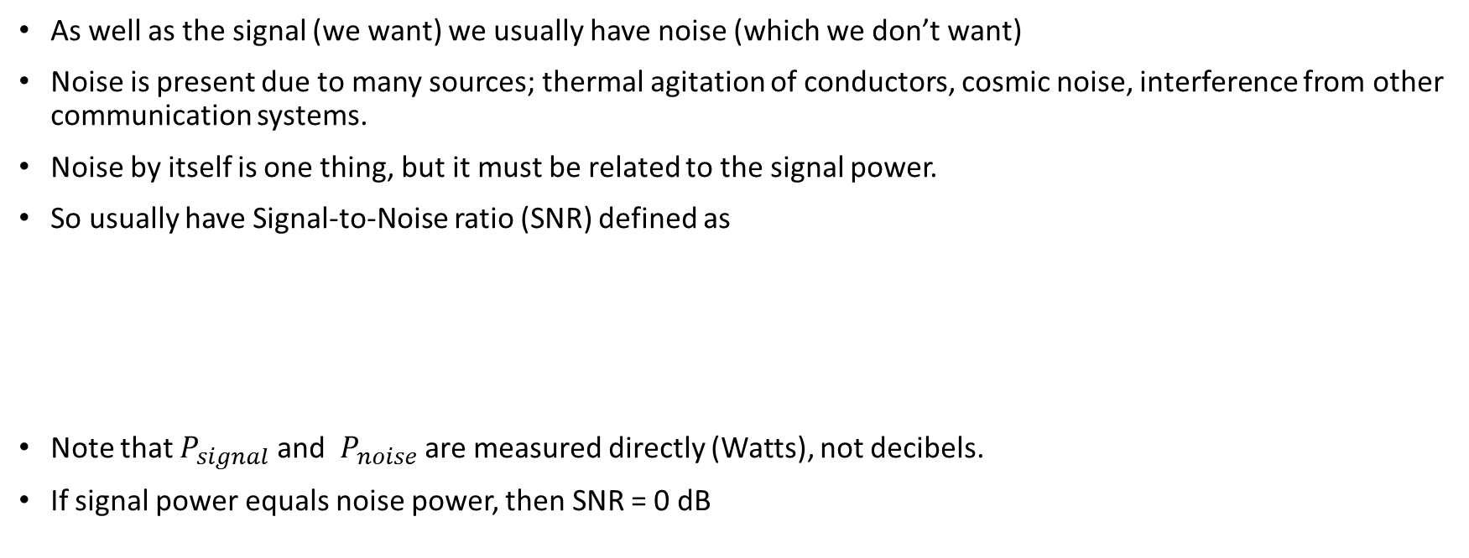
Noise
As well as the signal (we want) we usually have noise (which we don’t want)
Noise is present due to many sources; thermal agitation of conductors, cosmic noise, interference from other communication systems.
Noise by itself is one thing, but it must be related to the signal power.
So usually have Signal-to-Noise ratio (SNR) defined as
Note that $P_{signal}$ and $P_{noise}$ are measured directly (Watts), not decibels.
If signal power equals noise power, then SNR = 0 dB
$$SNR\left(dB\right)=10\log_{10}{\frac{P_{signal}}{P_{noise}}}$$

Slide 24
Chapter Summary – Key Points
Waveform equations, time and frequency.
Waveform operations such as averaging, multiplication, and phase shifting, and filtering.
One method of variable-frequency waveform generation: the Direct Digital Synthesizer.
The significance of power transfer, impedance matching, and noise in telecommunications system design.

