Slide 1
Wired, Wireless and Optical Systems
Text: Communication Systems Principles using MATLAB®
Text, drawings and images copyright © John Wiley & Sons 2018

Slide 2
Chapter Aims
Learn about wired systems – such as Ethernet, and how voltages encode data.
Learn about wireless systems – how radio modulation works.
Learn about fiber optic systems – how laser light encodes digital information within an optical fiber.
Some basic design principles for the above, such as how much power is required for a certain performance level.

Slide 3
Fourier Series
Any waveform which is periodic (ie repeats a basic template) can be decomposed
A sum of weighted sine waves, plus
A sum of weighted cosine waves, plus
A constant or DC offset
The DC offset is a special case of cosine with frequency = 0
Analysis: work out the weighting coefficients.
Synthesis: sum the weighted waves so as to approximate the original.
Extend this: sine and cosine expressed as one sine (or cosine) but with a certain amplitude and phase shift.
Usually only interested in the magnitude, which is square root of sine squared plus cosine squared.

Slide 4
Fourier Transform
Similar concept but now have a measured signal. A finite-duration measurement time.
Two-component wave: can we determine the frequencies present?
Expect two frequencies, but widens to become a `sinc’ function.
These sidelobes are due to a finite measurement time.
Smooth the wave using a taper or Window function.
Gives smoother spectrum but wider range, ie uncertainty.

Slide 5
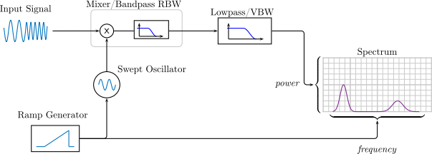
Spectrum Analyzer
Measures frequency content of a signal, eg radio signal.
Basically a Fourier Transform, but does this in a different way.
Sweeps the test frequency, mixes it with incoming frequency, detects the result and plots it as the spectrum.

Slide 6
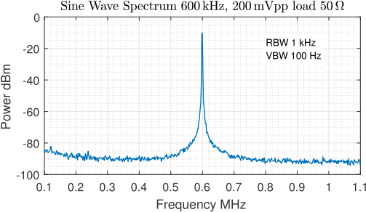
Spectrum Analyzer
Example with sine oscillator input.
Notes: power in dBm, frequency MHz, noise floor, resolution/width of spectral peak
Resolution bandwidth = width of the filter
Video bandwidth = averaging time.

Slide 7
Transmission Modes
Important distinction:
Baseband – where we send basically a voltage or light pulse. Typically wired local area networks and fiber optic.
Passband – where the information/data is modulated onto a carrier. Typically wireless but could be wired.

Slide 8
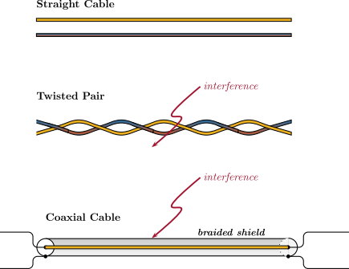
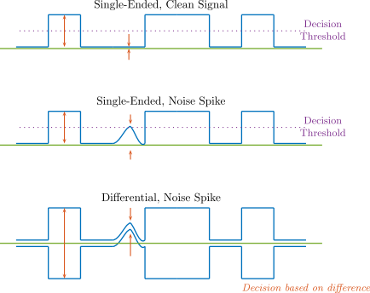
Cables and Pulses
Wires – shielded and twisted pair.
Single-ended or unbalanced vs Differential or balanced.

Slide 9
Pulse Transmission
Bandwidth of cable not infinite, lowpass filters pulse.
So pulse spreads out.
Other effects too, inductance and capacitance.
Pure pulses shown.
Pulse rings and ends at A.
Peak pulse magnitude at B.
Start new pulse at C.
Result: more pulses, more data sent in a given time.

Slide 10
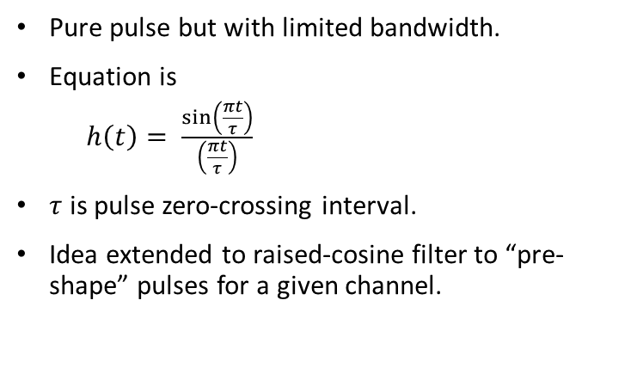
Sinc function
Pure pulse but with limited bandwidth.
Equation is
$h\left(t\right)= \frac{\sin\left(\frac{πt}{τ}\right)}{\left(\frac{πt}{τ}\right)}$
$τ$ is pulse zero-crossing interval.
Idea extended to raised-cosine filter to “pre-shape” pulses for a given channel.

Slide 11
Line Codes
Baseband
Why is encoding necessary? To maintain synchronism.
Sender clock may drift; receiver may drift. May have same frequency but different phase.
Long run of the same level looks like constant DC, so no timing information.
Possible to send more than one bit at a time.

Slide 12
Line Codes
Rules for each type of encoding.
Main aim: to give some transitions for receiver to see & lock onto.
Other techniques used in tandem, eg 4B5B to add sufficient transitions.
Another issue is spectrum: cable acts like an antenna, radiates out signal and causes interference.
Some techniques also used in magnetic recording.

Slide 13
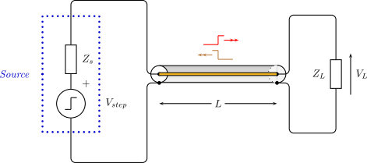
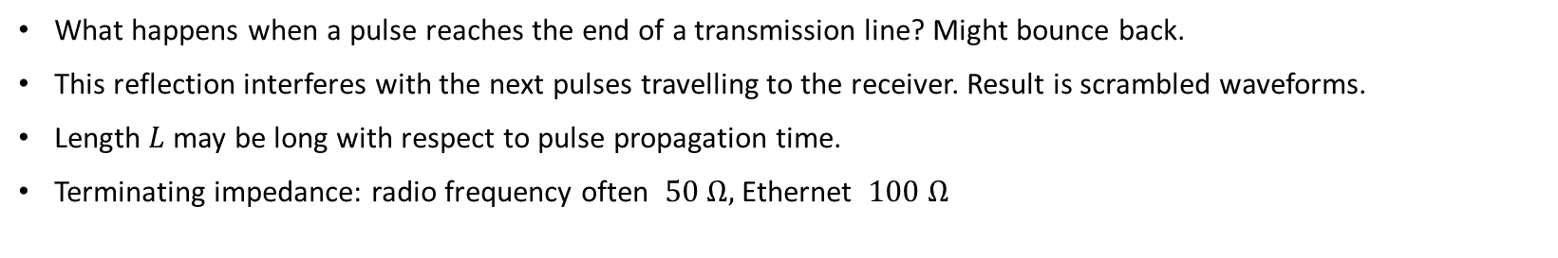
Pulse Reflection
What happens when a pulse reaches the end of a transmission line? Might bounce back.
This reflection interferes with the next pulses travelling to the receiver. Result is scrambled waveforms.
Length $L$ may be long with respect to pulse propagation time.
Terminating impedance: radio frequency often $50 Ω,$Ethernet $100 Ω$

Slide 14
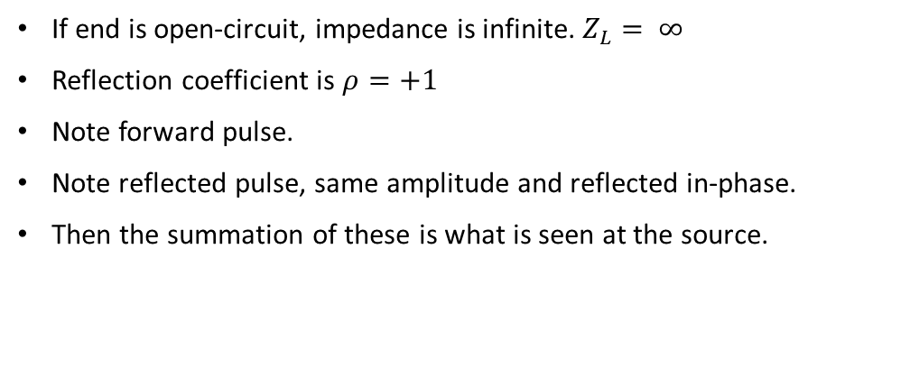
Pulse Reflection
If end is open-circuit, impedance is infinite. $Z_{L}= ∞$
Reflection coefficient is $ρ=+1$
Note forward pulse.
Note reflected pulse, same amplitude and reflected in-phase.
Then the summation of these is what is seen at the source.

Slide 15
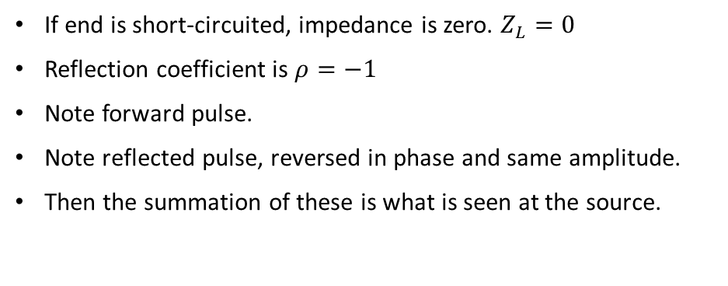
Pulse Reflection
If end is short-circuited, impedance is zero. $Z_{L}=0$
Reflection coefficient is $ρ=−1$
Note forward pulse.
Note reflected pulse, reversed in phase and same amplitude.
Then the summation of these is what is seen at the source.

Slide 16
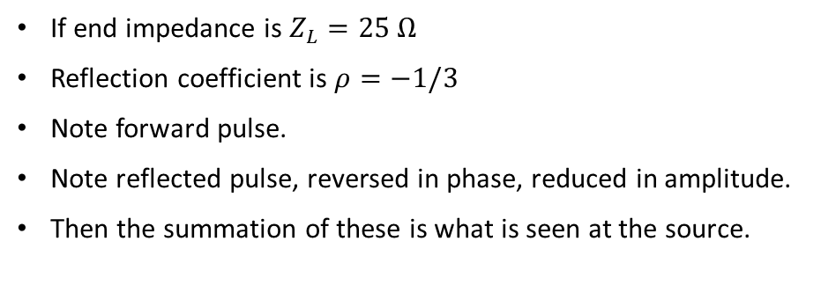
Pulse Reflection
If end impedance is $Z_{L}=25 Ω$
Reflection coefficient is $ρ=−1/3$
Note forward pulse.
Note reflected pulse, reversed in phase, reduced in amplitude.
Then the summation of these is what is seen at the source.

Slide 17
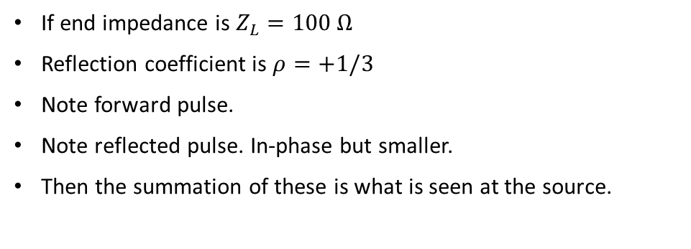
Pulse Reflection
If end impedance is $Z_{L}=100 Ω$
Reflection coefficient is $ρ=+1/3$
Note forward pulse.
Note reflected pulse. In-phase but smaller.
Then the summation of these is what is seen at the source.

Slide 18
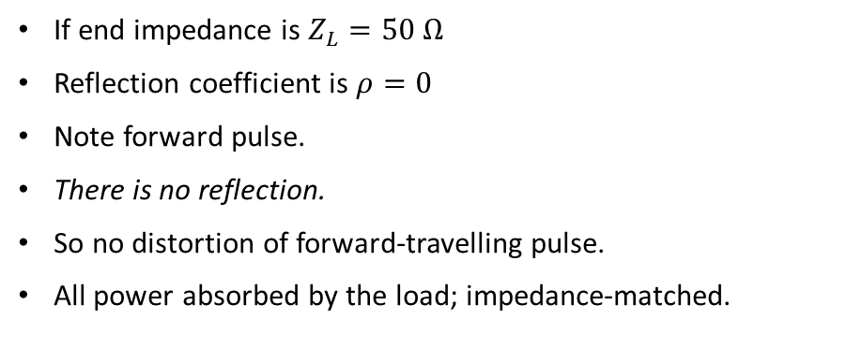
Pulse Reflection – Finally
If end impedance is $Z_{L}=50 Ω$
Reflection coefficient is $ρ=0$
Note forward pulse.
There is no reflection.
So no distortion of forward-travelling pulse.
All power absorbed by the load; impedance-matched.

Slide 19
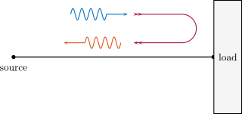
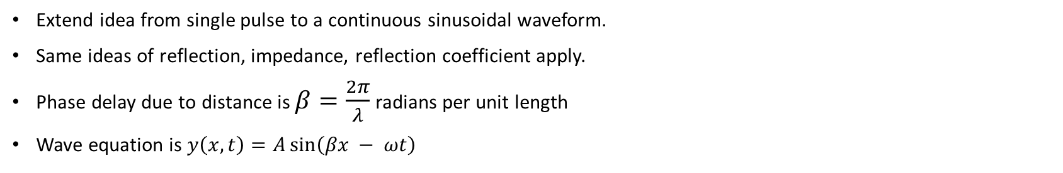
Wave Reflection
Extend idea from single pulse to a continuous sinusoidal waveform.
Same ideas of reflection, impedance, reflection coefficient apply.
Phase delay due to distance is $β=\frac{2π}{λ}$ radians per unit length
Wave equation is $y\left(x,t\right)=A\sin\left(βx − ωt\right)$

Slide 20
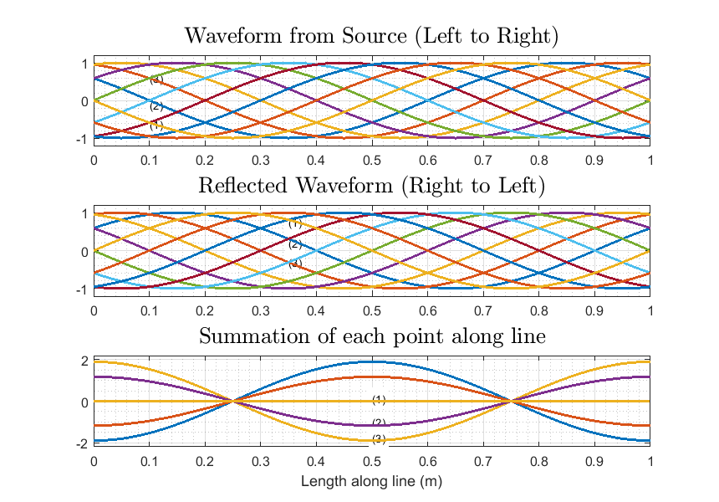
Wave Reflection
Extend idea from single pulse to a continuous sinusoidal waveform.
Note horizontal axis is distance, not time.
Reflection with phase of zero shown.

Slide 21
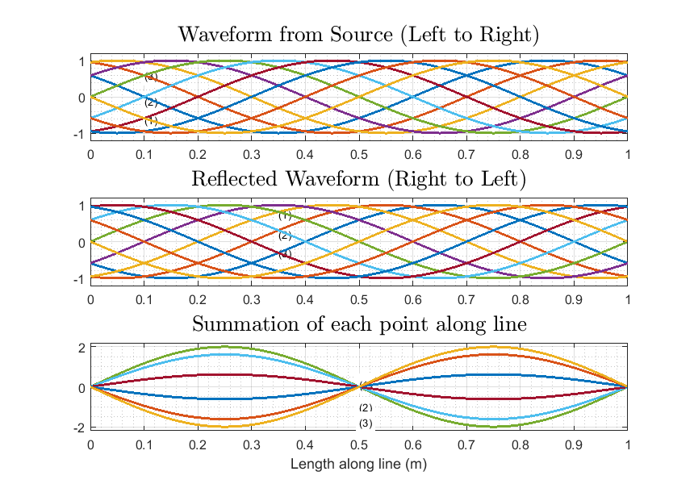
Wave Reflection
Extend idea from single pulse to a continuous sinusoidal waveform.
Note horizontal axis is distance, not time.
Reflection with phase of 180 degrees shown.

Slide 22
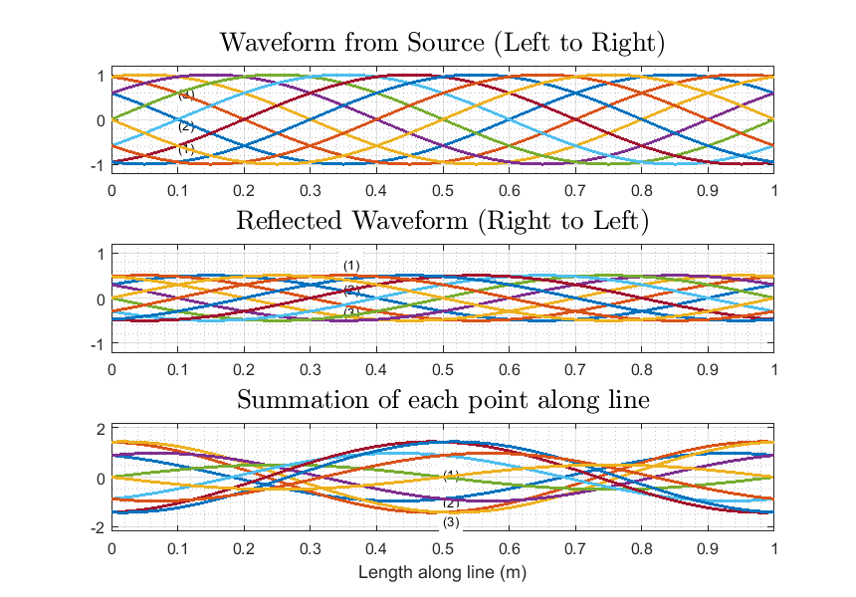
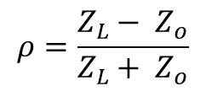
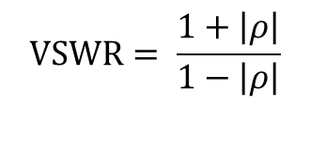
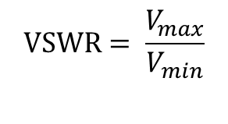

Wave Reflection
Extend idea from single pulse to a continuous sinusoidal waveform.
Note horizontal axis is distance, not time.
Reflection with phase of zero and gain 0.5
Looking at envelope (summation), have VSWR: Voltage Standing Wave Ratio
$$Z_{o}=\sqrt{\frac{L}{C}}$$
$$ρ=\frac{Z_{L}− Z_{o}}{Z_{L}+ Z_{o}}$$
$$VSWR= \frac{V_{max}}{V_{min}}$$
$$VSWR= \frac{1+\left|ρ\right|}{1−\left|ρ\right|}$$

Slide 23
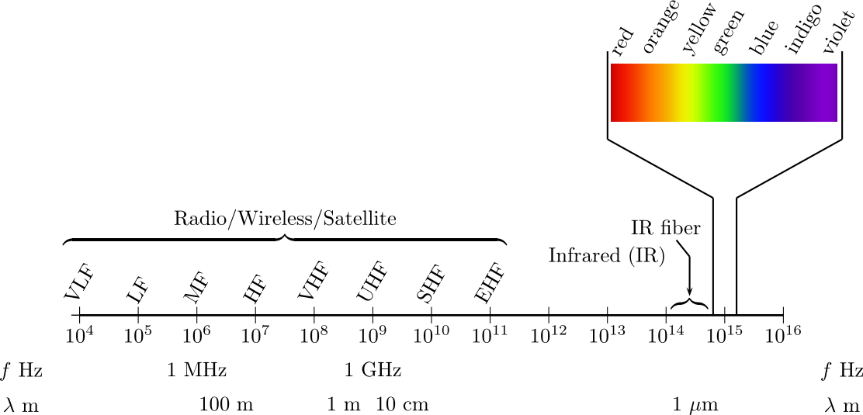
Radio and Wireless
Radio signals useful if we don’t want to be stuck in one place.
Very wide range of frequencies possible.
Which frequency works best depends on the application:
How far you want the signal to go (next door? into space?)
How large an antenna can you cope with?
How much data do you want to transmit (bits per second).
Is the sender or receiver moving? Is it in the air, underwater?
Note also fiber optic bandwidth, just below visible light.
Frequency versus wavelength
Lower frequency … longer wavelength
Shorter wavelength … higher frequency.

Slide 24
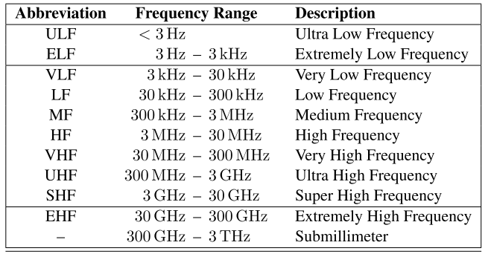
Radio and Wireless
Common radio/wireless bands
Extra low frequencies – maybe if you have a need to talk to a submarine.
Low and very low frequencies – need really big antennas.
Medium frequency – not difficult to receive, but over short range (think car radios)
High frequency – can bounce off the ionosphere. Used a lot before there were satellites or undersea fiber cables.
Very high frequency – emergency radios, shorter range and less interference.
Ultra high frequency – mobile cell phones, WiFi. Very short wavelength so small antenna. Such high frequencies are difficult to deal with. Problem: won’t travel through buildings or people that well.
Super high – satellite and point-to-point. But watch out for clouds.
General principle: lower frequencies radiate out equally, but higher frequencies tend to travel in a straight line.

Slide 25
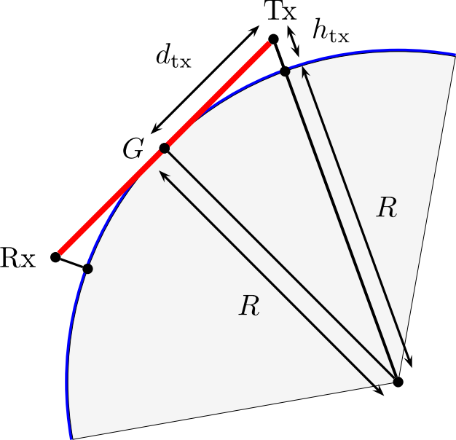
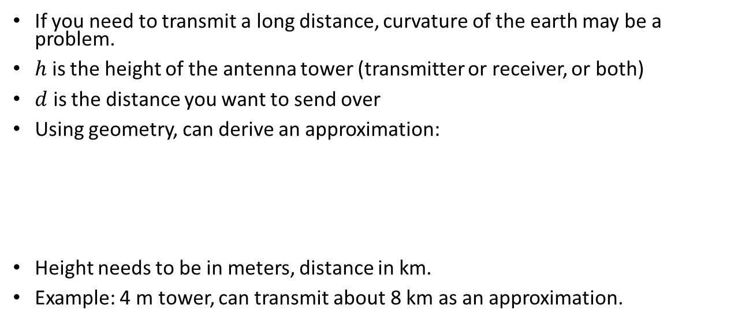

Radio Horizon
If you need to transmit a long distance, curvature of the earth may be a problem.
$h$ is the height of the antenna tower (transmitter or receiver, or both)
$d$ is the distance you want to send over
Using geometry, can derive an approximation:
Height needs to be in meters, distance in km.
Example: 4 m tower, can transmit about 8 km as an approximation.
$$d≈4√h$$

Slide 26
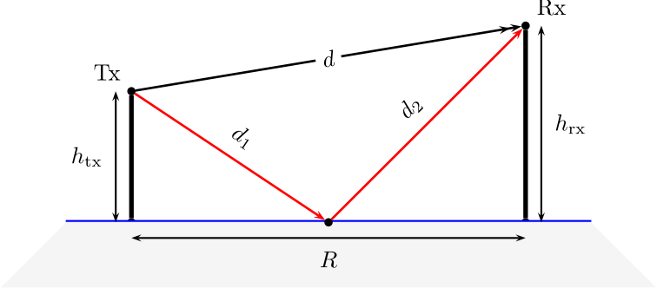
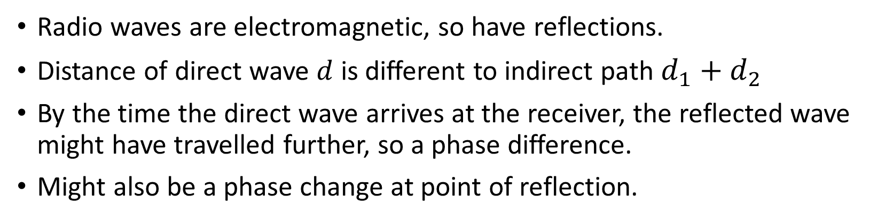
Radio Reflection
Radio waves are electromagnetic, so have reflections.
Distance of direct wave $d$ is different to indirect path $d_{1}+d_{2}$
By the time the direct wave arrives at the receiver, the reflected wave might have travelled further, so a phase difference.
Might also be a phase change at point of reflection.

Slide 27
Radio Reflection
Suppose delayed waveform is not actually delayed.
Not a problem, they reinforce each other.
This is actually good.
Step through following to show changes…

Slide 28
Radio Reflection
Suppose delayed waveform is delayed a little. Takes longer to get there.
They add, but result is not as large.
Not quite as good.

Slide 29
Radio Reflection
Delay a little more.
Result is getting smaller.

Slide 30
Radio Reflection
Delay such that they are out-of-phase.
They add… or actually cancel.
No signal at all at receiver.

Slide 31
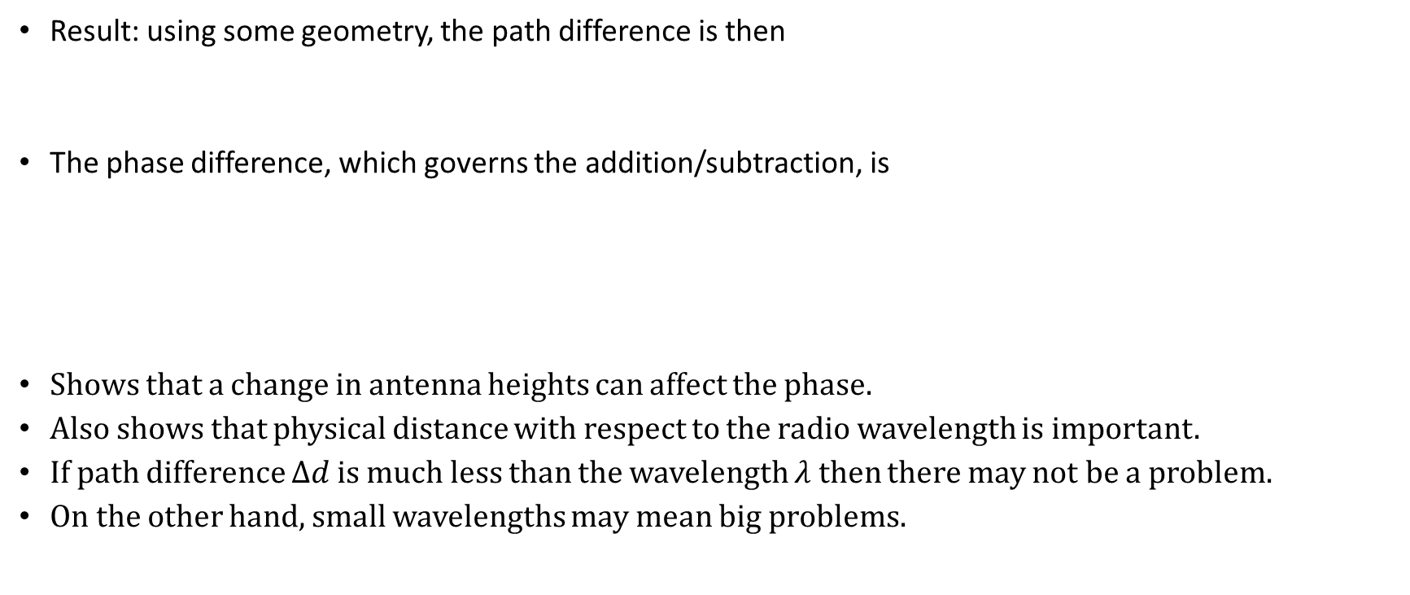


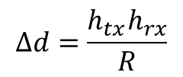
Radio Reflection
Result: using some geometry, the path difference is then
The phase difference, which governs the addition/subtraction, is
Shows that a change in antenna heights can affect the phase.
Also shows that physical distance with respect to the radio wavelength is important.
If path difference $Δd$is much less than the wavelength $λ$ then there may not be a problem.
On the other hand, small wavelengths may mean big problems.
$$∆d=\frac{h_{tx}h_{rx}}{R}$$
$$φ= β ∆d$$
$$β=\frac{2π}{λ}$$

Slide 32
Radio Diffraction
Drop a stone in a pond. Creates ripples.
Similar idea when radio wave encounters an obstacle (building, tree, mountain)
So some areas may be “dark” and not receive much signal.

Slide 33
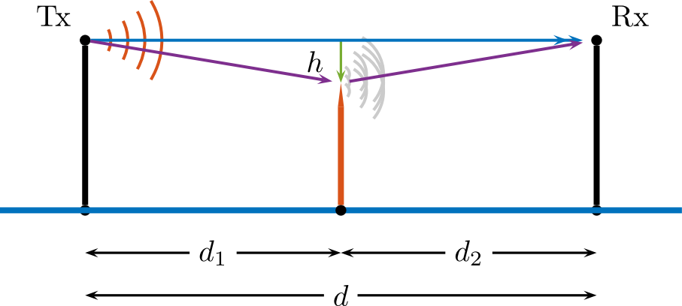

Radio Diffraction
Consider “knife-edge” diffraction.
Obstacle close to direct path, but not directly in path.
Partial cancellation may result if diffracted received wave out-of-phase with direct path wave.
Occurs when
$$h≈\frac{1}{2}λd$$

Slide 34
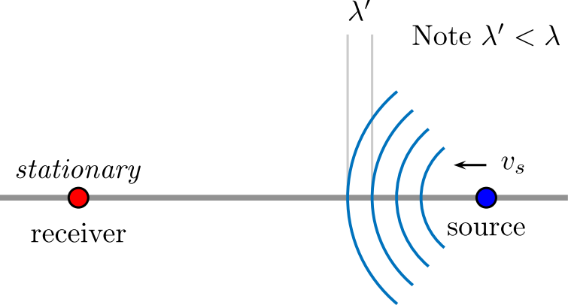
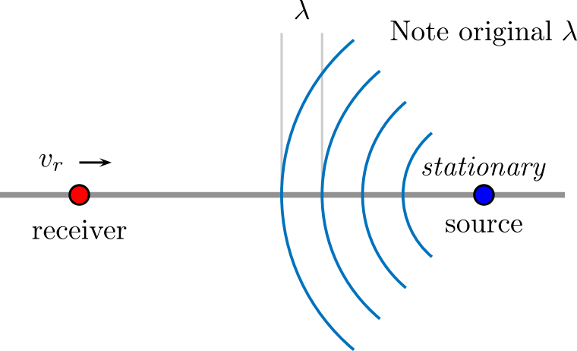

Moving Sender or Receiver
Results in Doppler Effect.
Changes apparent frequency of radio wave.
Apparent frequency
$$\tilde{f}=\left(\frac{1 +{ v}_{r}/v}{1 + v_{s}/v}\right)f$$

Slide 35
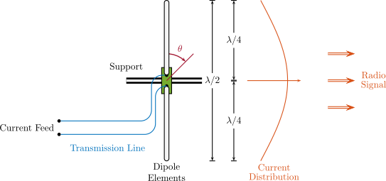
Radio Antennas
Many, many types. Dipole is the most fundamental.
Can act as send or receive antenna.
Key idea: the two “arms” act as a resonant circuit with reflections.
This maximizes the standing wave on the arms themselves.

Slide 36
Radio Antennas
Resulting dipole pattern, as if viewed from above.
Dipole arms along zero degree axis.
Maximum power out (or maximum sensitivity) perpendicular to this.
Minimum (theoretically zero) power (or sensitivity) along dipole axis.

Slide 37
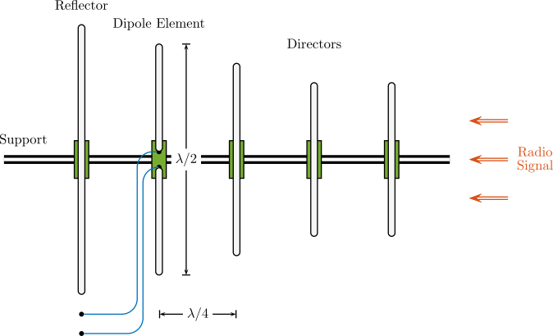
Radio Antennas
Extend dipole to a Yagi.
Directors and reflector.
Numerous variations on the basic theme.

Slide 38
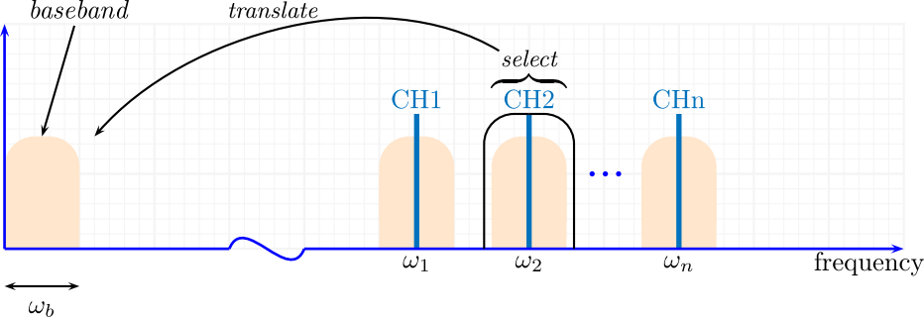
Radio Reception
Signal (voice, data) occupies baseband. But radio signal is much higher in frequency.
Problem: how to translate baseband up when transmitting?
Problem: how to translate radio back to baseband when receiving?
Need frequency translation.

Slide 39
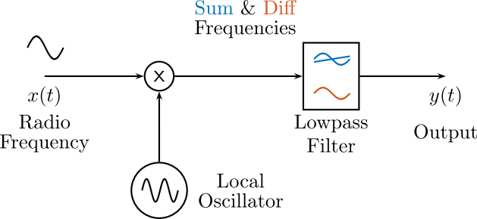
Radio Reception
Usual method is to use a mixer.
Multiplies radio frequency (RF) by an oscillator of similar (not identical) frequency.
Then removes high-frequency component with a filter.

Slide 40
Radio Reception
Why does mixing use multiplication?
Multiply these fairly close frequencies.
You can see that the product contains a higher frequency as well as a lower frequency.
Average out the higher frequency to see the lower one.

Slide 41
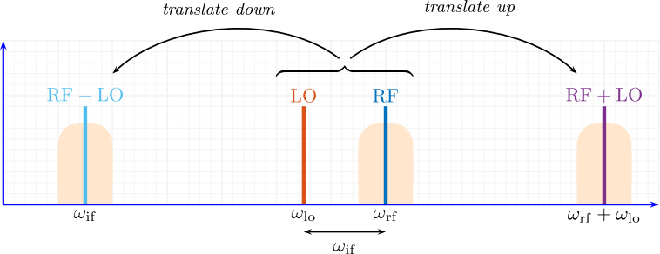
Radio Reception
Mixing uses the Local Oscillator (LO).
May be shown that the sum and difference frequencies result.
The Intermediate Frequency (IF) is the difference (lower) frequency.

Slide 42
Radio Noise
Other transmitters present.
Other devices may produce interfering signals.
Background noise.
Limit of resolution of receiver.

Slide 43
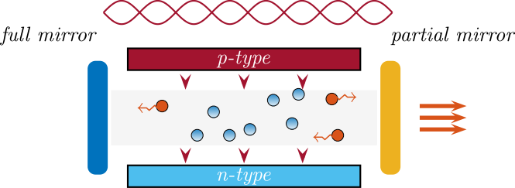
Optical Transmission
Optical fibers are capable of very fast data transmission. Was not always the case.
Requires matching source (Laser) with cable (fiber) with receiver (detector).
Laser source is a Laser Diode. Relies on standing waves within a cavity.
Laser may required optical stabilization and/or temperature control.
Multiple narrow emission lines (depends on type of laser).
Optical fiber may be single-mode or multi-mode.

Slide 44
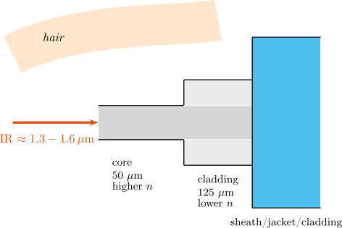
Optical Transmission
Single-mode much smaller than multimode.
Containment of light within a fiber requires both a core and a cladding.
Multimode optical fiber may be step-index or graded index.
The cladding is not just for strength, it is required to ensure light propagation

Slide 45
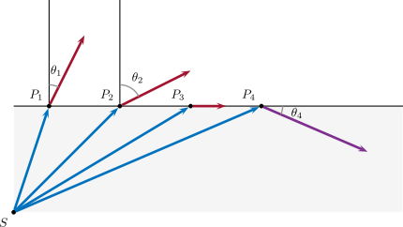
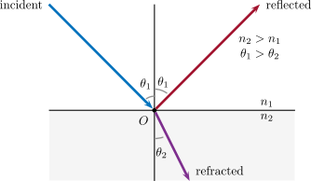
Optical Transmission
Single-mode much smaller than multimode.
Containment of light within a fiber requires both a core and a cladding.
Multimode optical fiber may be step-index or graded index.
Refraction is critical to fiber optics.

Slide 46
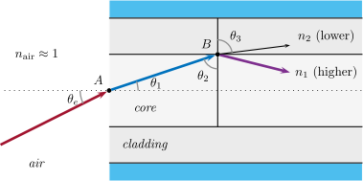
Optical Transmission
The cladding is not just for strength, it is required to ensure light propagation
Requires total internal reflection to keep light within core.

Slide 47
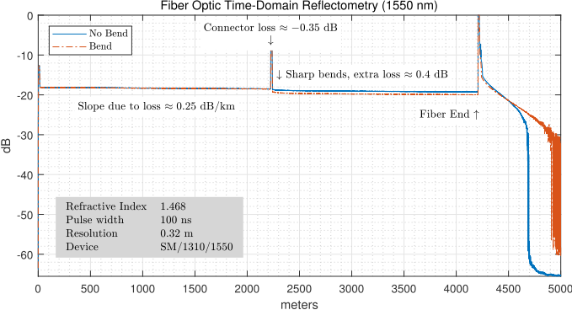
Optical Transmission
Test optical fibers using Optical Time Domain Reflectometry (OTDR)
Can tell connector loss, fiber signal loss, fiber breakages. Bends also cause loss of signal.

Slide 48
Chapter Summary – Key Points
Digital pulse transmission: line coding, synchronization and scrambling.
Principles of radio frequency: change in frequency by mixing; the definition of RF bands and their use in practice.
Transmission lines: reflections and standing waves.
Propagation of radio frequencies and basic principles of antennas.
Optical communications: light sources and detection, principles of optical fibers, and design and test of fiber links.

