Slide 1
Modulation & Demodulation
Text: Communication Systems Principles using MATLAB®
Text, drawings and images copyright © John Wiley & Sons 2018

Slide 2
Chapter Aims
To answer the question: how do we convert a signal or information to a form suitable for wired/wireless/optical transmission?
To learn about Modulation – convert to form suitable for transmission.
To learn about Demodulation – convert received signal back to a useful form.
Modulation types used for real-world transmission: Amplitude Modulation (AM), Frequency Modulation (FM), Phase Modulation (PM), Orthogonal Frequency Division Multiplexing (OFDM).

Slide 3
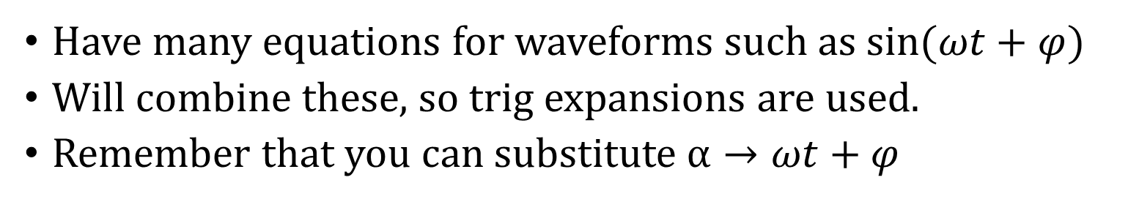
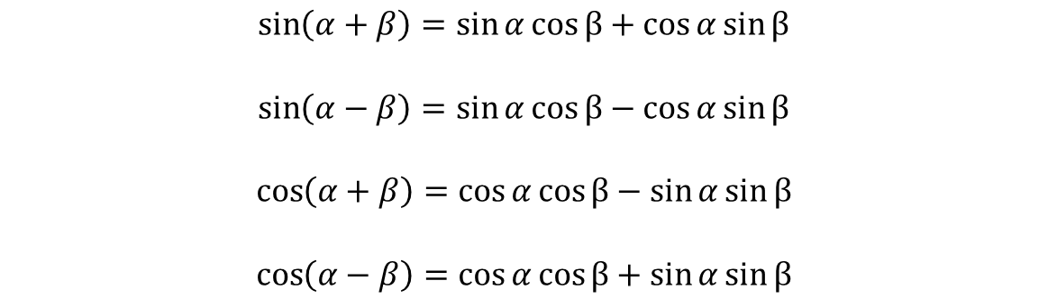
Useful Trig Formulas
Have many equations for waveforms such as $sin⁡(ωt+φ)$
Will combine these, so trig expansions are used.
Remember that you can substitute $α→ωt+φ$
$$\sin\left(α+β\right)=\sin{α\cos{β}}+\cos{α\sin{β}}$$
$$\sin\left(α−β\right)=\sin{α\cos{β}}−\cos{α\sin{β}}$$
$$\cos\left(α+β\right)=\cos{α\cos{β}}−\sin{α\sin{β}}$$
$$\cos\left(α−β\right)=\cos{α\cos{β}}+\sin{α\sin{β}}$$

Slide 4
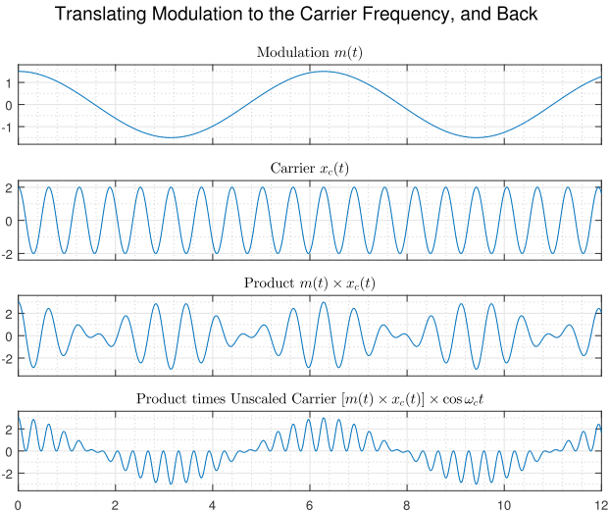
Frequency Conversion
Modulation is the lower-frequency signal; we want to transmit it.
Carrier is the higher-frequency signal; it “carries” the modulation
Need to modulate at the transmitter, demodulate at the receiver.
Simple product of signals shown.

Slide 5
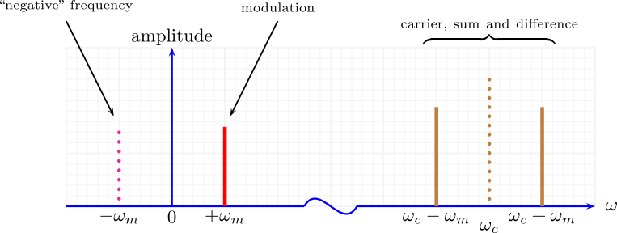
Frequency Conversion
What happens when we multiply signals?
In terms of frequencies: have sum and difference frequencies.

Slide 6

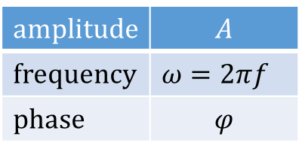
Modulation
Basic wave equation is
We can change:
in response to input signal (data).
Or, a combination of these…
$$x\left(t\right)=A\sin\left(ωt+φ\right)$$
amplitude | $$A$$
frequency | $ω=2πf$
phase | $$φ$$

Slide 7
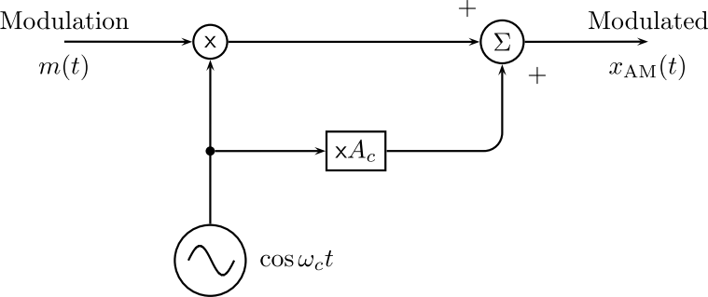
Amplitude Modulation
Multiply modulation by carrier
Add some carrier to aid the receiver.
Simple but limited in many ways.

Slide 8
Amplitude Modulation
Really just changes the amplitude of the carrier depending on the amplitude of the modulation.
Produces two sidebands either side of the carrier.

Slide 9
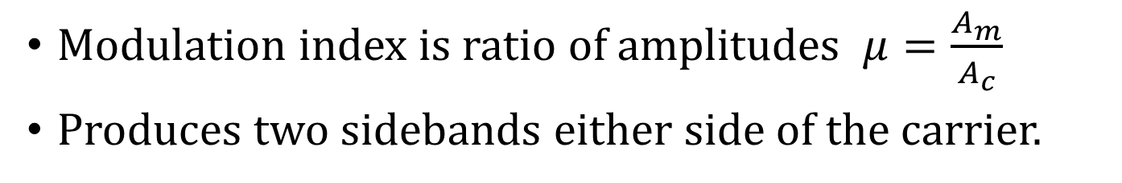
Amplitude Modulation
Modulation index is ratio of amplitudes $μ=\frac{A_{m}}{A_{c}}$
Produces two sidebands either side of the carrier.

Slide 10
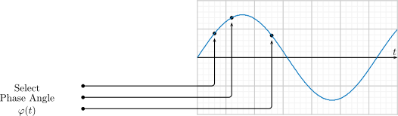
Frequency & Phase Modulation
Related but distinct.
Change the frequency or the phase… since these are both arguments of the sine (or cosine) function, they are similar except frequency is multiplied by time.
Think of stepping through a table of sine values:

Slide 11
Frequency & Phase Modulation
Step through this table at a fixed rate to generate the carrier.
Stepping through the table at a faster rate generates Frequency Modulation (FM).
Changing the step, in addition to the step required for the carrier, results in Phase Modulation (PM).

Slide 12
Frequency & Phase Modulation
FM waveform and corresponding spectrum.
Note amplitude remains the same.
Several sidebands, unlike AM.

Slide 13
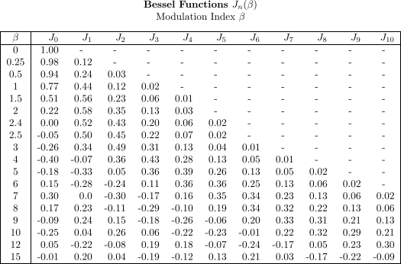

Frequency & Phase Modulation
Amplitude of sidebands determined by Bessel functions (table).
Modulation index is ratio of frequency deviation to modulating frequency:
$$β=\frac{Δf}{f_{m}}$$

Slide 14


Differences between Frequency & Phase Modulation
FM changes the instantaneous frequency.
PM changes the phase, but phase is always changing anyway… since otherwise the waveform would not change
Remember that a sinusoid is always governed by
Also frequency is the rate-of-change of phase.
Consider the following waveforms carefully…
$$x\left(t\right)=A\sin\left(ωt+φ\right)$$
$$ω_{i}\left(t\right)=\frac{dφ(t)}{dt}$$

Slide 15
Differences between FM & PM
FM changes the instantaneous frequency.
PM changes the phase, but phase is always changing anyway.

Slide 16
Differences between FM & PM
FM changes the instantaneous frequency.
PM changes the phase, but phase is always changing anyway.

Slide 17
Differences between FM & PM
FM changes the instantaneous frequency.
PM changes the phase, but phase is always changing anyway.

Slide 18
Comparison between FM & PM

Slide 19
How to Demodulate AM/FM/PM?
AM much easier.
Many, many ways for each.
Depends on complexity (determines cost) .
Depends on required accuracy of demodulated output.
Could be hardware (circuits) or software (take samples, use code).

Slide 20
AM Demodulation
Square waveform.
Lowpass filter or simple hold.
Remove DC offset.

Slide 21
FM Demodulation
Take rate-of-change of signal.
Then looks like AM.

Slide 22
Phase Tracking and Synchronization
If receiver does not know the carrier, it must use incoherent demodulation.
If receiver does know carrier, both frequency and phase, it can use coherent or synchronous demodulation.
For bit timing of digital streams, synchronization is essential.
Need a Phase-Locked Loop (PLL).

Slide 23
Phase-Locked Loop (PLL)
Has a local oscillator of about the right frequency.
Compares this to the incoming wave. Generates a phase error.
Phase error used to adjust or tune the local oscillator.
Application of classic closed-loop feedback.
Variation called Costas loop, which has two oscillators (sine and cosine).

Slide 24
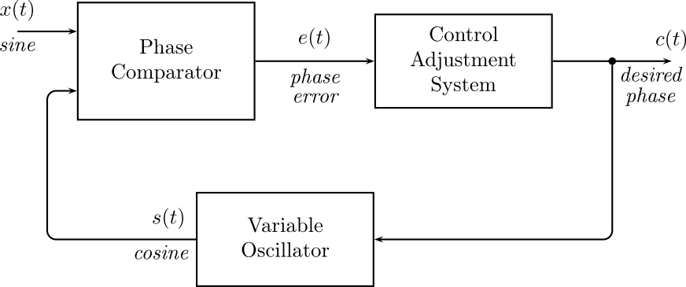
Phase-Locked Loop (PLL)
The feedback loop.
Issues: how to quickly adjust the oscillator so that it tracks.
Don’t want adjustment too slow.
Don’t want overshoot.
First question: how to compare phase?

Slide 25
PLL Phase Comparator
Multiply incoming signal and local signal, average out (lowpass filter).

Slide 26
PLL Operation – Phase Adjustment
Input and oscillator waves shown.
Adjusts oscillator frequency to track phase.
Amplitude of oscillator not critical.

Slide 27
PLL Operation – Frequency Adjustment
Input and oscillator waves shown.
Adjusts oscillator to go to new frequency.
This means changing the phase step.

Slide 28
Binary Data Passband Encoding
Basically just extend previous amplitude, frequency or phase modulation idea.
Simple initially, as there are only two levels: 1 = a given amplitude, frequency or phase 0 = another amplitude/frequency/phase

Slide 29
Amplitude Shift Keying (ASK)

Slide 30
Frequency Shift Keying (FSK)

Slide 31
Phase Shift Keying (PSK)

Slide 32
Recovering Digital Pulses
Noisy channel distorts waveform, how to make bit decisions?
Two solutions: correlate-integrate or matched filter.

Slide 33
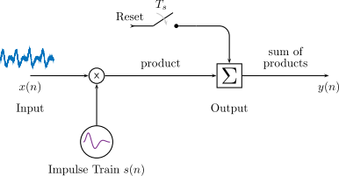
Correlate-Integrate
Multiply incoming waveform by expected pulse shape.
Integrate over one bit/symbol period.

Slide 34

Matched Filter
Uses a filter which is the time-reverse of the channel impulse.
How does this work?

Slide 35
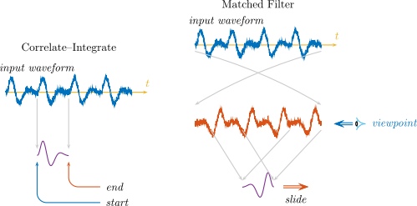
Correlate-Integrate & Matched Filter
Correlate requires a waveform generator to match channel response.
Matched filter requires a filter to perform convolution.

Slide 36
Filtering & Convolution
Convolution multiples incoming signal by coefficients, adds up result.
Then slides signal along.
MATLAB has conv() function:
x = [1 2 3 4 5 6 7 8];
h = [10 11 12];
conv(x, h)
ans =
10 31 64 97 130 163 196 229 172 96

Slide 37
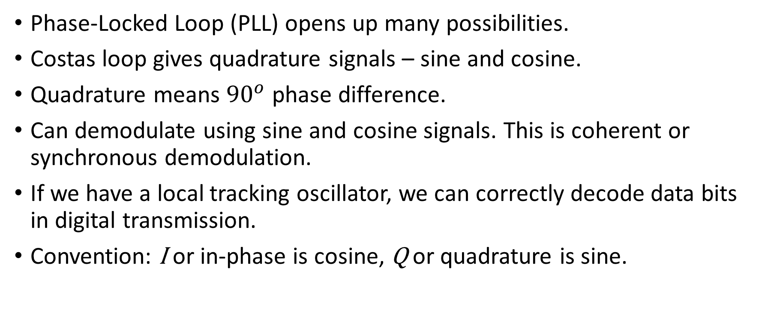
Demodulation using IQ Signals
Phase-Locked Loop (PLL) opens up many possibilities.
Costas loop gives quadrature signals – sine and cosine.
Quadrature means ${90}^{o}$ phase difference.
Can demodulate using sine and cosine signals. This is coherent or synchronous demodulation.
If we have a local tracking oscillator, we can correctly decode data bits in digital transmission.
Convention: I or in-phase is cosine, Q or quadrature is sine.

Slide 38
IQ Signals and Phase Quadrature
Quadrature signals give us a way to separate out two components.
Idea of quadrature demodulation of digital data:
Multiply incoming waveform by sine, add up over one symbol time.
Multiply incoming waveform by cosine, add up over one symbol time.
This gives two separate “channels”.
Can go further: change amplitude and phase.

Slide 39
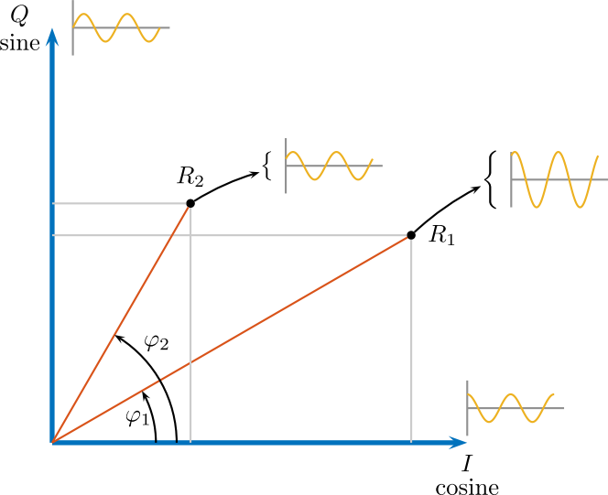
IQ Signal Conventions
I or in-phase is cosine, Q or quadrature is sine.
Physical time signal… visualize on IQ diagram:

Slide 40
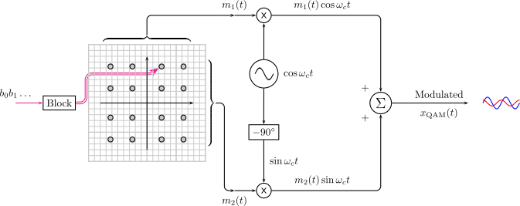
Quadrature Signals for Digital Modulation
Select amplitude and phase of a point…. 16 points would give 4 bits at a time.
Same as sine amount + cosine amount.

Slide 41
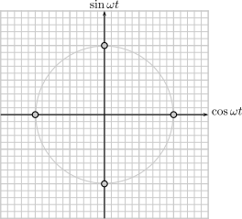
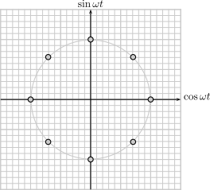
Quadrature Modulation
Change the phase - Quadrature Phase Shift Keying (QPSK)
Results in a constellation: 2 bits or 3 bits as shown, could be more.

Slide 42
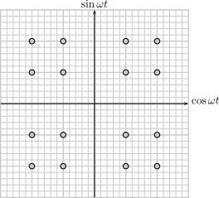
Quadrature Modulation
Change the phase as well as amplitude.
Quadrature Amplitude Modulation (QAM)
16 point constellation shown, could encode 4 bits at a time.

Slide 43
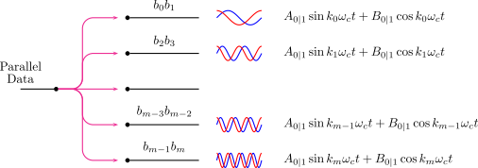
Using Multiple Frequencies
A set of amplitudes and phases for each of several frequencies.
Orthogonal Frequency Division Multiplexing (OFDM).
Useful because channels can change.
Used in various systems wireless, cable modems, digital TV.

Slide 44
Spread Spectrum
Original approach to telecommunications: use as narrow a bandwidth as possible.
Spread Spectrum (SS) idea: to spread the signal over a wider band.
Why? Several reasons…
Interference usually only affects part of the message, so it could be recovered.
Reduces possibility of snooping (eavesdropping) on a transmission.
Makes it easier to share a channel without co-ordination (cellular radio).

Slide 45
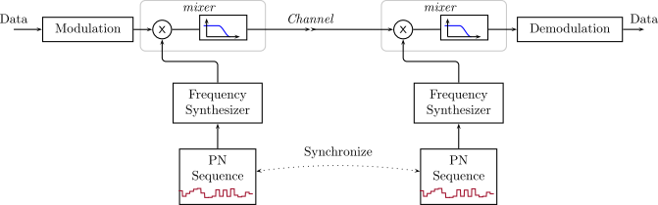
Spread Spectrum
Frequency Hopping: use a frequency that changes in a pseudo-random way.
Dwell time much longer than a single bit.

Slide 46
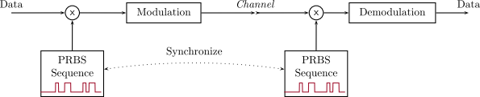
Spread Spectrum
Direct Sequence: use a frequency that changes in a pseudo-random way but very fast (several times per bit).

Slide 47
Chapter Summary – Key Points
Analog modulation, including AM, SSB, FM and PM.
Approaches to demodulation of analog modulation.
Phase lock, and the PLL and Costas loops.
Multi-bit digital modulation using QAM and QPSK.
Advanced modulation techniques, such as OFDM, for increased digital bit rate.
Spread-spectrum techniques: direct-sequence (DSSS) and frequency-hopping (FHSS).

