Slide 1
Internet Protocols
Text: Communication Systems Principles using MATLAB®
Text, drawings and images copyright © John Wiley & Sons 2018

Slide 2
Chapter Aims
To understand how data transmission on the Internet works using packet-switching.
To learn about packet addressing, packet routing.
How data is reliably delivered – checking, retransmission.
How throughput is maximized.
Problems that can occur: data packet congestion.
Routing algorithms – need to search for next-hop destination for all packets. Needs to be very fast.

Slide 3
Packet Switched Systems
Could establish a connection between sender (source) and receiver (destination) for the duration of a data transfer.
Not an efficient use of a shared data pipe.
Packet switching slices all data up into packets at the sender.
Reassembles them at the receiver.

Slide 4
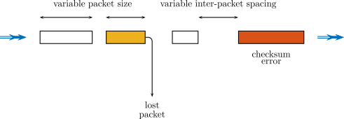
Packet Switching
Each data packet travels independently.
Needs source and destination address, packet identifier for correct reassembly, error-checking information.
Needs a protocol to deal with lost or corrupted packets (resend? ignore?)

Slide 5
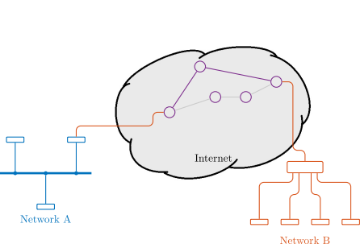
Internet: Interconnected Network
Multiple, separate network islands.
Connected together to form an internet.
Different network types, wireless, wired, low-speed, high-speed, etc
Leads to possibility of multiple routes from source to destination.
Routers must forward packets at each hop.
Endpoints agree what to do in event of flow of packets is interrupted.

Slide 6
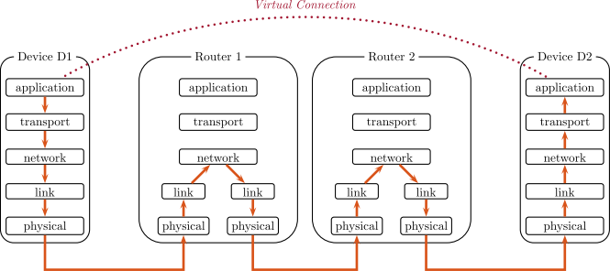
Protocol Stack
More reliable & easier to design/code/manage if functionality is separated.
Physical connection (modulation etc), link (get data from one to another), network (across hops via routers), transport (check data integrity), application (web, email voice)

Slide 7
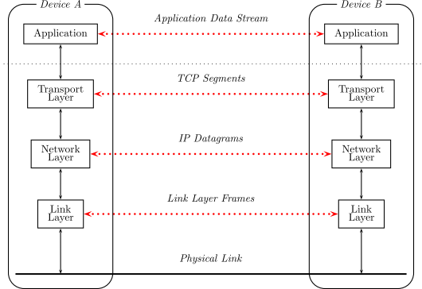
Protocol Stack: Virtual Data Flow
Each “layer” talks to corresponding “layer”.
Assumes other layers just do their job.

Slide 8
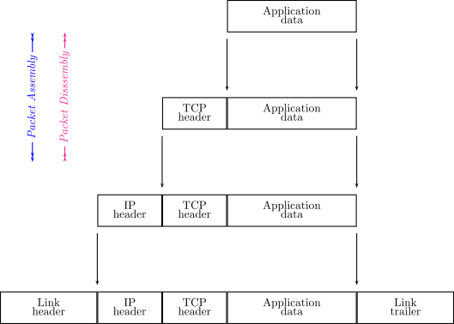
Protocol Stack: Data Encapsulation
Each “layer” encapsulates or wraps the data from above.
Uses a header – first bytes in a packet.
Any given layer unwraps by removing the header, then passing to adjacent layer.

Slide 9
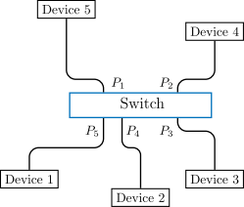
Local Area Networks
Ethernet – wired network.
Switch directs traffic (Ethernet frames) internal to network.
Needs a gateway to Internet.

Slide 10

Local Area Networks
Ethernet frame data format.
On receipt of data, `to’ address is checked. If it is this device, then higher protocol layers are given the data field.
Data from higher protocol layers are assembled into Ethernet frame and `to’/`from’ addresses added, then frame sent onto link.

Slide 11
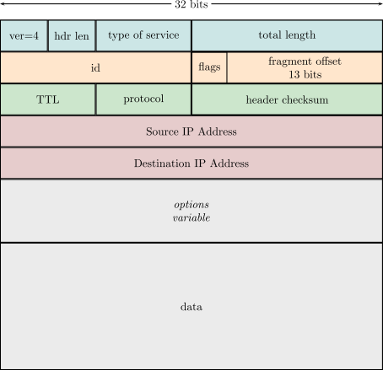
Internet Protocol (IP)
Data frames called datagrams.
IPv4 addresses 32 bits long.
TTL = Time To Live hop-count so datagrams don’t circulate endlessly.
Checksum – special addition to check data header.
Datagram may have to be fragmented if a given link cannot handle the full size.

Slide 12
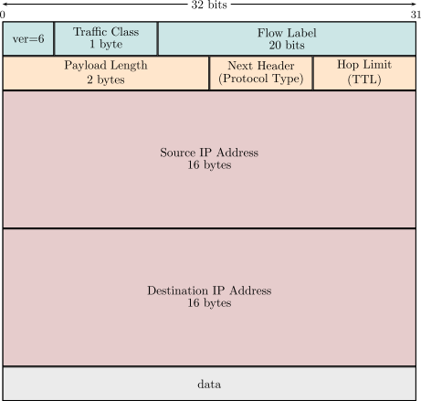
Internet Protocol version 6
Data frames still called datagrams.
Used lessons from IPv4, eg autoconfig.
New concepts such as flows, since different sources have different requirements (eg real-time).
IPv6 addresses 128 bits long.
Problem: IPv4 and IPv6 must coexist. This is not easy, cannot just “switch off” devices using IPv4 .

Slide 13
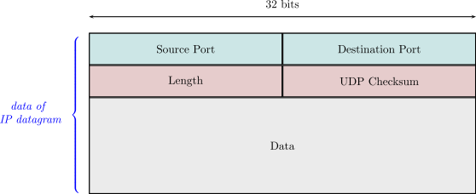
User Datagram Protocol (UDP)
Just to send a block of data from one device to another.
Not sequenced, payload not error-checked.
Quick. No retransmission.
Real-time voice/video/games.

Slide 14
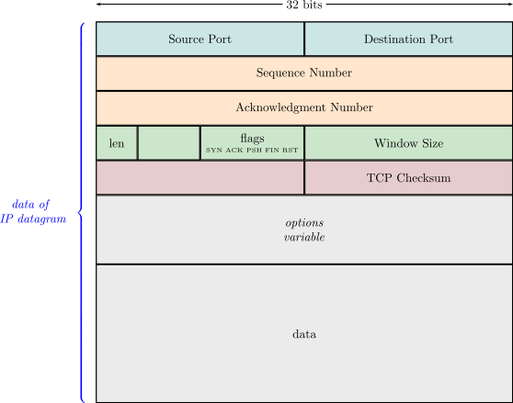
Transmission Control Protocol (TCP)
To send a reliable, byte-stream.
If errors, arranges retransmission.
Tries to maximize throughput without saturating network.
Heavy-lifter of the Internet. Often termed TCP/IP

Slide 15

Recap: what goes where
Each layer does its own job.
Adds header on sending.
Removes header on receipt.

Slide 16
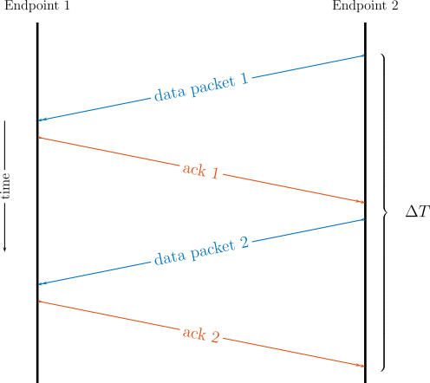
TCP: Reliable Transmission
Acknowledge (ACK) each packet: inefficient if network mostly reliable.
Would need to wait one round-trip time (RTT) until sending more data.
Effectively throttles (limits) the data transfer rate.

Slide 17
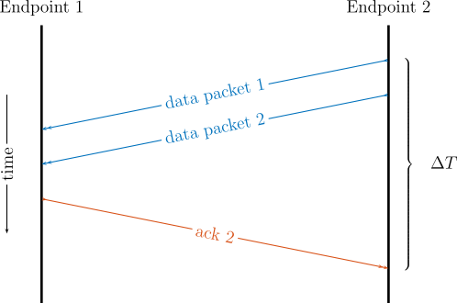
TCP: Reliable Transmission
Multiple packets ACK’d at once.
Have 2 outstanding, or 3 or 4 or …?
Need to be careful, introducing too many packets will saturate network.

Slide 18
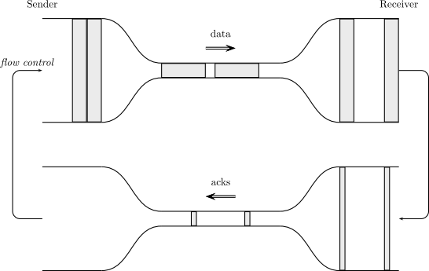
TCP: Reliable Transmission
Visualize as “data flow pipe”
We don’t know the constrictions.
A good policy: when we receive an ACK, can send even more data.
Approach limit carefully.

Slide 19
TCP Timeout
What if no ACK returns? Need a timeout.
Called Retransmission Timeout (RTO).
RTO too large, will wait too long to resend a packet.
RTO too short, will keep resending unnecessarily on slow link.
RTO should be based on Round-Trip Time (RTT).
RTO needs to be RTT with a safety margin.
RTO needs to adapt, depends dynamically on RTT.

Slide 20
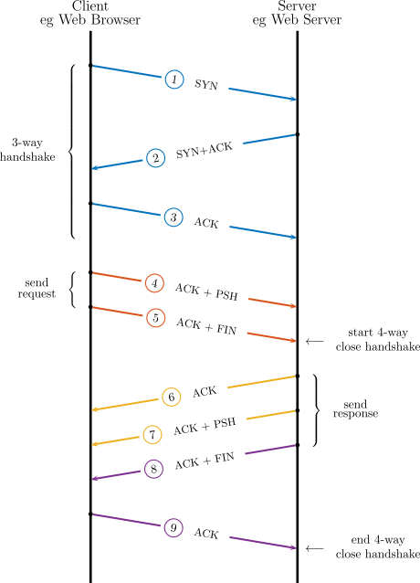
TCP Handshake
Start-up and close-down connections.
SYN is synchronize byte position counter.
Don’t want to send data to application in small portions – buffer for throughput.
But need to tell application when done Example: web page ready.
PSH = Push data flag
FIN = Finish flag.
3-way startup handshake. 4-way closedown.

Slide 21
TCP Throughput
Throughput and congestion avoidance.
CWND = Congestion Window
Documented in RFC 5861

Slide 22
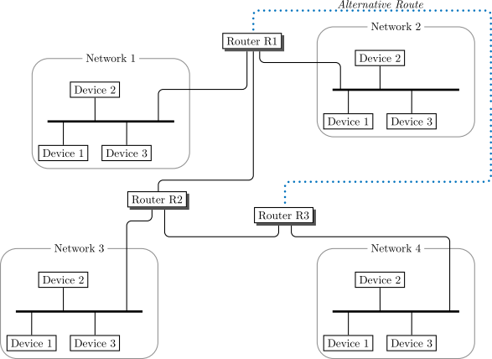
IP Routing
Could be multiple routes from source to destination.
Routes may change, even over the life of one transfer.
So, packets could become reordered.
Routing is distributed: no “master router”
Router is a normal machine that has more than one network interface & routing software (daemon/service).

Slide 23
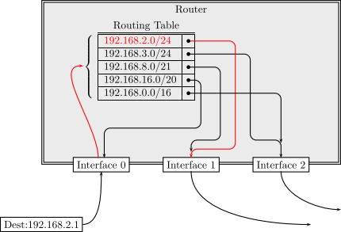
IP Routing
Incoming IP datagrams, what to do?
Must make a decision: which interface to forward it on.
Distributed routing: possibility of loops.
Packet could circulate endlessly.
Which interface gets packet closer to destination?

Slide 24
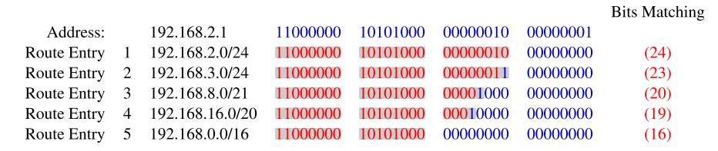
IP Routing
Based on longest-matching prefix (LMP)
Each possible route has a bitmask for routes it covers.
The incoming packet destination is compared to the possible route up to the bitmask.
The longest match is the best route, ie gets closer to the destination.

Slide 25
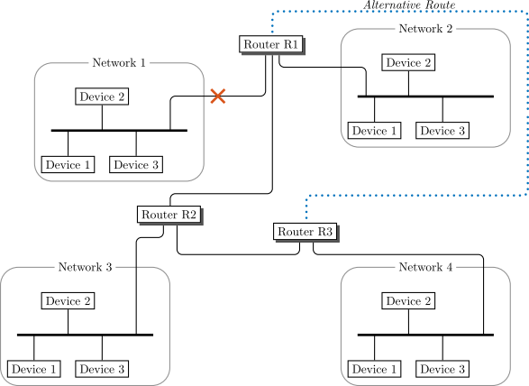
IP Routing
How an incorrect route could get advertised.
Note “alternate route” – good.
Routing messages: “I can reach Network X”
Depends on timing, wrong information propagated.

Slide 26
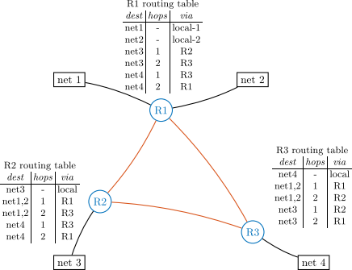
Link-State Routing
Routers build their own network topology maps.
Shortest-path problem involved.

Slide 27
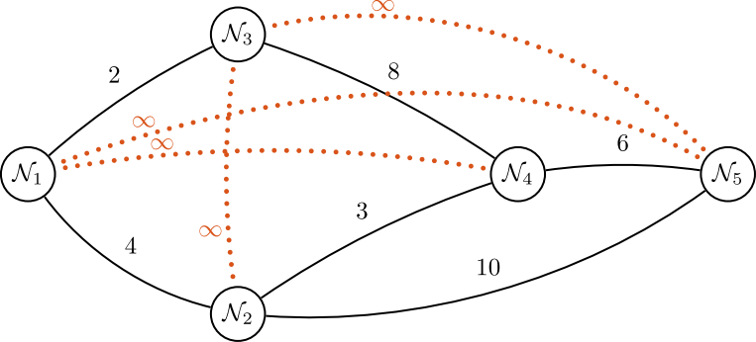
Link-State Routing
Shortest-path problem: how to get from one node to the next.
What is the best next-hop (forwarding interface)?

Slide 28
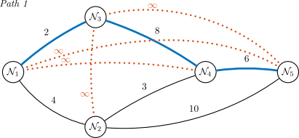
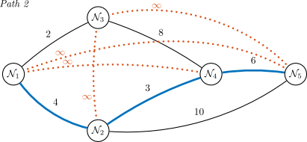
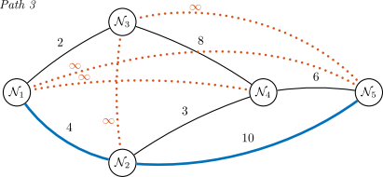
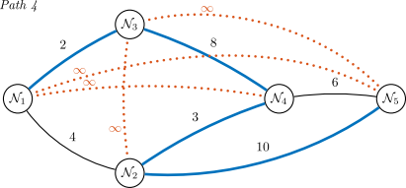
Shortest-Path
Very inefficient to enumerate all possible paths.

Slide 29
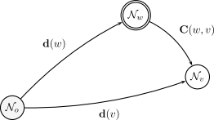
Shortest-Path
Very inefficient to enumerate all possible paths.
Better: keep direct cost and cost of path via another node.
Remember best node for each via-path.
From the endpoint, backtrack to select optimal predecessor.

Slide 30
Chapter Summary – Key Points
Protocol layering and frame encapsulation.
Internet Protocol and IP addressing.
Transmission Control Protocol, the sliding-window used in TCP, optimizing throughput and avoiding congestion.
Checksums in IP and TCP.
Routing packets from source to destination.
Searching in route tables.
Distance-vector and link-state algorithms for routing.

