Slide 1
Quantization & Coding
Text: Communication Systems Principles using MATLAB®
Text, drawings and images copyright © John Wiley & Sons 2018

Slide 2
Chapter Aims
To study quantization – how to allocate bits to sampled data.
To learn some coding methods for bit allocation, to minimize number of bits required.
How images are compressed.
How speech and audio is compressed – different algorithms.

Slide 3
Probability Density
Histogram (discrete-valued) and Probability Density Function (PDF)

Slide 4
Probability Density
Common PDF for noise is Gaussian.

Slide 5
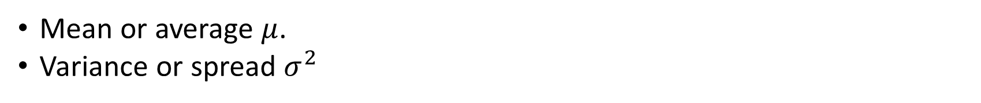
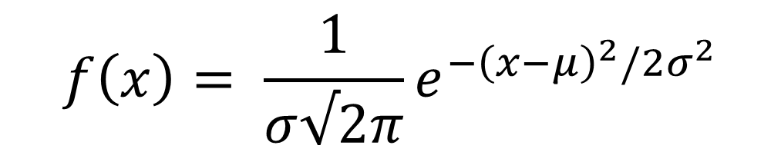
Probability Density
Common PDF for noise is Gaussian.
$$f\left(x\right)= \frac{1}{σ√2π}e^{−{\left(x−μ\right)}^{2}/2σ^{2}}$$
Mean or average $μ$.
Variance or spread $σ^{2}$

Slide 6
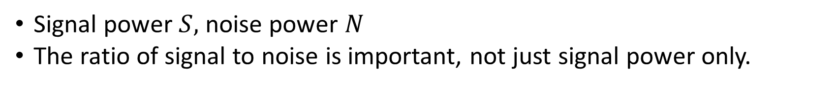
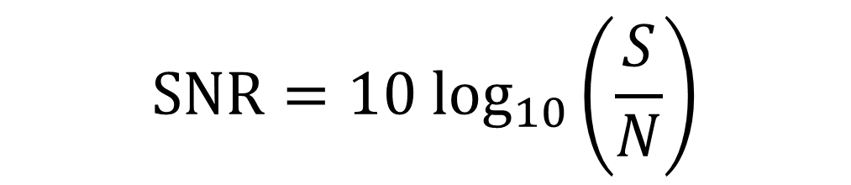
Noise Affects Digital Channel Capacity
Signal-to-Noise ratio (SNR)
$$SNR=10 \log_{10}\left(\frac{S}{N}\right)$$
Signal power $S,$ noise power $N$
The ratio of signal to noise is important, not just signal power only.

Slide 7
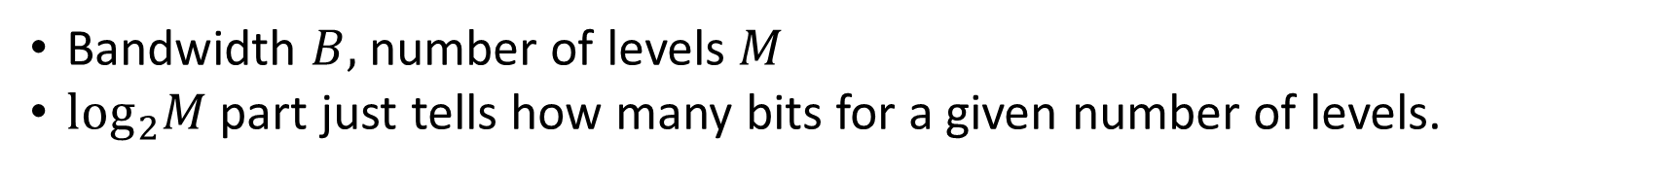
Hartley’s Law
Relates channel capacity (bits per second) to bandwidth and number of levels:
$$C=2B \log_{2}M$$
Bandwidth $B,$number of levels $M$
$\log_{2}M$ part just tells how many bits for a given number of levels.

Slide 8

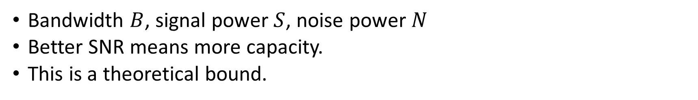
Shannon’s Capacity Formula
Also called Shannon-Hartley Theorem
Relates channel capacity (bits per second) to bandwidth and SNR
$$C=B \log_{2}\left(1+\frac{S}{N}\right)$$
Bandwidth $B$, signal power $S$, noise power $N$
Better SNR means more capacity.
This is a theoretical bound.

Slide 9
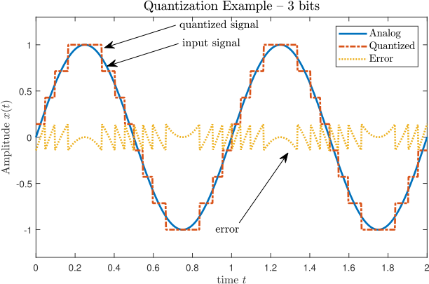
Quantization
Selecting a level to represent a signal’s value.
Usually 8 bits (per color for RGB images), 16 bits per sample for audio

Slide 10

Number of Bits Determine SNR
Number of bits determines number of levels.
Number of levels determines amount of noise.
Result: Signal-to-Noise Ratio (SNR) is proportional to number of bits.
This is an approximation only.
Other factors come into play: likelihood of levels, perception, speaker/image display device.
$$SNR∝N$$

Slide 11
Source Coding
Essentially, how to assign codewords (bits) to a “symbol”
Symbol may be a pixel color, a voice sample, etc
A fixed number of bits per symbol is usually very inefficient.
Example: ASCII code uses 7 bit codes, but some letters (A, E) may be more prevalent than others (Z, Q).
Furthermore, there may be patterns that can be exploited (eg Q always followed by U).

Slide 12
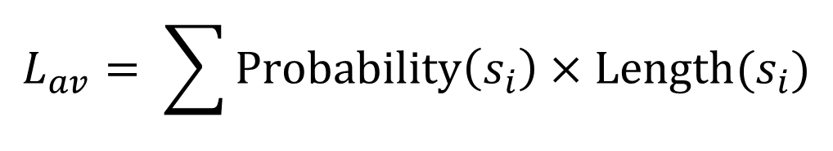
Codeword Length
Suppose we assign a 2-bit pattern to A, a 12-bit pattern to Z, etc.
The average codeword length for all letters would then be
$$L_{av}= \sum{Probability\left(s_{i}\right)×Length(s_{i})}$$
Basically weights each codeword’s length with its probability

Slide 13
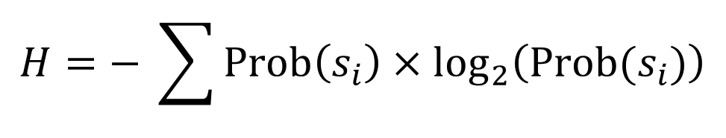
Entropy
Average information content.
The average code length if we had a perfect code, in theory.
Defined as
$$H=− \sum{Prob\left(s_{i}\right)×\log_{2}\left(Prob(s_{i})\right)}$$
Example: 4 symbols. If each was equally likely, then probability is ¼ and log to base 2 is -2. So number of bits for each is 2.
This is weighted by the probability.
Negative cancels the log of a fraction above.

Slide 14
Huffman Code
A way of assigning variable-bitlength codewords to a set.
Gives unique codewords (so no confusion when decoder receives a bitstream)
Also separates codewords without using a special “comma” separator.
Used within other systems, eg digital TV, MPEG.
Requires probabilities of each source symbol to be known, or at least estimated. These may change over time.

Slide 15
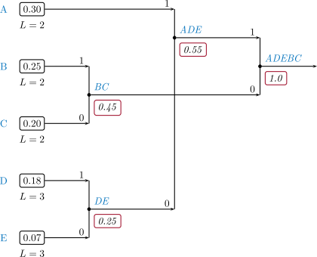
Huffman Code
Write symbols with probabilities.
Successively join pairs until only one “leaf” left.
Assign 1/0 for each branch.
Encode left-right.
Decode right-left.

Slide 16
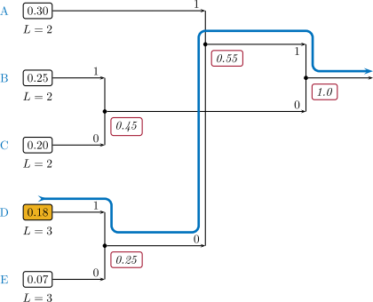
Huffman Code - Encoding
Tree structure known to encoder.
Given a symbol, work towards root.
Record 1/0 for each branch merge.

Slide 17

Huffman Code - Decoding
Tree structure known to decoder.
Start at root node.
Received 1/0 determines branch to be taken at each step.
Arrive at end symbol, restart.

Slide 18
Huffman Code – Important Aspects
Tree structure must be known to both encoder and decoder.
May adapt tree as source is encoded – but care must be taken to ensure encoder and decoder remain synchronized with identical tree.
Many trees possible, depends on which nodes are combined in order.
Lowest average codeword length when sibling property maintained – always combine two lowest probability nodes at each step.

Slide 19
Block Encoders
Huffman code exploits redundancy of one symbol at a time.
But there is usually inter-symbol redundancy as well.
Disadvantage: must buffer blocks of symbols before output of codeword. Leads to coding delay and more complexity.
Two main approaches: sliding-window and dictionary.

Slide 20
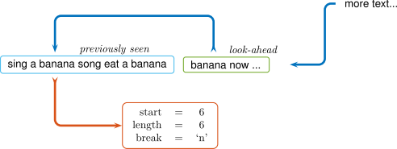
Lempel-Ziv Window
Use past data as predictor of future.
Encode block as start/length/break, where start is index into window of previous data.

Slide 21
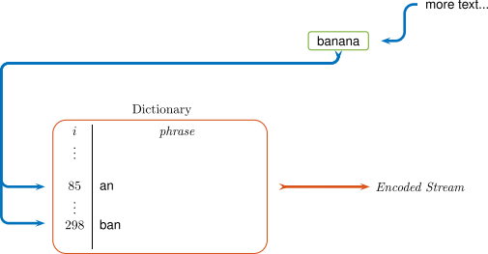
Lempel-Ziv Dictionary
Create dictionary of past data.
Encode block as index into dictionary.
Problem: creating dictionary, size of dictionary.

Slide 22
Lempel-Ziv Approaches
More than one symbol at a time leads to very large compression ratios.
Could also lead to data expansion, especially while “learning” data patterns.
Encoding could be slow – need for search.
Dictionary could fill up, need to purge old patterns from it.
Many variations, LZW, LZO, …

Slide 23
Lossy Coding
Previous approaches “lossless” – data out equals data in.
Lossy – data out might not exactly equal data in.
Example: one pixel in an image wrong, would you notice?
Highest compression ratios.
Often used in conjunction with lossless coding as last stage.

Slide 24
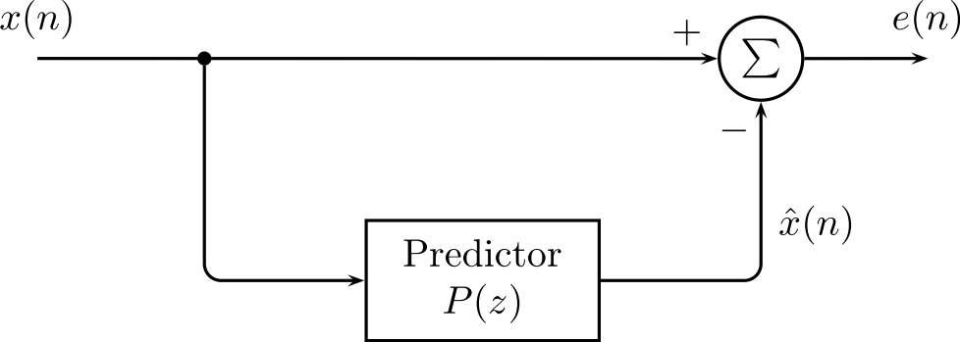
Differential Coding
Instead of sending each sample, send difference (plus or minus) from current sample to next.
Error resulting should be small, hence fewer bits required per sample
Improve by using more sophisticated predictor.

Slide 25
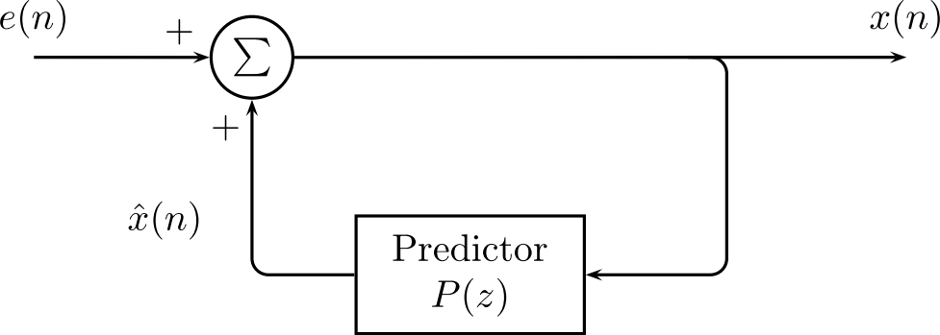
Differential Coding
Decoder also forms prediction, receives error and adds to form output.
So prediction must be based on past samples.

Slide 26
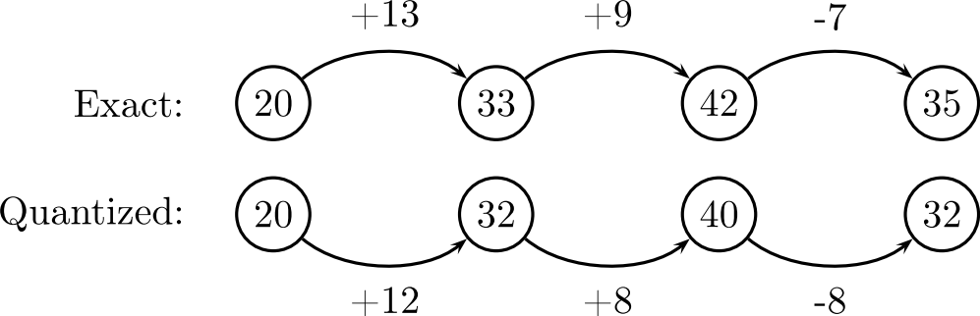
Differential Coding
Prediction must be based on past samples.
Also quantized samples.
If not, error accumulates.
Example shows quantizing to nearest multiple of 4.

Slide 27
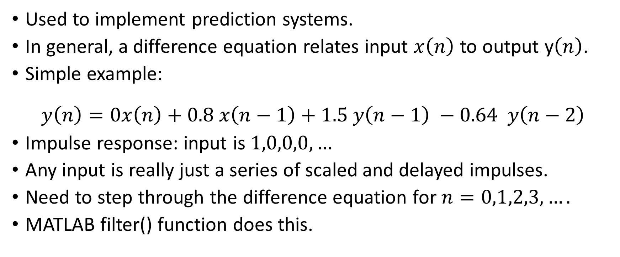
Difference Equations
Used to implement prediction systems.
In general, a difference equation relates input $x\left(n\right)$ to output y$\left(n\right)$.
Simple example:
$$y\left(n\right)=0x\left(n\right)+0.8 x\left(n−1\right)+1.5 y\left(n−1\right) −0.64 y\left(n−2\right)$$
Impulse response: input is $1,0,0,0,…$
Any input is really just a series of scaled and delayed impulses.
Need to step through the difference equation for $n=0,1,2,3,….$
MATLAB filter() function does this.

Slide 28
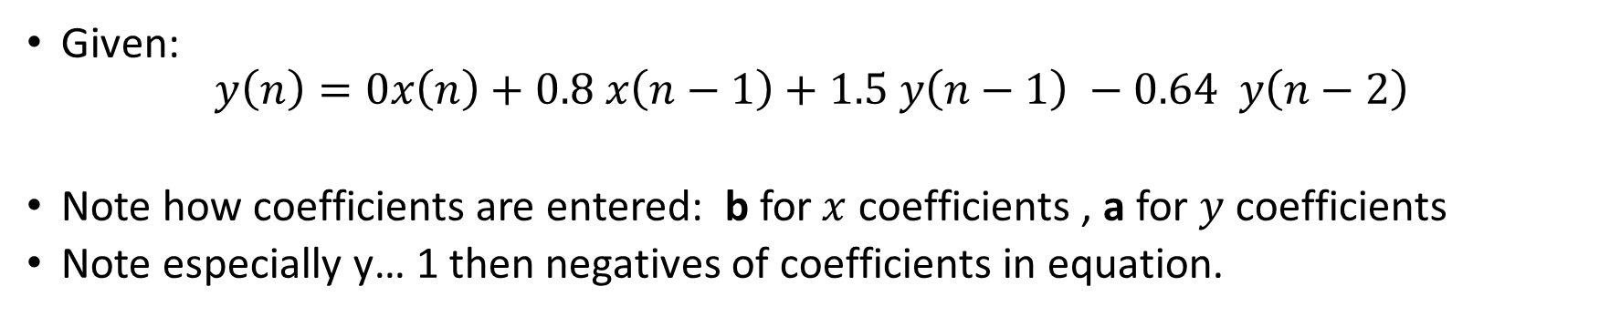
MATLAB filter function
Given:
$$y\left(n\right)=0x\left(n\right)+0.8 x\left(n−1\right)+1.5 y\left(n−1\right) −0.64 y\left(n−2\right)$$
Note how coefficients are entered: b for$x$ coefficients , a for $y$ coefficients
Note especially y… 1 then negatives of coefficients in equation.
b = [0 0.8];
a = [1 -1.5 0.64];
x = zeros(25,1);
x(1) = 1;
y = filter(b, a, x);
stem(y);

Slide 29
MATLAB filter function
Input shown as an impulse, but could be anything.
Note how output oscillates and decays away – characteristic of recursive systems.

Slide 30
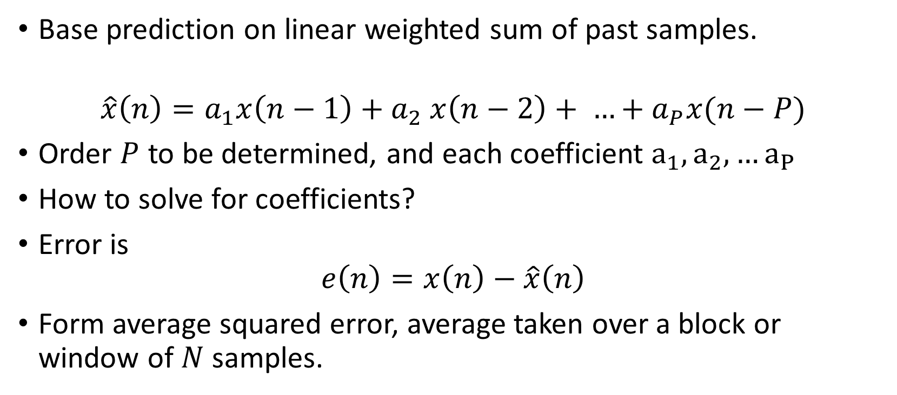
Linear Prediction
Base prediction on linear weighted sum of past samples.
$$\hat{x}\left(n\right)=a_{1}x\left(n−1\right){+ a}_{2}x\left(n−2\right)+ …+a_{P}x(n−P)$$
Order $P$ to be determined, and each coefficient $a_{1},a_{2},…a_{P}$
How to solve for coefficients?
Error is
$$e\left(n\right)=x\left(n\right)−\hat{x}\left(n\right)$$
Form average squared error, average taken over a block or window of $N$ samples.

Slide 31
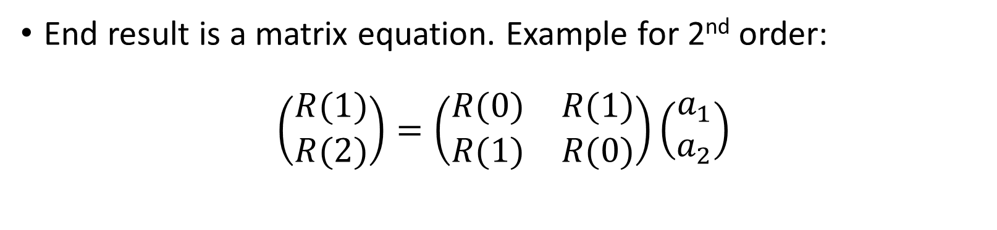
Linear Prediction
End result is a matrix equation. Example for 2nd order:
$$\left(\begin{matrix}R(1) \\ R(2)\end{matrix}\right)=\left(\begin{matrix}R(0) & R(1) \\ R(1) & R(0)\end{matrix}\right)\left(\begin{matrix}a_{1} \\ a_{2}\end{matrix}\right)$$

Slide 32
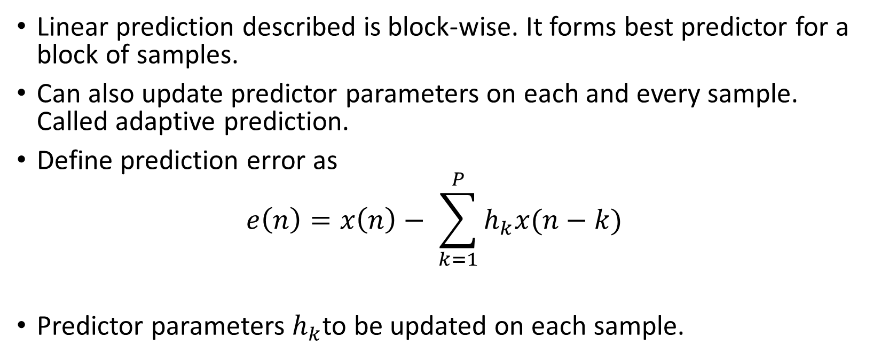
Adaptive Linear Prediction
Linear prediction described is block-wise. It forms best predictor for a block of samples.
Can also update predictor parameters on each and every sample. Called adaptive prediction.
Define prediction error as
$$e\left(n\right)=x\left(n\right)− \sum_{k=1}^{P}{h_{k}x(n−k)}$$
Predictor parameters $h_{k}$to be updated on each sample.

Slide 33
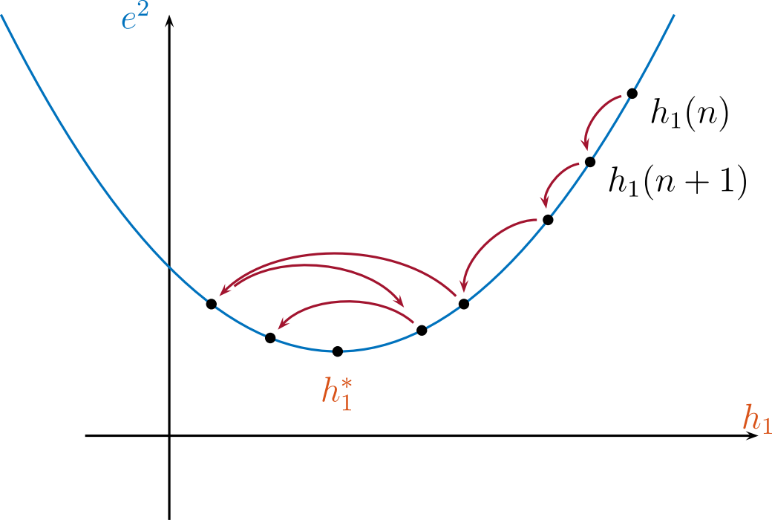
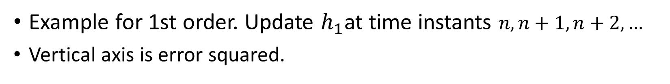
Adaptive Linear Prediction
Example for 1st order. Update $h_{1}$at time instants $n, n+1, n+2, …$
Vertical axis is error squared.

Slide 34
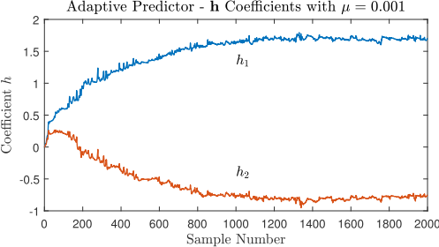
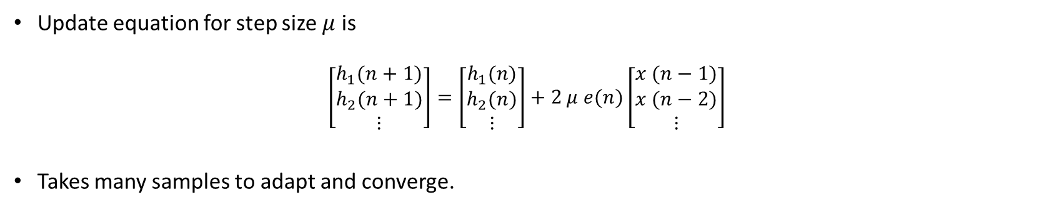
Adaptive Linear Prediction
Update equation for step size $μ$ is
$$\left[\begin{matrix}h_{1}(n+1) \\ h_{2}(n+1) \\ ⋮\end{matrix}\right]=\left[\begin{matrix}h_{1}(n) \\ h_{2}(n) \\ ⋮\end{matrix}\right]+2 μ e(n)\left[\begin{matrix}x (n−1) \\ x (n−2) \\ ⋮\end{matrix}\right]$$
Takes many samples to adapt and converge.

Slide 35
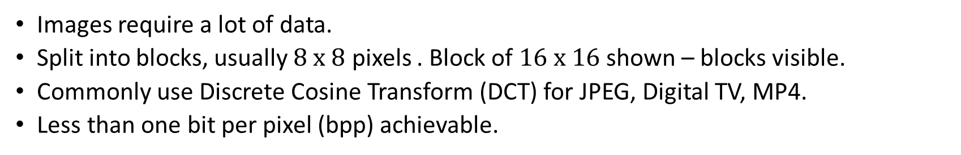
Image Coding
Images require a lot of data.
Split into blocks, usually $8 x 8$ pixels . Block of $16 x 16$shown – blocks visible.
Commonly use Discrete Cosine Transform (DCT) for JPEG, Digital TV, MP4.
Less than one bit per pixel (bpp) achievable.

Slide 36
Discrete Cosine Transform
Idea of DCT: use weighting coefficients for “tiles” or sub-blocks.
Only transmit certain coefficients and/or quantize coefficients coarsely.
Tiles are based on 2-dimensional cosine function. Hence DCT.
Inverse DCT restores original block.

Slide 37
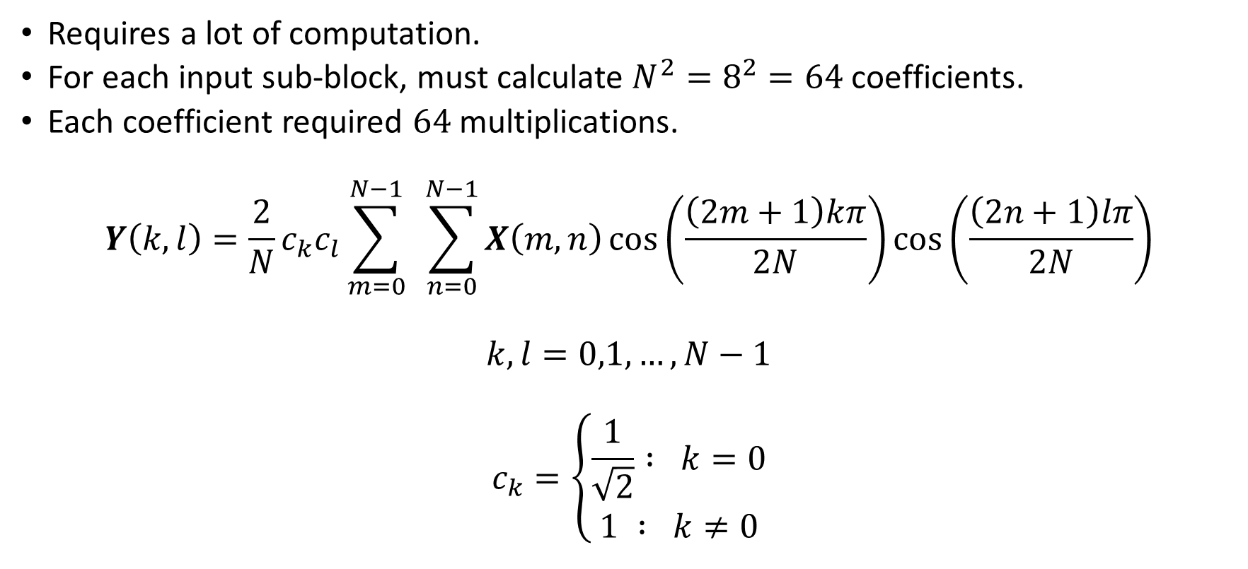
Discrete Cosine Transform
Requires a lot of computation.
For each input sub-block, must calculate $N^{2}=8^{2}=64$ coefficients.
Each coefficient required $64$ multiplications.
$$Y\left(k,l\right)=\frac{2}{N}c_{k}c_{l}\sum_{m=0}^{N−1}{ }\sum_{n=0}^{N−1}{X\left(m,n\right)\cos\left(\frac{\left(2m+1\right)kπ}{2N}\right)\cos\left(\frac{\left(2n+1\right)lπ}{2N}\right)}$$
$$k,l=0,1,…, N−1$$
$$c_{k}=\left\{\begin{aligned}\frac{1}{\sqrt{2}} : k=0 \\ &1 : k≠0\end{aligned}\right.$$

Slide 38
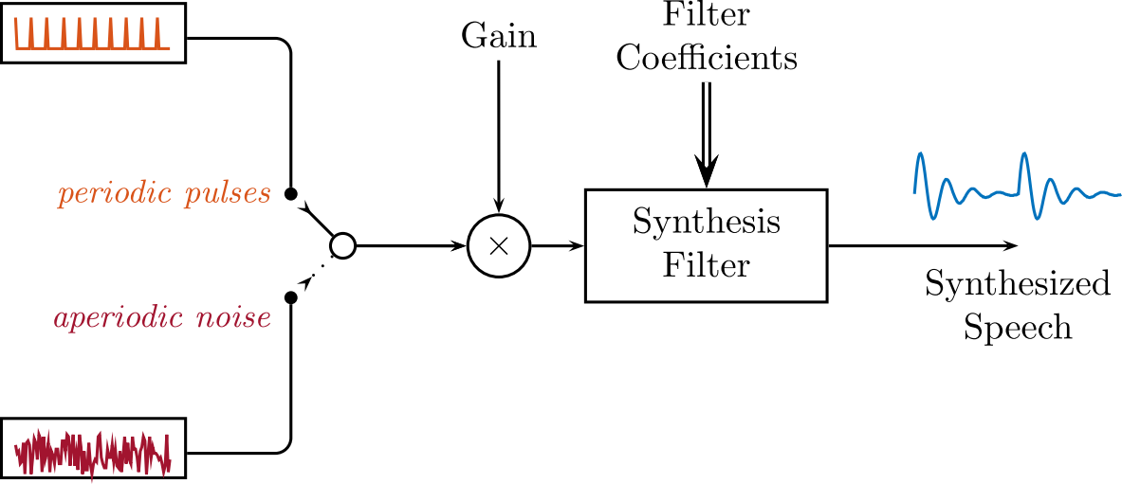
Speech Coding
Recall linear prediction. Transmit predictor coefficients and error samples.
LPC coder for speech does not transmit error.
Instead, uses “excitation” which may be pulses or noise.
Gives very high compression, reduced quality.

Slide 39
Speech Coding
LPC approach works because speech resonances modelled by predictor poles. Note peaks in spectrum.
Usually 10th order is sufficient.
So only need to transmit 10 coefficients per frame of about 20 milliseconds.

Slide 40
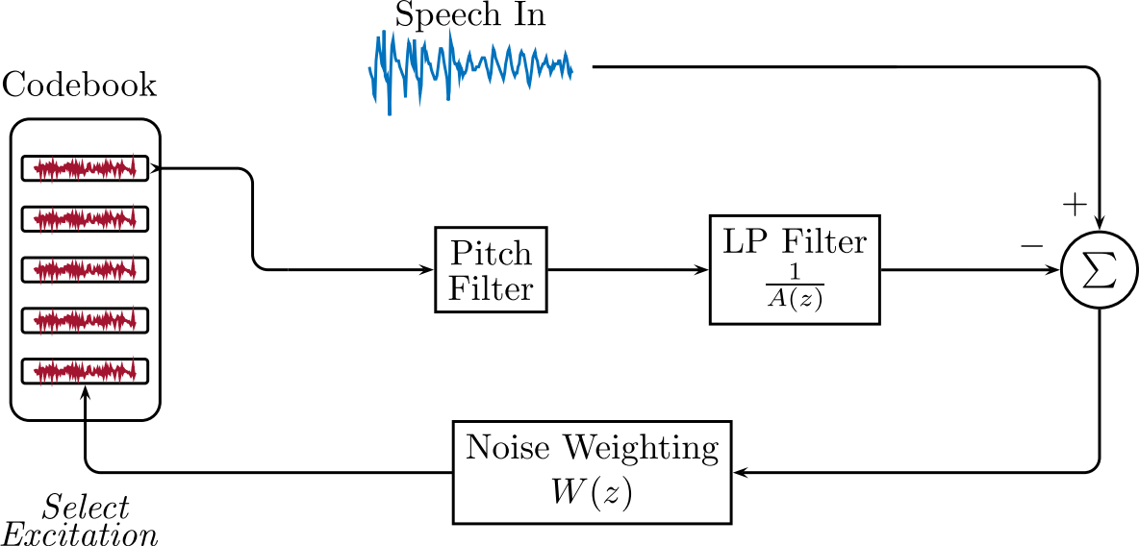
Speech Coding
Improve quality using Code Excited Linear Prediction (CELP)
Uses a codebook of possible excitations.
Closed-loop feedback compares “synthesized” speech to input.

Slide 41
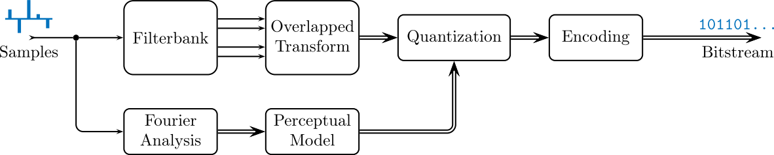
Audio Coding
LPC/CELP not good for audio/music – distortion evident.
MP4 uses DCT in one dimension (transform below) but overlaps blocks to prevent/reduce audible artifacts.
Note frequency analysis using Fourier Transform, Quantization (lossy) and encoding (lossless)

Slide 42
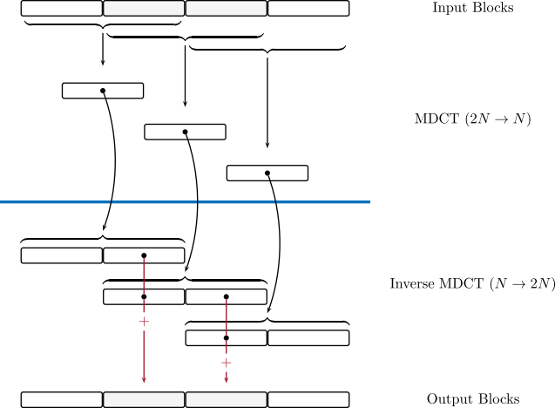
Transform Coding of Audio
Modified DCT for audio encoding.
Overlaps successive blocks for continuity.
MDCT transform with overlap/add gives perfect reconstruction.

Slide 43
Chapter Summary – Key Points
Scalar quantization, including fixed and variable-step characteristics.
Vector quantization - training and search methods.
Image encoding using block transforms.
Speech encoding using analysis-by-synthesis, and music encoding using transforms.

