Slide 1
Data Transmission & Integrity
Text: Communication Systems Principles using MATLAB®
Text, drawings and images copyright © John Wiley & Sons 2018

Slide 2
Chapter Aims
To examine error detection and error correction.
Algorithms for detection of errors.
Algorithms for correction of errors.
Need for encryption. How encryption works.
Security-related issues such as authentication.

Slide 3
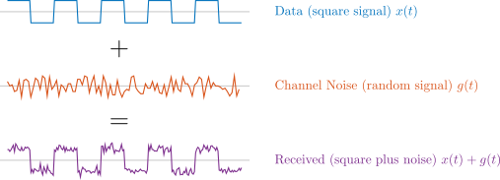
Real-World has Noise
Random noise (unpredictable) or predictable noise .
Digital transmission helps… threshold for detection; also can add error detection. Even correct errors in some cases.
Think what would happen in case shown if noise becomes larger.

Slide 4
Noise Signal
Commonly use Gaussian random variable as an approximation.
Statistically, actual sample values drawn from set with this distribution or probability density function (PDF).

Slide 5
Probability Density
Common PDF for noise is Gaussian.

Slide 6
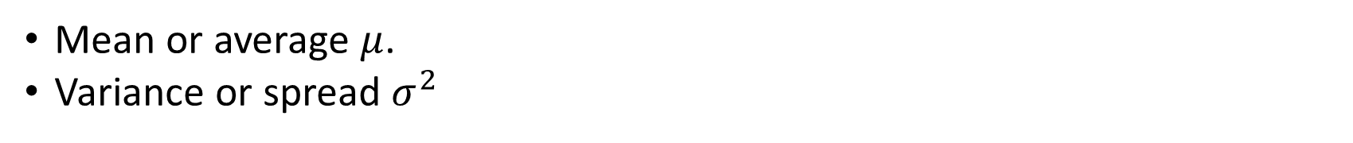
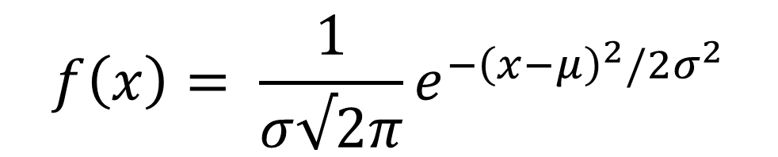
Probability Density
Common PDF for noise is Gaussian.
$$f\left(x\right)= \frac{1}{σ√2π}e^{−{\left(x−μ\right)}^{2}/2σ^{2}}$$
Mean or average $μ$.
Variance or spread $σ^{2}$

Slide 7
Noise Signal
Distribution of amplitudes of this signal is important.

Slide 8
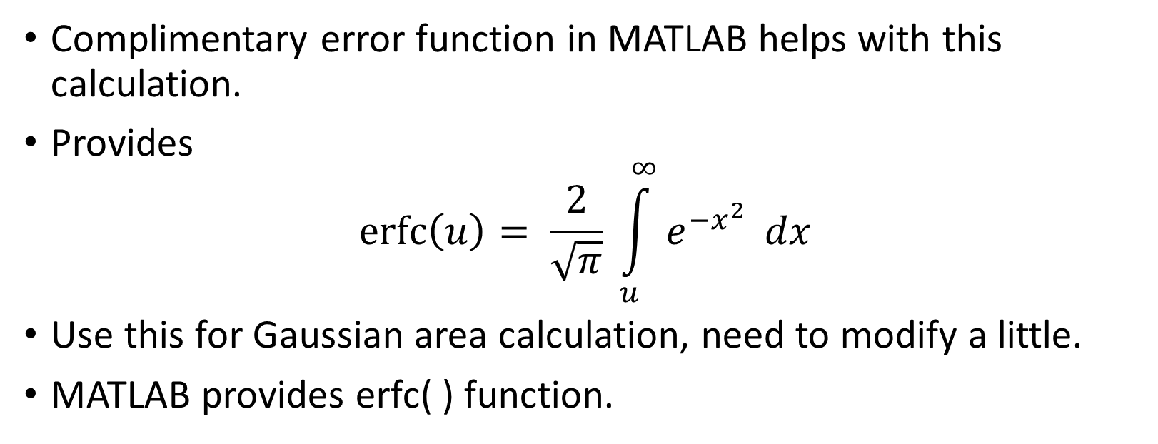
PDF Areas
Complimentary error function in MATLAB helps with this calculation.
Provides
$$\operatorname{erfc}\left(u\right)= \frac{2}{\sqrt{π}} \int_{u}^{∞}{e^{−x^{2}}} dx$$
Use this for Gaussian area calculation, need to modify a little.
MATLAB provides erfc( ) function.

Slide 9
Noise and Digital Signals
How does Noise PDF relate to digital decision?
Simple binary case shown.

Slide 10
Noise and Digital Signals
More complicated modulation – 2 bits per symbol or more

Slide 11
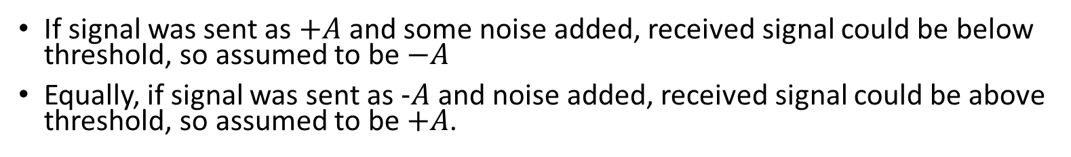
Noise and Digital Signals
If signal was sent as $+A$and some noise added, received signal could be below threshold, so assumed to be $−A$
Equally, if signal was sent as $−A$ and noise added, received signal could be above threshold, so assumed to be $+A$.

Slide 12
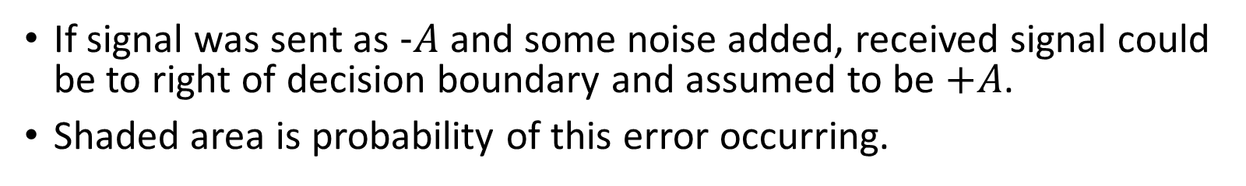
Noise and Digital Signals
If signal was sent as $−A$and some noise added, received signal could be to right of decision boundary and assumed to be $+A$.
Shaded area is probability of this error occurring.

Slide 13
Bit Error Rate and SNR
Compute error probability as determined by SNR.
Depends on modulation scheme employed.

Slide 14
Binary Operations for Detecting Errors
The Exclusive-OR function is often used in error detection, and also error correction.
Output is a Boolean function of inputs.
Two-input XOR as shown below acts as a “bit difference detector”
Input A | Input B | A XOR B
0 | 0 | 0
0 | 1 | 1
1 | 0 | 1
1 | 1 | 0

Slide 15
Correcting Errors
First question: why not just repeat bits?
This doesn’t really help much, and creates a lot of overhead.
Repetition code shown below, output divided into groups of 3 to analyse.
Output bits (9) are called codewords for the channel.
Input Bits |  | Coded Output Bits
0 | 0 | 0 | 0 | 0 | 0 | 0 | 0 | 0 | 0 | 0
0 | 1 | 0 | 0 | 0 | 0 | 0 | 0 | 1 | 1 | 1
1 | 0 | 0 | 0 | 0 | 1 | 1 | 1 | 1 | 1 | 1
1 | 1 | 1 | 1 | 1 | 1 | 1 | 1 | 1 | 1 | 1

Slide 16
Repetition Code
Suppose one bit changes, can we detect the error?
Yes.. Because 000 000 010 is not a valid codeword.
Can we correct the error?
Yes…if receiver assumes the 1 should be 0 and codeword sent was 000 000 000.
Input Bits |  | Coded Output Bits
0 | 0 | 0 | 0 | 0 | 0 | 0 | 0 | 0 | 1 | 0
0 | 1 | 0 | 0 | 0 | 0 | 0 | 0 | 1 | 1 | 1
1 | 0 | 0 | 0 | 0 | 1 | 1 | 1 | 1 | 1 | 1
1 | 1 | 1 | 1 | 1 | 1 | 1 | 1 | 1 | 1 | 1

Slide 17
Repetition Code
Suppose two bits change, can we detect the error?
Yes.. Because 000 000 011 is not a valid codeword.
Can we correct the error?
Yes…if receiver assumes the valid codeword sent was 000 000 111. But this is wrong!
Input Bits |  | Coded Output Bits
0 | 0 | 0 | 0 | 0 | 0 | 0 | 0 | 0 | 1 | 1
0 | 1 | 0 | 0 | 0 | 0 | 0 | 0 | 1 | 1 | 1
1 | 0 | 0 | 0 | 0 | 1 | 1 | 1 | 1 | 1 | 1
1 | 1 | 1 | 1 | 1 | 1 | 1 | 1 | 1 | 1 | 1

Slide 18
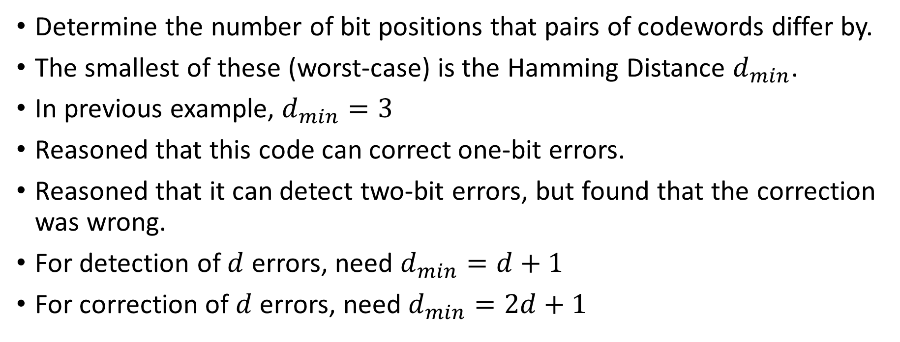
Hamming Distance
Determine the number of bit positions that pairs of codewords differ by.
The smallest of these (worst-case) is the Hamming Distance $d_{min}$.
In previous example, $d_{min}=3$
Reasoned that this code can correct one-bit errors.
Reasoned that it can detect two-bit errors, but found that the correction was wrong.
For detection of $d$ errors, need $d_{min}=d+1$
For correction of $d$ errors, need $d_{min}=2d+1$

Slide 19
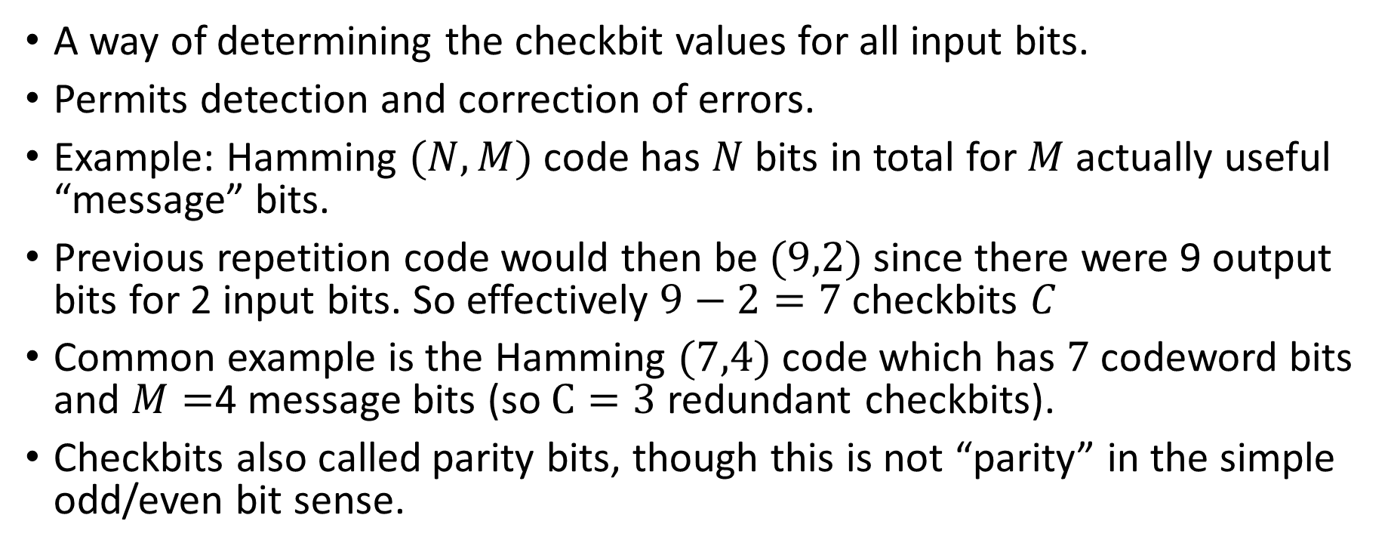
Hamming Code
A way of determining the checkbit values for all input bits.
Permits detection and correction of errors.
Example: Hamming $(N,M)$ code has $N$ bits in total for $M$ actually useful “message” bits.
Previous repetition code would then be $(9,2)$ since there were 9 output bits for 2 input bits. So effectively $9−2=7$ checkbits $C$
Common example is the Hamming $(7,4)$ code which has $7$ codeword bits and $M=$4 message bits (so $C=3$redundant checkbits).
Checkbits also called parity bits, though this is not “parity” in the simple odd/even bit sense.

Slide 20
Hamming Code
Procedure for determining checkbits described in text.
Only requires multiple XOR operations.
Problem: can only correct single-bit errors.
Can address this problem by forming a block and calculating Hamming checkbits across rows. Permits multiple-bit error correction, but has longer delay.

Slide 21
Checksums
Simple to perform in software.
Extended addition of 16 bit “words” to form a sum, which should be identical at sender and receiver.
A few extensions to make it easier (faster) to calculate.
Used in TCP/IP protocols.
Can detect errors but not correct.
So TCP implements retransmission of data packets which have an invalid checksum.
Issue: endian order of processors.

Slide 22
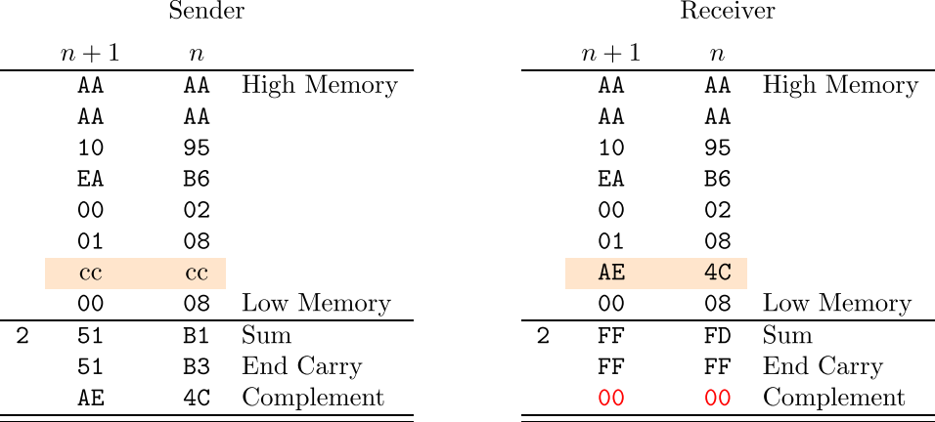
Checksum – Little Endian
Packet of data in memory. Shown as hexadecimal.
Sender sets checksum bytes cc cc to zero.
Add up, note end-around carry of overflow.
Receiver does same calculation, but with received checksum in place.
Result should be zero if no errors. Quick to test.

Slide 23
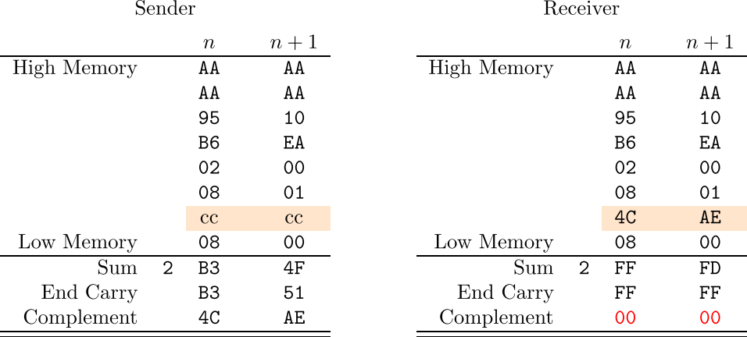
Checksum – Big Endian
Same calculation and same result, but byte order inherently reversed
So can send packets from one type of machine to another and checksum still “works”.
Don’t need special tests to determine processor type. Subtle but important point.

Slide 24
Cyclic Redundancy Checks
Checksum are byte-oriented (actually use 16 bits for addition)
Cyclic Redundancy Checks (CRCs) calculate a value based on operations on sequential bits.
Fast, can be done in hardware, used in Ethernet.
Idea: consider a “message” string of data bits as a large “number”, divide by a predetermined binary value. The remainder is the CRC.
Not actually “division” but uses XOR operations.
Can detect errors, but not correct for them.
Key advantage: very low overhead of extra bits added. Message may be 1000’s of bits long, only 16-32 bits added for checking.

Slide 25
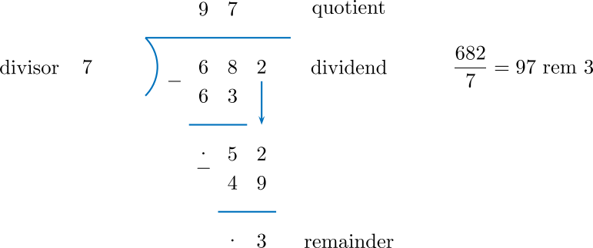
Cyclic Redundancy Checks
Procedure is to add redundant bits to message, successively multiply by 1 or 0 and XOR.
Decimal example shown to fix ideas, but not actually done this way.
682 is the “message”, the remainder of 3 is the error check.
If message corrupted, receiver will obtain a different remainder.

Slide 26
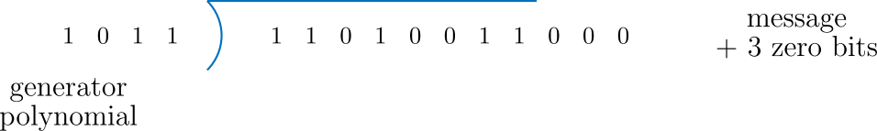
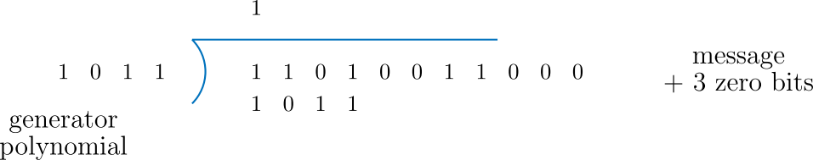
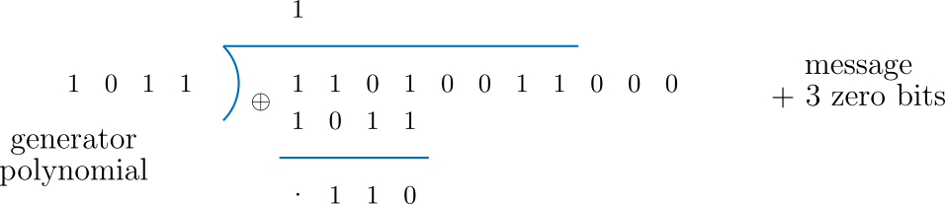
Cyclic Redundancy Checks
Binary “division” as shown.
Zero bits appended: one less than divisor or generator
At each step:
Multiply by 1 or 0
Perform XOR
Bring down a new bit
Repeat until end.

Slide 27
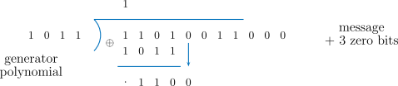
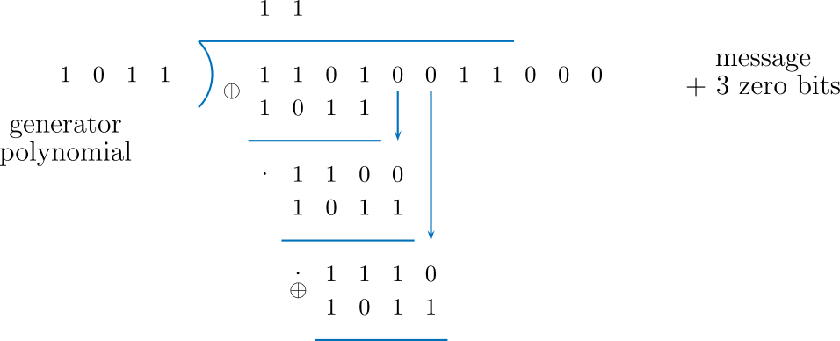
Cyclic Redundancy Checks
Binary “division” as shown.
Zero bits appended: one less than divisor or generator
At each step:
Multiply by 1 or 0
Perform XOR
Bring down a new bit
Repeat until end.

Slide 28
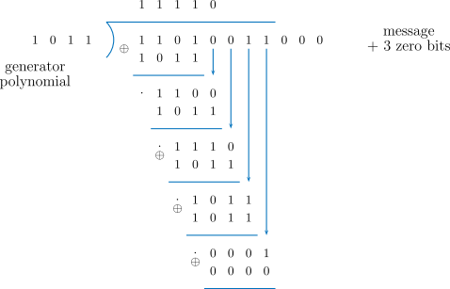
Cyclic Redundancy Checks
Binary “division” as shown.
Zero bits appended: one less than divisor or generator
At each step:
Multiply by 1 or 0
Perform XOR
Bring down a new bit
Repeat until end.

Slide 29
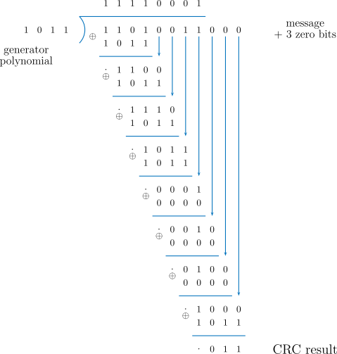
Cyclic Redundancy Checks
Eventually sender gets this.
The CRC result is sent in place of the three zero bits.

Slide 30
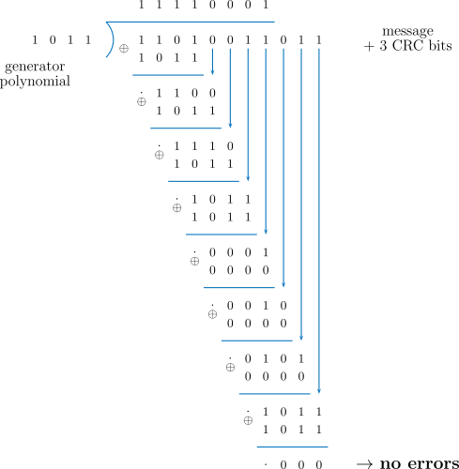
Cyclic Redundancy Checks
Receiver performs the same calculation.
Zero remainder indicates no errors.

Slide 31
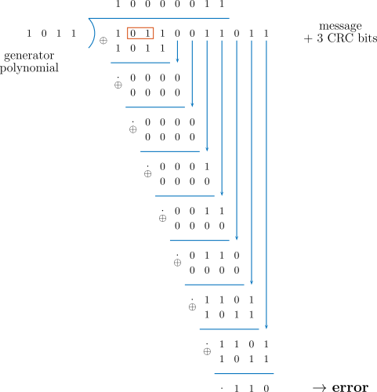
Cyclic Redundancy Checks
Receiver does same calculation.
Non-zero remainder indicates an error occurred in transmission.
Can fail if error burst corrupts data such that remainder still happens to be zero. Unlikely but possible.

Slide 32
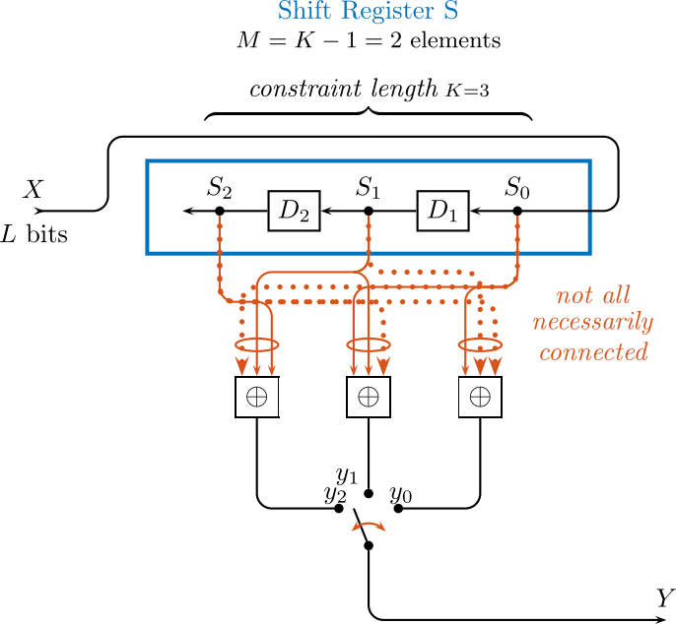
Convolutional Coding
Uses shift registers like CRCs
Uses Hamming distance.
Not block-oriented like Hamming code and CRC.
Continuously calculates output stream, receiver may need to backtrack if issues detected.
Can both detect and correct errors, so very useful.
Input shift registers form a “current state” and output is sequential XOR of input and certain states.

Slide 33
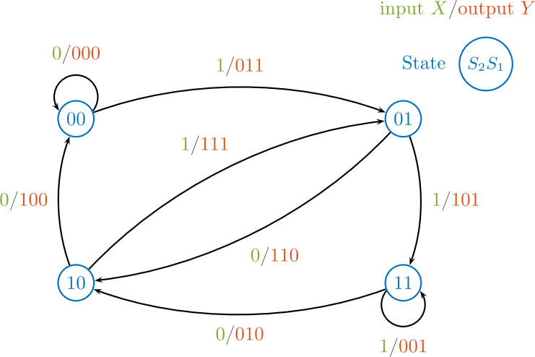
Convolutional Coding
Circles are states (2 bits so 4 states here).
In a given state, input bit causes:
Output of a bit pattern.
Transition to another state.
Receiver should follow the same sequence of states around if no errors in transmission.
If an invalid codeword received in a given state, need to go back a few instants (backtrack) to see what the most likely sequence of states was.
Hamming distance detection effectively augmented by known/allowed state transitions.

Slide 34
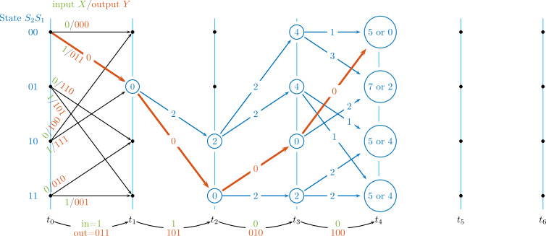
Convolutional Coding
Trellis formed by states and transitions.
Numbers on arrows show Hamming distance between what was received and the possible bits for each transition.
Within each state, keep track of two lowest cumulative distances, also the previous state node which resulted in each value.
Don’t make a decision straight away, defer….

Slide 35
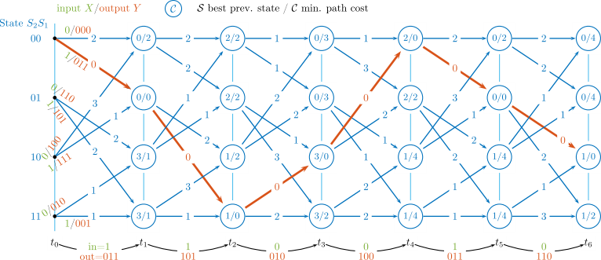
Convolutional Coding
Eventually after a few steps, have this situation.
Backtracking from final state with lowest cumulative path cost shows the best path.
The best path determines the actual sequence, and thus guesses the original bit pattern at the sender.

Slide 36
Encryption & Security
Packets on Internet could go through many routers.
Data send wirelessly could be intercepted without your knowledge.
Problems:
How to ensure privacy via encryption.
How to exchange passwords if used. If they are captured or guessed, then communication is compromised.
How to authenticate your dealings, ensure you are not talking to fake/phishing websites.

Slide 37
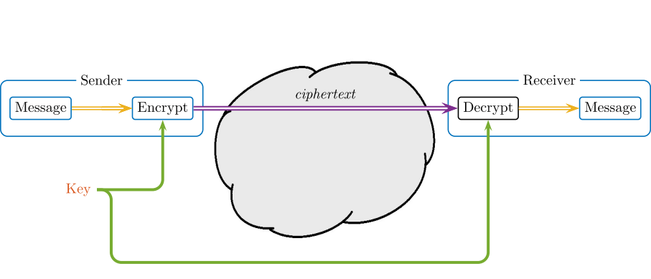
Encryption
Situation if we have a secret key or password.
Assume ciphertext can be collected.
Assume bad guys know the encryption/decryption algorithm.
That only leaves the key. How to give it to the other party?

Slide 38
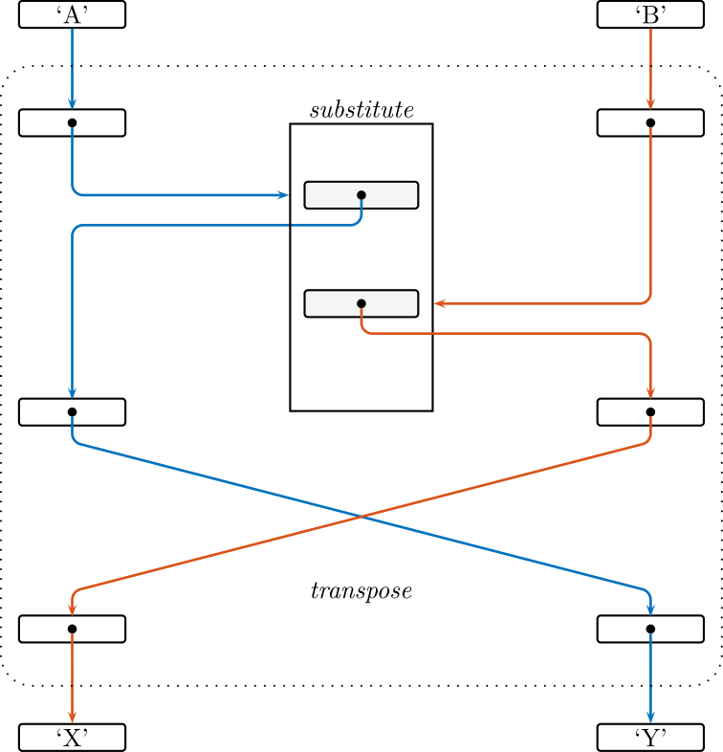
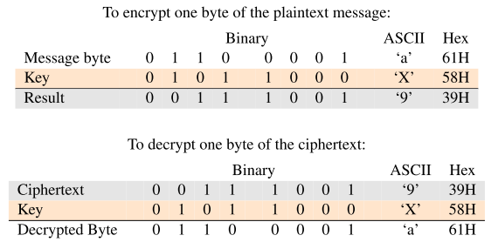
Encryption
Exclusive OR (XOR) function is useful, as it is invertible. Pattern of XORing repeated for each word in password, result is pseudo-random.
Other tools include transposition and substitution. Aim to make it difficult to “work backwards”. Key/password determines order of operations. Numerous variations possible.
Aim to thwart guessing by attacker.

Slide 39
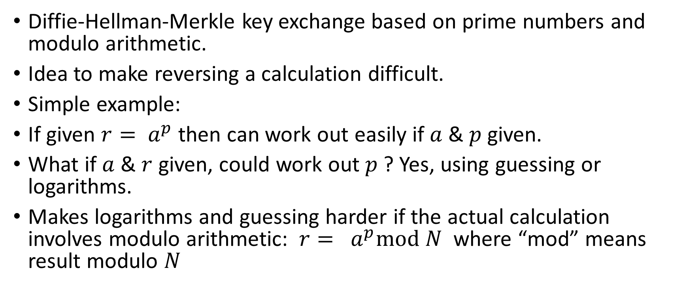
Key Exchange
Diffie-Hellman-Merkle key exchange based on prime numbers and modulo arithmetic.
Idea to make reversing a calculation difficult.
Simple example:
If given $r= a^{p}$ then can work out easily if $a$ & $p$ given.
What if $a$ & $r$ given, could work out $p$ ? Yes, using guessing or logarithms.
Makes logarithms and guessing harder if the actual calculation involves modulo arithmetic: $r= a^{p}mod N$ where “mod” means result modulo $N$

Slide 40
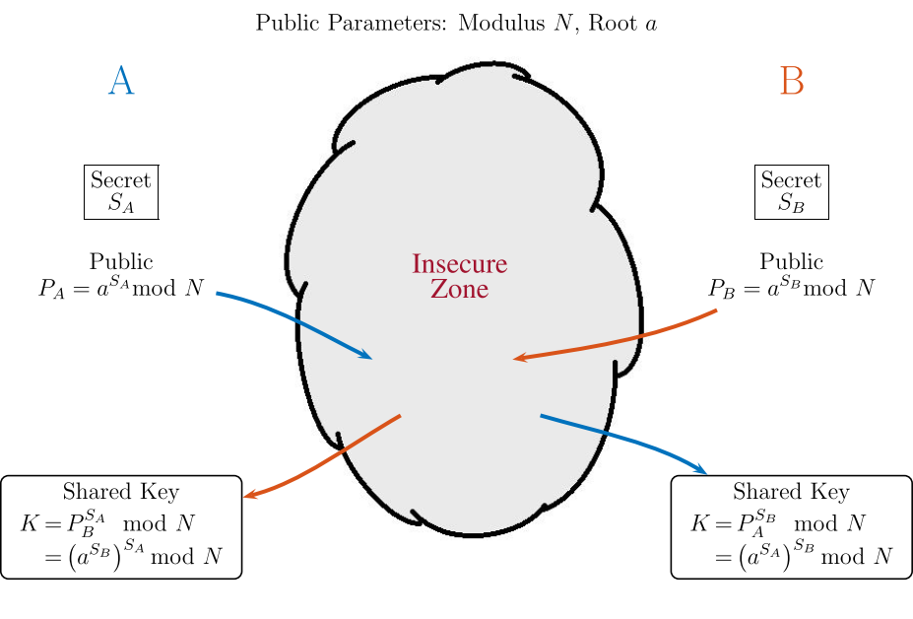
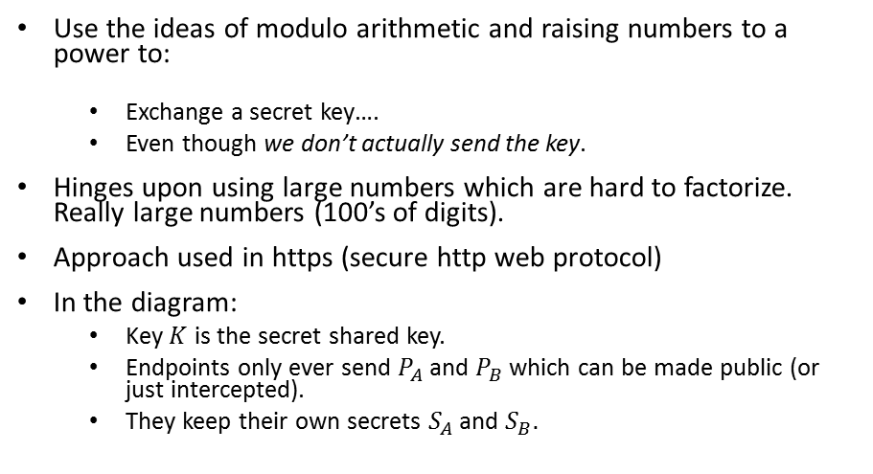
Key Exchange
Use the ideas of modulo arithmetic and raising numbers to a power to:
Exchange a secret key….
Even though we don’t actually send the key.
Hinges upon using large numbers which are hard to factorize. Really large numbers (100’s of digits).
Approach used in https (secure http web protocol)
In the diagram:
Key $K$ is the secret shared key.
Endpoints only ever send $P_{A}$ and $P_{B}$ which can be made public (or just intercepted).
They keep their own secrets $S_{A}$ and $S_{B}.$

Slide 41
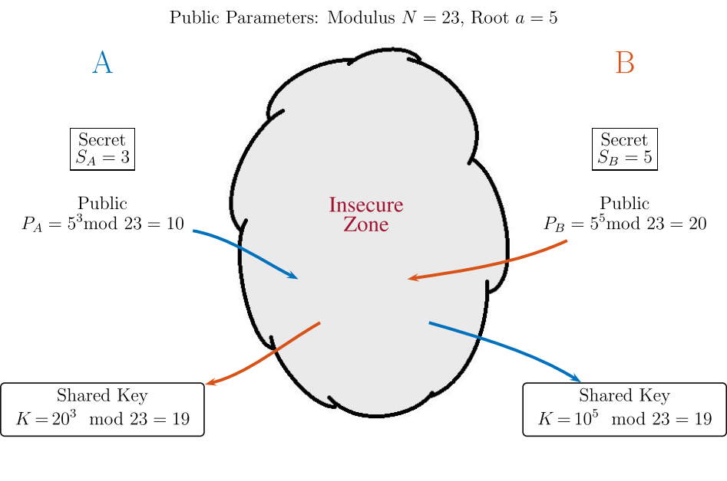
Key Exchange : numerical example
In practice, have to use much much bigger numbers.
Once key has been exchanged, can use conventional “secret key” encryption for the actual data exchange.

Slide 42
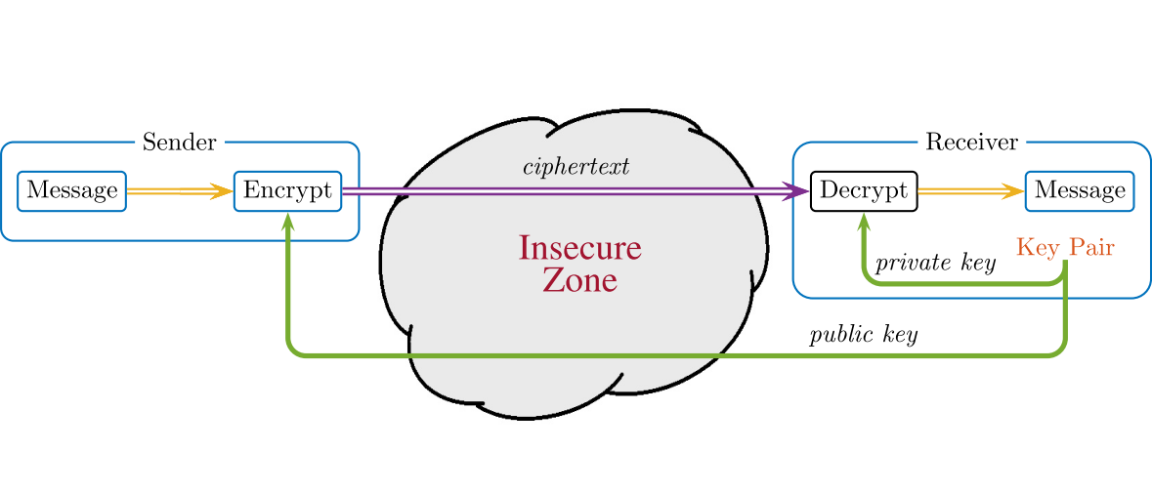
Public Key Encryption
Mathematics similar but idea different.
Encrypts all data in transmission, uses two keys: one public, one private.
Important distinction: the encryption key and decryption key are different. Cannot determine decryption key if only encryption key known.

Slide 43
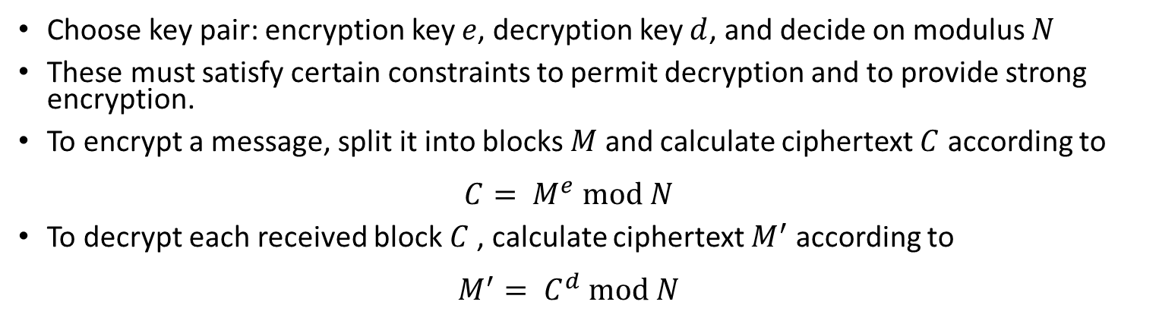
Public Key Encryption
Choose key pair: encryption key $e$, decryption key $d$, and decide on modulus $N$
These must satisfy certain constraints to permit decryption and to provide strong encryption.
To encrypt a message, split it into blocks $M$ and calculate ciphertext $C$ according to $C= M^{e} mod N$
To decrypt each received block$C$ , calculate ciphertext $M^{′}$ according to $M^{′}= C^{d} mod N$

Slide 44
Public Key Encryption
Why not just use public key encryption all the time?
It requires very large numbers for security, and calculations involving modulo arithmetic. Hence potentially slow.

Slide 45
Chapter Summary – Key Points
Error detection, using checksums and cyclic redundancy checks.
Error correction, using the Hamming code and convolutional codes.
Secret-key encryption methods.
Key exchange methods.
Public-key encryption methods.

