Slide 1
5 Quantization and coding

Slide 2
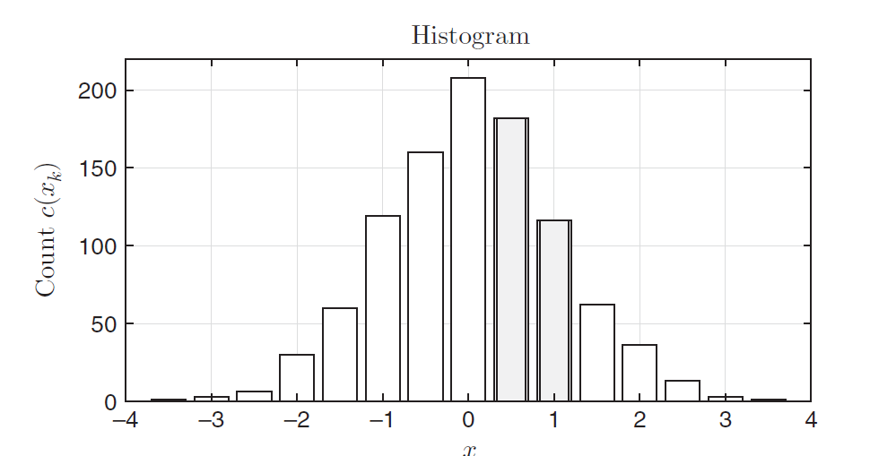
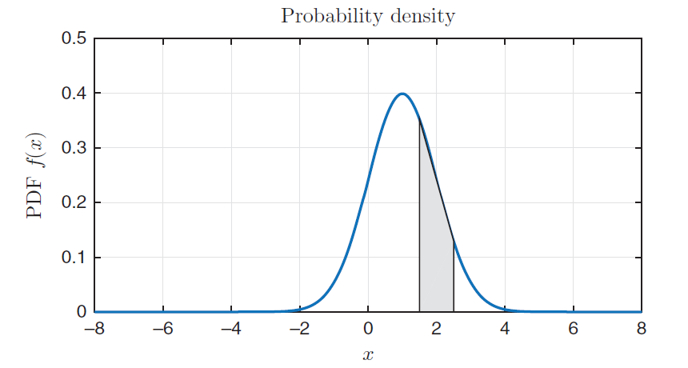
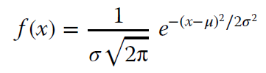
Gaussian distribution

Slide 3
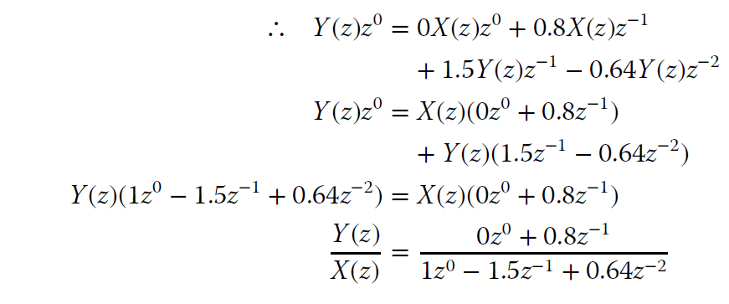
Difference equation
Z transform

Slide 4
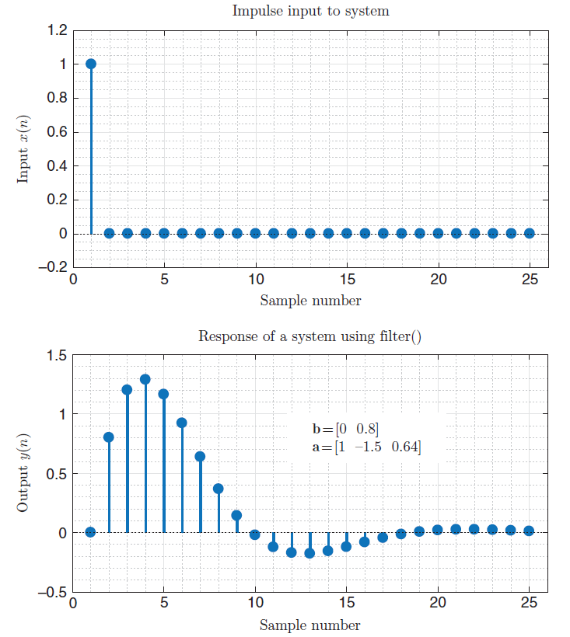
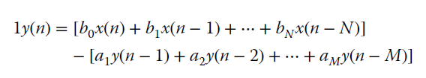


Slide 5



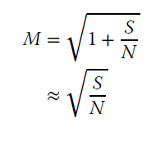
Digital channel capacity
Hartley’s law
Shannon-Hartley law
B is the bandwidth of the channel (Hz), M is the number of levels used for each signaling element, and bps denotes the transmission rate in bits per second.
Upper bound
Considering noise

Slide 6



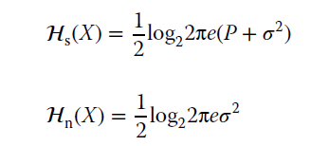
Derivation of Shannon-Hartley law
Zero mean Gaussian PDF
Entropy

Slide 7
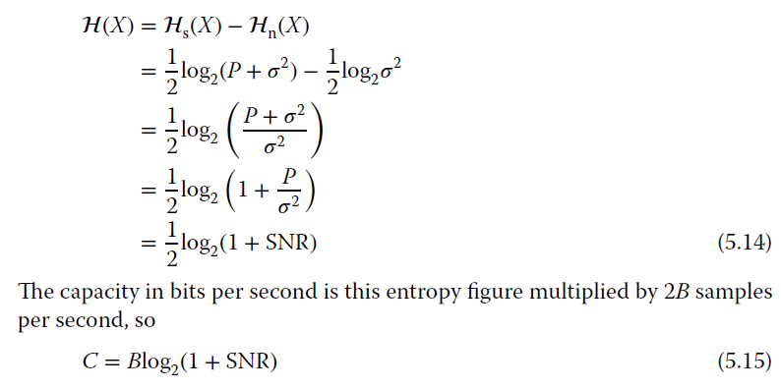

Slide 8
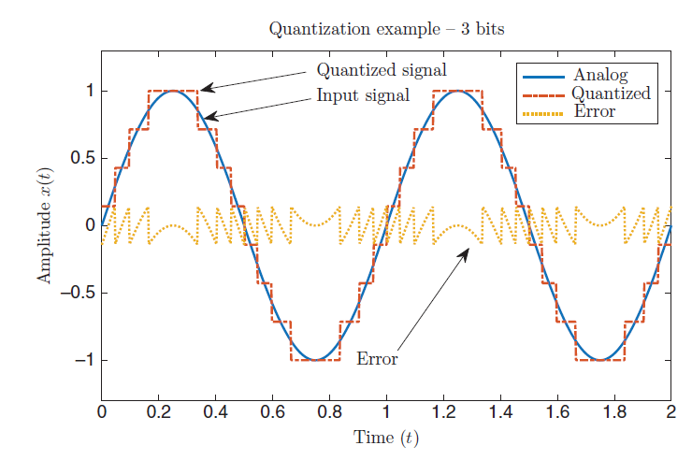
Scalar quantization

Slide 9
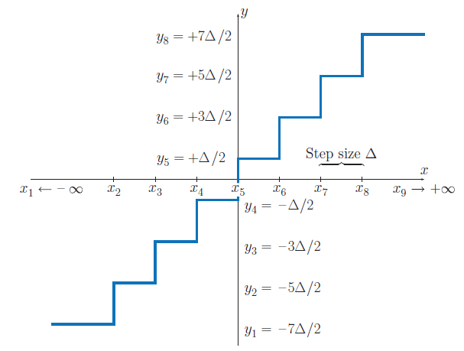

Slide 10

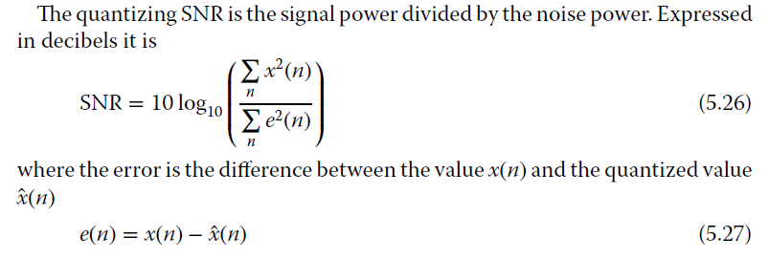

Step size

Slide 11
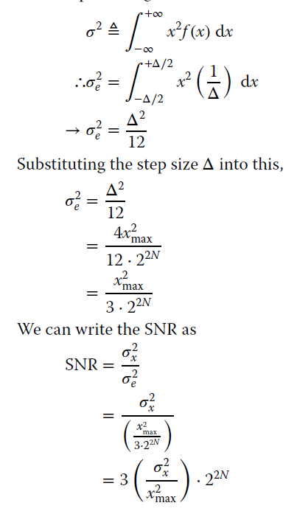
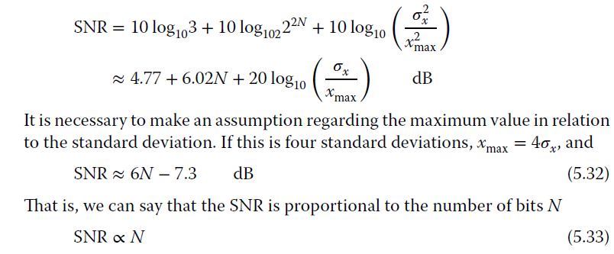

Slide 12
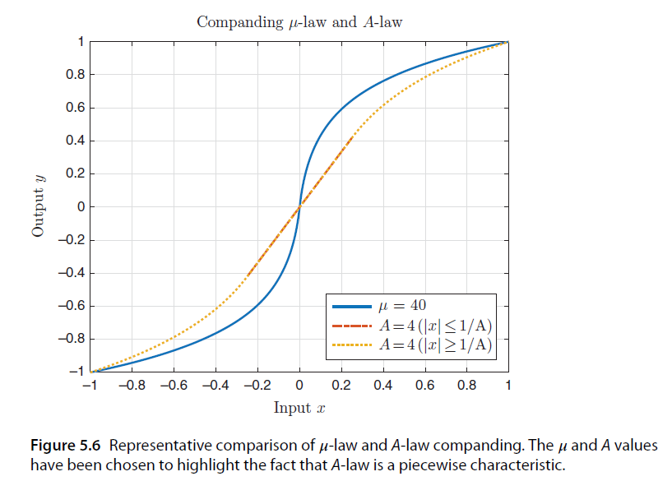
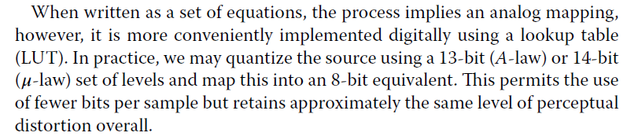
Companding
“weak sounds required more delicate treatment than strong”

Slide 13
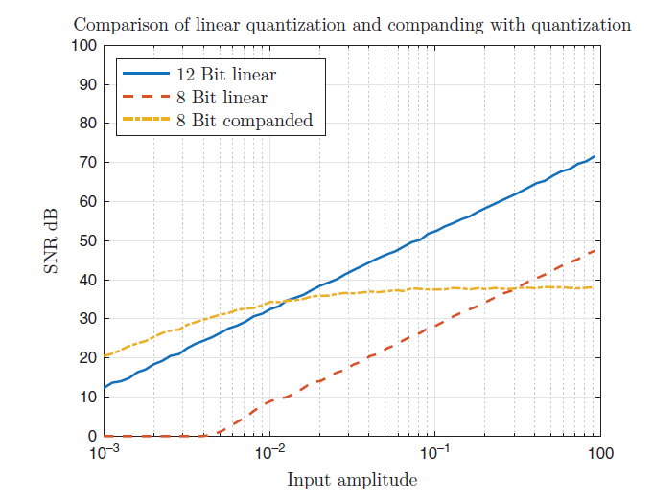
8-bit μ-law

Slide 14
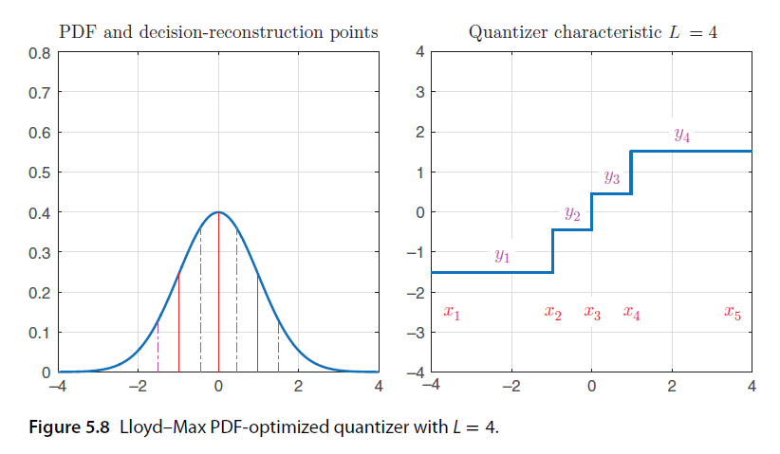
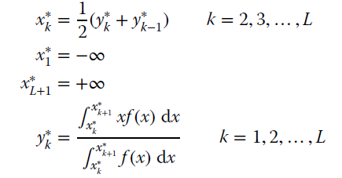
Lloyd-Max algorithm

Slide 15
Adaptive scalar quantization
When the encoder is operating, it always uses the same decision points and reconstruction levels. However, speech and audio signals are not stationary – they change over time.

