Slide 1
Chapter 2
Wired, Wireless and Optical Systems
2.1 ~ 2.3

Slide 2
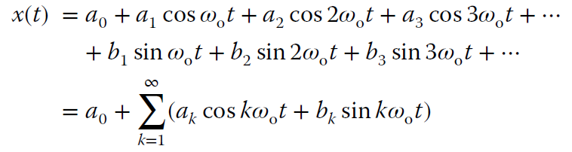

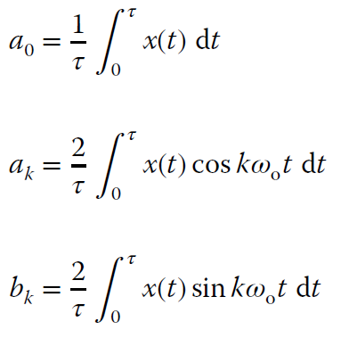


1 Periodic signal and Fourier Series
a waveform repeats over a time interval 𝜏, called the waveform period.
A sum of weighted sine waves
A sum of weighted cosine waves
A constant or DC offset

Slide 3
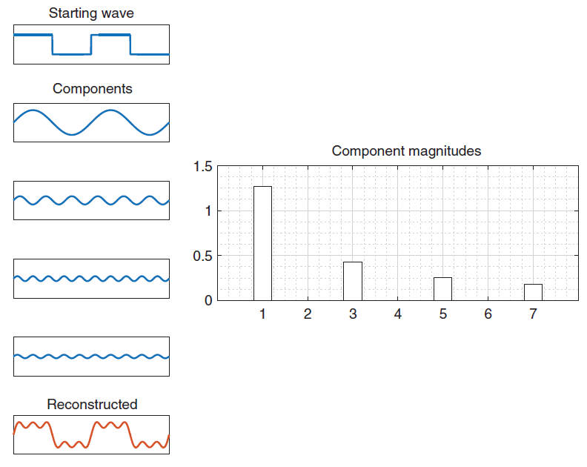
A example of square pulse waveform
Fundamental wave
(first harmonic)
Harmonic wave

Slide 4

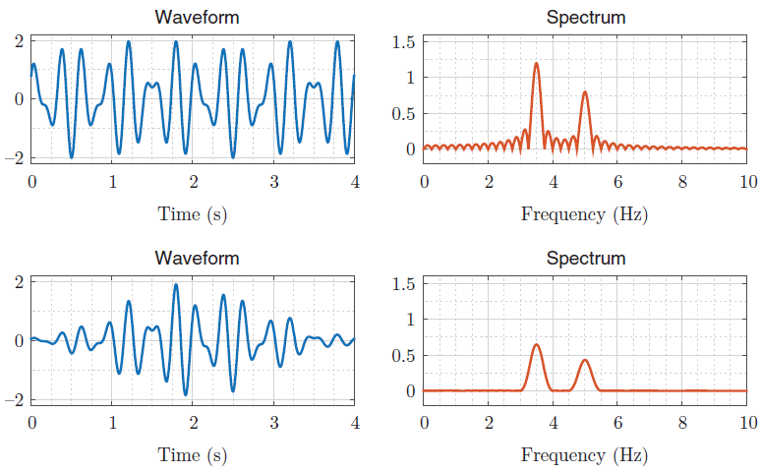
2 Nonperiodic signal and Fourier Transform
Remember that
Then we have the definition of Fourier transform presented as

Slide 5
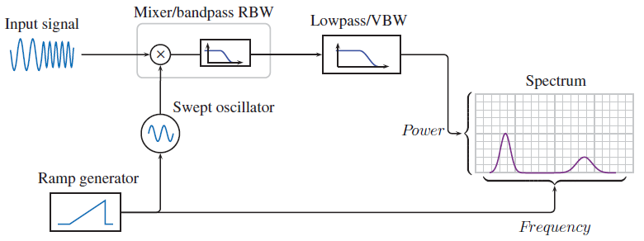
3 Spectrum analyzer
Resolution bandwidth (RBW)
Video bandwidth (VBW)
Smooth the waveform and attenuate phase noise
Averaging traces have a similar effect
Sweep time
Shape factor
Local oscillator (LO)
The resolution bandwidth (RBW) filter is swept over the desired range and is implemented as a mixer (multiplier and
bandpass filter). The video bandwidth (VBW) filter serves to smooth out the resulting display.
Radio frequency (RF)
Intermediate frequency (IF)

Slide 6
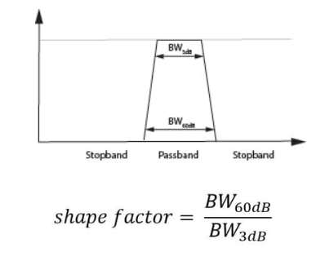
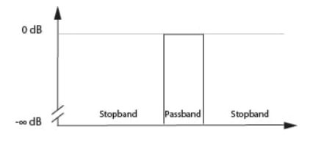
An ideal filter

Slide 7
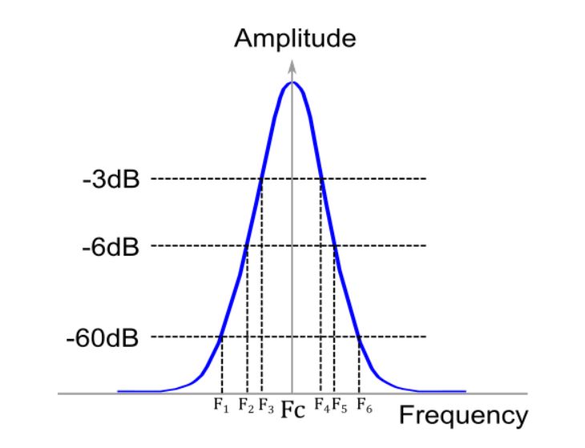
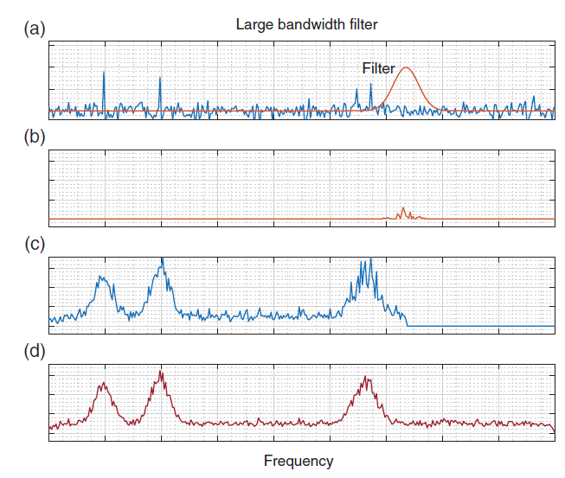
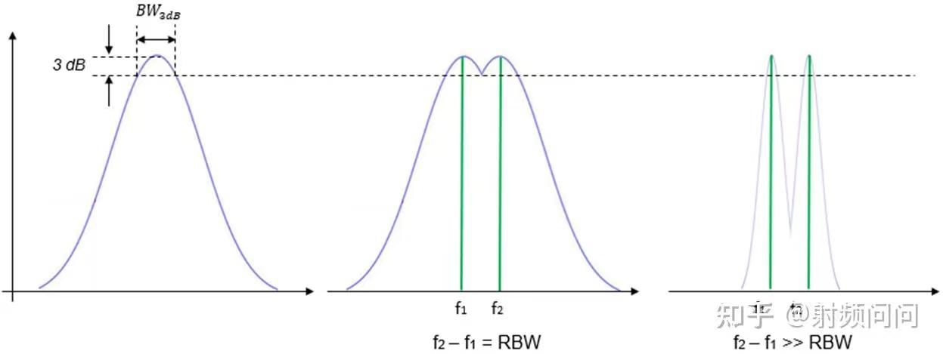

Slide 8
