Slide 1
Data transmission and integrity
6.1 – 6.5

Slide 2
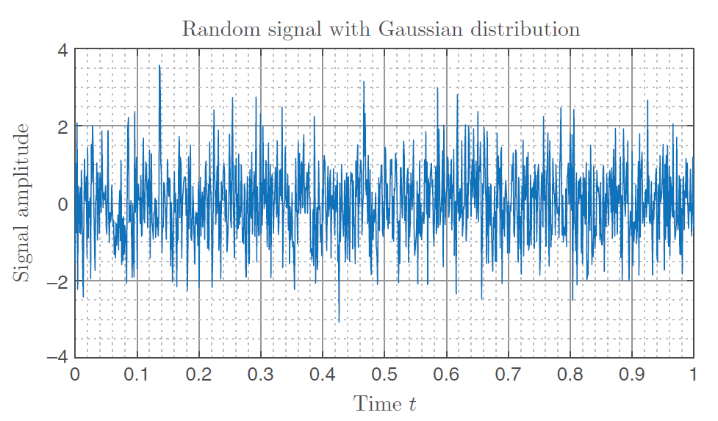
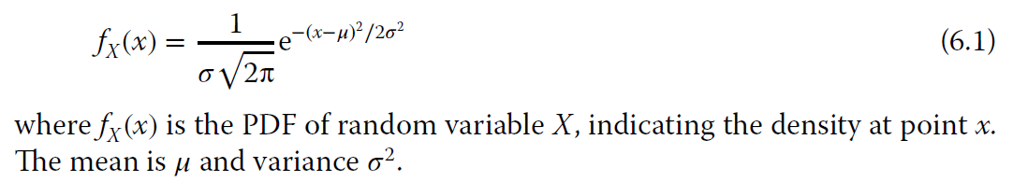
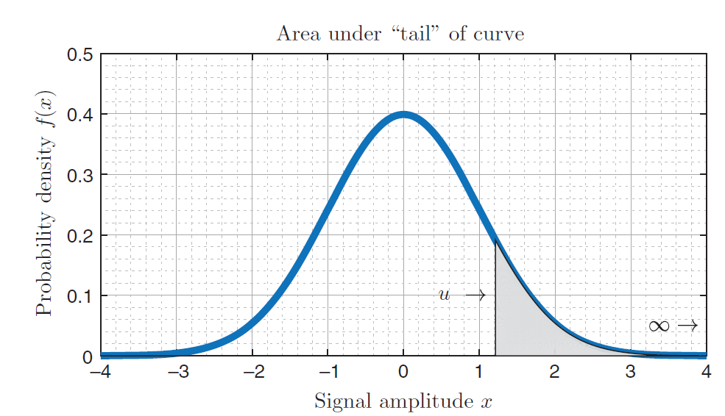

Slide 3
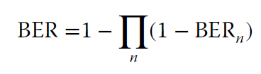
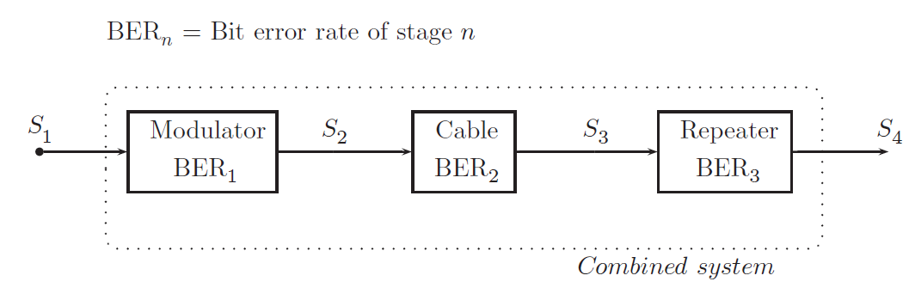

Slide 4
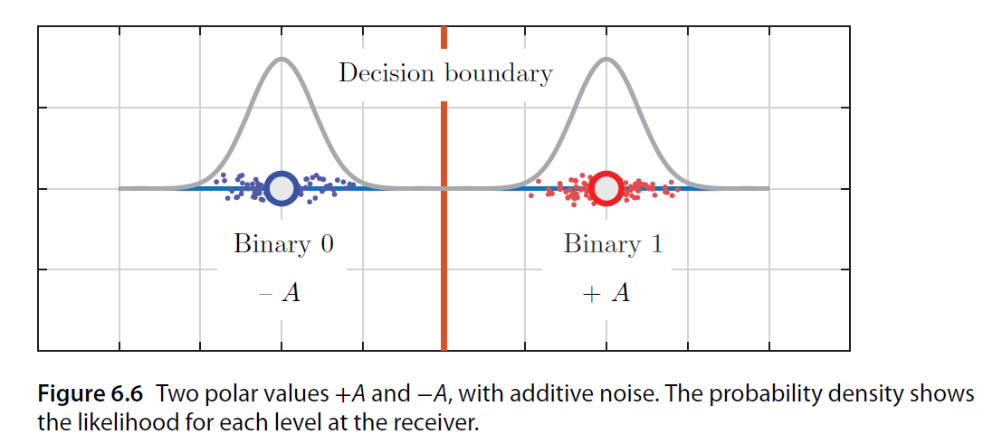
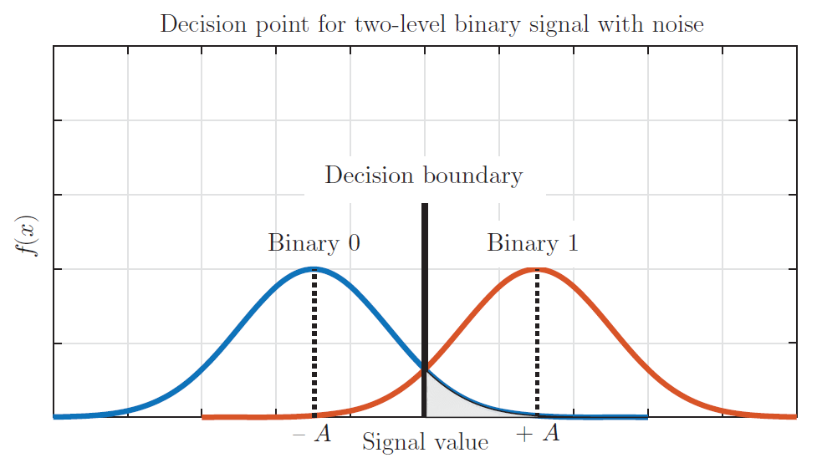

Slide 5
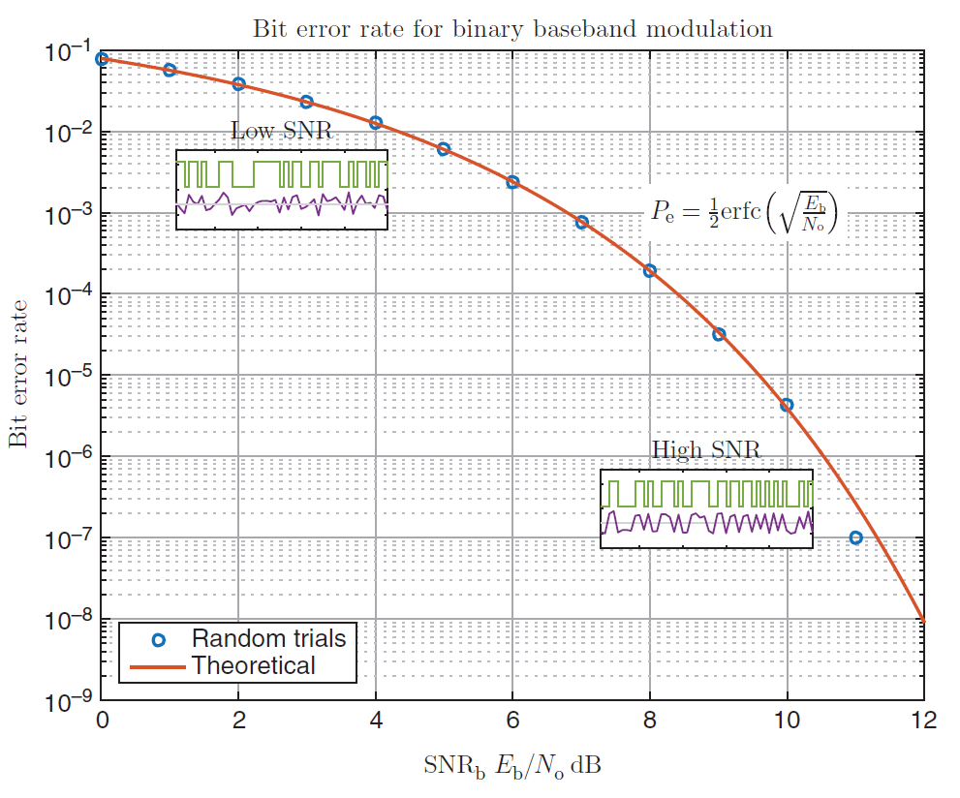

Slide 6
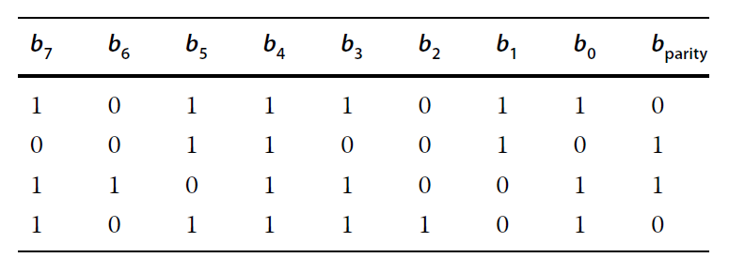
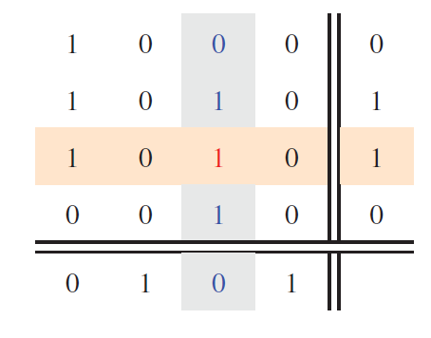

Slide 7
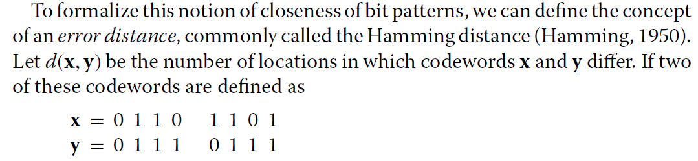



Detect d errors
correct d errors

Slide 8
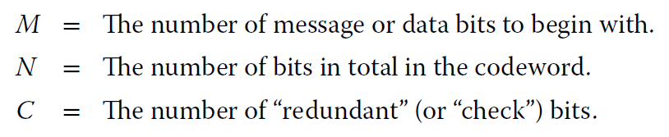
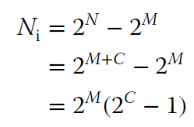
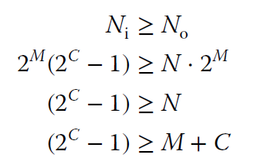

In order to detect and correct single-bit errors, the number of invalid codewords, which we derived as Ni = 2M(2C − 1), must be greater than (or at the very least, equal to) the number of single-bit errors. The latter was derived to be No = N ⋅ 2M.
Thus the condition is

Slide 9
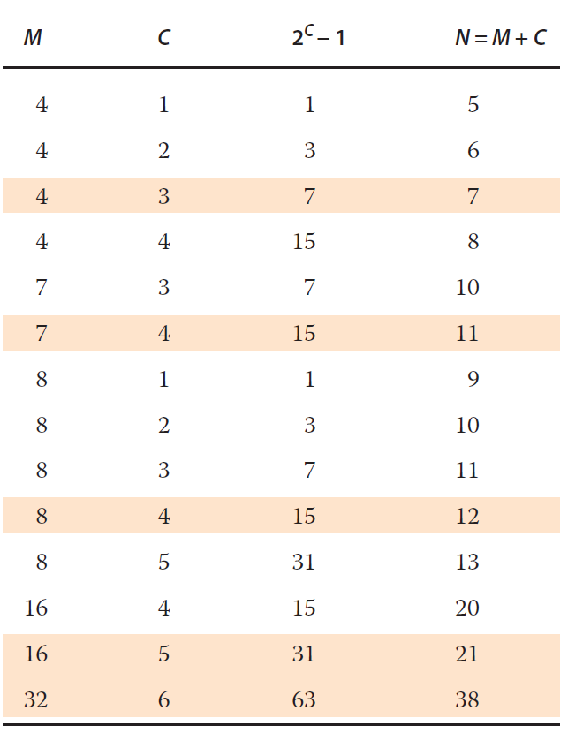

Slide 10

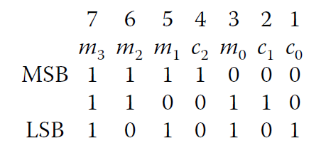
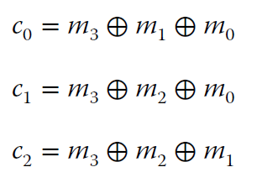

Slide 11
Checksum
The core idea of the checksum is to partition the data into a convenient size such as 8-bit bytes or 16-bit words. The data is then treated as a sequence of integers, and a summation formed.
One approach is simply to discard the overflow; for 8-bit accumulation of the sum, this is effectively a modulo-256 summation. A second, improved approach is to wrap the overflow around and add it back in to the checksum. This is termed an end-around carry.
For example, suppose we add the hexadecimal values E7 and 46. The result is 012D, which is clearly greater than can be contained in an 8-bit accumulator. End-around carry simply takes the overflow of 01 and adds it to the value 2D

Slide 12
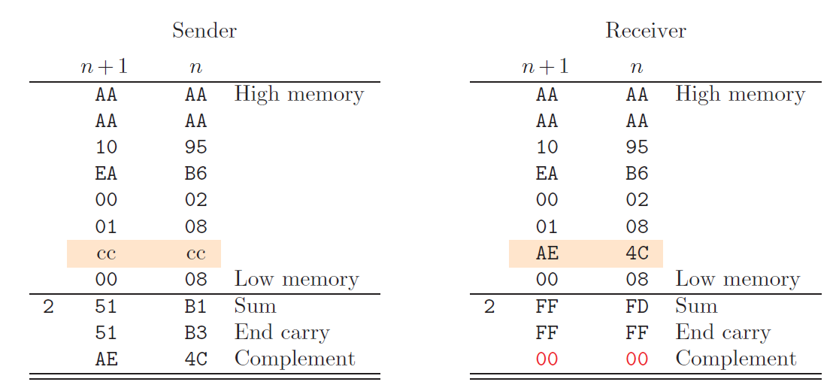

Slide 13
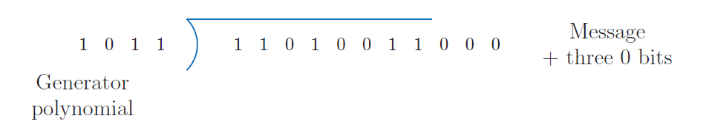
Generally speaking, checksums are more suited to software computation, whereas CRCs are more suited to calculation via hardware. Whereas the checksum is computed with addition operations, the CRC may be computed using shift registers and XOR gates.

Slide 14
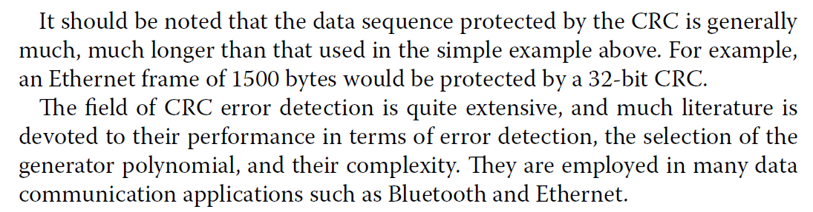

Slide 15
convolutional coding
The class of error detection and correction termed convolutional coding adopts a different approach. Essentially, the raw data itself is not sent. Rather, a sequence of check symbols is sent (the codewords), from which both error checking information and the original data may be determined.

Slide 16
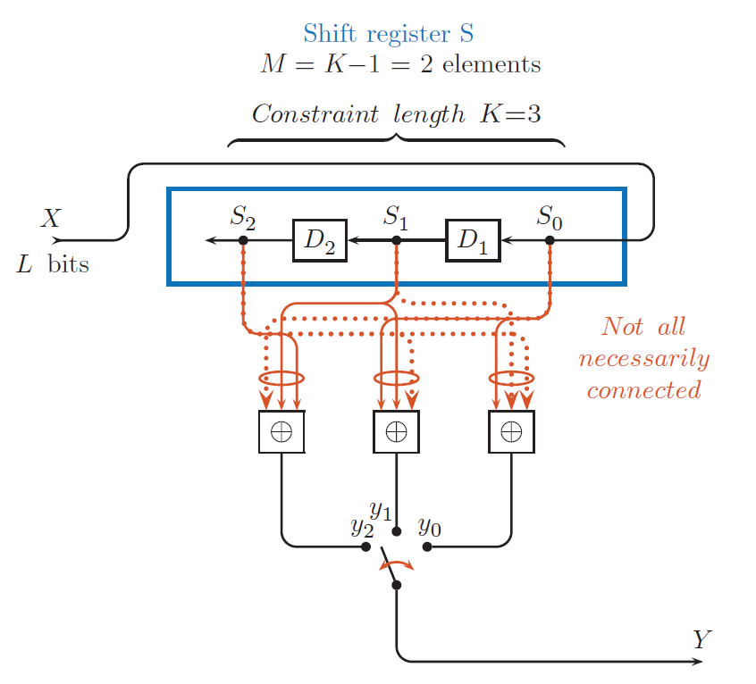

Slide 17
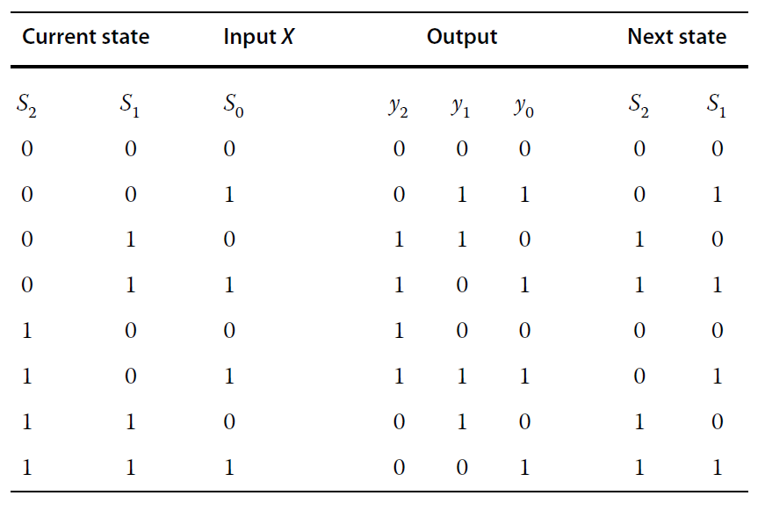

Slide 18
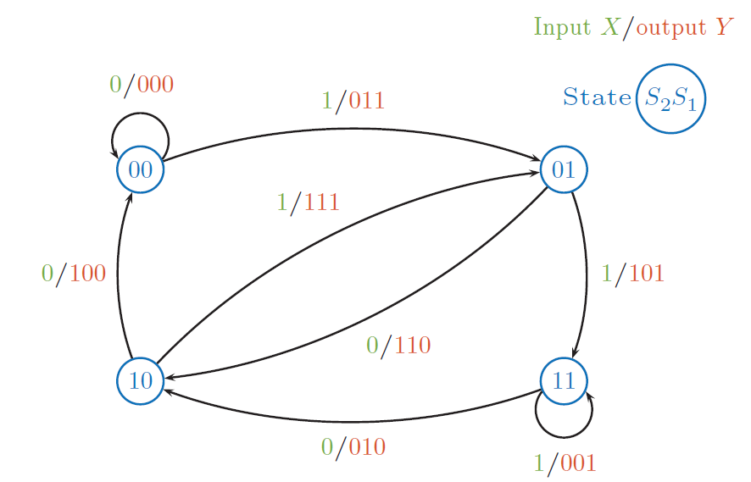

Slide 19
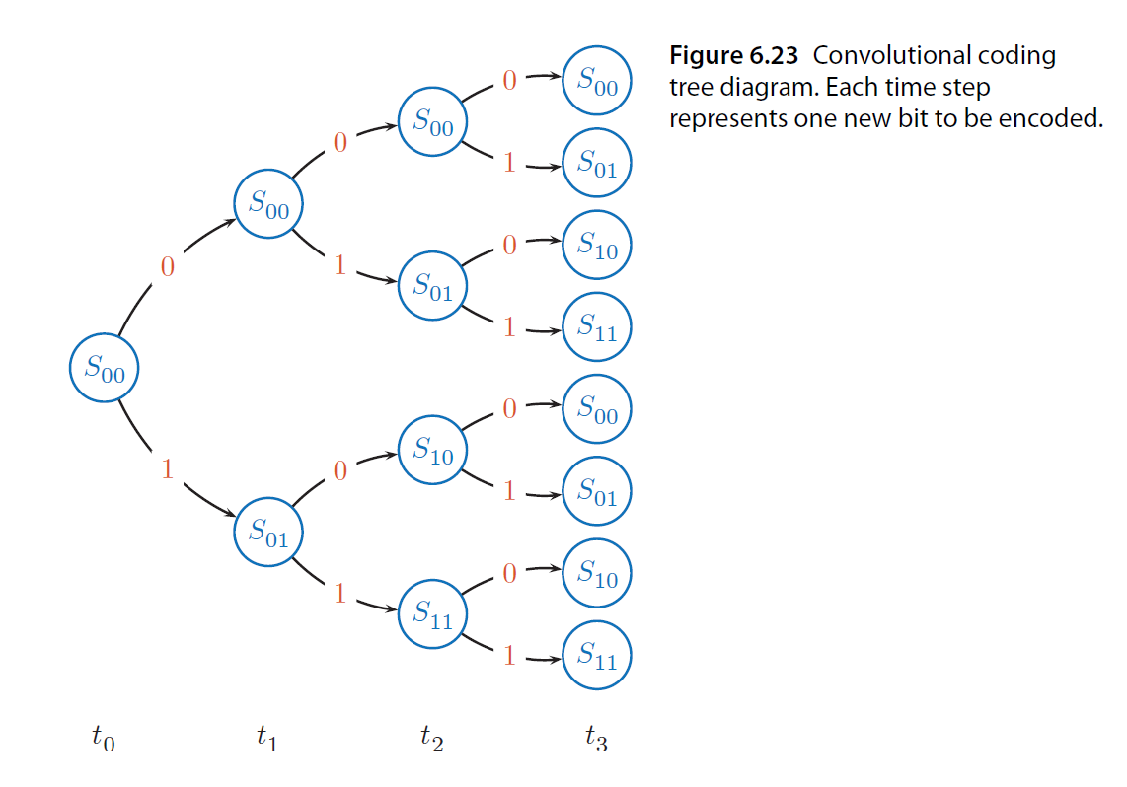

Slide 20
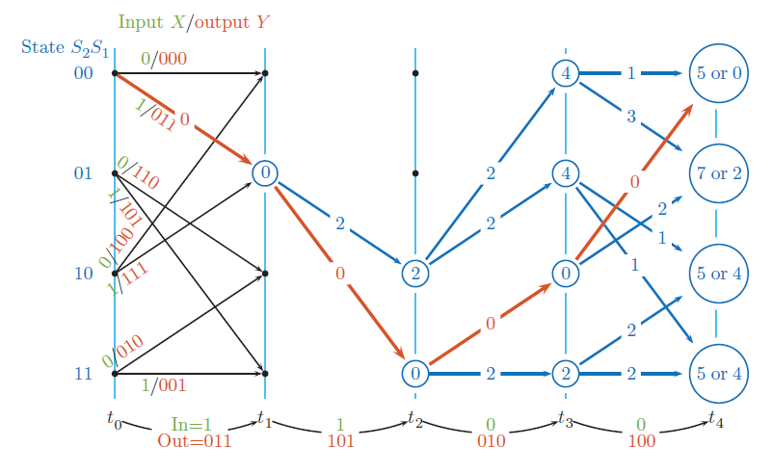

Slide 21
