Slide 1
3 Modulation and demodulation
Radio frequency carrier
Medium frequency signal
AM
FM
PM
Modulated signal
Preliminaries:
Trigonometry
Complex numbers

Slide 2

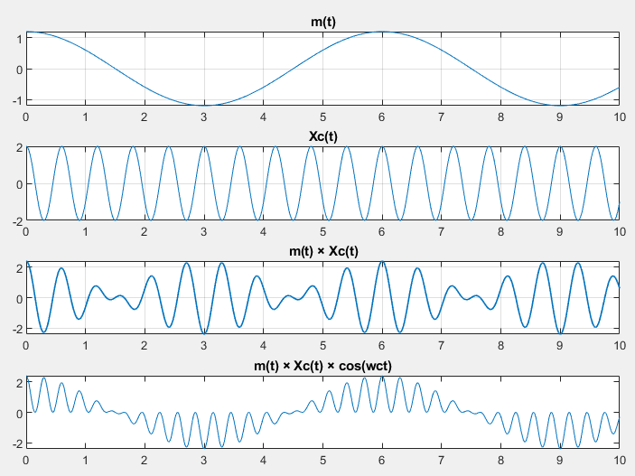

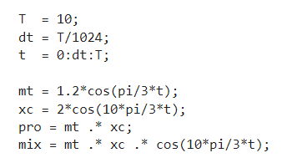

Slide 3


Amplitude Modulation

Slide 4
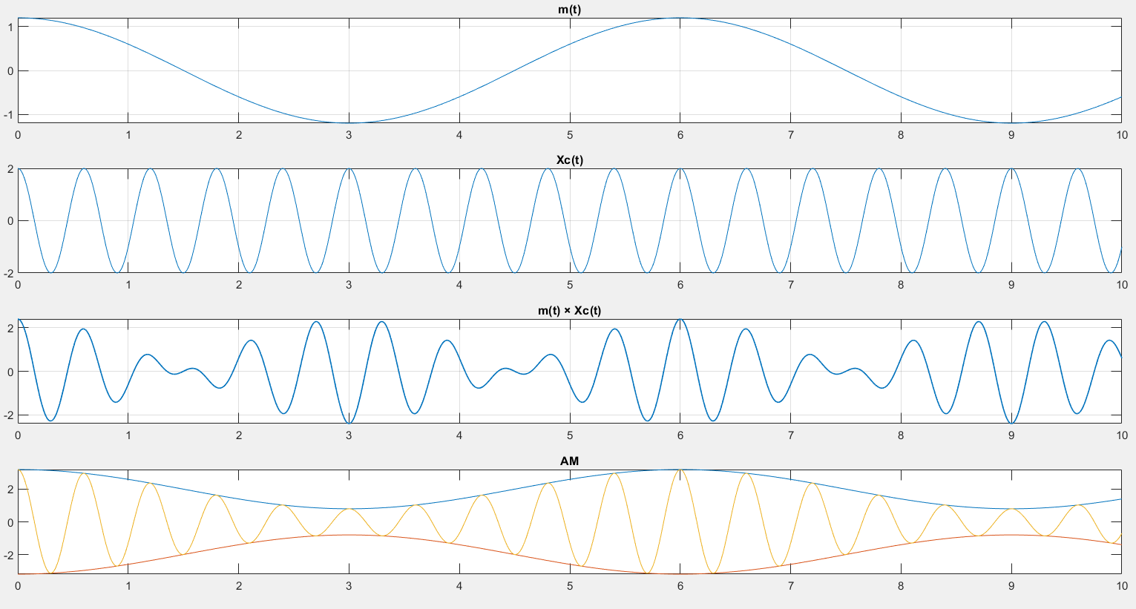

Slide 5

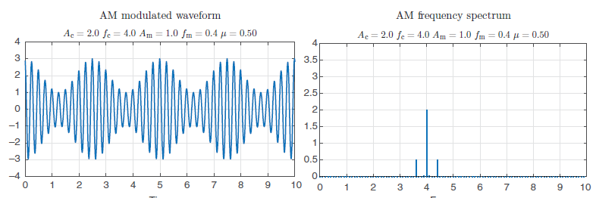

Slide 6

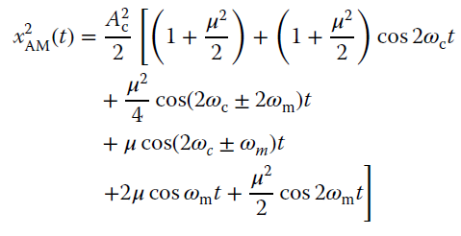

Slide 7

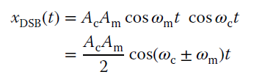
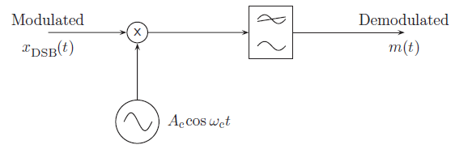

Slide 8
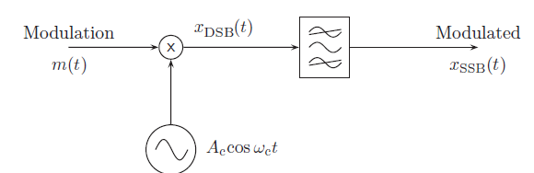
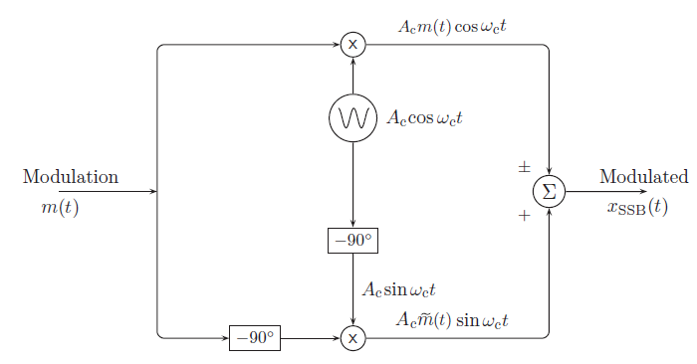
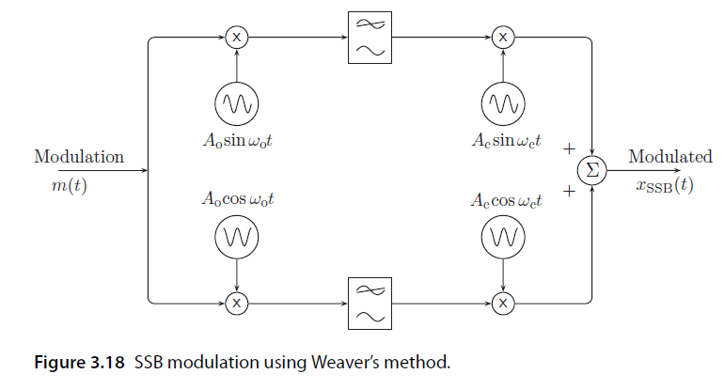

Slide 9



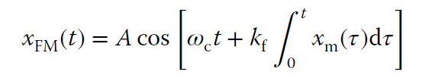

Slide 10
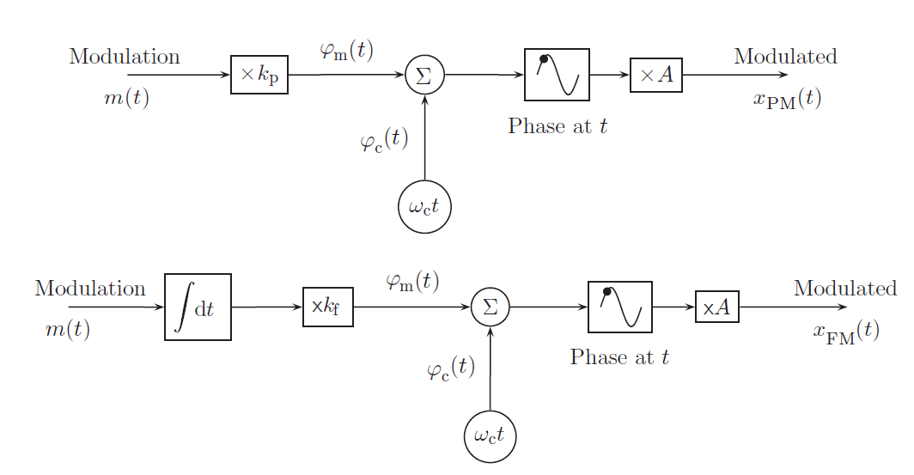

Slide 11
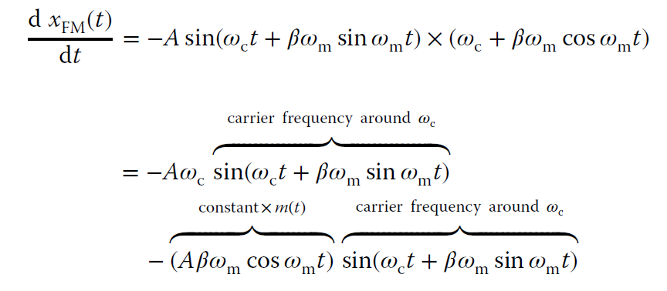
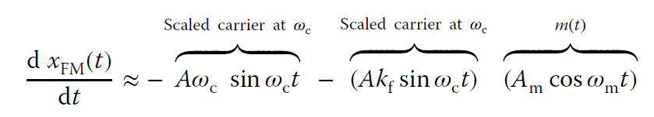
Wc >> Wm

Slide 12
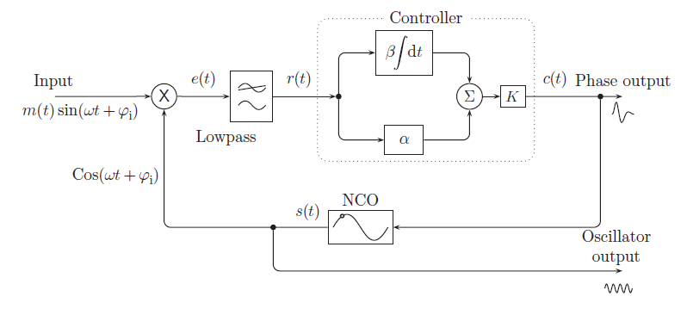

Slide 14
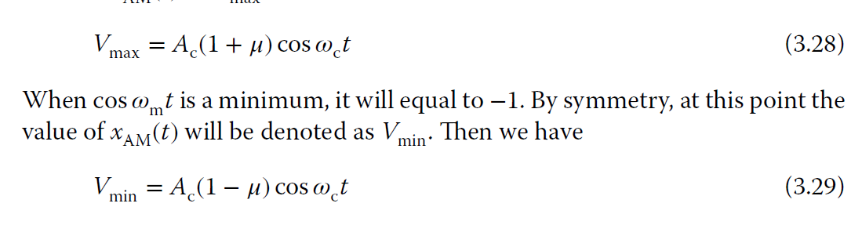
3.2

Slide 15
3.3
sin(x)sin(y) = (1/2)[cos(x - y) - cos(x + y)]
s(t) = cos(ωc * t) * m(t) + Ac*cos(wc*t)
= cos(ωc * t) * Am * cos(ωm * t)
= Am/2 * [cos((ωc - ωm) * t) + cos((ωc + ωm) * t)]

Slide 16
3.4
Pc = Ac^2 / 2
Ps = Am^2 / 8
Total Power
= Pc+ 2 * Ps
= (Ac^2)/2 + 2 * (Am^2)/8
= (Ac^2)/2 + (Am^2)/4
= (Ac^2 + Am^2/2)/2
= (Ac^2 + (μ*Ac)^2/2)/2
= Ac^2/2 * (1 + μ^2/2)
= Pc * (1 + μ^2/2)

