Slide 1
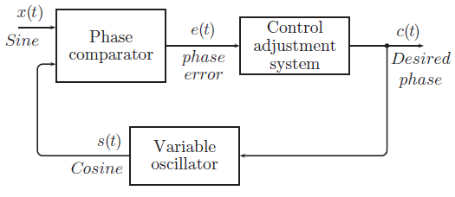
PLL Phase-Locked Loop
The phase comparator determines how close the waveforms are and guides the oscillator via the controller to either increase or decrease its frequency so as to more closely align the timing (or phase) with the incoming waveform.

Slide 2
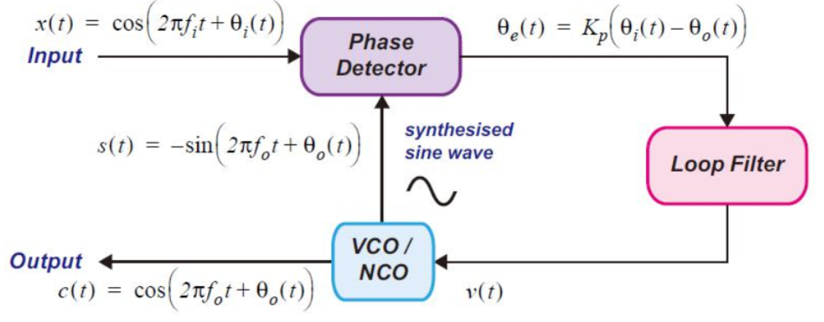
A More Detailed Example
图源：(49条消息) 数字信号处理基础----PLL_pll结构_black_pigeon的博客-CSDN博客
鉴相器
环路滤波器
数控振荡器

Slide 3
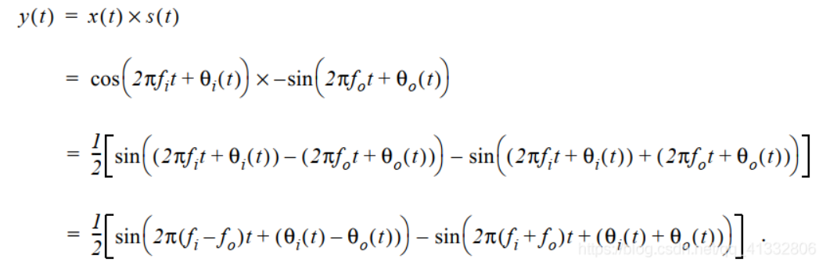
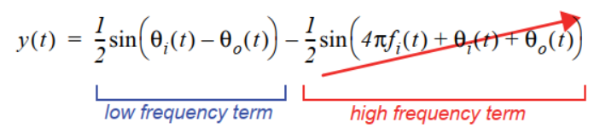

图源：(49条消息) 数字信号处理基础----PLL_pll结构_black_pigeon的博客-CSDN博客
Considering that fi will finally equal to fo
When x is small, sinx ≈ x

Slide 4
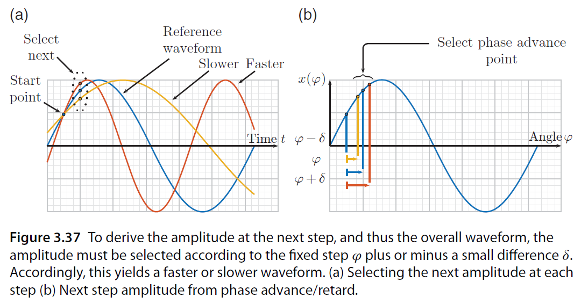
NCO Numerically Controlled Oscillator

Slide 5
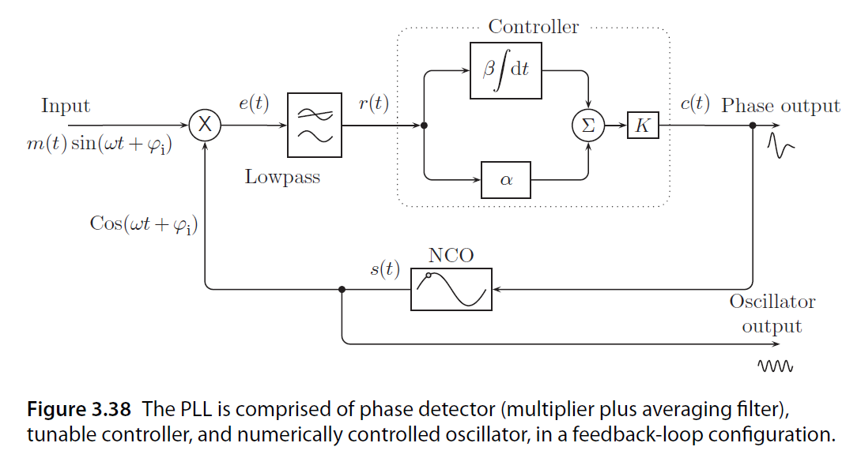
The constant 𝛼 is just a multiplier, and in simple terms controls how fast the loop reaches steady-state synchronization. The value of 𝛽 controls how much of the cumulative error is introduced , thus tending to increase or decrease the oscillator drive signal. A constant multiplier K is also included for convenience. Tuning K, 𝛼, and 𝛽 then controls the response of the PLL to changes in the input frequency and/or phase.

