Slide 1


3 modulation and demodulation

Slide 2
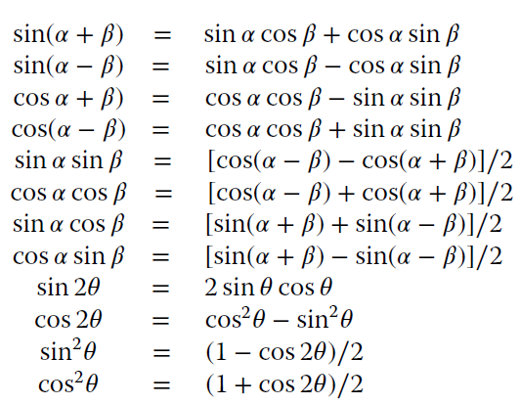
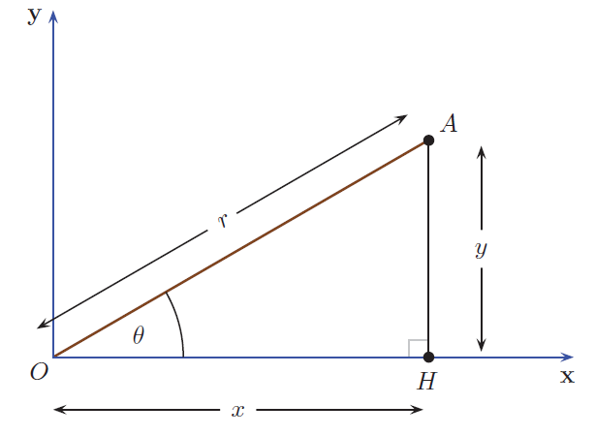
3.3 useful preliminaries

Slide 3
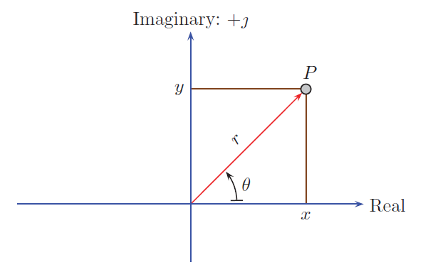
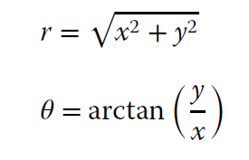

3.3.2 complex numbers

Slide 4
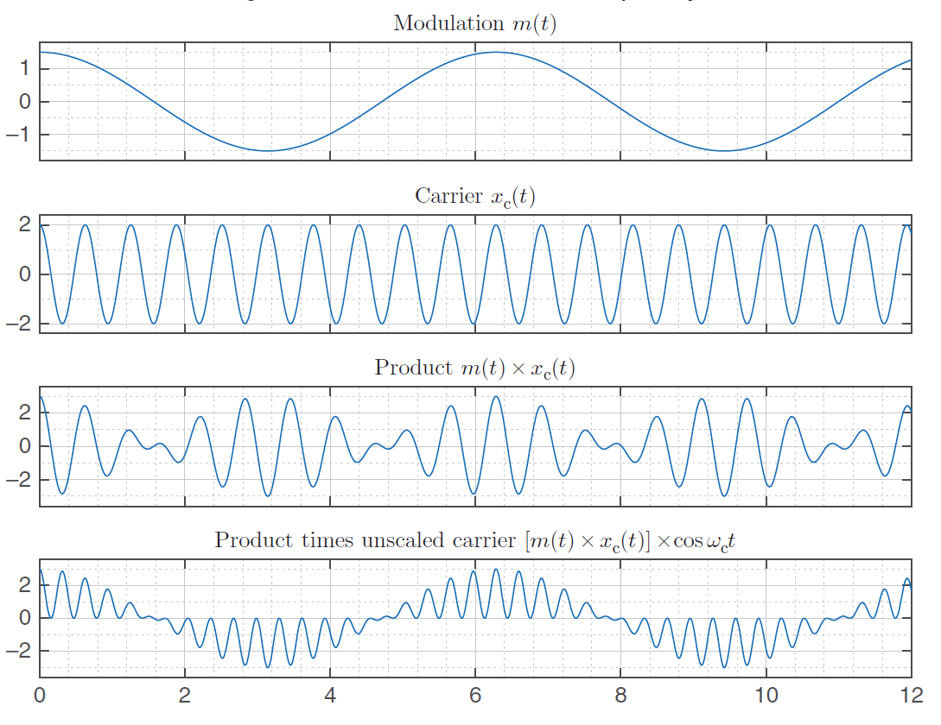


3.4 the need for modulation

Slide 5
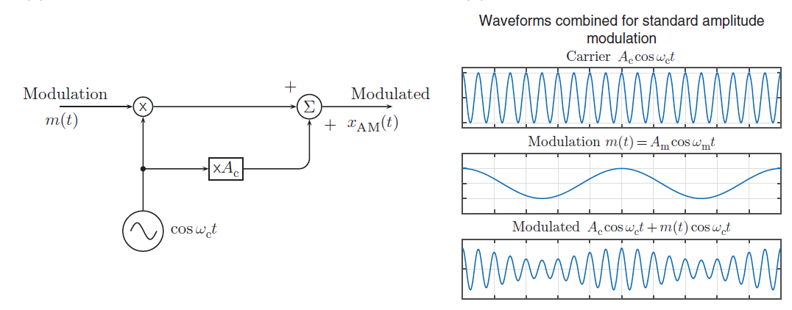

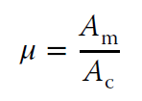
3.5 amplitude modulation
Modulation index

Slide 6
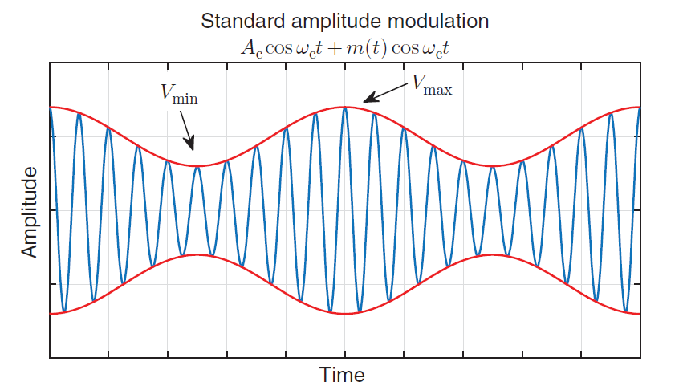



Slide 7




Slide 8
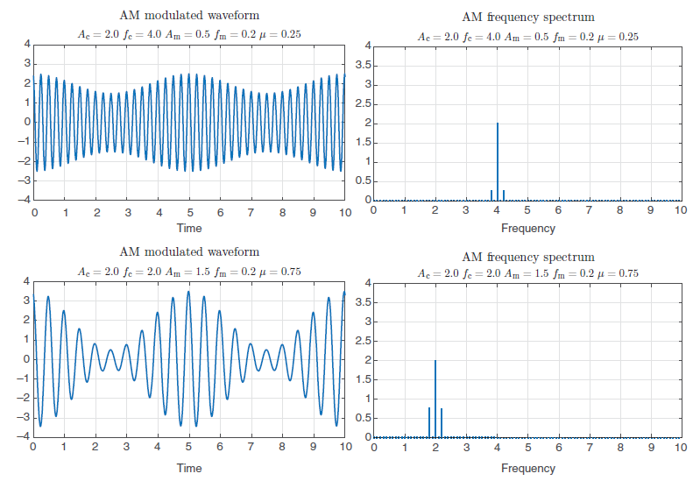

Slide 9
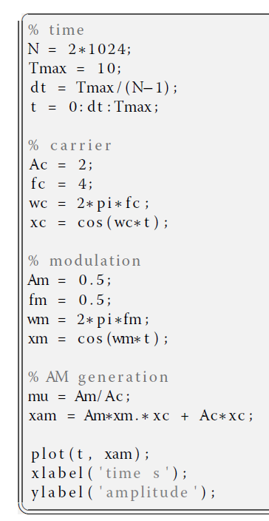

Slide 10
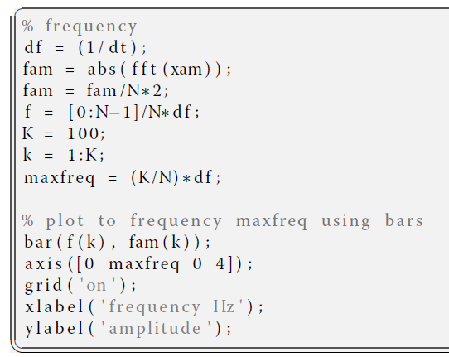

Slide 11
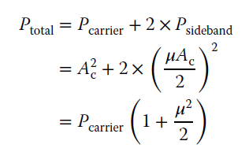
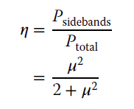
3.5.2 power analysis

Slide 12


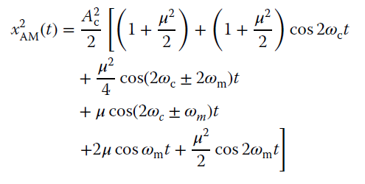


3.5.3 AM demodulation
3.27
？？？

Slide 13



3.5.4 variations of AM
If we omitted the carrier altogether, the result is double-sideband AM (DSB-AM) (usually just referred to as DSB). This is simply a matter of just multiplying the modulating signal by the carrier.

Slide 14



Slide 15
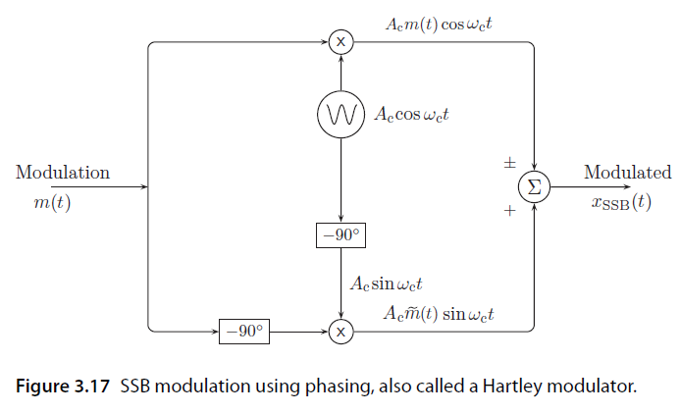





Slide 16
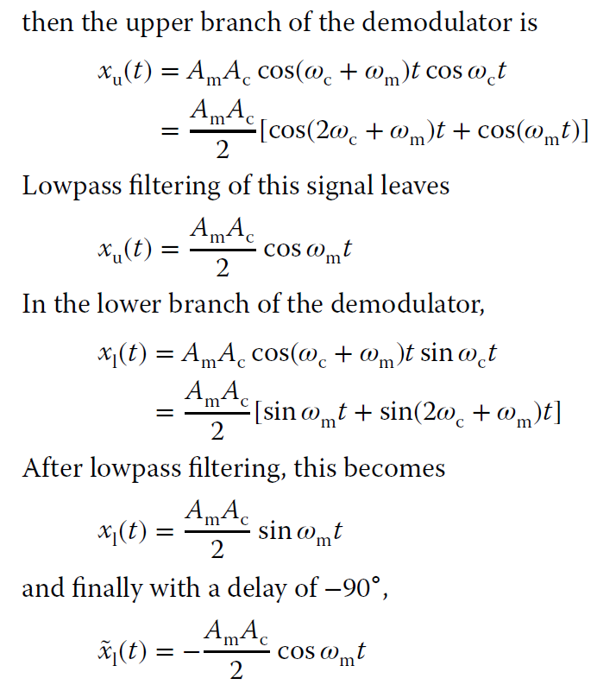
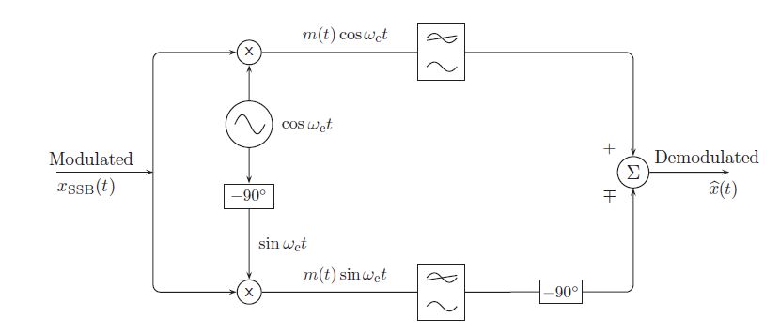

Slide 17
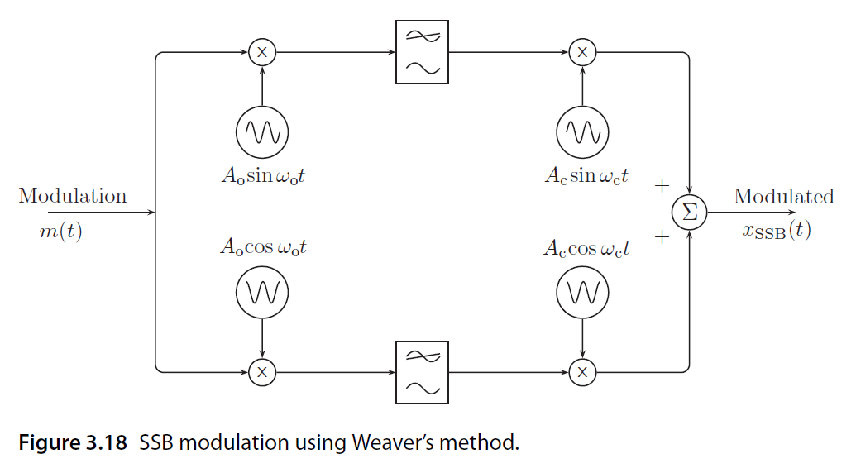
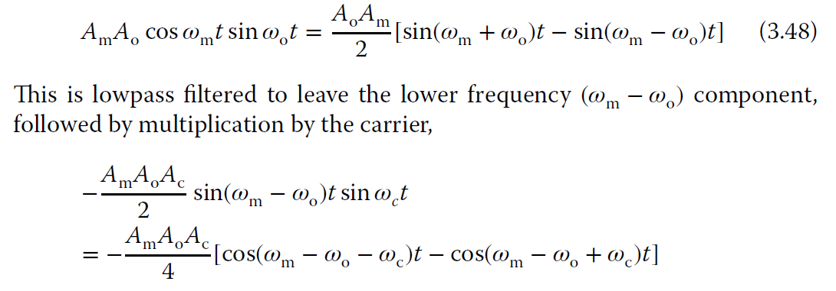
Upper path

Slide 18
