Slide 1
3.6 Frequency and phase modulation
3.6.1 – 3.6.4

Slide 2


3.6.1 FM and PM concepts
AM is susceptible to noise and power inefficient, but FM and PM have a better performance
Carrier wave:
phase angle

Slide 3
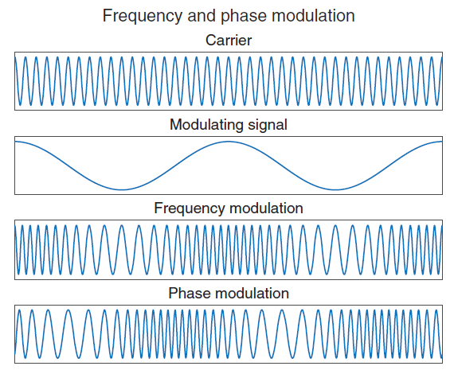
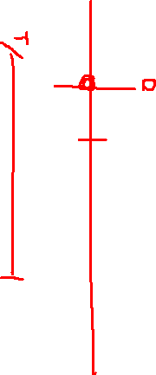

Slide 4



3.6.2 FM and PM analysis
Frequency (radians per second) is the rate change of phase (in radians)
FM and PM are closely related and are sometimes grouped under the heading of angle modulation

Slide 5



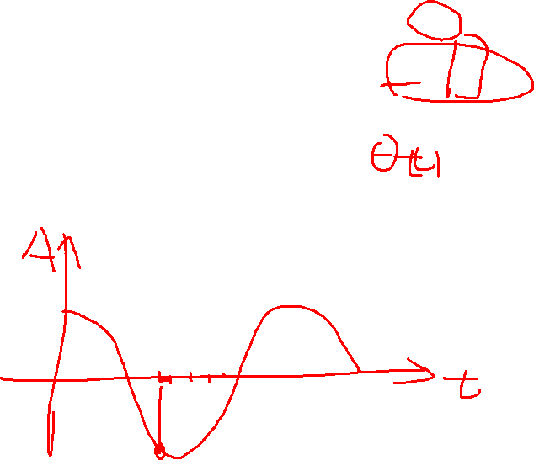
PM is just changing the phase term in response to the modulation voltage.

Slide 6

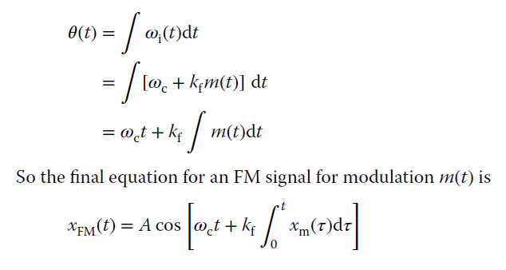
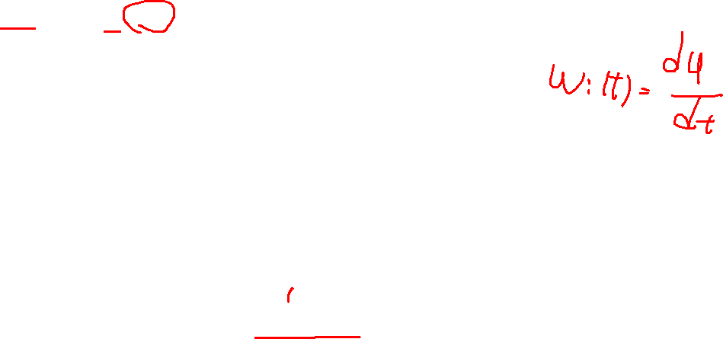

Slide 7
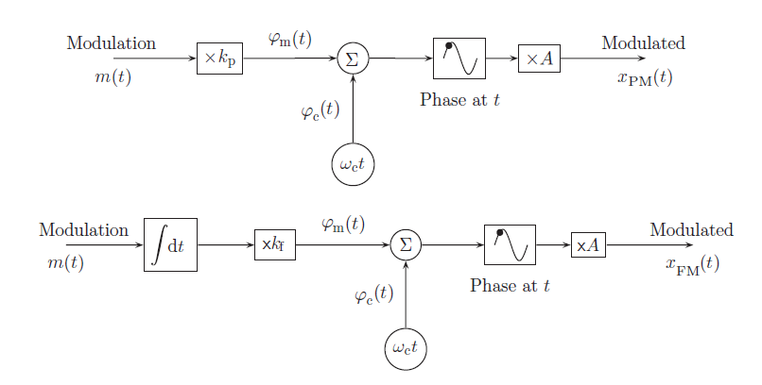
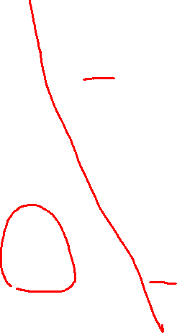

Slide 8
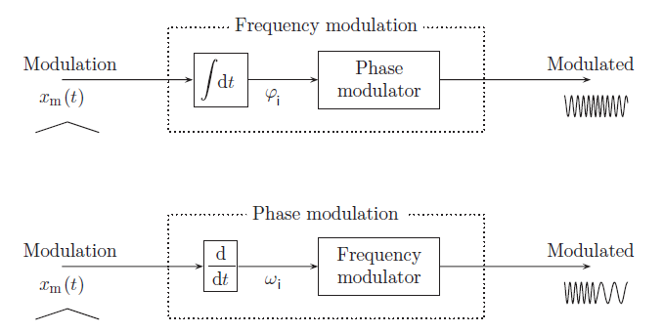
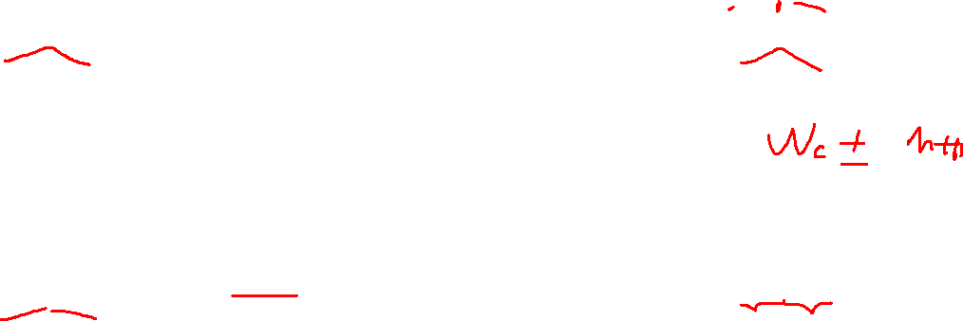
3.6.3 Generation of FM and PM signals

Slide 9
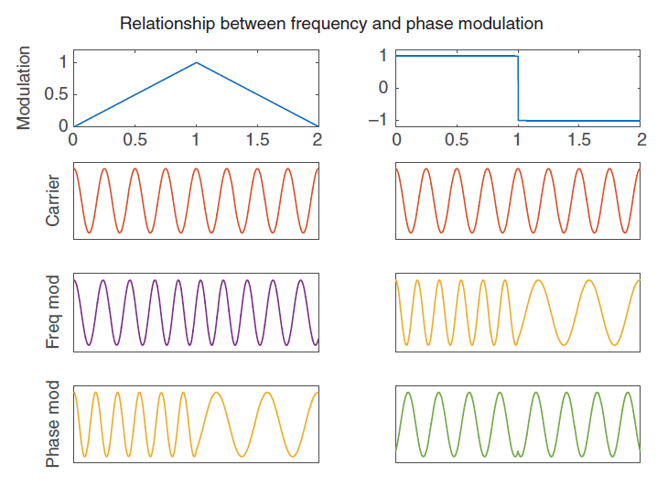
3.6.4 The spectrum of frequency modulation

Slide 10

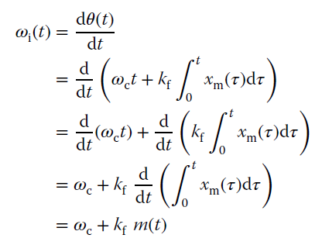



Slide 11

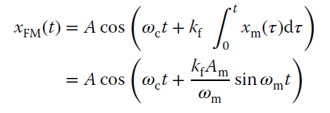





FM modulation index
(deviation ratio(DR))

Slide 12



Slide 13

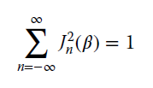
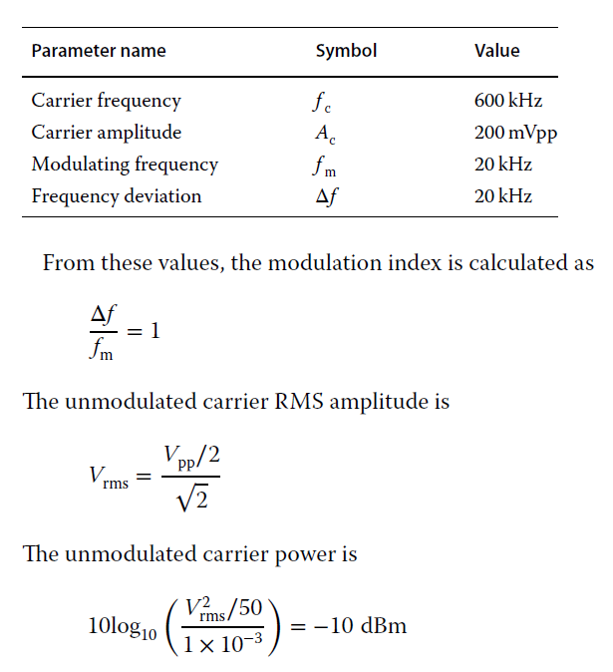
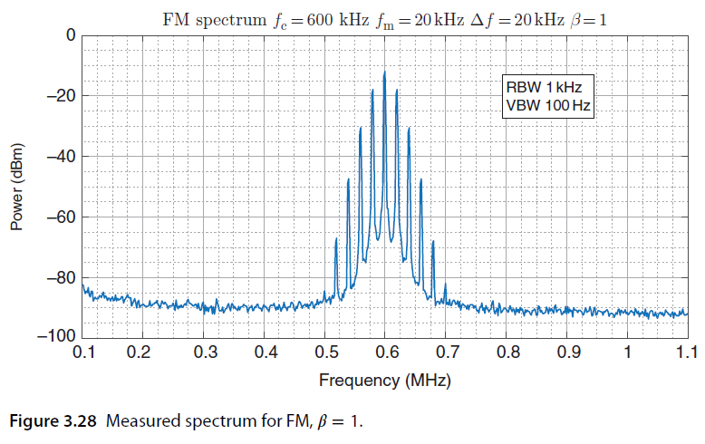
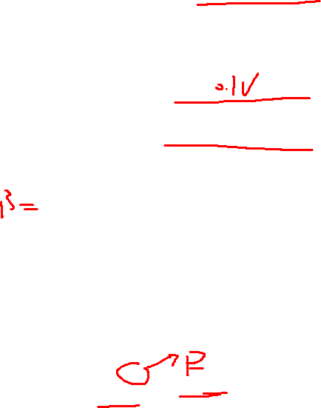

Slide 14
