Slide 1
Contents
What is an individual project?
What academic support are you given?
How did you decide on a project?
What is your project about?
What do you hope to achieve by the end?
Are there particular modules that have fed into your project?
How is it currently progressing?
What challenges are you facing?
What do you have to produce by the end?
If successful what impact could your project have?

Slide 2
Parallel Programming Tools for Exploring Immune System Development
OLIVER BINNS

Slide 3
Overview
Biological Background
Motivation
Solutions
Results
Notes:
PPSim is an existing simulation that was created to explore the development of clusters of lymphoid cells in the gut.
Aim to make it run faster using parallelism
… 3 months to run
Down to 5.4 hours
In depth programming project

Slide 4
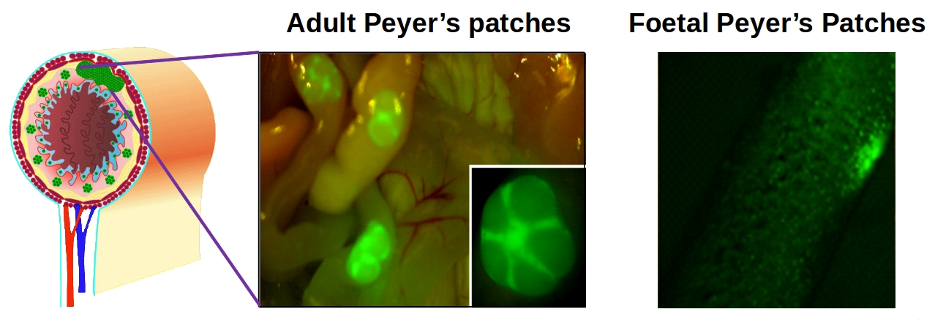
What is it about?
PPSim
ABM simulation
94.265s per execution
585,000 executions required
Notes:
PPSim is an existing simulation that was created to explore the development of clusters of lymphoid cells in the gut.
This is an inconvenient amount of time, even when run on a HPC.
Meant my supervisor Kieran had to wait 3 months for his results.. Play video games?
Get to the end and find a bug?
Run again?

Slide 5

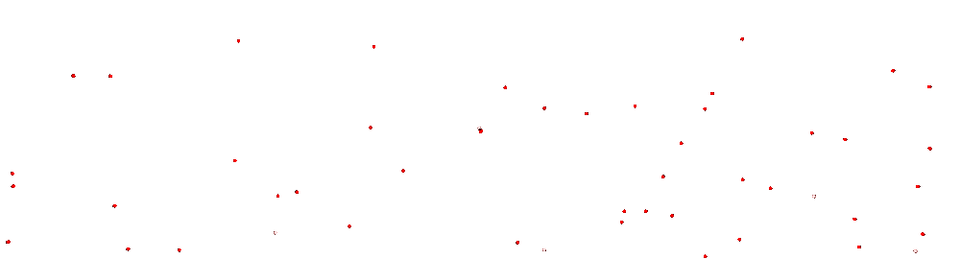
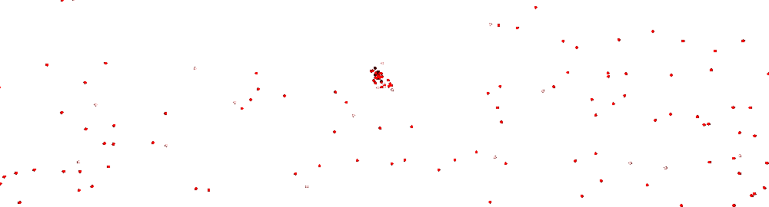
Visualisation
Notes:
Three types of cell- (agents)
Static LTo
LTi + LTin begin migration in
LTin activates LTo
LTo emits chemokines- a chemical which the LTi responds to
LTi begin to move towards LTo
Patch is formed!

Slide 6

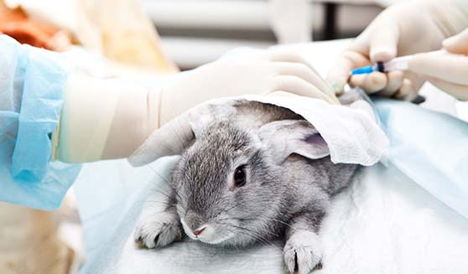
Motivation
Short Term
Simulations used for novel biological findings
Long Term
$2.5bn R&D cost per drug *
3Rs: Animal Testing
* : J. DiMasi et al, 2016
Notes:
Obviously there’s a lot of scope within biology for simulations to help with testing.
So far it’s been used to gain a greater understanding of Peyer’s Patch formation.
Further understanding means we could trigger a faster immune response to pathogens
Impact of work has gone to three pharmaceutical firms and one cosmetic firm

Slide 7
Problems?
Too Slow!
Shortage of Computer Scientists
Efficient Parallel Programming is HARD.
Notes:
PPSim is an existing simulation that was created to explore the development of clusters of lymphoid cells in the gut.
Aim to make it run faster using parallelism
… 3 months to run
Down to 5.4 hours
In depth programming project

Slide 8
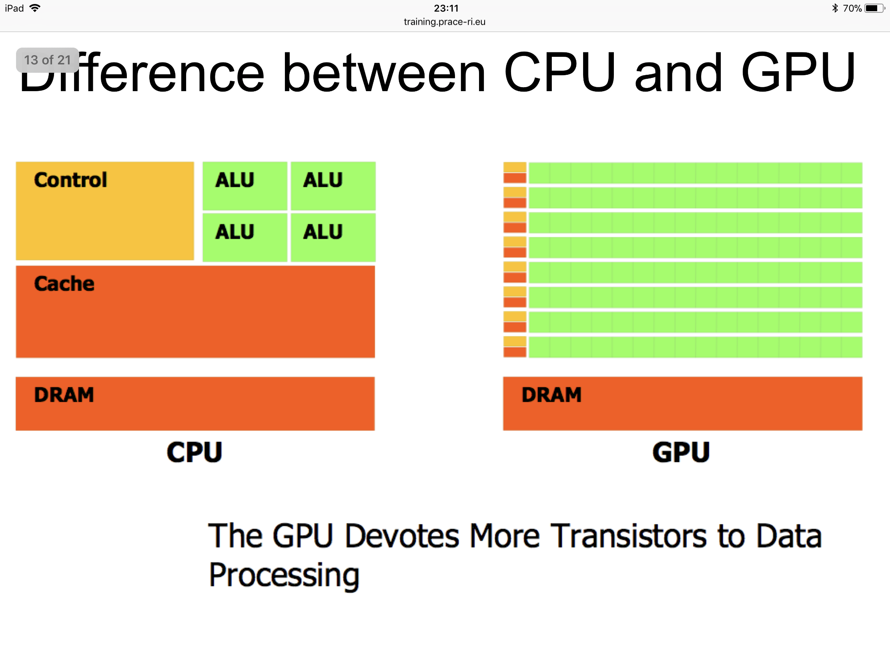
Program Parallelisation
CPU
GPU
4+ Cores
2500+ Cores
Notes:
Agent-Based Modelling lends well to parallelism because each agent runs autonomously *except for* interaction.
Central Processing Unit: Instruction Parallel
Graphic Processing Unit: Highly Data Parallel
CPU can handle different tasks at once
GPU can go through sheer quantity of numbers, particularly in matrix form, performing the same operation

Slide 9

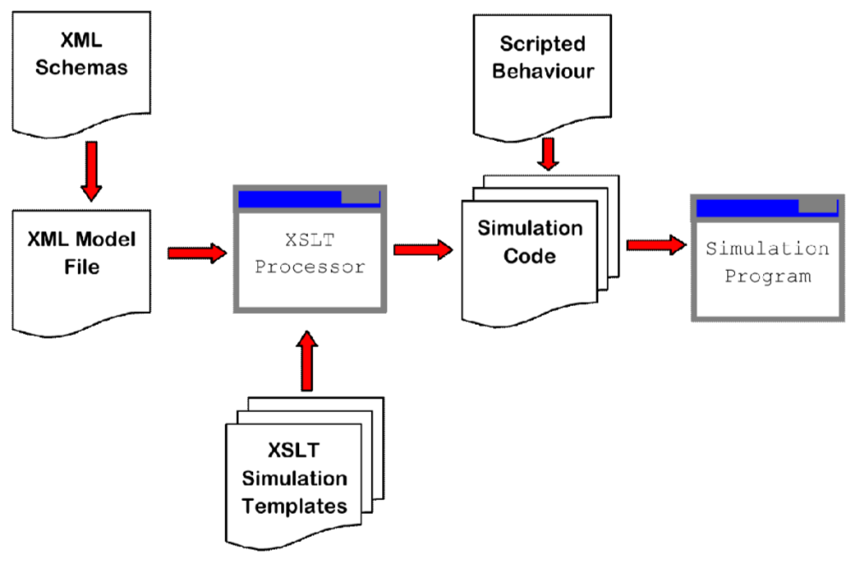
Behaviour
Fits project goals:
Speed Up *
Ease-of-Creation (Easier?)
Structure
* : P. Richmond and D. Romano, 2011
Notes:
Analysed a number of ABM frameworks
Speed Up:
Has shown performance on Desktop, comparable to HPC like that used for PPSim
Ease of Creation: FLAME GPU manages cross-thread communication
Still requires a computer scientist
Model-Driven?
Can go further

Slide 10
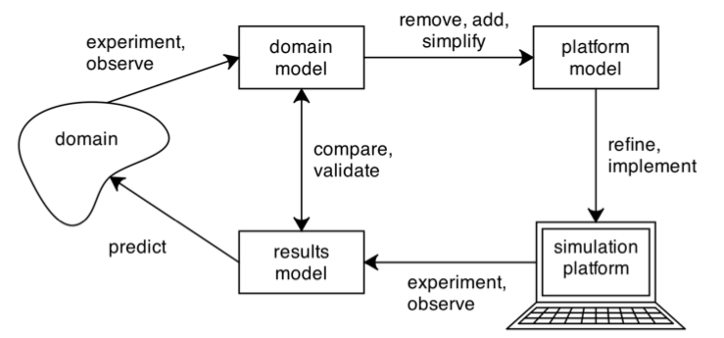
Modelling Process
*
+
autogenerate?
* : M. Read, 2011
Notes:
At the start of the project, we already HAD Domain + Platform Models
Talk through CoSMoS
This project I attempted to begin development on tools which autogenerate the simulation platform

Slide 11
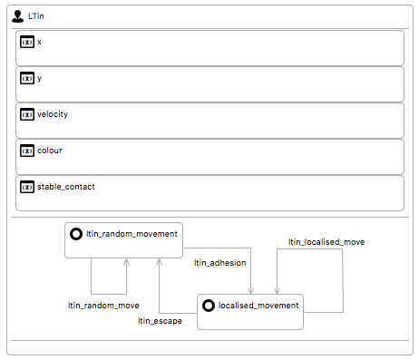
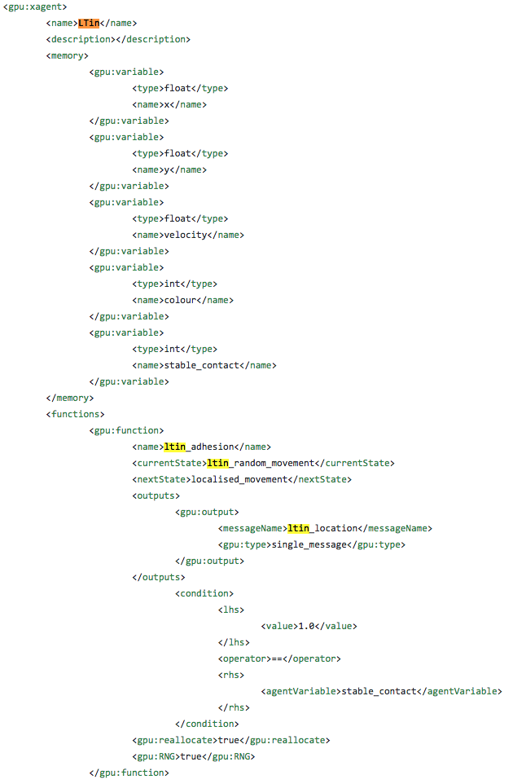
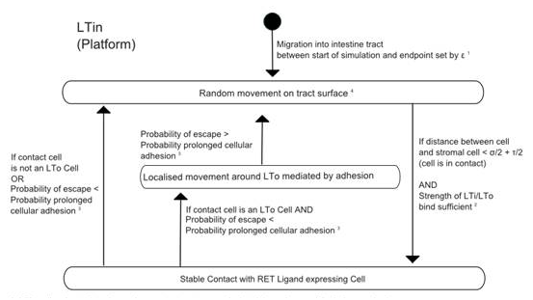
Results
Ease-of-Creation
*
* : K. Alden, 2012
Notes:
For Domain Users: due to a shortage of Computer Scientists
Epsilon for Eclipse, transform platform model into simulation model
Software Engineer still needed for programming behavior script.
FLAME GPU –enhancements
Visited Sheffield for 2 hour meeting with Paul Richmond, May 1st

Slide 12
Results
Speed Up
94.265s vs 25.039s
But not comparable:
Hardware Differences
Significant Implementation Differences
Full Biological Analysis Required (Ongoing)
Notes:
Initially planned to compare speed up against PPSim
Face Validity
Expected behaviour is present
Hard to say more than that without full biological testing

Slide 13
Further Work
PPSim v2
FLAME GPU
Software Generalisability
Hardware Availability
Notes:
Full Statistical Analysis to show it really demonstates Peyer’s Patch development
Enhancements to FLAME GPU: already met Paul Richmond to discuss (1 May)
See if we can also generalise behaviour and allow this to be extracted from Domain Models
Extract implementation details, such as variable types
Lack of GPU availability:
Evaluate cross-platform GPU support, currently FLAME only supports NVIDIA

Slide 14
Any Questions?
All project code, report and slides available at: github.com/oliver-binns/PRIY.git

