Slide 1

Stabilizing Ruthenium through Ru–O–Mn Interfacial Coupling for Acidic Oxygen Evolution
Final-year project · Progress review (first presentation)
Candidate
Zhao Shen
Programme
NUS–ECUST Joint Programme (MSE 311)
Supervisor
Prof. Xue Junmin, Materials Science and Engineering
Mentor
Yu Junchen, NUSRI-CQ
Date
24 September 2026

Slide 2
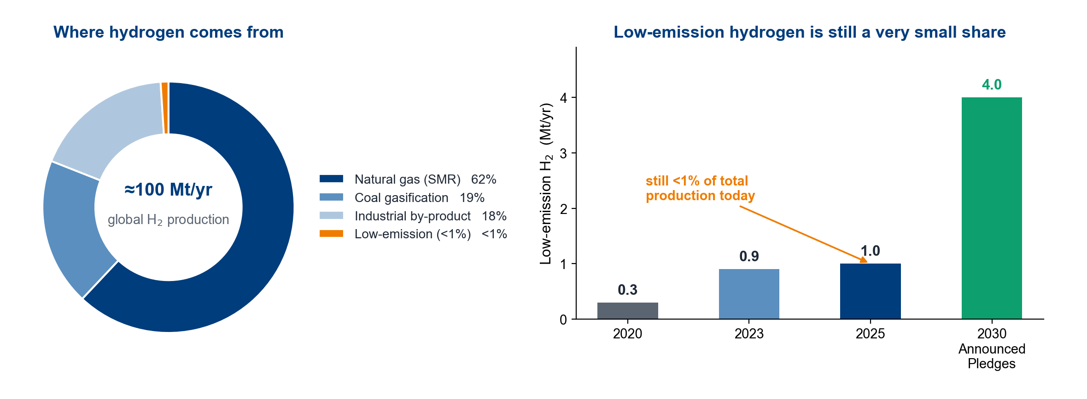
Hydrogen: why the world is moving to it
Hydrogen production is about 100 Mt per year and is still dominated by unabated fossil fuels. Low-emission hydrogen from electrolysis is about 1 Mt, i.e. below 1%.
Demand is expected to grow under announced pledges, so the production route — not the molecule — is the bottleneck. Water electrolysis is the route that can be decarbonised, and its cost is set by the anode.
Data: IEA Global Hydrogen Review 2025 and 2026.
1

Slide 3
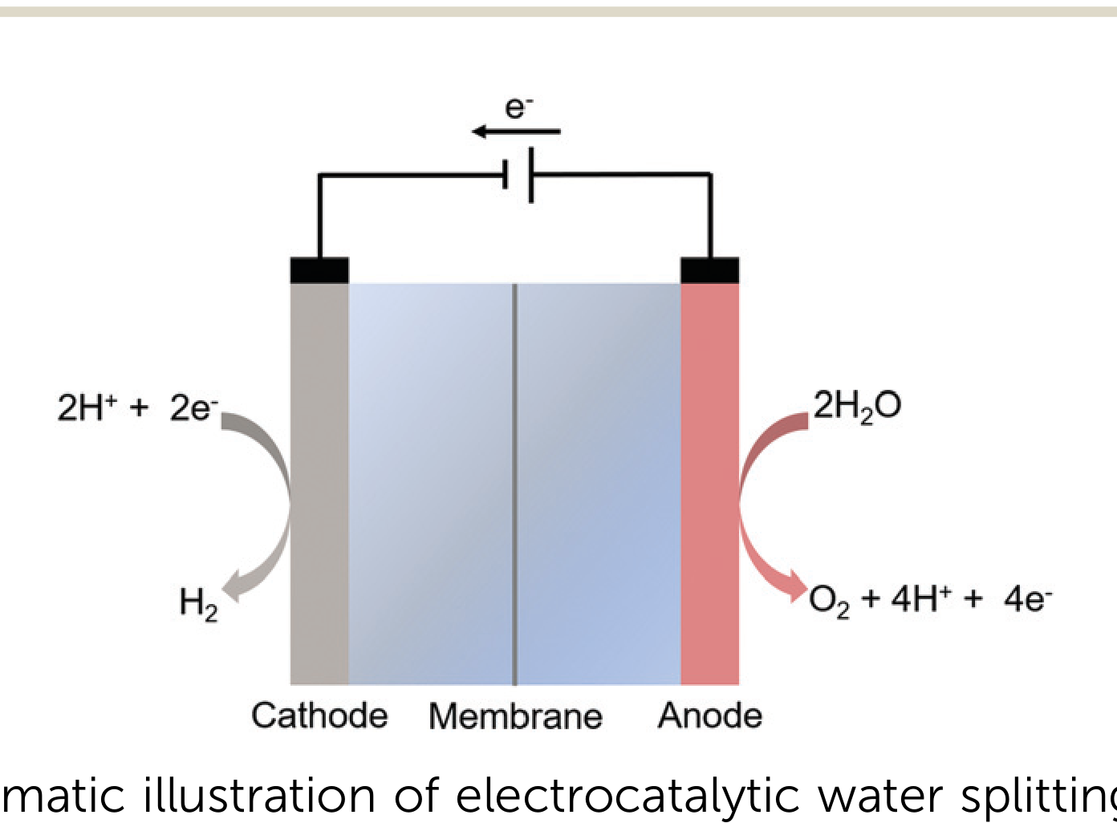
Making hydrogen: water electrolysis and its two half-reactions
Cathode (HER): 2 H₂O + 2 e⁻ → H₂ + 2 OH⁻
Anode (OER): 2 H₂O → O₂ + 4 H⁺ + 4 e⁻
OER is the bottleneck
Four electrons and four protons move through several intermediates, so the reaction is slow and carries most of the cell overpotential.
Two environments, two material sets
Alkaline media allow cheap Ni, Co or Fe oxides; acidic media (PEM) require Ir or Ru oxides.
Water splitting is two half-reactions, and the oxygen evolution reaction at the anode limits the whole cell.
Panel: Chem. Soc. Rev. 2020, 49, 2196, Fig. 1 (re-rendered at high resolution).
2

Slide 4
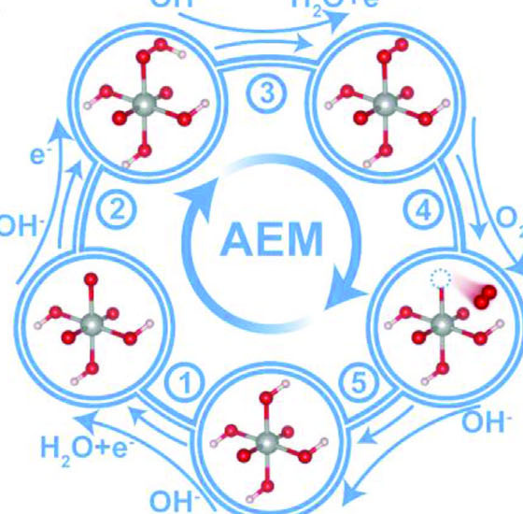
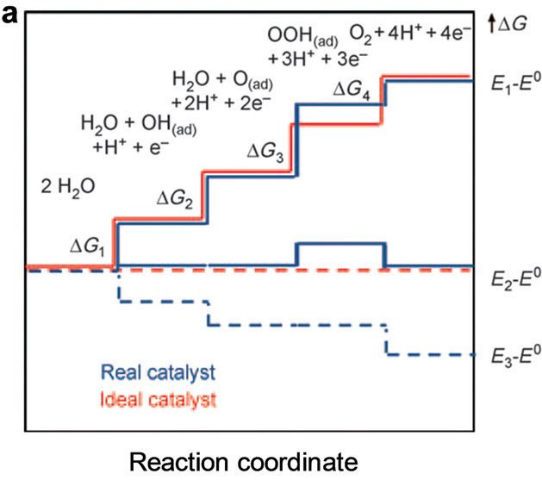
Mechanism I: adsorbate evolution (AEM) — four steps, one limit
The four steps use adsorbed oxygen only; the free-energy path is the same four steps (left: Adv. Energy Mater. 2023, Fig. 3a; right: Chem. Soc. Rev. 2020, Fig. 3a, adapted).
The *OH–*OOH scaling gap of about 3.2 eV prevents equal step energies, so one step is always larger.
Result: an intrinsic floor of about 0.37 V — activity cannot be improved within AEM.
Adv. Energy Mater. 2023, 13, 2301951, Fig. 3a · Chem. Soc. Rev. 2020, 49, 2196, Fig. 3a (adapted).
3

Slide 5
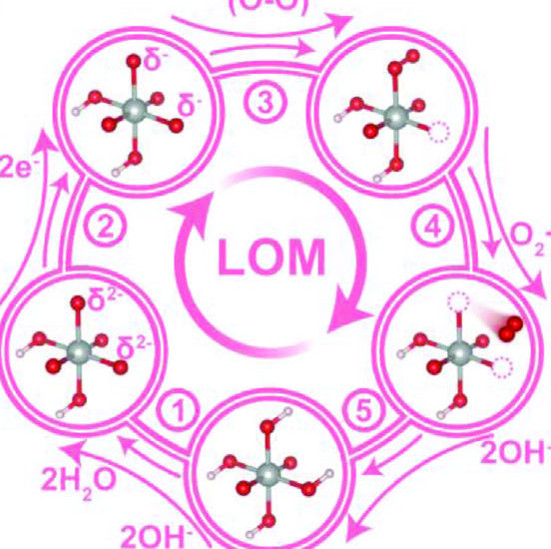
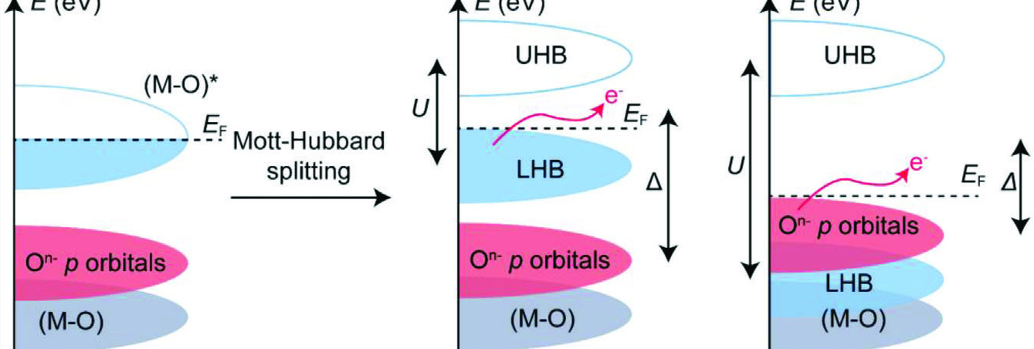
Mechanism II: lattice oxygen (LOM) — fast, but it destroys the surface
LOM: lattice oxygen is oxidised and leaves as O₂, so an oxygen vacancy is left behind (Adv. Energy Mater. 2023, Fig. 3b).
It switches on when the oxygen 2p states rise above the metal–oxygen band, close to the Fermi level (Fig. 3e, Mott–Hubbard picture).
Consequence: the vacancy stays, and the metal is released together with the oxygen.
Adv. Energy Mater. 2023, 13, 2301951, Fig. 3b and Fig. 3e.
4

Slide 6
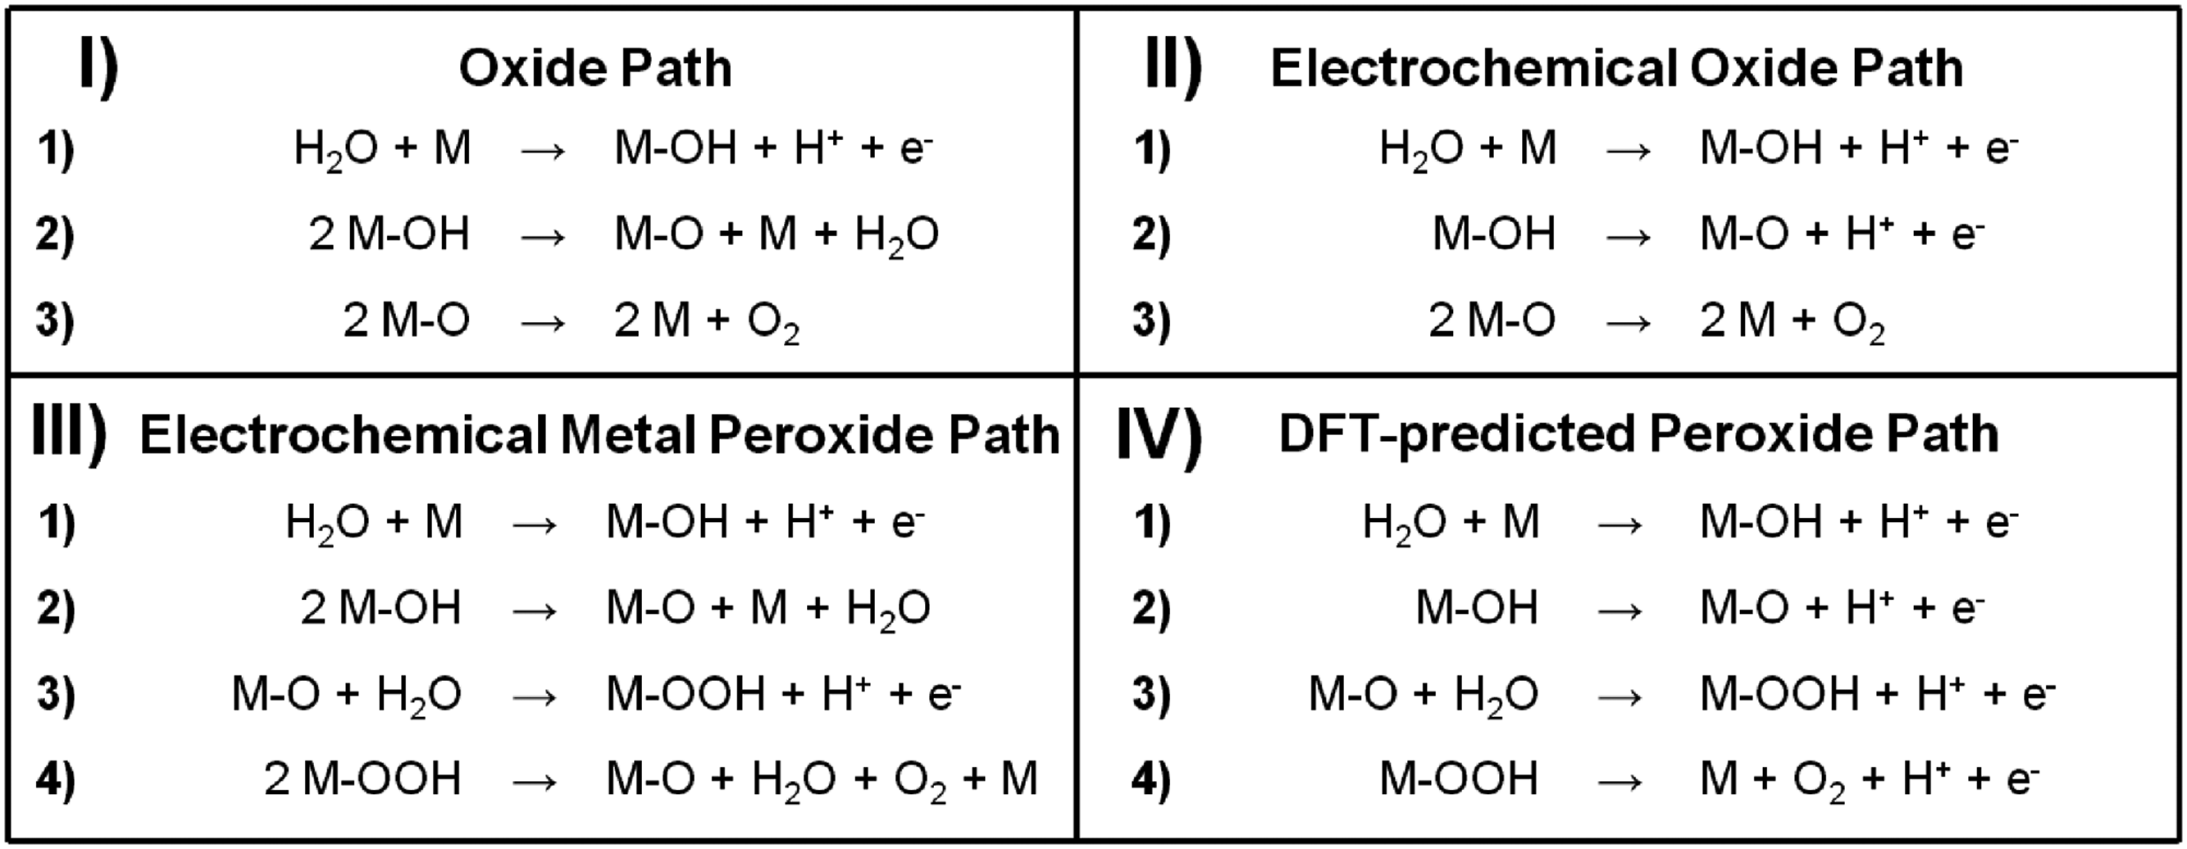
Mechanism III: the oxide path (OPM), and COM briefly
COM (our group)
Light drives electron transfer from the oxygen states to the metal, and the O–O bond forms on the oxygen states — a related route that also avoids the *OOH step.
Reported precedent
Ru on α-MnO₂ by cation exchange: 161 mV, more than 200 h, oxide path mechanism, no oxygen vacancy.
Panel I is the oxide path: two adjacent metal–oxo sites couple directly to O₂, with no *OOH intermediate and no oxygen vacancy (Adv. Energy Mater. 2016, Fig. 1).
OPM keeps the surface intact while avoiding the *OOH bottleneck, which is why it is the route we target.
Adv. Energy Mater. 2016, 6, 1601275, Fig. 1 · COM: Nature 2022, 611, 702; reviewed in Adv. Energy Mater. 2023, 13, 2301951, §2.
5

Slide 7
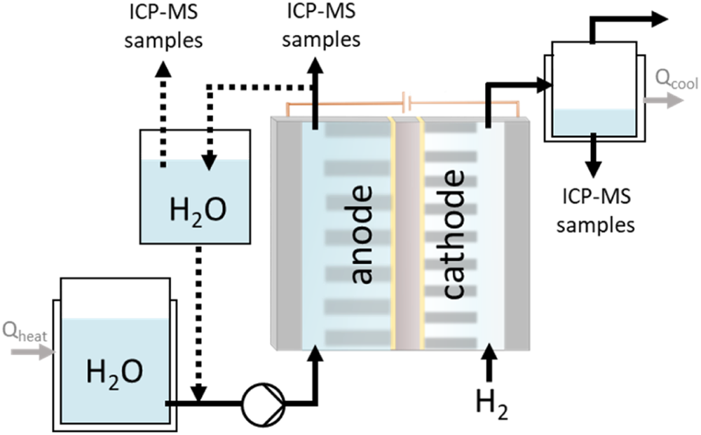
Platform: acidic PEM, because that is where the durability problem is
PEM matches renewable electricity
High current density, fast response and high-purity hydrogen; the membrane is acidic, so the anode sees about 1 M proton activity (pH 0).
Only Ir and Ru oxides survive there
Alkaline systems can use Ni, Co or Fe oxides. In acid the choice collapses to iridium and ruthenium, and iridium is the scarcest option.
The anode environment decides which elements are allowed, so the project is defined by durability at low noble-metal loading rather than by activity.
Panel: PEM electrolysis system review (cell schematic) · Chem. Soc. Rev. 2020, 49, 2196, §4.4.
6

Slide 8
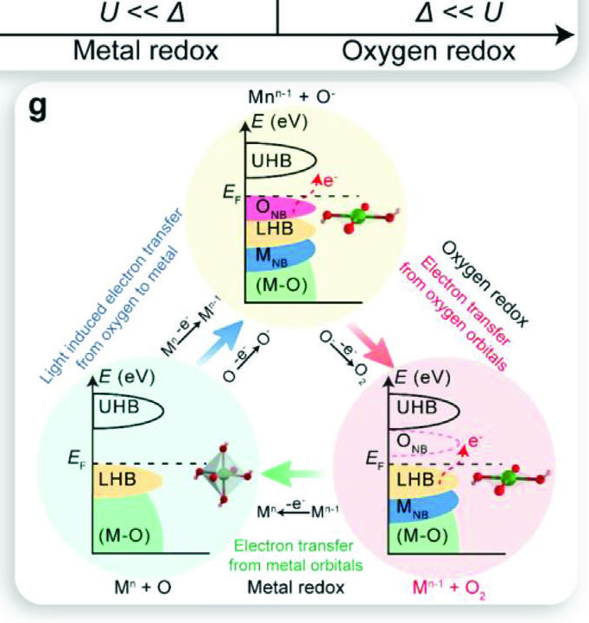
Element: ruthenium is cheap and active — but it dissolves
Why Ru and not Ir
RuO₂ is more active than IrO₂ for OER, and ruthenium is far cheaper and more abundant; iridium supply is the ceiling for PEM deployment.
Failure channel 1 — over-oxidation
Ruthenium is oxidised beyond +4 to soluble RuO₄ and leaves the electrode.
Failure channel 2 — lattice oxygen
Lattice oxygen participates, a vacancy is left behind, and the metal follows the oxygen out.
Both descriptions refer to the same surface: the metal redox and the oxygen redox must be controlled together. The proof of stabilisation has to be a dissolution measurement.
Adv. Energy Mater. 2023, 13, 2301951, Fig. 3g and §6.
7

Slide 9
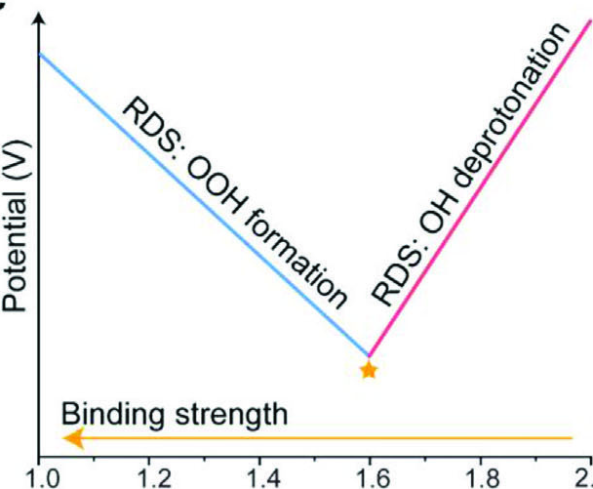
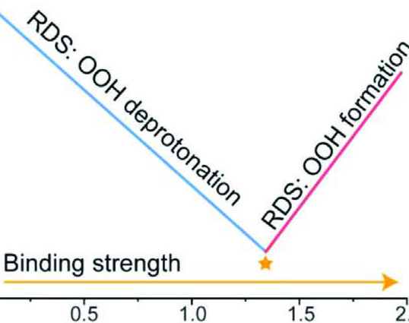
Route: target OPM, keep AEM as the fallback, avoid LOM
Our ranking
1. OPM — direct O–O coupling, no vacancy.
2. AEM — safe, but capped at 0.37 V.
3. LOM — activity paid for with the surface: avoid.
Precedent
Ru on α-MnO₂ by cation exchange: 161 mV at 10 mA cm⁻², more than 200 h, oxide path, no oxygen vacancy.
Both volcano plots show the same ceiling: activity is set by the adsorption energies of the intermediates, and the scaling relation fixes the height of the volcano.
Breaking that ceiling requires a different route — for us, OPM on a MnO₂-stabilised Ru site.
Adv. Energy Mater. 2023, 13, 2301951, Fig. 3c and Fig. 3d; precedent as reviewed there, §6.
8

Slide 10
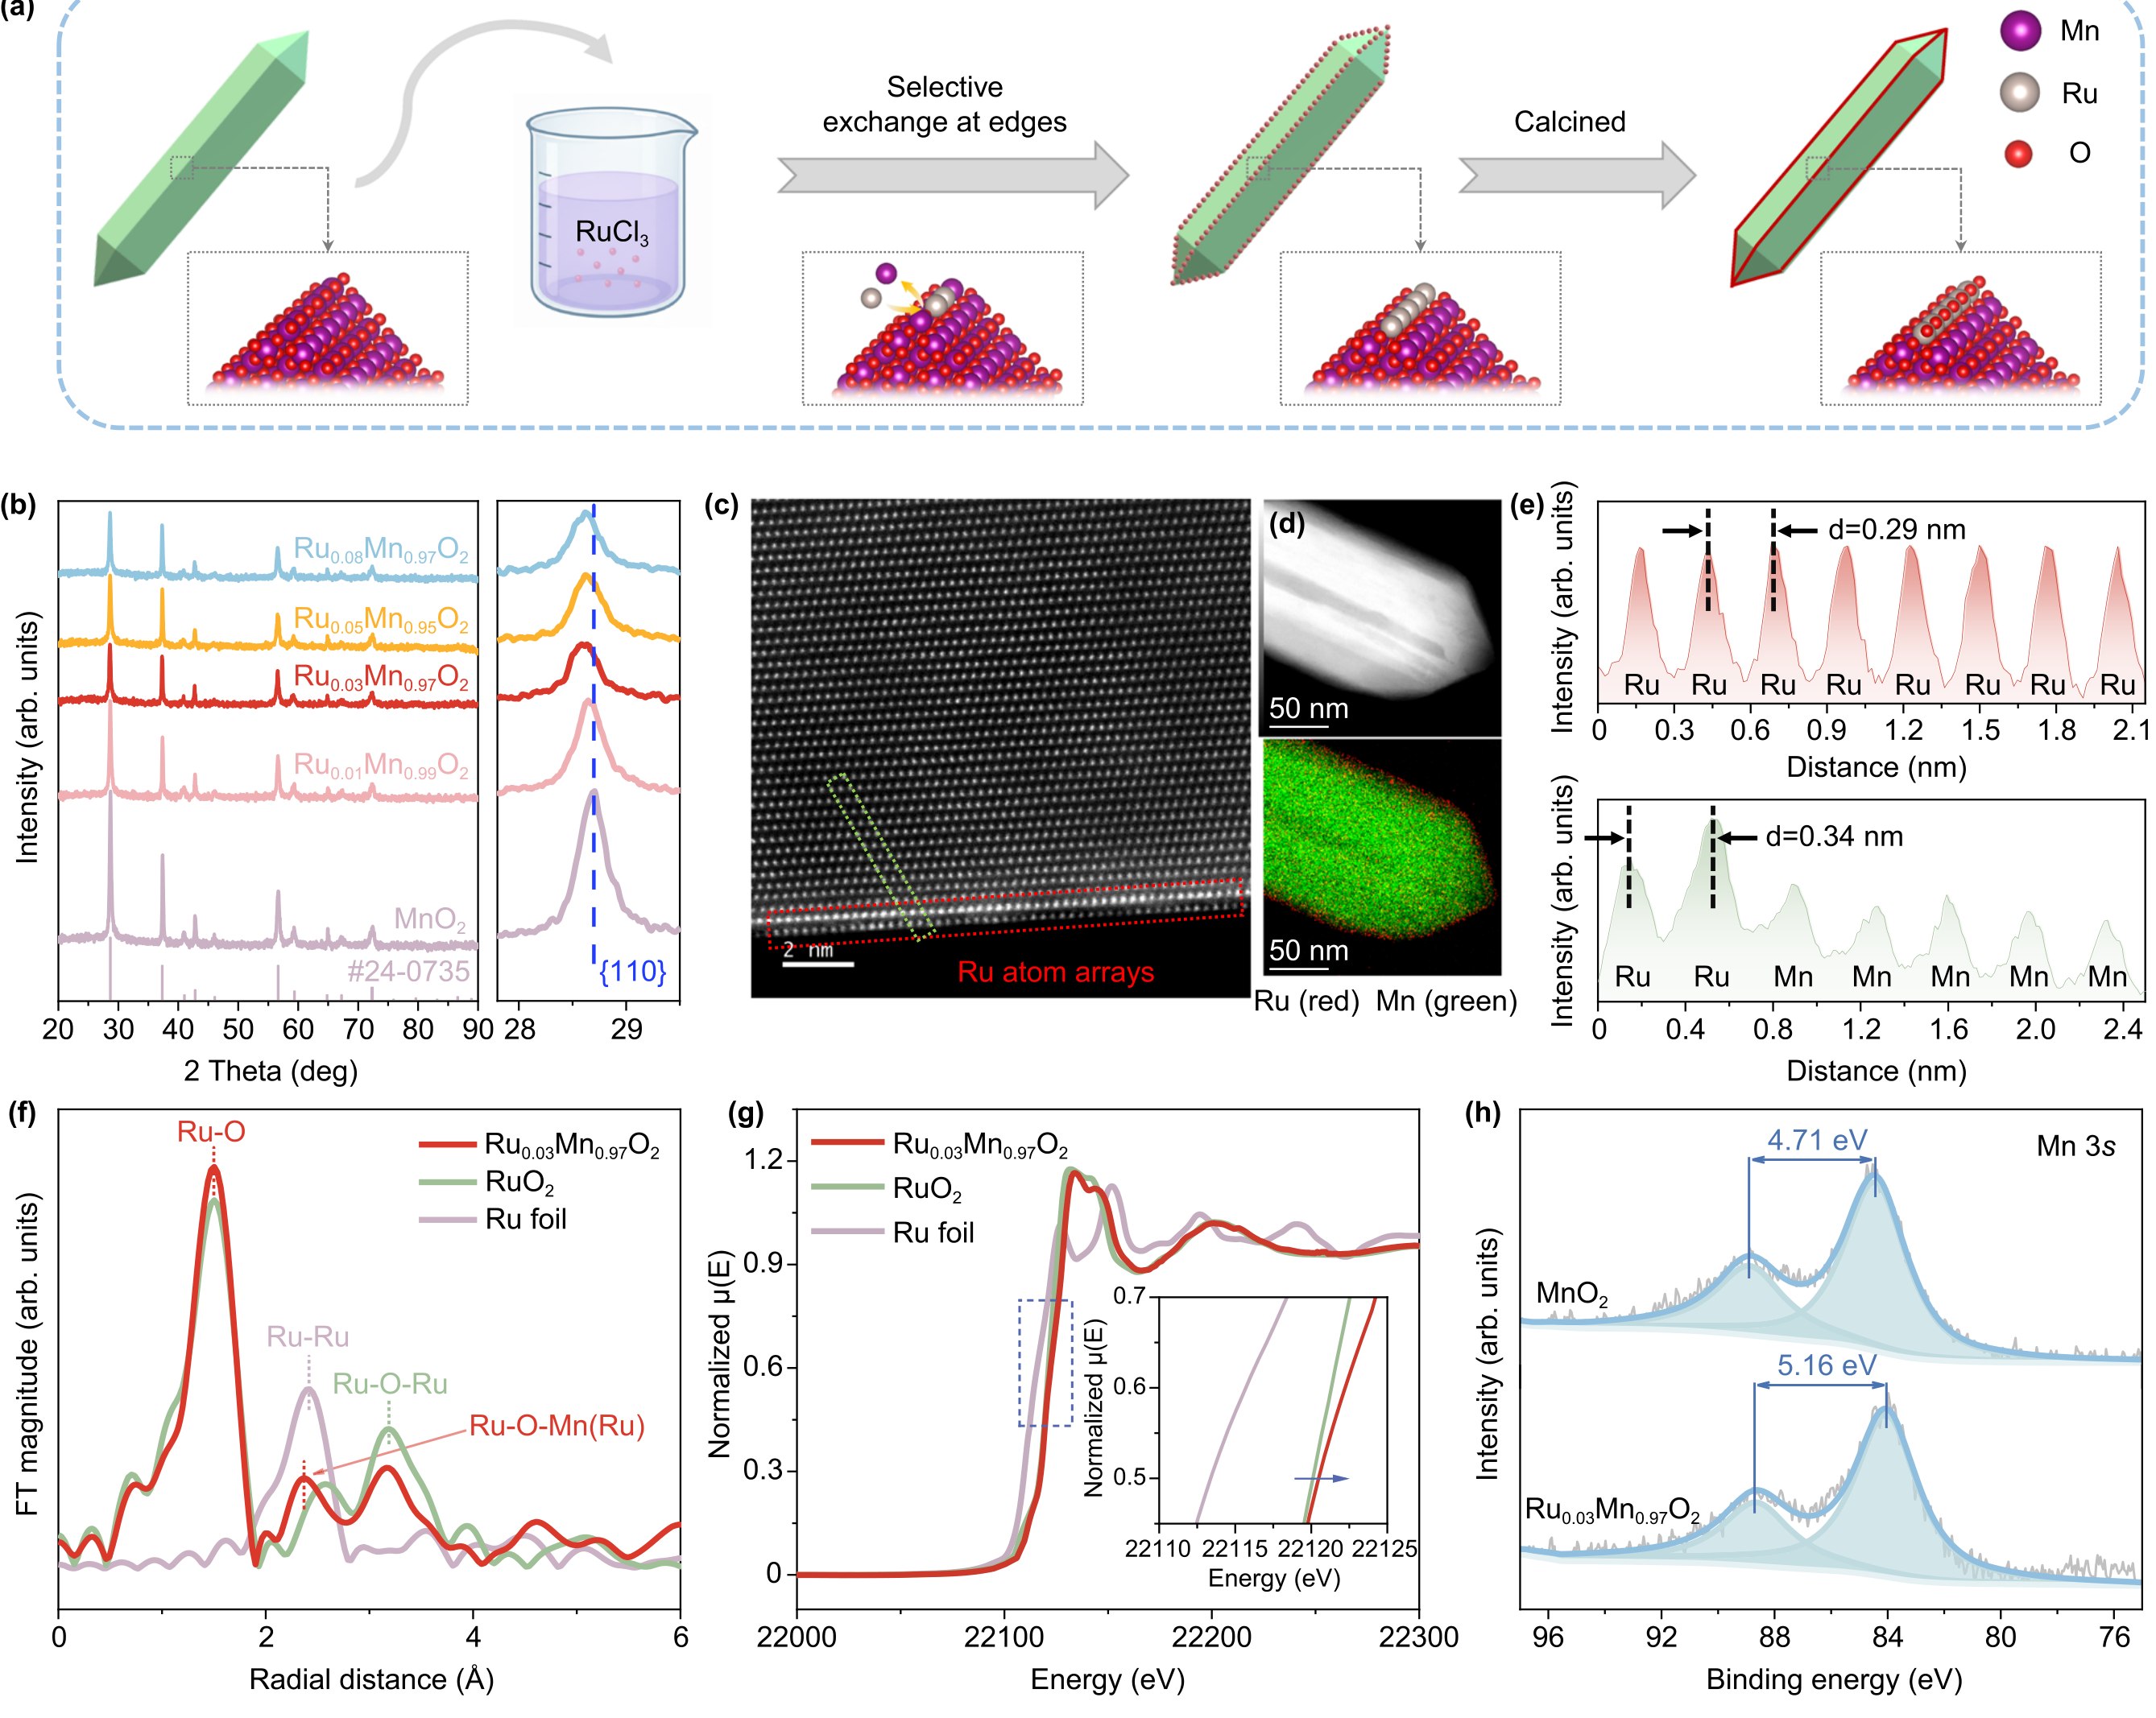
Solution: put Ru into a MnO₂ framework by electrodeposition
Mn³⁺/Mn⁴⁺ buffers the charge
The MnO₂ framework holds Ru near +4, outside the RuO₄ window.
The metal goes inside the lattice
Electrodeposited MnO₂ oxidises the metal and drives it in, forming M–O–Mn bridges; EXAFS shows the Ru–O–Mn shell.
Electrodeposition makes it tunable
Deposition charge, current and bath pH set the phase and edge-site density.
Figure: (a) synthesis route; (b) XRD of the Ru₀.₀₃Mn₀.₉₇O₂ series; (c) atomic-resolution STEM;
(d) EDS mapping; (e) intensity profiles; (f) Ru K-edge FT-EXAFS; (g) XANES; (h) Mn 3s XPS.
Our contribution: build it by electrodeposition and prove Ru sits inside the lattice, not on the surface.
Nat. Commun. 2026, 17, 7657, Fig. 2 · Science 2024, 384, 666, Fig. 1A (precedent with Ir).
9

Slide 11
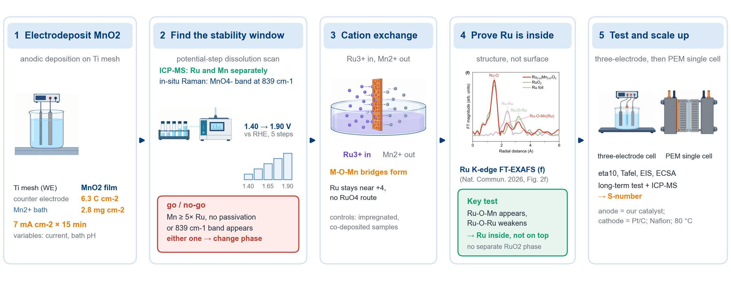
Experiment plan: deposit, window, exchange, prove, test
First priority: step 2 — the go/no-go on which dissolves first, Mn or Ru, and at what potential.
Schematic drawn for this project: parameters per the group protocol; characterisation and testing practice follow Adv. Energy Mater. 2023 §5.
10

