Slide 1

FINAL-YEAR PROJECT · PROGRESS REVIEW
Stabilizing Ruthenium through
Ru–O–Mn Interfacial Coupling
for Acidic Oxygen Evolution
TODAY
01 Background
Why acidic OER is a durability
problem
02 Literature review
The five assigned papers
03 Experiment plan
Synthesis, testing and
go / no-go design
Candidate
Zhao Shen
Programme
NUS–ECUST Joint Programme (MSE 311)
Supervisor
Prof. Xue Junmin, Materials Science & Engineering
Mentor
Junchen Yu · Laboratory: NUSRI-CQ
Group meeting
Thursday 24 September 2026, 16:30
Every literature slide draws only on the five papers provided by my mentor.
Notes:
Good afternoon everyone. My name is [Name], and my final-year project is "Stabilizing Ruthenium through Ru–O–Mn Interfacial Coupling for Acidic Oxygen Evolution", supervised by Professor Xue Junmin, with [mentor] as my mentor. Today I will cover three things: the background, the literature review, and the experiment plan.

Slide 2

OUTLINE
What I will cover
2 / 10
01
02
03
Background
Literature review
Experiment plan
Why acidic OER is a durability problem,
and why ruthenium
Five assigned papers:
design · reconstruction · interface & device
Synthesis · activation · characterisation ·
testing · go / no-go
Every literature slide draws only on the five papers provided by my mentor: CSC-4 (Chem. Soc. Rev. 2020) · AEM-5 (Adv. Energy Mater. 2023, our group) · NE-2 (Nat. Energy 2023) · NC-1 (Nat. Commun. 2024) · Science-3 (Science 2025).
NUS MSE 311 · Final-Year Project progress review · 24 September 2026
Outline
Notes:
The outline is simple. First, why acidic oxygen evolution is a durability problem and why ruthenium is the element we care about. Second, what the five papers I was given actually teach us. Third, what we plan to do — synthesis, characterization and testing — and where the main risk is.

Slide 3
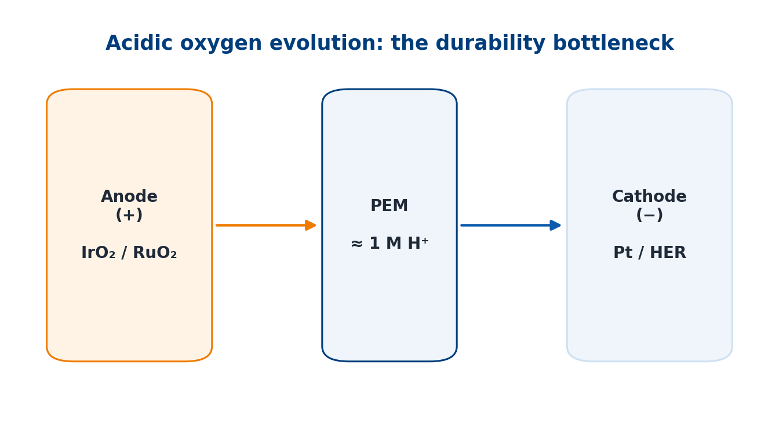
BACKGROUND
Acidic water electrolysis: the bottleneck is durability
3 / 10
In one sentence: we want to make the acidic OER anode cheaper by keeping Ru from dissolving — and we build the Ru–O–Mn interface that does this by electrodeposition, a process we can tune.
一句话：让酸性析氧阳极更便宜——关键是别让钌溶掉；我们用电沉积来造负责这件事的 Ru–O–Mn 界面（工艺参数可调）。
PEM electrolysis works at ≈ 1 M proton activity
Almost no transition-metal oxide survives; only Ir and Ru oxides do
Ir is among the scarcest elements; even IrO₂ dissolves as soluble IrO₄²⁻
So the constraint is durability at low noble-metal loading
Why it matters for us
– Noble-metal loading, not activity, sets the cost of PEM stacks.
– Our target metal (Ru) is cheaper — but the least stable.
Schematic: PEM electrolyser — only Ir/Ru oxides survive the acidic anode.
Takeaway: acidic OER is limited by durability at low noble-metal loading — not by activity.
Source: CSC-4, Chem. Soc. Rev. 2020, §4.4 (p. 2208).
NUS MSE 311 · Final-Year Project progress review · 24 September 2026
Background
Notes:
Proton exchange membrane electrolysis is the most mature route to green hydrogen, and it works in a strongly acidic environment — the sulfonic-acid membrane is equivalent to roughly one molar proton. In that environment almost no transition-metal oxide survives; only iridium and ruthenium oxides do. Iridium, however, is one of the scarcest elements on earth, and even the benchmark IrO₂ is not immune: it dissolves in both acid and base through formation of soluble IrO₄²⁻. So the bottleneck is not activity — it is durability at low noble-metal loading. That is the problem this project sits in.

Slide 4
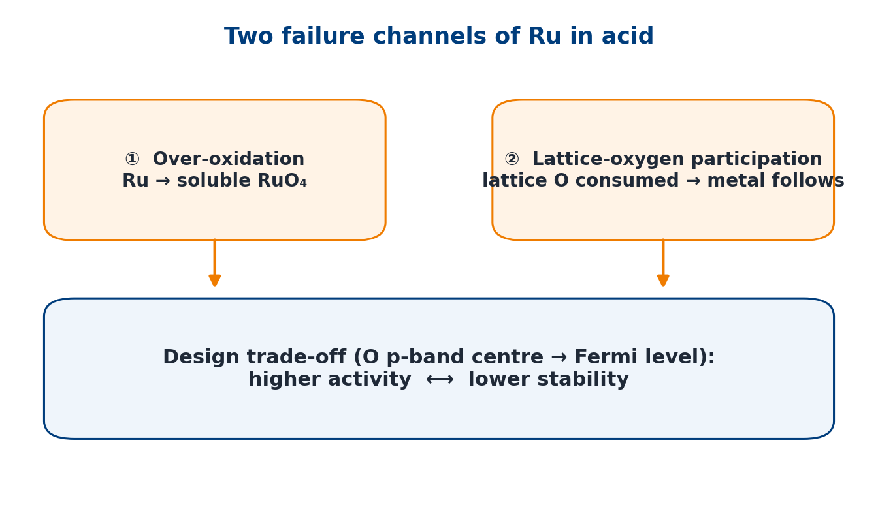
BACKGROUND
The Ru paradox: more active and cheaper — but less stable
4 / 10
RuO₂ is more active and far cheaper than IrO₂
Failure channel ①: over-oxidation to soluble RuO₄
Failure channel ②: lattice-oxygen (LOM) participation — the metal follows the oxygen
Design trade-off: O p-band centre closer to E_F → higher activity, lower stability
The question is not activity, but how to keep Ru where it is
What this implies
– Stabilisation must reduce Ru dissolution, not just lower the overpotential.
– Any gain must be shown by a dissolution-based metric.
Ru fails through RuO₄ formation and lattice-oxygen participation; activity and stability trade off.
Takeaway: Ru needs a stabilisation strategy, not simply a higher intrinsic activity.
Sources: AEM-5, Adv. Energy Mater. 2023, §6 (p. 15); CSC-4 §2.2–2.3 (p. 2202).
NUS MSE 311 · Final-Year Project progress review · 24 September 2026
Background
Notes:
Ruthenium is the attractive alternative: RuO₂ is more active and far cheaper than IrO₂. But in acid, Ru fails through two channels. First, over-oxidation to soluble RuO₄ — ruthenium can be pushed to a high oxidation state where it leaves the surface. Second, participation of lattice oxygen: when oxygen evolution proceeds through the lattice-oxygen mechanism, lattice oxygen is consumed and the metal follows it into solution. There is also a well-known design trade-off: moving the oxygen p-band centre closer to the Fermi level increases activity but decreases stability. So the question is not "which catalyst is more active", but how do we keep ruthenium where it is.

Slide 5
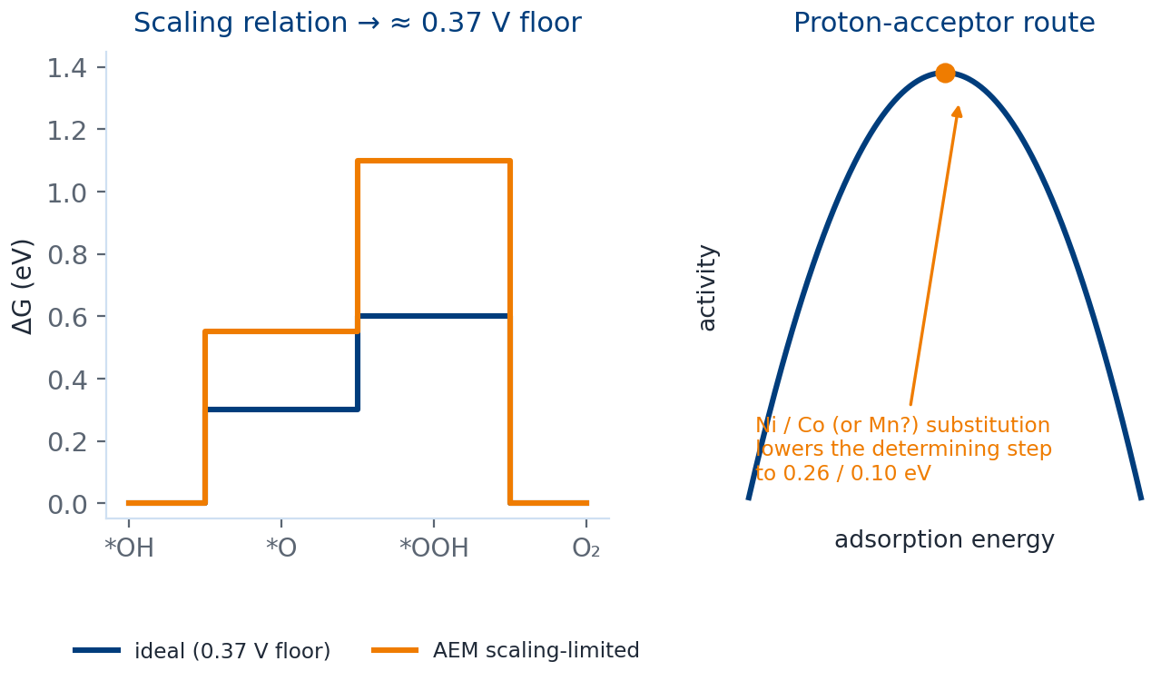
LITERATURE
I — Design principles, and why MnO₂ is allowed
5 / 10
Scaling relation caps AEM at ≈ 0.37 V overpotential
Proton-acceptor route: Ni/Co into RuO₂ activates bridging oxygen (step 0.26 / 0.10 eV)
γ-MnO₂ reported to run 8000 h at pH 2
Warning: a suitable potential window must be identified
Mn³⁺ provides the optimal eg occupancy (eg = 1)
Two consequences for us
– Mn can play the proton-acceptor / charge-buffer role (Mn³⁺, e_g = 1).
– Its usable potential window must be measured first.
Scaling relation, the proton-acceptor route, and the reported acid stability of γ-MnO₂.
Takeaway: design rules exist (proton acceptor) and MnO₂ is allowed in acid — but its potential window must be found.
Sources: CSC-4 §2.1 (p. 2197), §3.2 (pp. 2203–2204), §4.4 (p. 2208), §2.2 (p. 2200).
NUS MSE 311 · Final-Year Project progress review · 24 September 2026
Literature review
Notes:
From the Chem Soc Rev review I take the design frame. First, the scaling relation between the *OH and *OOH intermediates caps the adsorbate-evolution mechanism at roughly 0.37 volts of overpotential; breaking it requires stabilising *OOH independently, introducing a proton acceptor, or switching to the lattice-oxygen mechanism. The proton-acceptor route is the one relevant to us: substituting nickel or cobalt into RuO₂ activates bridging oxygen and lowers the potential-determining step to about 0.26 and 0.10 volts — below the volcano top. Second, and very practical: the same review reports that γ-MnO₂ can operate for 8000 hours at pH 2, and that doping with titanium or germanium stabilises its reaction terminus and creates more coordinatively unsaturated sites. It also warns that a suitable potential window must be identified for any transition-metal oxide — and that warning becomes our first experiment. Third, manganese is not just a bystander: Mn³⁺ provides the optimal e_g occupancy of one.

Slide 6
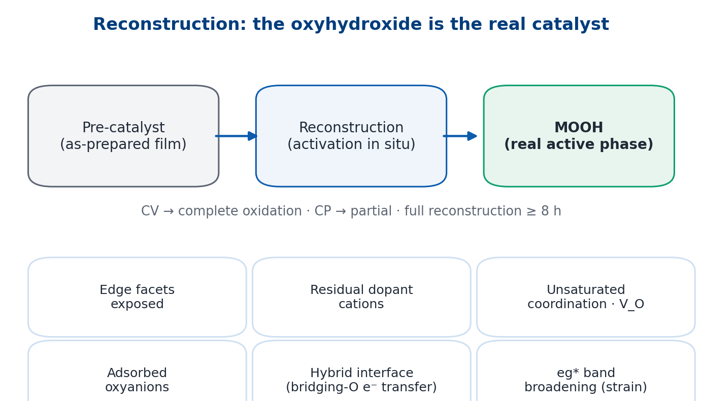
LITERATURE
II — Reconstruction chemistry and Ru stabilisation in acid
6 / 10
The real active phase is the reconstructed oxyhydroxide, not the as-prepared film
Four reconstruction mechanisms; six activity factors (strain → eg* broadening; hybrid interfaces)
Activation protocol matters: CV → complete oxidation, CP → partial; full reconstruction ≥ 8 h
In acid: Ru fails via RuO₄ + LOM; two proven routes — single-atom confinement, higher oxygen-vacancy formation energy
Precedent recorded there: Ru/α-MnO₂ cation exchange — 161 mV, > 200 h
How we use it
– The film we deposit is a pre-catalyst; the interface forms on activation.
– Activation protocol is an experimental variable, not a step.
Pre-catalyst → reconstruction → oxyhydroxide (real active phase); six factors govern its activity.
Takeaway: the real catalyst is the reconstructed oxyhydroxide; in acid, two stabilisation routes are already proven.
Source: AEM-5, Adv. Energy Mater. 2023, §3–§6 (pp. 5–16), incl. p. 6 and p. 13.
NUS MSE 311 · Final-Year Project progress review · 24 September 2026
Literature review
Notes:
From our own group's review I take the reconstruction language. The catalytically real phase is not the as-made solid but the oxyhydroxide formed by irreversible reconstruction, and six factors govern its activity — edge facets, residual dopant cations, coordinatively unsaturated sites and oxygen vacancies, adsorbed oxyanions, hybrid interfaces where a bridging oxygen transfers electrons, and e_g* band broadening caused by lattice strain. Two practical points for us: the activation protocol changes the product — cyclic voltammetry gives complete oxidation, whereas chronopotentiometry gives only partial reconstruction; and complete reconstruction can take more than eight hours. For acid specifically, the review states that Ru fails through RuO₄ formation and lattice-oxygen participation, and that two stabilisation routes are proven: confining the metal as single-atom sites, or raising the oxygen-vacancy formation energy — for example tungsten- or erbium-doped RuO₂ reaches 168 millivolts and 500 hours in acid. The same section records a Ru on α-MnO₂ precedent — cation exchange, in-situ reconstruction into Ru atom arrays, the oxide path mechanism without oxygen vacancies, 161 millivolts and more than 200 hours — as reviewed in that paper.

Slide 7
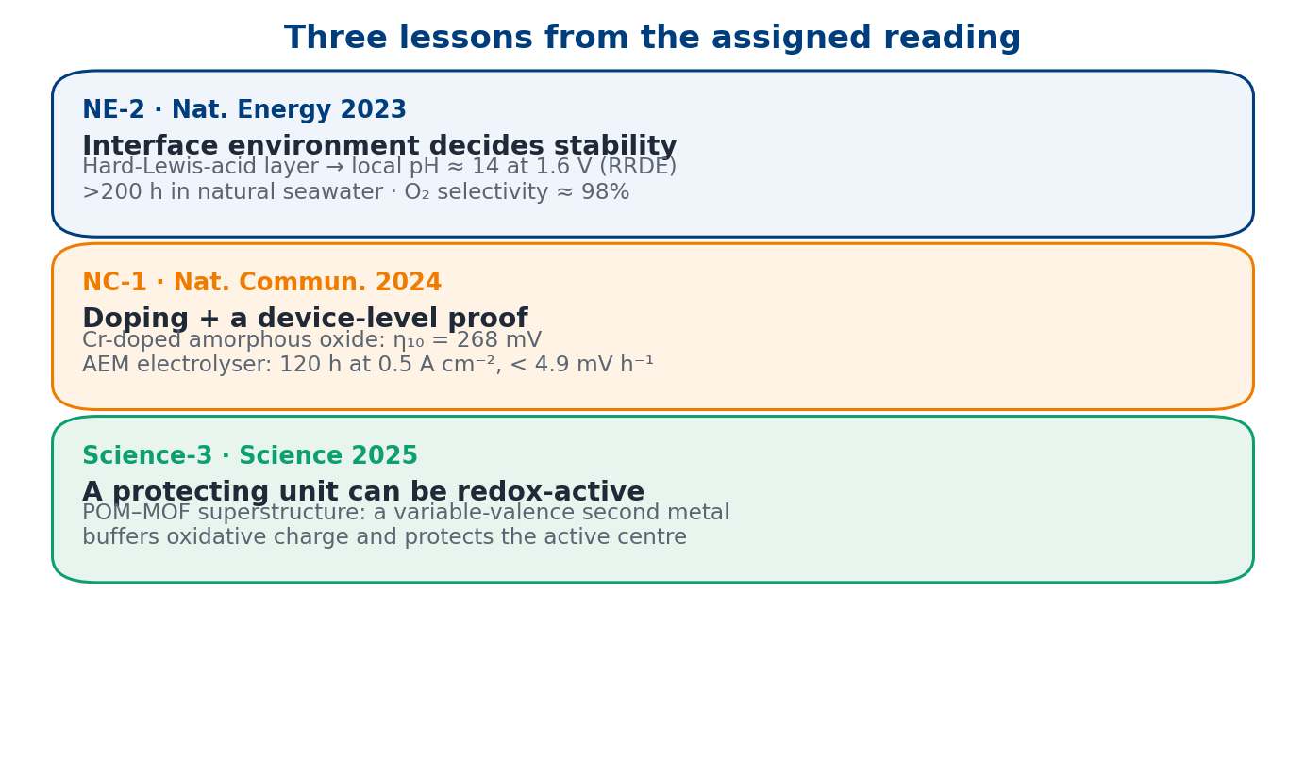
LITERATURE
III — Interface environment, doping practice, device-level proof
7 / 10
NE-2: what happens around the site decides stability (local pH ≈ 14 at 1.6 V)
NC-1: doping stabilises the metal — and always finish with a device test
Science-3: a protecting unit can be redox-active, not inert
Together: principles, chemistry, interface and device practice are established
What is missing: how to BUILD the Ru–MnO₂ interface controllably and scalably
So the gap is
– Chemistry: established. Interface environment: understood.
– Process: how to build Ru–O–Mn controllably — still open.
One lesson per paper: interface environment, doping plus a device test, and redox-active protection.
Takeaway: principles, chemistry, interface and device practice are established — building the interface is not.
Sources: NE-2 pp. 264–267 and Methods p. 270; NC-1; Science-3.
NUS MSE 311 · Final-Year Project progress review · 24 September 2026
Literature review
Notes:
Three more lessons, one per paper. From the Nature Energy seawater work: what happens around the active site matters. A hard-Lewis-acid layer of Cr₂O₃ splits water at the surface and builds local alkalinity — the surface pH reaches about 14 at 1.6 volts, measured with an iridium-oxide ring electrode — and the electrode then survives more than 200 hours in natural seawater with about 98 percent oxygen selectivity; importantly, the authors show the same approach also works on manganese oxide. From the Nature Communications electrolyser paper: chromium doping plus an amorphous structure gives 268 millivolts, and — the part I find most instructive — they finish with a device-level test: an anion-exchange-membrane electrolyser running 120 hours at 0.5 amps per square centimetre with decay below 4.9 millivolts per hour. From the Science paper on polyoxometalate-MOF superstructures: the protecting unit does not have to be inert — a variable-valence second metal can buffer oxidative charge and protect the catalytic centre. Putting the five papers together: the design principles, the reconstruction chemistry, the interface environment and the device practice are all established; what none of them shows is how to build the Ru–MnO₂ interface in a controllable, scalable way.

Slide 8
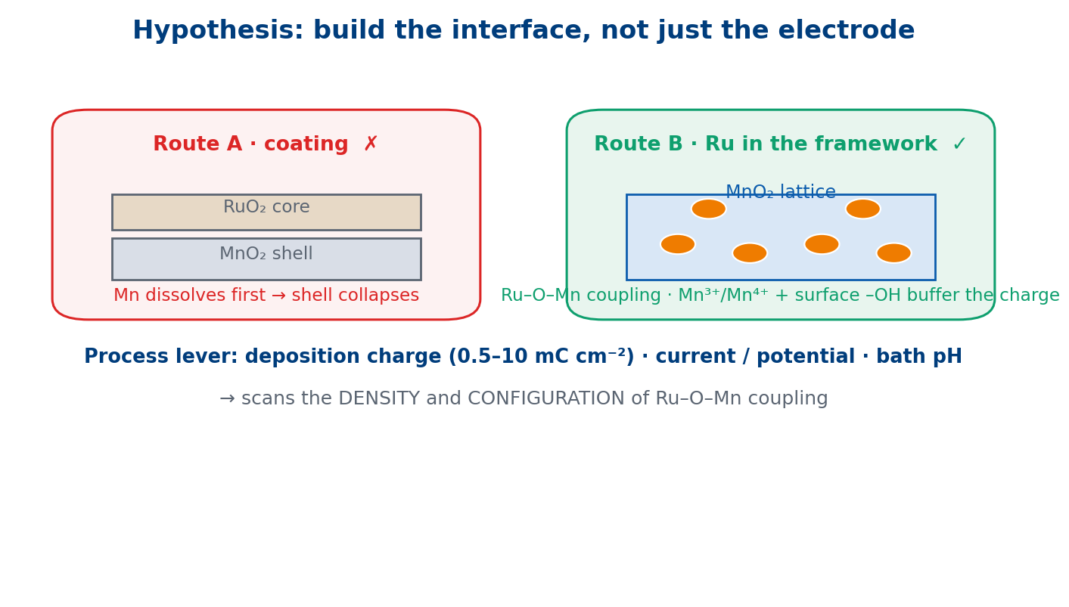
EXPERIMENT PLAN
Gap & hypothesis — electrodeposition as the process lever
8 / 10
Hypothesis (material): electrodeposited MnO₂ as support AND redox mediator
Mn³⁺/Mn⁴⁺ + surface –OH buffer the oxidative charge at Ru → keep Ru near +4, out of the RuO₄ window
Hypothesis (process): deposition charge / current / bath pH control phase, morphology, edge-site density
→ we can SCAN the density and configuration of Ru–O–Mn coupling
This process control is what the existing literature does not provide
Process variables we will scan
– Deposition charge 0.5–10 mC cm⁻² · current / potential · bath pH.
– Ru route: co-deposition vs impregnation vs cation exchange.
A coating dissolves first; putting Ru into the MnO₂ framework is the working hypothesis.
Takeaway: electrodeposition turns the Ru–O–Mn interface into a tunable process variable.
Rationale based on CSC-4 (p. 2200, p. 2208) and AEM-5 (§6, pp. 15–16).
NUS MSE 311 · Final-Year Project progress review · 24 September 2026
Experiment plan
Notes:
That gap defines the project. Our hypothesis has two parts. Material-wise: electrodeposited MnO₂ acts as both the support and a redox mediator. Manganese is redox-active — Mn³⁺/Mn⁴⁺ — and its surface hydroxyls can buffer the oxidative charge arriving at ruthenium, keeping Ru near the +4 state and away from the high oxidation state where RuO₄ forms; in other words, the interface oxygen is pushed out of the dissolution window. Process-wise: electrodeposition makes the interface itself a tunable variable — deposition charge, current or potential, and bath pH control the phase of MnO₂, its morphology, and above all its edge-site density, so we can scan the density and configuration of Ru–O–Mn coupling instead of hoping for it. That process control is what the existing literature does not provide.

Slide 9
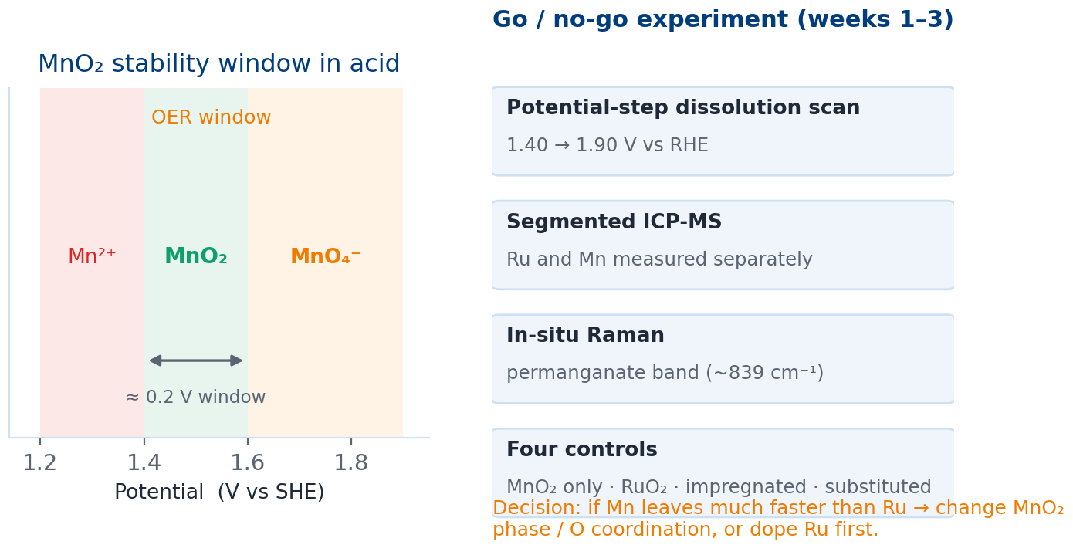
EXPERIMENT PLAN
Main risk, and our go / no-go experiment
9 / 10
The risk is MnO₂ itself, not Ru: MnO₂ only stable in a narrow window (~1.4–1.6 V vs SHE)
A MnO₂ coating would therefore dissolve first
Working answer: put Ru INTO the MnO₂ framework (cf. the cation-exchange precedent)
Go / no-go in weeks 1–3: potential-step scan + segmented ICP-MS for Ru AND Mn + in-situ Raman
Four controls; if Mn leaves first and cannot be suppressed → change phase / oxygen coordination, or dope Ru first
Decision rule
– If Mn dissolves much faster than Ru and cannot be suppressed → change phase.
– Otherwise → proceed to interface engineering and parameter sweep.
Manganese in acid: narrow stability window → possible permanganate formation above ~1.6 V.
Takeaway: first test whether Mn or Ru leaves faster — before optimising anything else.
Sources: CSC-4 §4.4 (p. 2208, "a suitable potential window must be identified"); AEM-5 §6 (pp. 15–16), §8.1 (p. 18).
NUS MSE 311 · Final-Year Project progress review · 24 September 2026
Experiment plan
Notes:
The biggest risk is not ruthenium — it is MnO₂ itself. The thermodynamics of manganese in acid are tight: Mn²⁺ below about 1.4 volts, MnO₂ only in a narrow window around 1.4 to 1.6 volts, and soluble permanganate above that; the Chem Soc Rev review makes exactly this point when it says a suitable potential window must be found. So a MnO₂ coating on ruthenium would probably dissolve first. Our working answer is to put ruthenium into the MnO₂ framework rather than on top of it — which is why the cation-exchange precedent recorded in our review matters. To test this early we will run a go / no-go experiment in the first two to three weeks: a potential-step dissolution scan from 1.40 to 1.90 volts versus RHE, with segmented ICP-MS measuring both ruthenium and manganese, plus in-situ Raman watching for the permanganate band, and four controls — electrodeposited MnO₂ alone, a RuO₂ reference, ruthenium impregnated on the surface, and ruthenium substituted into the framework. If manganese dissolves much faster than ruthenium and cannot be suppressed, we change phase or oxygen coordination, or we reverse the order and dope ruthenium first.

Slide 10
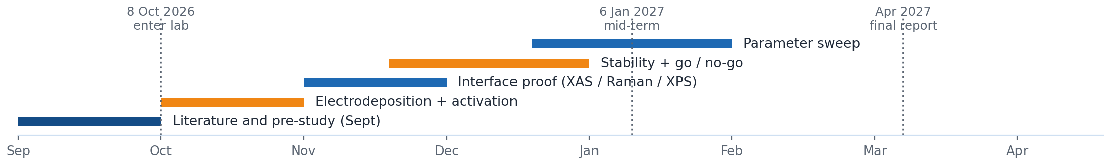
EXPERIMENT PLAN
Synthesis, characterisation, testing and timeline
10 / 10
Synthesis
Electrodeposit MnO₂ on Ti felt / carbon paper; deposition charge 0.5–10 mC cm⁻², current / potential / bath pH; Ru by co-deposition, impregnation or cation exchange; one fixed activation protocol (CV vs CP).
Characterisation
Paired XRD / Raman / XPS / HRTEM-EDS before and after activation; operando XAS at Ru and Mn K-edges (decisive for Ru–O–Mn); EPR for oxygen vacancies.
Testing
iR-corrected LSV with η₁₀, Tafel, EIS; normalised by mass and ECSA; long-term chronopotentiometry with segmented ICP-MS (Ru + Mn) and a stability number — metrics the assigned reviews report only as decay rates.
Device
Single-cell test reported as current density / duration / retention with Faradaic efficiency (following NE-2 and NC-1).
Milestones: 8 Oct 2026 enter lab · 6 Jan 2027 mid-term · Apr 2027 final report | Sources: AEM-5 §5 (pp. 11–15) and p. 6 · NE-2 pp. 268–270 · NC-1.
NUS MSE 311 · Final-Year Project progress review · 24 September 2026
Experiment plan · slide 10
Notes:
Concretely. Synthesis: electrodeposit MnO₂ on a corrosion-resistant substrate such as titanium felt or carbon paper, scanning deposition charge from 0.5 to 10 millicoulombs per square centimetre together with current, potential and bath pH; then introduce ruthenium by one of three routes — co-deposition, impregnation or cation exchange — and fix one activation protocol, because cyclic voltammetry and chronopotentiometry give different degrees of reconstruction. Characterisation: paired XRD, Raman, XPS and HRTEM-EDS before and after activation, then operando X-ray absorption at both the Ru and Mn K-edges as the decisive evidence for Ru–O–Mn coupling, with EPR for oxygen vacancies and surface-sensitive probes chosen per our group's review. Testing: iR-corrected polarisation with η₁₀, Tafel slope and EIS, normalised by mass and by electrochemically active surface area; then long-term chronopotentiometry with segmented ICP-MS for both Ru and Mn and a stability number — note that the reviews I was given report decay rates but not dissolution metrics, so we will generate them ourselves. Device: a single-cell test reported in the current-density / duration / retention format with Faradaic efficiency, following the two device papers. Timeline: I enter the laboratory on the 8th of October; synthesis and activation in October, interface proof in November, stability and the go / no-go decision in November and December, parameter sweep in December and January, mid-term defence on the 6th of January 2027, and the final report in April. That is my plan — and I have two questions for the group at the end.

Slide 11
APPENDIX — NOT PART OF THE ASSIGNED READING LIST
Additional literature I found (answer only if asked)
Lin C. et al., Nat. Catal. 2021, 4, 1012–1023
Ru/α-MnO₂ by cation exchange → Ru atom arrays, OPM, no oxygen vacancies; 161 mV, > 200 h. Already recorded in AEM-5 (pp. 15–16).
Song H.-Q. et al., JACS 2026, 148(2), 2693–2702
MnO₂ "nanoshield" formed in situ on Ru-doped Mn₃O₄; reported η = 176 mV (0.5 M H₂SO₄), 50 mA cm⁻² > 8800 h. (Closed access — title-level only.)
Yan T. et al., Nat. Commun. 2026, 17, 7657
Isolated Ru at β-MnO₂ edge sites, "robust Ru–O–Mn motifs"; S-number 4.37 × 10⁸; PEMWE 1 A cm⁻² > 1000 h. Interface made by hydrothermal + ion exchange, NOT electrodeposition.
If asked: "Those are outside the reading list my mentor gave me, so I have only looked at them at abstract level. Their Ru–O–Mn interfaces were built by cation exchange or hydrothermal routes, whereas our question is whether electrodeposition can build and tune that interface. I can review them properly and report back."
NUS MSE 311 · Final-Year Project progress review · 24 September 2026
Appendix 1
Notes:
Only use this slide if the mentor explicitly asks about newer work outside the assigned list. Keep the framing: not on my reading list, abstract level only, and our difference is the electrodeposition process route.

Slide 12
APPENDIX — BACKUP
Key numbers at a glance (all from the assigned five)
CSC-4
Volcano-top limit ≈ 0.37 V · proton acceptor lowers the step to 0.26 / 0.10 eV · γ-MnO₂: 8000 h at pH 2 · Mn³⁺: e_g = 1
AEM-5
Ru fails via RuO₄ + LOM · W/Er-doped RuO₂: 168 mV, 500 h · Ru/α-MnO₂ precedent: 161 mV, > 200 h, OPM, no V_O
NE-2
Surface pH ≈ 14 at 1.6 V (RRDE, N_D = 0.37) · O₂ selectivity ≈ 98% · > 200 h · 60 °C: 1.87 V at 1.0 A cm⁻²
NC-1
Cr-doped amorphous oxide: η₁₀ = 268 mV · AEM electrolyser 2.1 V at 1.5 A cm⁻² · 120 h at 0.5 A cm⁻², < 4.9 mV h⁻¹
Science-3
POM–MOF superstructure · variable-valence second metal buffers oxidative charge · protects the active centre
Discipline: every number on this slide is traceable to a page of the five assigned papers; the assigned reviews do not report dissolution-based metrics (S-number, ICP-MS rates), so those we will generate ourselves.
NUS MSE 311 · Final-Year Project progress review · 24 September 2026
Appendix 2
Notes:
Backup slide for numbers. Use only if a specific figure is questioned.

