Slide 1

Stabilizing Ruthenium through Ru–O–Mn Interfacial Coupling for Acidic Oxygen Evolution
Final-year project · Progress review (first presentation)
Candidate
Zhao Shen
Programme
NUS–ECUST Joint Programme (MSE 311)
Supervisor
Prof. Xue Junmin, Materials Science and Engineering
Mentor
Yu Junchen, NUSRI-CQ
Date
24 September 2026

Slide 2
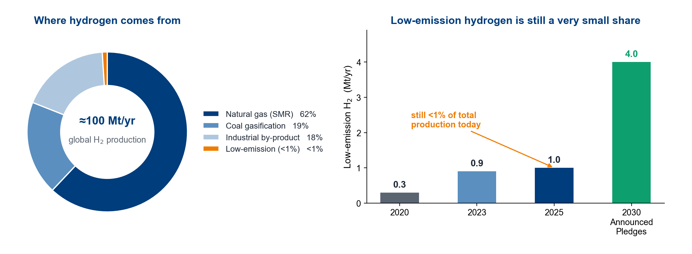
Hydrogen: why the world is moving to it
Hydrogen production is about 100 Mt per year and is still dominated by unabated fossil fuels. Low-emission hydrogen from electrolysis is about 1 Mt, i.e. below 1%.
Demand is expected to grow under announced pledges, so the production route — not the molecule — is the bottleneck. Water electrolysis is the route that can be decarbonised, and its cost is set by the anode.
Data: IEA Global Hydrogen Review 2025 and 2026.
1

Slide 3
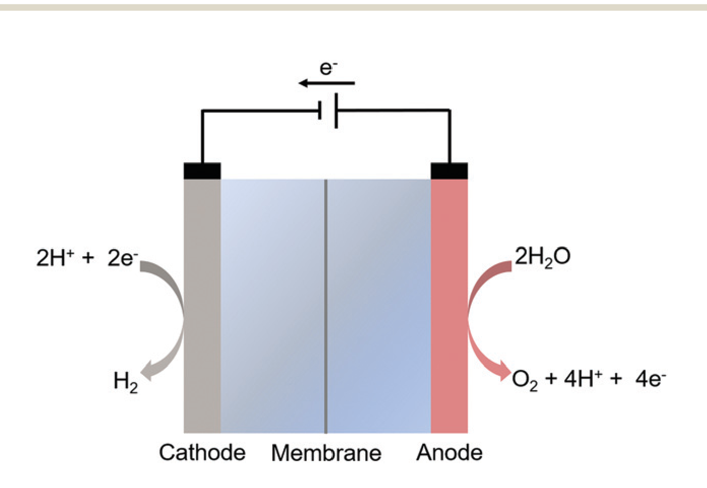
Making hydrogen: water electrolysis and its two half-reactions
Cathode (HER): 2 H₂O + 2 e⁻ → H₂ + 2 OH⁻
Anode (OER): 2 H₂O → O₂ + 4 H⁺ + 4 e⁻
OER is the bottleneck
Four electrons and four protons move through several intermediates, so the reaction is slow and carries most of the cell overpotential.
Two environments, two material sets
Alkaline media allow cheap Ni, Co or Fe oxides; acidic media (PEM) require Ir or Ru oxides.
Water splitting is two half-reactions, and the oxygen evolution reaction at the anode limits the whole cell.
Panel: Chem. Soc. Rev. 2020, 49, 2196, Fig. 1 (re-rendered at high resolution).
2

Slide 4
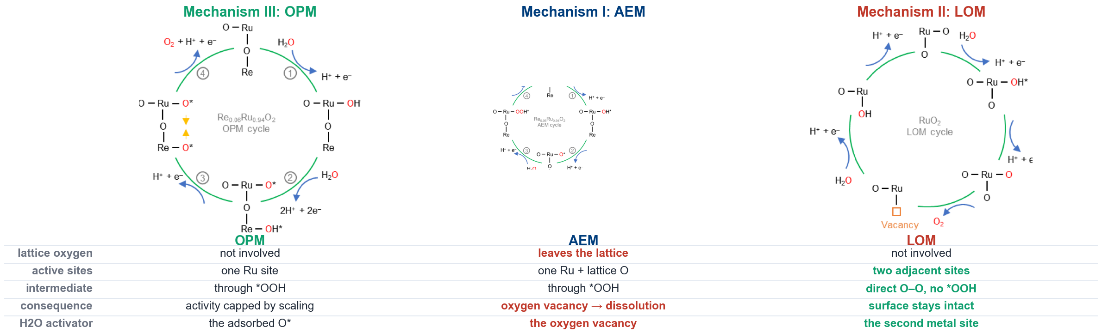
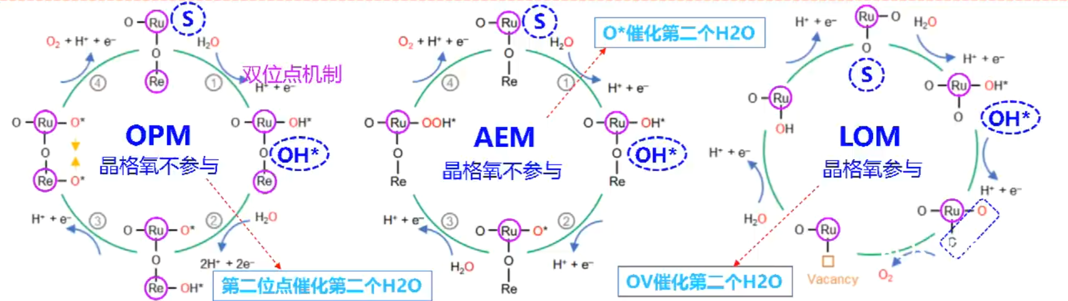
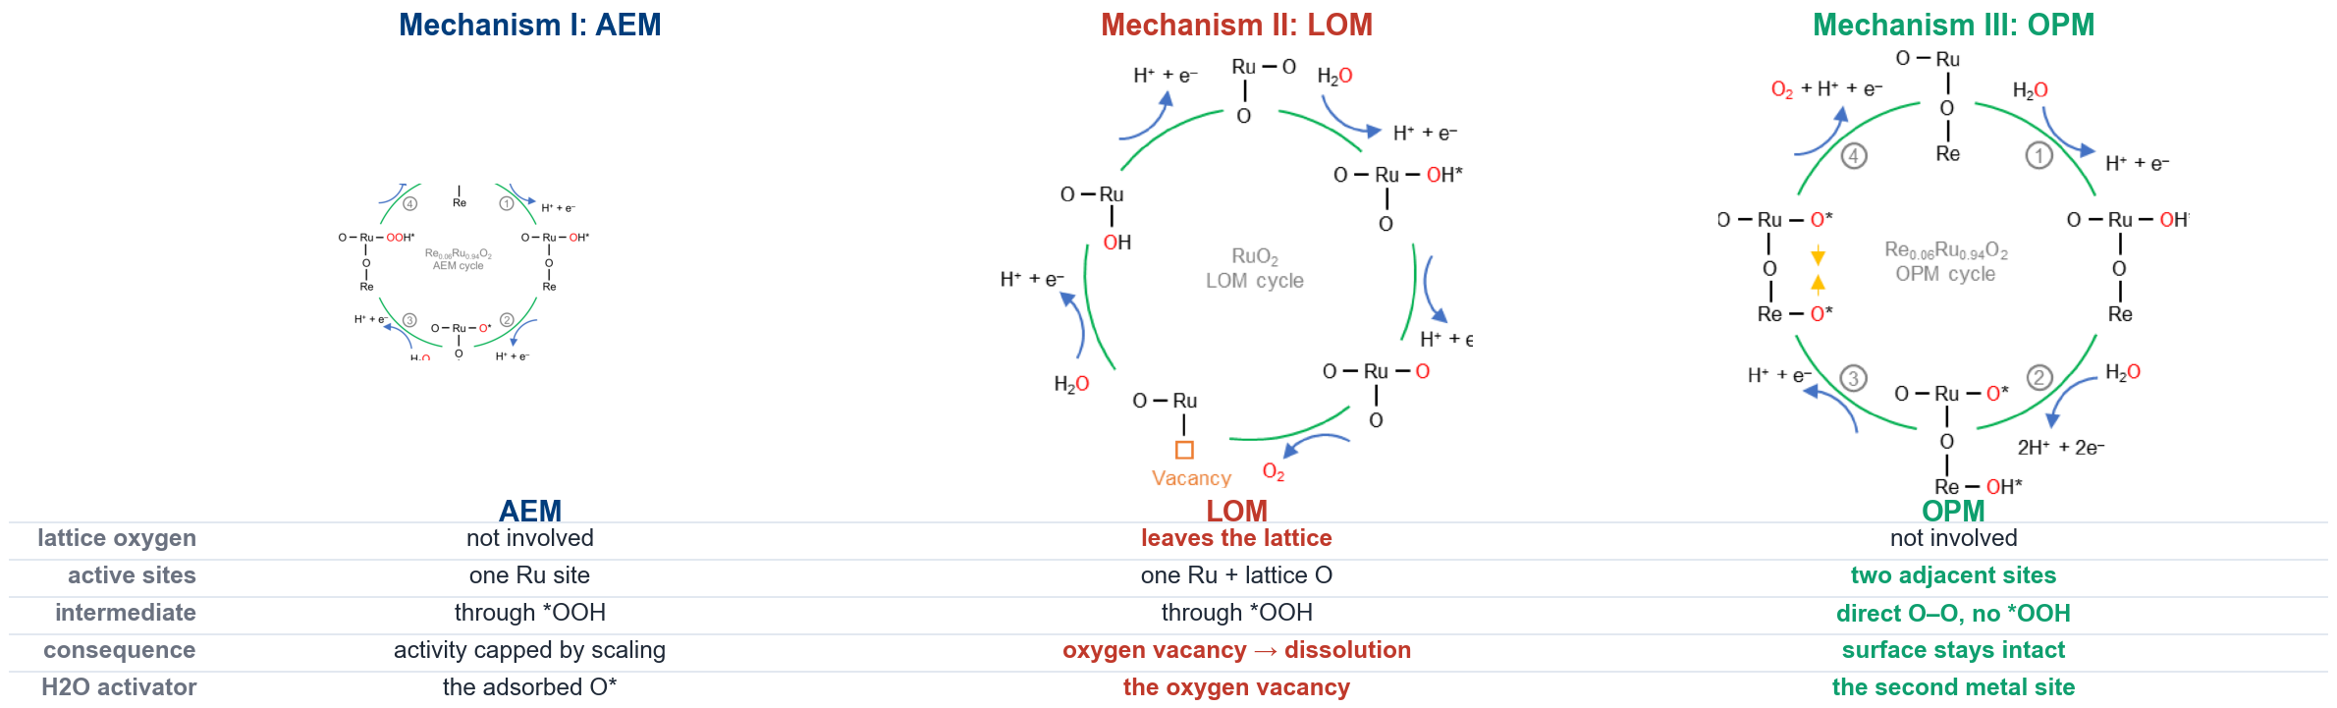
Three mechanisms side by side: what really differs
The three routes differ in two things: whether lattice oxygen is consumed, and whether one site or two adjacent sites perform the O–O coupling.
We target OPM: direct coupling needs no *OOH and leaves no vacancy, while LOM destroys the surface and AEM has a restriction.
Panels: Nat. Commun. 2023, 14, 354, Fig. 4d (AEM) and Supplementary Figs. 26 (LOM) and 35 (OPM), CC-BY.
3

Slide 5
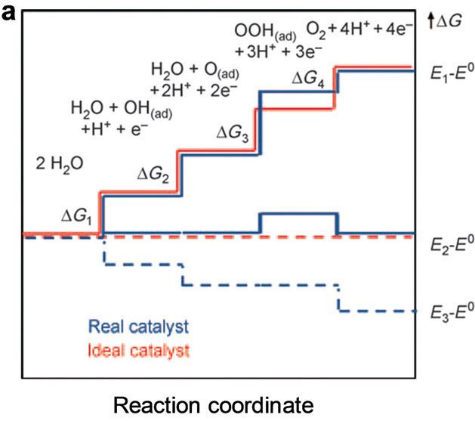
Mechanism I: AEM — four steps, and a ceiling you cannot remove
The four steps
AEM uses adsorbed oxygen only — H₂O → *OH → *O → *OOH → O₂ — all on the same metal site.
Why it is capped
Because *OH and *OOH both bind through a single oxygen, their energies move together: the scaling gap is about 3.2 eV, so one step is always larger than 1.23 eV.
Left: ideal versus real free-energy steps at U = 0 — no catalyst can make all four equal.
Result: an intrinsic floor of about 0.37 V. AEM can be improved, but never below that floor.
Chem. Soc. Rev. 2020, 49, 2196, Fig. 2a (adapted) · floor from Adv. Energy Mater. 2023, 13, 2301391, §3.2.
4

Slide 6
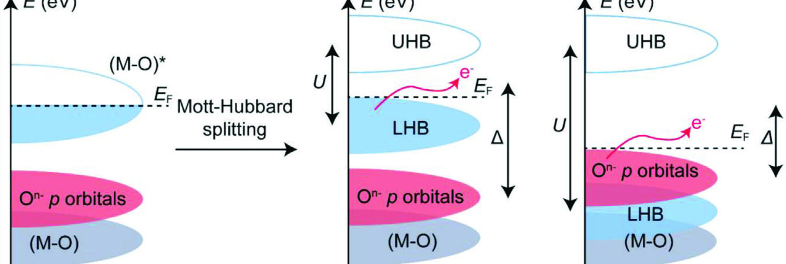
Mechanism II: LOM — faster, but the surface pays for it
When it switches on
Once the oxygen 2p states rise above the metal–oxygen band, lattice oxygen is oxidised and leaves as O₂.
What is left behind
An oxygen vacancy — and the metal is released together with the oxygen. This is the dissolution channel we must avoid in acid.
Left: Mott–Hubbard picture — the O 2p band is pushed towards the Fermi level, so lattice oxygen becomes redox-active.
LOM buys activity with the surface: the vacancy stays, and the metal follows the oxygen into solution.
Adv. Energy Mater. 2023, 13, 2301391, Fig. 1e (Mott–Hubbard picture) and §4; vacancy-to-dissolution link as reviewed there, §6.
5

Slide 7
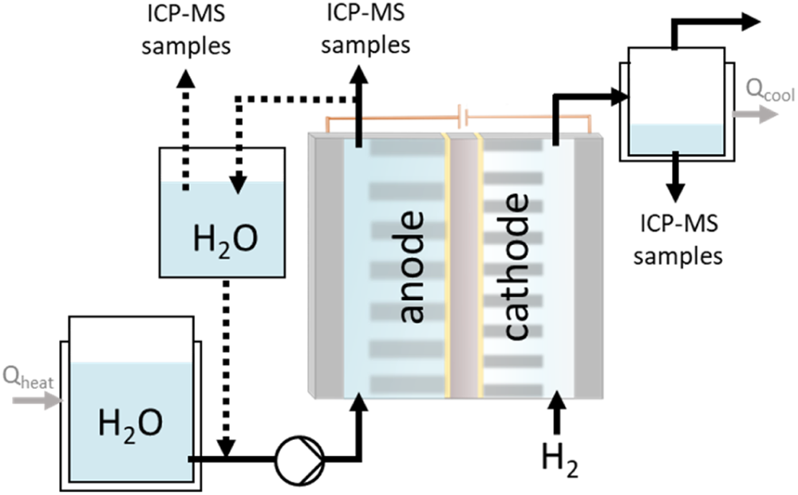
Platform: acidic PEM, because that is where the durability problem is
PEM matches renewable electricity
High current density, fast response and high-purity hydrogen; the membrane is acidic, so the anode sees about 1 M proton activity (pH 0).
Only Ir and Ru oxides survive there
Alkaline systems can use Ni, Co or Fe oxides. In acid the choice collapses to iridium and ruthenium, and iridium is the scarcest option.
The anode environment decides which elements are allowed, so the project is defined by durability at low noble-metal loading rather than by activity.
Panel: PEM electrolysis system review (cell schematic) · Chem. Soc. Rev. 2020, 49, 2196, §4.4.
6

Slide 8
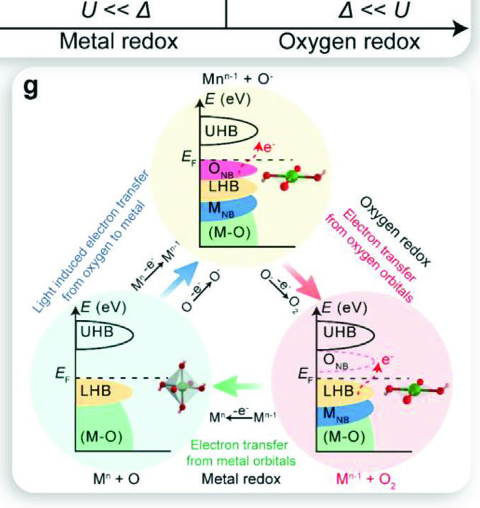
Element: ruthenium is cheap and active — but it dissolves
Why Ru and not Ir
RuO₂ is more active than IrO₂ for OER, and ruthenium is far cheaper and more abundant; iridium supply is the ceiling for PEM deployment.
Failure channel 1 — over-oxidation
Ruthenium is oxidised beyond +4 to soluble RuO₄ and leaves the electrode.
Failure channel 2 — lattice oxygen
Lattice oxygen participates, a vacancy is left behind, and the metal follows the oxygen out.
Both descriptions refer to the same surface: the metal redox and the oxygen redox must be controlled together. The proof of stabilisation has to be a dissolution measurement.
Adv. Energy Mater. 2023, 13, 2301391, Fig. 1g and §6 · Re-doped RuO₂: Nat. Commun. 2023, 14, 354.
7

Slide 9
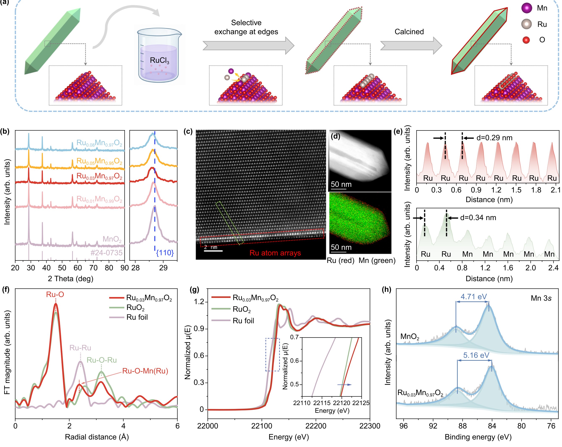
Solution: put Ru into a MnO₂ framework by electrodeposition
Mn³⁺/Mn⁴⁺ buffers the charge
The MnO₂ framework holds Ru near +4, outside the RuO₄ window.
The metal goes inside the lattice
Electrodeposited MnO₂ oxidises the metal and drives it in, forming M–O–Mn bridges; EXAFS shows the Ru–O–Mn shell.
Electrodeposition makes it tunable
Deposition charge, current and bath pH set the phase and edge-site density.
Figure: (a) synthesis route; (b) XRD of the Ru₀.₀₃Mn₀.₉₇O₂ series; (c) atomic-resolution STEM;
(d) EDS mapping; (e) intensity profiles; (f) Ru K-edge FT-EXAFS; (g) XANES; (h) Mn 3s XPS.
Our contribution: build it by electrodeposition and prove Ru sits inside the lattice, not on the surface.
Nat. Commun. 2026, 17, 7657, Fig. 2 · Science 2024, 384, 666, Fig. 1A (precedent with Ir).
8

Slide 10
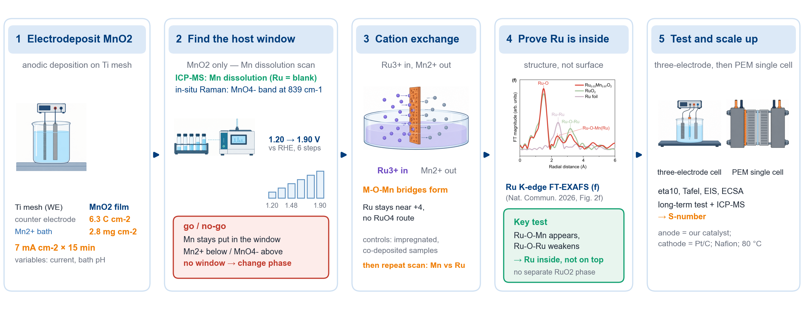
Experiment plan: deposit, window, exchange, prove, test
First priority: step 2 — find the MnO₂ host window (Mn²⁺ below, MnO₄⁻ above) before loading Ru.
Schematic drawn for this project: parameters per the group protocol; characterisation and testing practice follow Adv. Energy Mater. 2023 §5.
9

