Slide 1

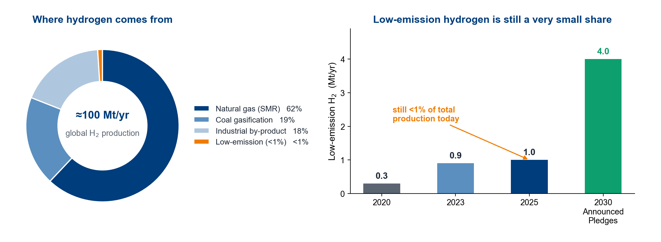
Hydrogen: why the world is moving to it
Hydrogen production is ≈100 Mt per year and is still dominated by unabated fossil fuels; low-emission hydrogen from electrolysis is about 1 Mt, i.e. below 1%.
Demand is expected to grow under announced pledges, so the production route — not the molecule — is the bottleneck. Water electrolysis is the route that can be decarbonised, and its cost is set by the anode.
Data: IEA Global Hydrogen Review 2025 and 2026 (production shares; low-emission hydrogen; Announced Pledges Scenario).
1

Slide 2
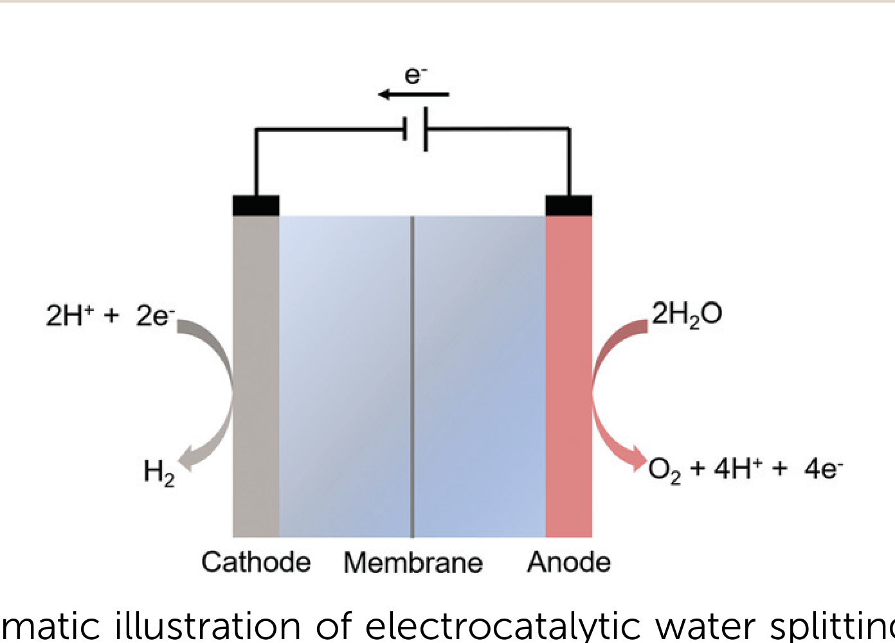
Making hydrogen: water electrolysis and its two half-reactions
Cathode (HER): 2 H₂O + 2 e⁻ → H₂ + 2 OH⁻
Anode (OER): 2 H₂O → O₂ + 4 H⁺ + 4 e⁻
OER is the bottleneck
It moves four electrons and four protons through several intermediates, so it is kinetically slow and carries most of the cell overpotential.
Two environments, two material sets
Alkaline media allow cheap Ni, Co or Fe oxides; acidic media (PEM) require Ir or Ru oxides.
Water splitting is two half-reactions; the oxygen evolution reaction at the anode limits the whole cell.
Panel: Chem. Soc. Rev. 2020, 49, 2196, Fig. 1 (re-rendered at high resolution).
2

Slide 3
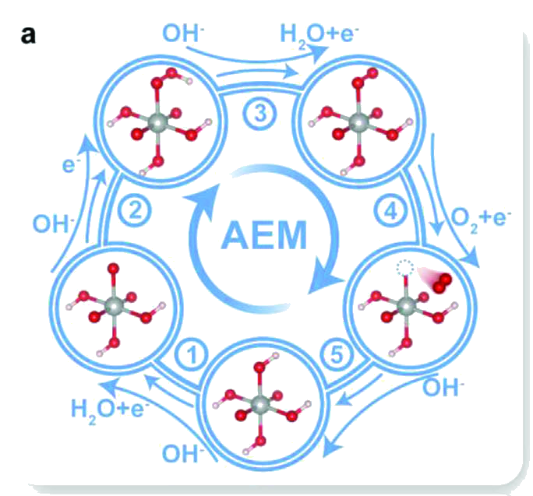
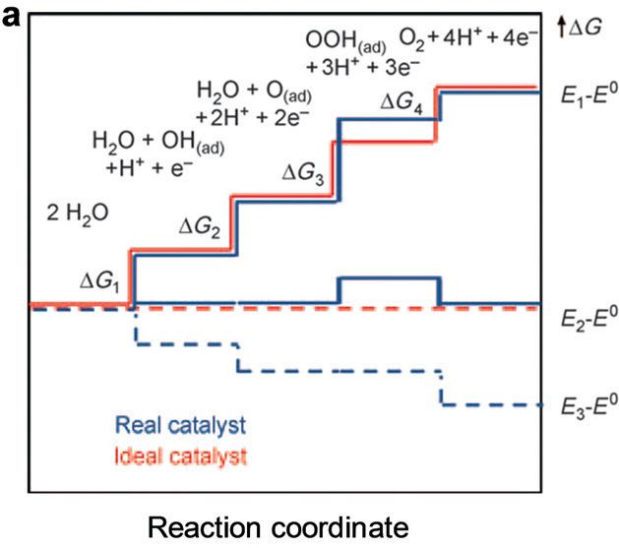
Mechanism I: adsorbate evolution (AEM) — four steps, one limit
The four steps use adsorbed oxygen only (AEM-5, Fig. 3a); the free-energy path is the same four steps (CSC-4, Fig. 3a, adapted).
The *OH–*OOH scaling gap (≈3.2 eV) prevents equal step energies, so one step is always larger.
Result: an intrinsic floor of about 0.37 V — activity cannot be improved within AEM.
Adv. Energy Mater. 2023, 13, 2301951, Fig. 3a · Chem. Soc. Rev. 2020, 49, 2196, Fig. 3a (adapted).
3

Slide 4
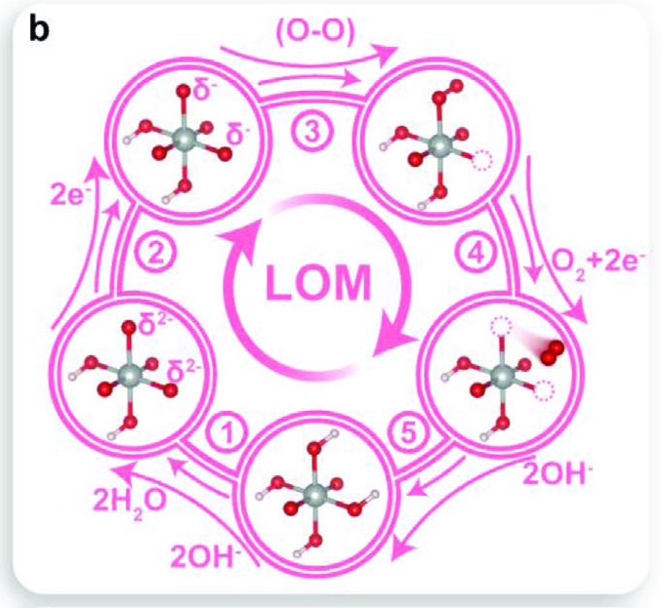
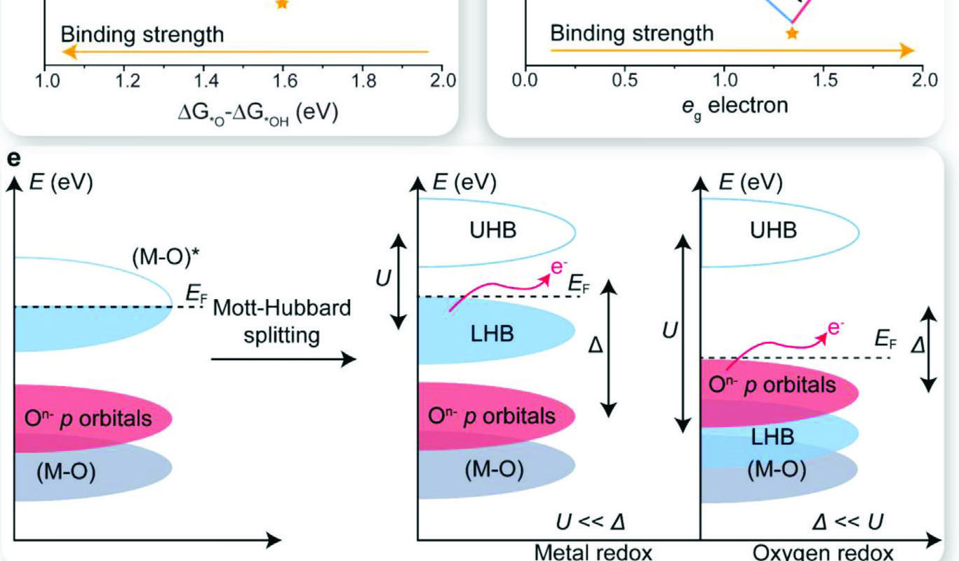
Mechanism II: lattice oxygen (LOM) — fast, but it destroys the surface
LOM: lattice oxygen is oxidised and leaves as O₂, leaving an oxygen vacancy (Adv. Energy Mater. 2023, Fig. 3b).
It switches on when the oxygen 2p states rise above the metal–oxygen band, close to the Fermi level (Fig. 3e, Mott–Hubbard picture).
Consequence: a vacancy is left behind, and the metal is released with the oxygen.
Adv. Energy Mater. 2023, 13, 2301951, Fig. 3b and Fig. 3e.
4

Slide 5
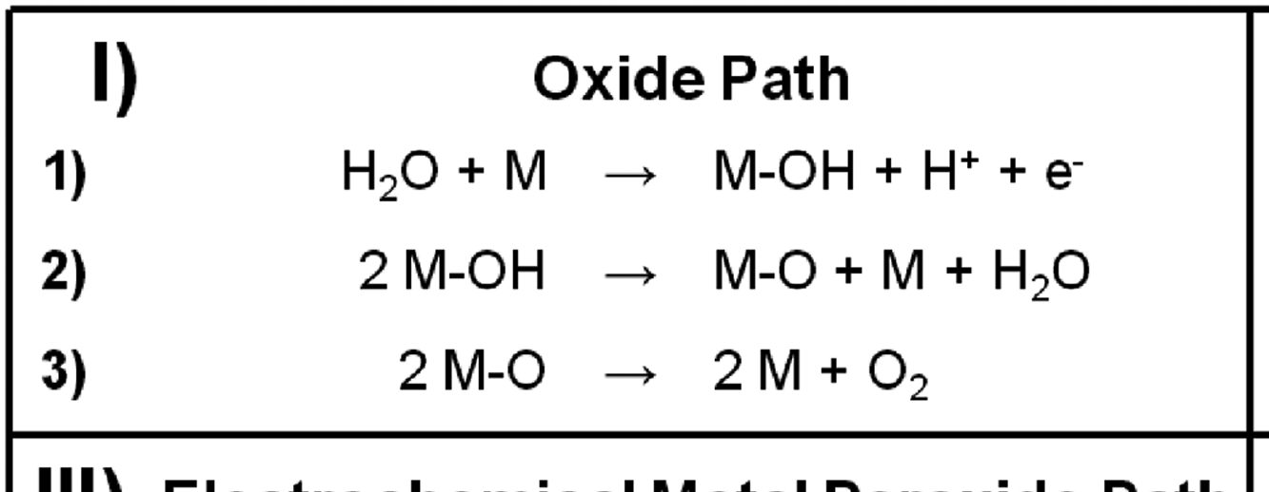
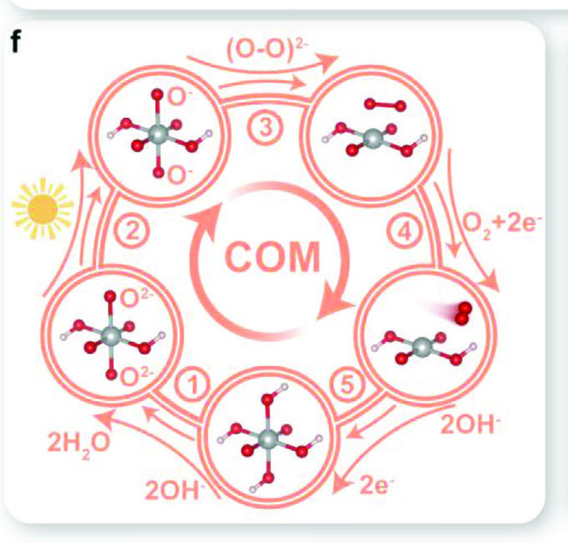
Mechanism III: oxide path (OPM) — and COM as a related route
OPM: two adjacent metal–oxo sites couple directly to O₂ — no *OOH intermediate, and no oxygen vacancy (Adv. Energy Mater. 2016, Fig. 1I).
COM (our group): light drives electron transfer to the metal, and O–O coupling occurs on the oxygen states (Adv. Energy Mater. 2023, Fig. 3f).
OPM keeps the surface intact while avoiding the *OOH bottleneck — this is the route we target.
Adv. Energy Mater. 2016, 6, 1601275, Fig. 1I · Adv. Energy Mater. 2023, 13, 2301951, Fig. 3f · Nature 2022, 611, 702.
5

Slide 6
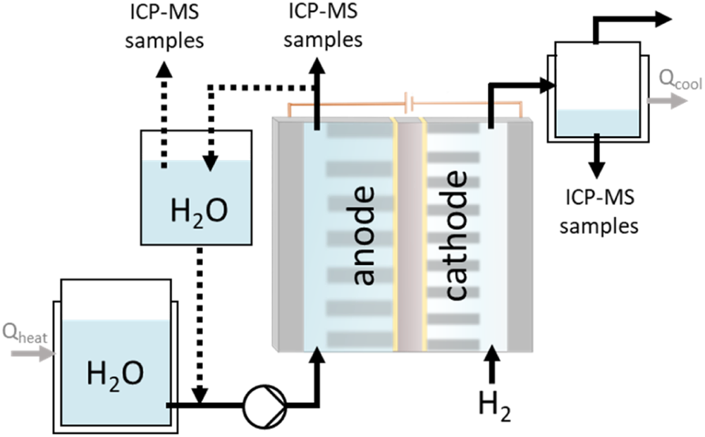
Platform: acidic PEM, because that is where the durability problem is
PEM matches renewable electricity
High current density, fast response and high-purity hydrogen; the membrane is acidic, so the anode sees about 1 M proton activity (pH 0).
Only Ir and Ru oxides survive there
Alkaline systems can use Ni, Co or Fe oxides; in acid the choice collapses to iridium and ruthenium — and iridium is the scarcest option.
The anode environment decides which elements are allowed: in acid, only Ir and Ru oxides are viable.
So the project is defined by durability at low noble-metal loading, not by activity.
Panel: PEM electrolysis system review (cell schematic). · Chem. Soc. Rev. 2020, 49, 2196, §4.4.
6

Slide 7
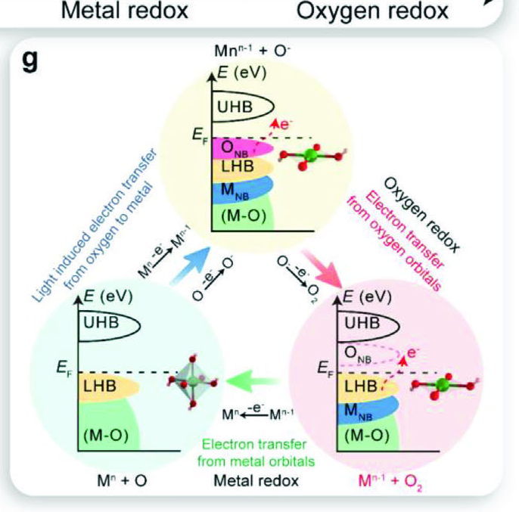
Element: ruthenium is cheap and active — but it dissolves
Why Ru, not Ir
RuO₂ is more active than IrO₂ for OER, and ruthenium is far cheaper and more abundant; iridium supply is the ceiling for PEM deployment.
Failure channel 1 — over-oxidation
Ruthenium is oxidised beyond +4 to soluble RuO₄ and leaves the electrode.
Failure channel 2 — lattice oxygen
Lattice oxygen participates (LOM), a vacancy is left behind, and the metal follows the oxygen out.
Metal redox and oxygen redox are the two competing descriptions of the same surface; both must be controlled.
Ruthenium needs a stabilisation strategy, and the proof must be a dissolution measurement.
Adv. Energy Mater. 2023, 13, 2301951, Fig. 3g · Adv. Energy Mater. 2023, 13, 2301951, §6.
7

Slide 8
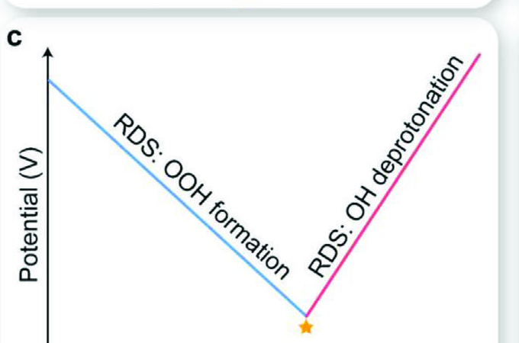
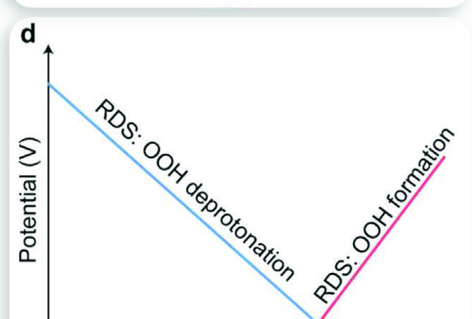
Route: target OPM, keep AEM as the fallback, avoid LOM
Our ranking
1. OPM — direct O–O coupling, no vacancy.
2. AEM — safe but capped at ≈0.37 V.
3. LOM — activity at the cost of the surface: avoid.
Precedent
Ru on α-MnO₂ prepared by cation exchange: 161 mV at 10 mA cm⁻², more than 200 h, oxide path mechanism, no oxygen vacancy.
Both volcano plots show the same ceiling: activity is set by the adsorption energies of the intermediates.
Breaking the scaling relation requires a different route — for us, OPM on a MnO₂-stabilised Ru site.
Adv. Energy Mater. 2023, 13, 2301951, Fig. 3c and Fig. 3d · precedent as reviewed in the same review, §6.
8

Slide 9
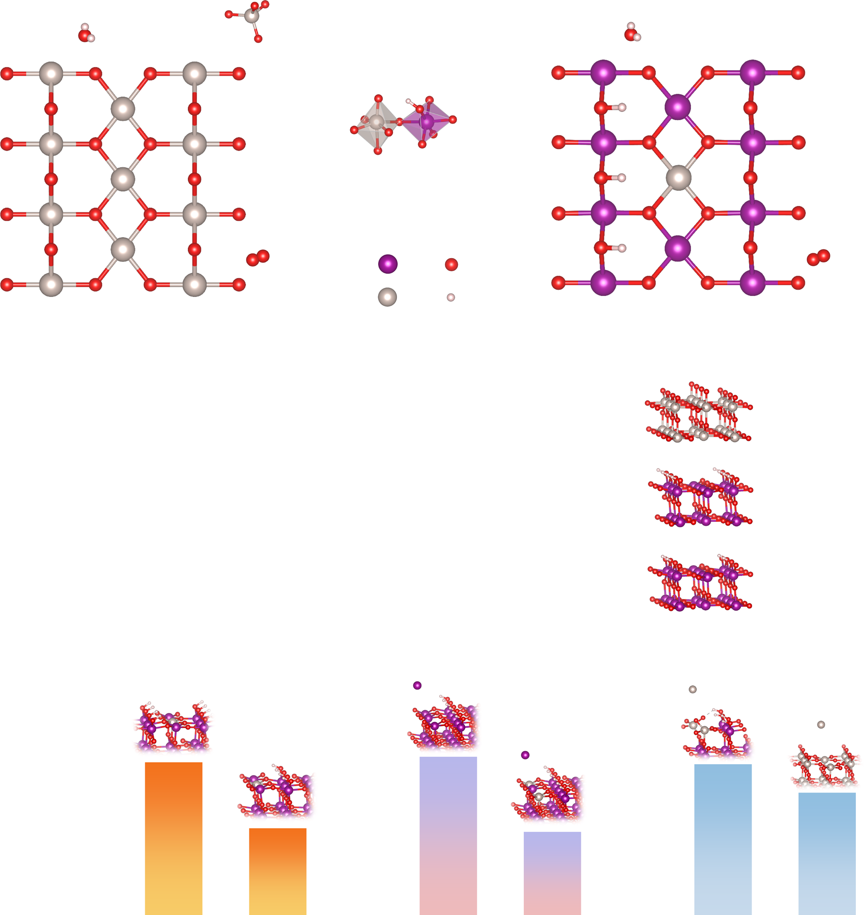
Solution: put Ru into a MnO₂ framework by electrodeposition
Mn³⁺/Mn⁴⁺ buffers the charge
The MnO₂ framework holds ruthenium near +4, outside the RuO₄ window, and the surface hydroxyls take part in the reaction (Nat. Commun. 2026, Fig. 1).
The metal goes into the lattice, not on top
The same idea is demonstrated with iridium: electrodeposited MnO₂ oxidises the metal and drives it in, giving M–O–Mn bridges (Science 2024, Fig. 1A).
Electrodeposition makes it tunable
Deposition charge, current and bath pH set the phase and the edge-site density, so the density of Ru–O–Mn coupling becomes a process variable we can scan. This is what the literature does not provide.
A cooperative Ru–MnO₂ architecture supplies both the support and the redox buffer; our contribution is to build it by electrodeposition and to prove ruthenium sits inside the lattice.
Nat. Commun. 2026, Fig. 1 (Ru–MnO₂ architecture) · Science 2024, 384, 666, Fig. 1A (precedent with Ir).
9

Slide 10
Experiment plan: deposit, window, exchange, prove, test
1 Electrodeposit MnO₂
Ti mesh or Ti felt; 7 mA cm⁻² for 15 min (≈6.3 C cm⁻²); current and bath pH as variables.
2 Find the stability window
Potential-step scan 1.40 → 1.90 V vs RHE with segmented ICP-MS (Ru and Mn separately).
3 Cation exchange with Ru
Bring Ru into the MnO₂ framework; run impregnated and co-deposited controls in parallel.
4 Prove Ru is inside
EXAFS: Ru–O–Mn appears while Ru–O–Ru weakens; paired XPS, Raman and STEM before and after activation.
5 Test and scale to a device
η10, Tafel, EIS and ECSA; long-term chronopotentiometry with ICP-MS, then a single-cell PEM test.
First priority is step 2: if manganese dissolves much faster than ruthenium and cannot be suppressed, the phase or the oxygen coordination is changed before any optimisation.
Characterisation and testing practice follows Adv. Energy Mater. 2023 §5 and Science 2024 (device-level reporting).
10

