Slide 1

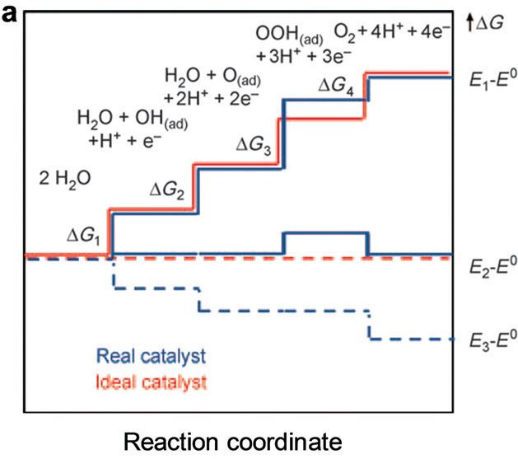
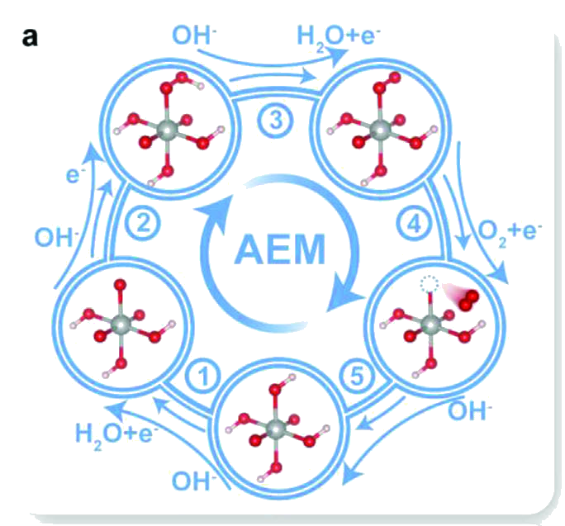
Mechanism I: the adsorbate evolution mechanism (AEM)
Left — the four-electron AEM cycle on a single metal site (Adv. Energy Mater. 2023, Fig. 3a): adsorbates only, no lattice oxygen involved.
Right — the free-energy path of the same four steps (Chem. Soc. Rev. 2020, Fig. 3a, adapted).
The *OH–*OOH scaling gap (≈3.2 eV) locks one step about 0.37 V above equilibrium: this is the AEM ceiling.
Figures reproduced from Adv. Energy Mater. 2023, 13, 2301951 and Chem. Soc. Rev. 2020, 49, 2196; adapted for this presentation.
3

