Slide 1

Stabilizing Ruthenium through Ru–O–Mn Interfacial Coupling for Acidic Oxygen Evolution
Final-year project · Progress review (first presentation)
Candidate
Zhao Shen
Programme
NUS–ECUST Joint Programme (MSE 311)
Supervisor
Prof. Xue Junmin, Materials Science and Engineering
Mentor
Yu Junchen, NUSRI-CQ
Date
24 September 2026

Slide 2
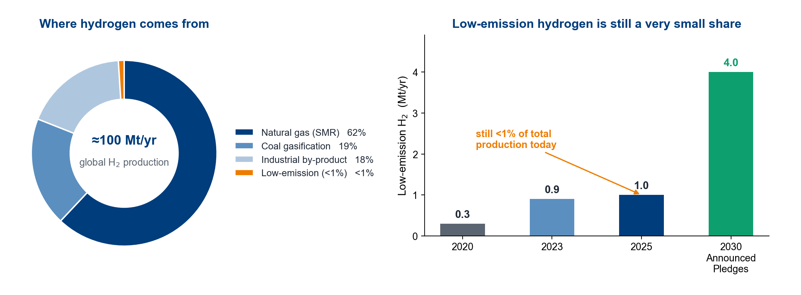
Hydrogen: why the world is moving to it
About 100 Mt H2 a year; low-emission H2 is still under 1%.
The bottleneck is the route, not the molecule.
Data: IEA Global Hydrogen Review 2025 and 2026.
1

Slide 3
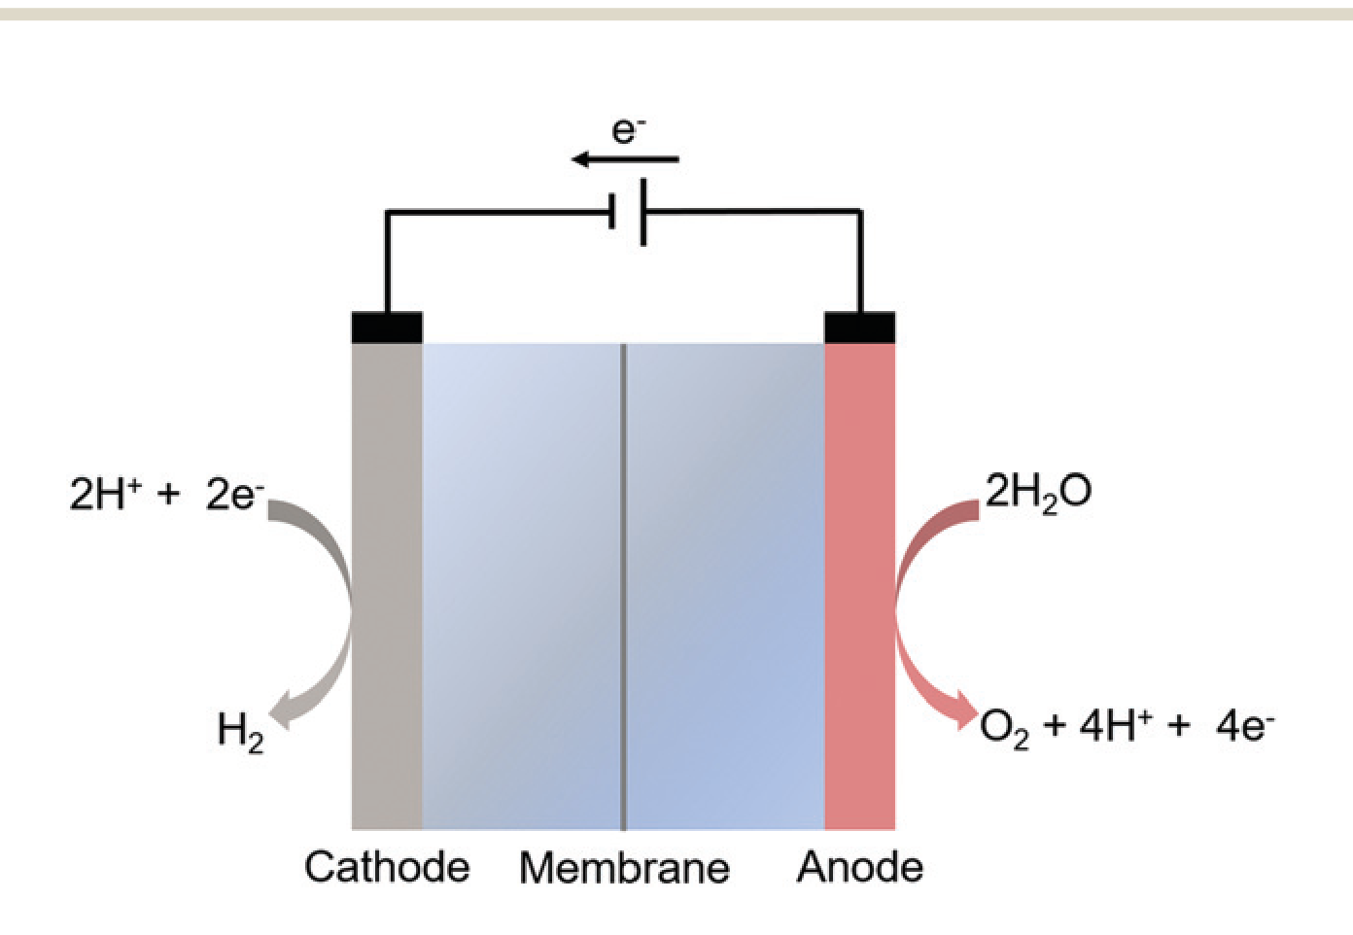
Making hydrogen: two half-reactions
Cathode (HER): 2 H₂O + 2 e⁻ → H₂ + 2 OH⁻
Anode (OER): 2 H₂O → O₂ + 4 H⁺ + 4 e⁻
OER is the bottleneck
Four electrons and four protons: the slow half-reaction.
Two environments, two material sets
Alkaline: cheap Ni, Co or Fe. Acid (PEM): only Ir or Ru.
The anode limits the whole cell.
Panel: Chem. Soc. Rev. 2020, 49, 2196, Fig. 1 (re-rendered at high resolution).
2

Slide 4
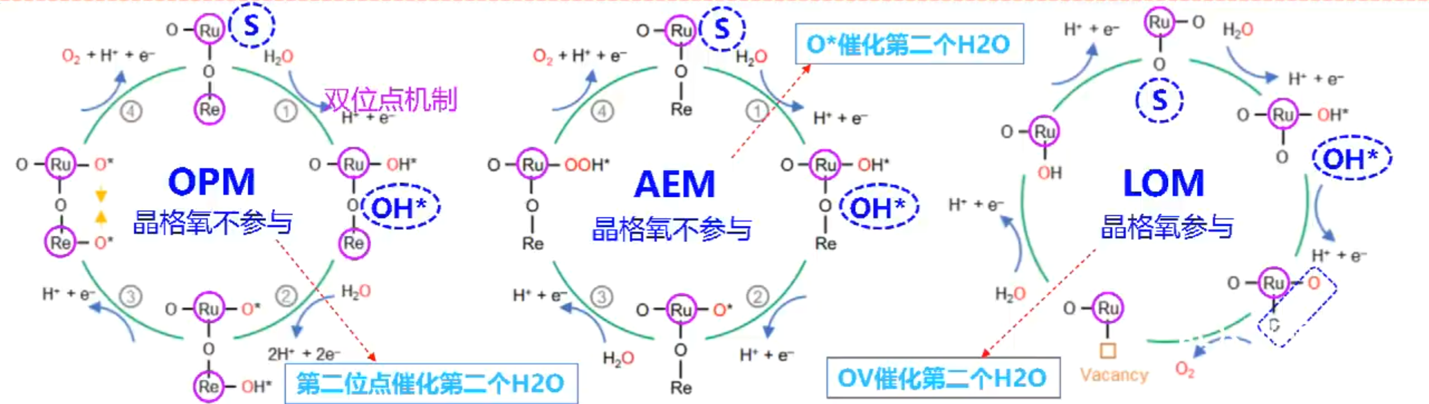
Three mechanisms side by side: what really differs
O catalyzes the
second H2O
Dual-site mechanism
Lattice oxygen does not
participate
Lattice oxygen does not
participate
Lattice oxygen
participates
Second site catalyzes
the second H2O
OV catalyzes the
second H2O
The three routes differ in two things: whether lattice oxygen is consumed, and whether one site or two adjacent sites perform the O–O coupling.
We target OPM: direct coupling needs no *OOH and leaves no vacancy, while LOM destroys the surface and AEM has an restriction.
Panels: Nat. Commun. 2023, 14, 354, Fig. 4d (AEM) and Supplementary Figs. 26 (LOM) and 35 (OPM), CC-BY.
3

Slide 5
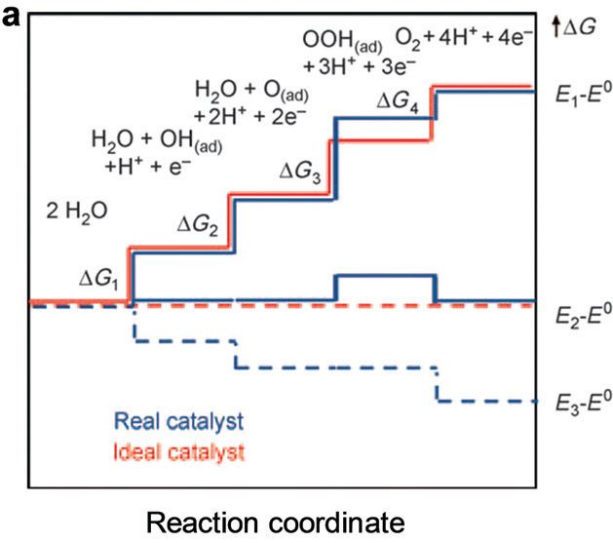
Mechanism I: AEM and its 0.37 V ceiling
The four steps
One site: H2O -> *OH -> *O -> *OOH -> O2.
Why it is capped
*OH and *OOH are locked together by a ~3.2 eV scaling gap.
Ideal steps are equal; real steps never are.
Floor ~ 0.37 V: AEM cannot go below it.
Chem. Soc. Rev. 2020, 49, 2196, Fig. 2a (adapted) · floor from Adv. Energy Mater. 2023, 13, 2301391, §3.2.
4

Slide 6
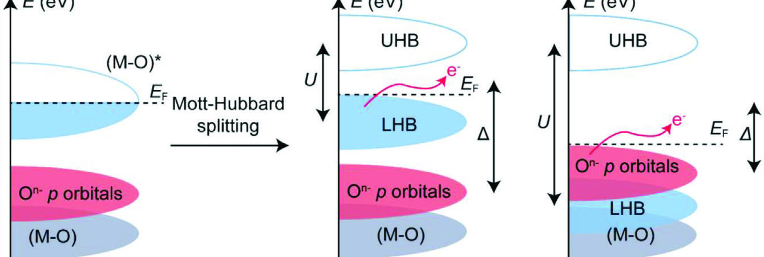
Mechanism II: LOM pays with the surface
When it switches on
When O 2p rises to E_F, lattice O leaves as O2.
What is left behind
Vacancy left behind -> the metal dissolves in acid.
Mott-Hubbard: the O 2p band rises towards E_F.
LOM buys activity with the surface.
Adv. Energy Mater. 2023, 13, 2301391, Fig. 1e (Mott–Hubbard picture) and §4; vacancy-to-dissolution link as reviewed there, §6.
5

Slide 7
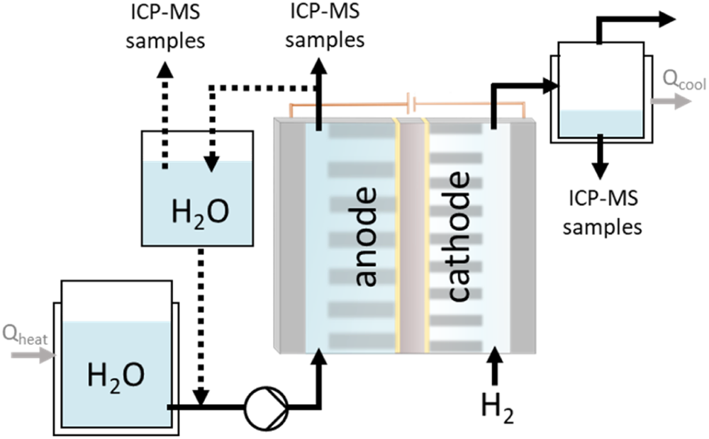
Platform: why acidic PEM
PEM matches renewable electricity
High current density; the anode sees ~1 M H+ (pH 0).
Only Ir and Ru oxides survive there
In acid only Ir or Ru survive - and Ir is the scarcest.
This project is about durability at low noble-metal loading.
Panel: PEM electrolysis system review (cell schematic) · Chem. Soc. Rev. 2020, 49, 2196, §4.4.
6

Slide 8
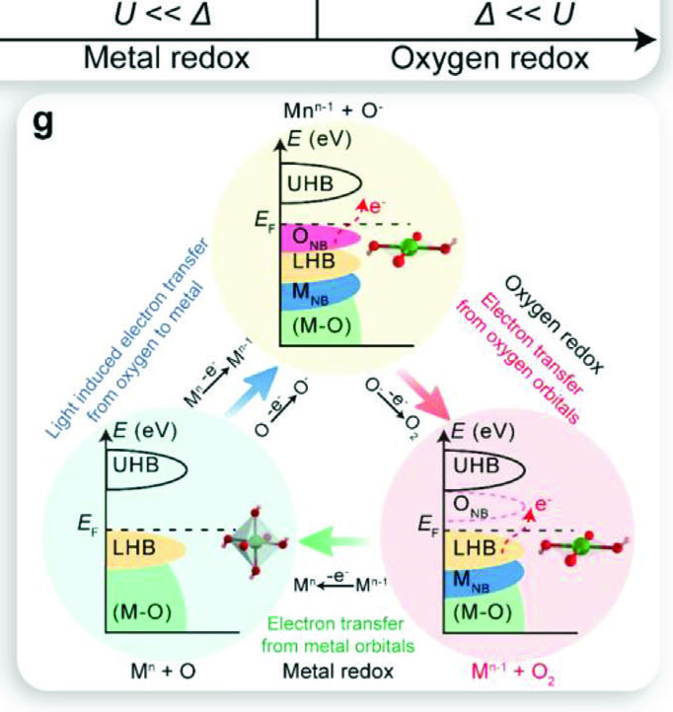
Element: Ru is active - but it dissolves
Why Ru and not Ir
More active than IrO2, far cheaper, more abundant.
Failure channel 1 — over-oxidation
Ru above +4 becomes soluble RuO4 and leaves.
Failure channel 2 — lattice oxygen
Lattice O leaves -> vacancy -> metal follows.
Both channels act together: stability is proved by dissolution numbers.
Adv. Energy Mater. 2023, 13, 2301391, Fig. 1g and §6 · Re-doped RuO₂: Nat. Commun. 2023, 14, 354.
7

Slide 9
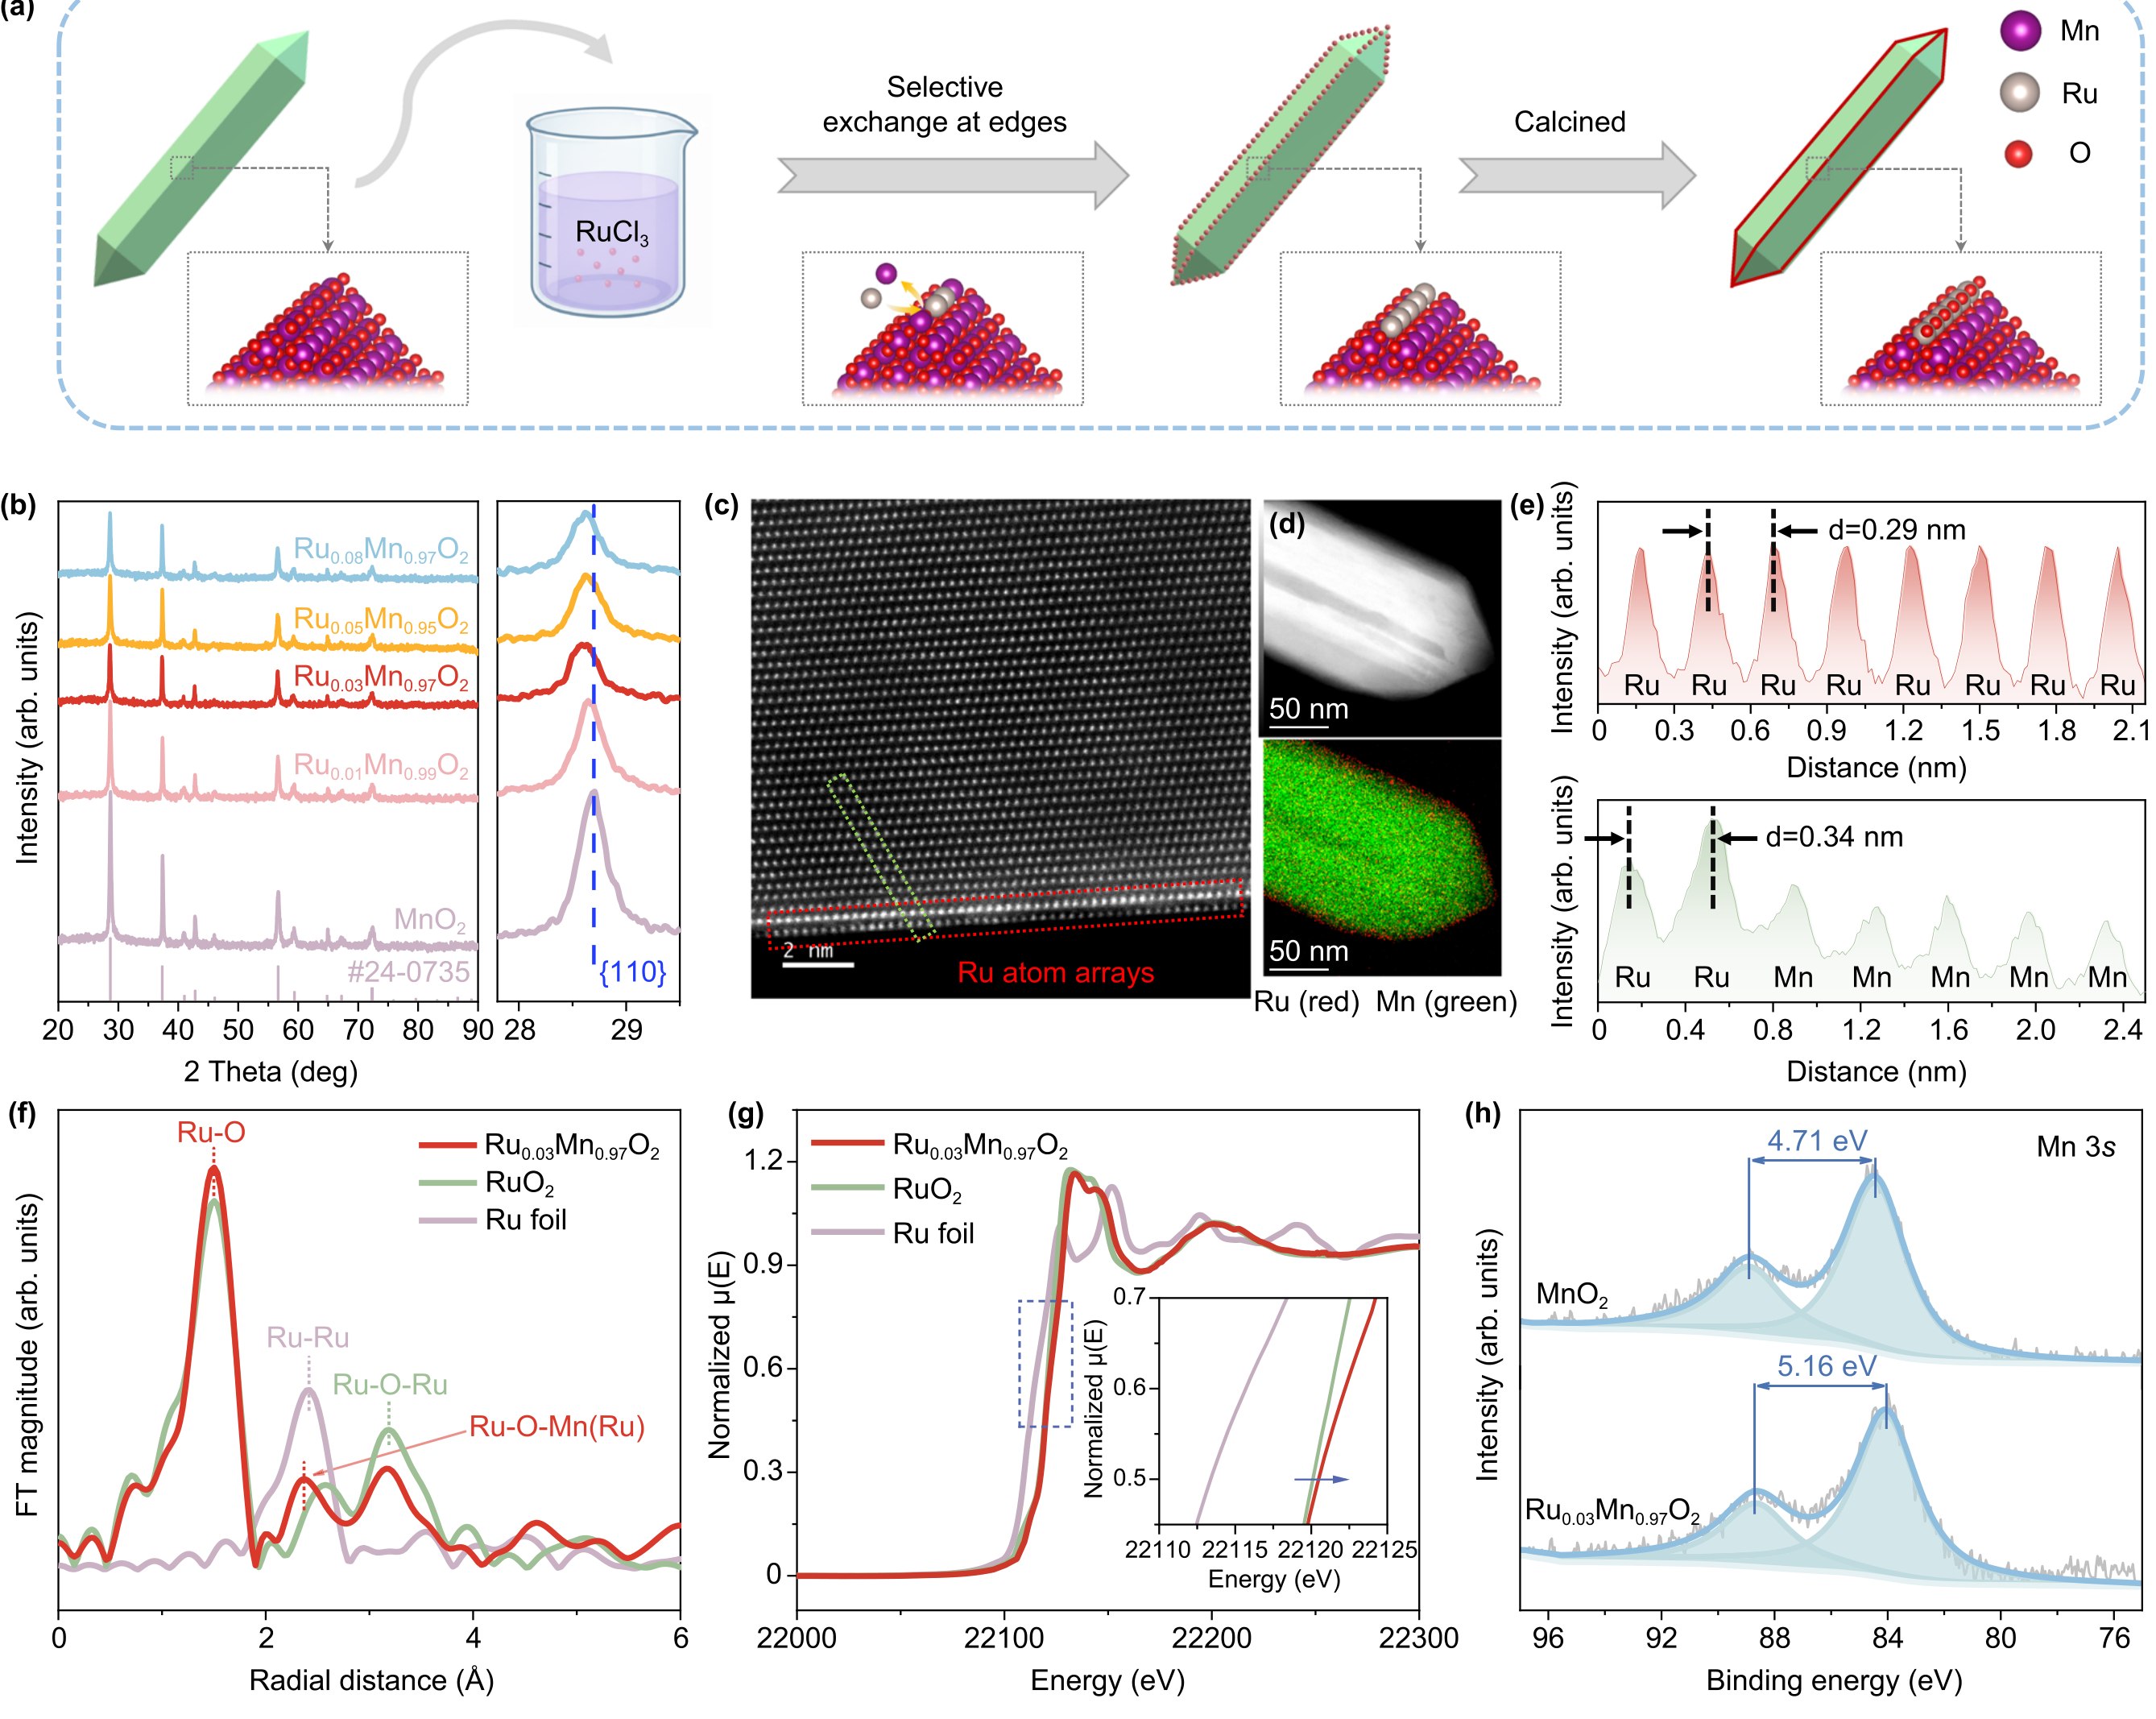
Solution: Ru inside a MnO2 framework
Mn³⁺/Mn⁴⁺ buffers the charge
Holds Ru near +4 - outside the RuO4 window.
The metal goes inside the lattice
It drives Ru in, forming M-O-Mn bridges.
Electrodeposition makes it tunable
Charge, current and bath pH set the phase.
Fig. 2: synthesis, structure and spectroscopy (a-h).
Our job: electrodeposit it and prove Ru sits inside.
Nat. Commun. 2026, 17, 7657, Fig. 2 · Science 2024, 384, 666, Fig. 1A (precedent with Ir).
8

Slide 10
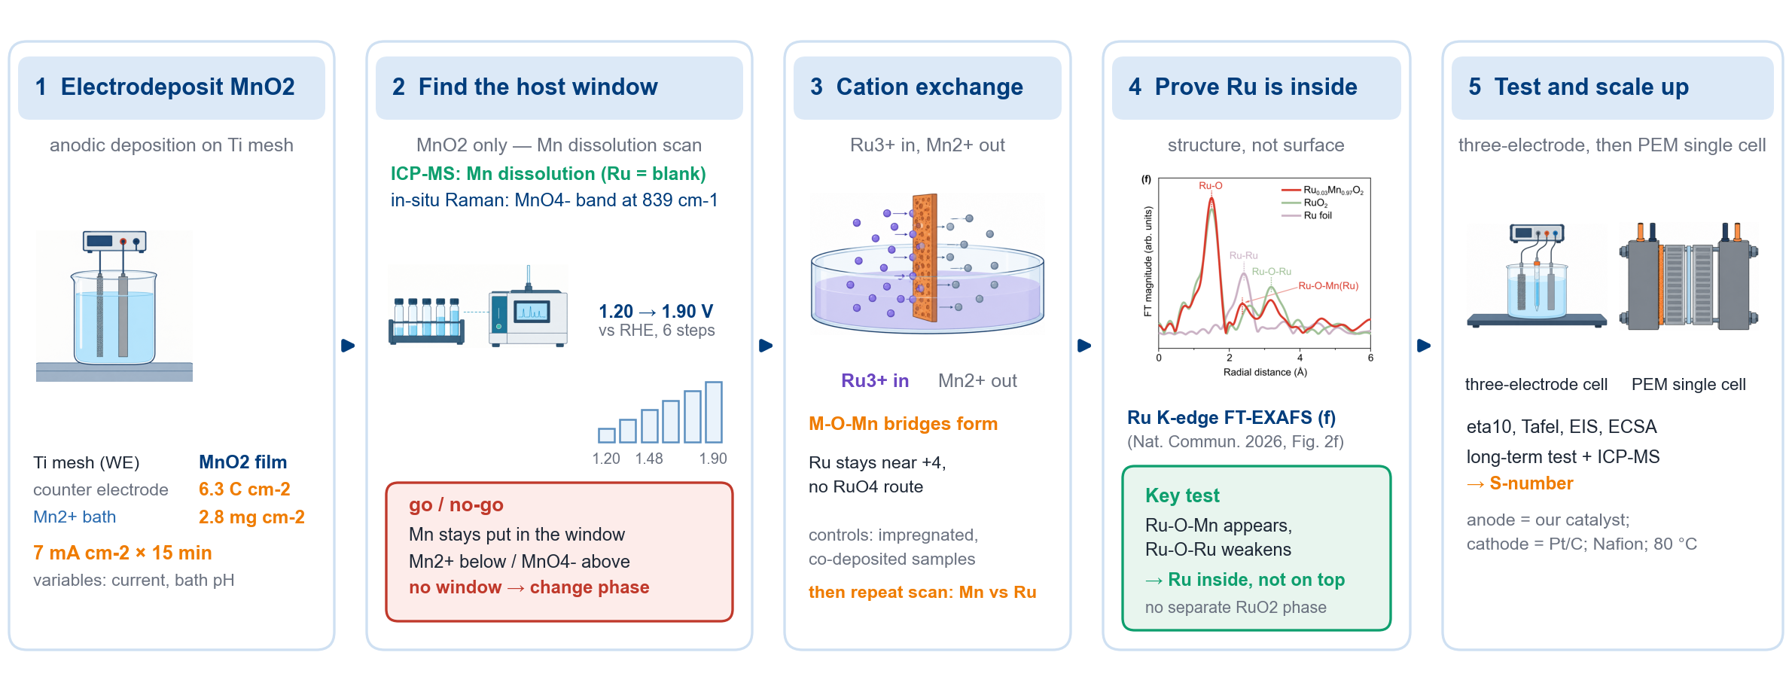
Experiment plan: deposit, window, exchange, prove, test
First priority: the host window (step 2).
Schematic drawn for this project: parameters per the group protocol; characterisation and testing practice follow Adv. Energy Mater. 2023 §5.
9

