Slide 1

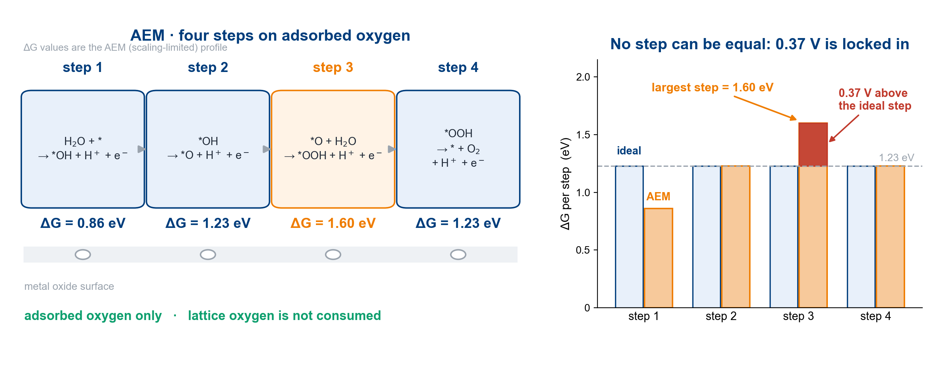
AEM: four steps on adsorbed oxygen, capped at 0.37 V
One step is always larger: AEM cannot go below about 0.37 V.
Chem. Soc. Rev. 2020, 49, 2196 · Adv. Energy Mater. 2023, 13, 2301391
3

