Slide 1

FINAL-YEAR PROJECT · PROGRESS REVIEW
Stabilizing Ruthenium through
Ru–O–Mn Interfacial Coupling
for Acidic Oxygen Evolution
TODAY
01 Background
Why acidic OER is a durability
problem
02 Literature review
The five assigned papers
03 Experiment plan
Synthesis, testing and
go / no-go design
Candidate
Zhao Shen
Programme
NUS–ECUST Joint Programme (MSE 311)
Supervisor
Prof. Xue Junmin, Materials Science & Engineering
Mentor
Yu Junchen · Laboratory: NUSRI-CQ
Group meeting
Thursday 24 September 2026, 16:30
Notes:
Good afternoon everyone. My name is [Name], and my final-year project is "Stabilizing Ruthenium through Ru–O–Mn Interfacial Coupling for Acidic Oxygen Evolution", supervised by Professor Xue Junmin, with [mentor] as my mentor. Today I will cover three things: the background, the literature review, and the experiment plan.
【中文对照】【封面】题目：通过 Ru–O–Mn 界面耦合稳定钌，用于酸性析氧。汇报人 Zhao Shen；导师薛军民教授；mentor 禹俊辰；组会时间 9 月 24 日 16:30。今天讲三块：背景 / 文献综述 / 实验计划。

Slide 2

OUTLINE
What I will cover
2 / 10
01
02
03
Background
Literature review
Experiment plan
Why acidic OER is a durability problem,
and why ruthenium
Five assigned papers:
design · reconstruction · interface & device
Synthesis · activation · characterisation ·
testing · go / no-go
NUS MSE 311 · Final-Year Project progress review · 24 September 2026
Outline
Notes:
The outline is simple. First, why acidic oxygen evolution is a durability problem and why ruthenium is the element we care about. Second, what the five papers I was given actually teach us. Third, what we plan to do — synthesis, characterization and testing — and where the main risk is.
【中文对照】【目录】三块结构：① 背景——为什么酸性析氧的瓶颈是耐久性、为什么关注钌；② 文献综述——mentor 给的 5 篇文献各教会我们什么；③ 实验计划——合成、活化、表征、测试与 go/no-go 判据。声明：文献页只用 mentor 指定的 5 篇。

Slide 3
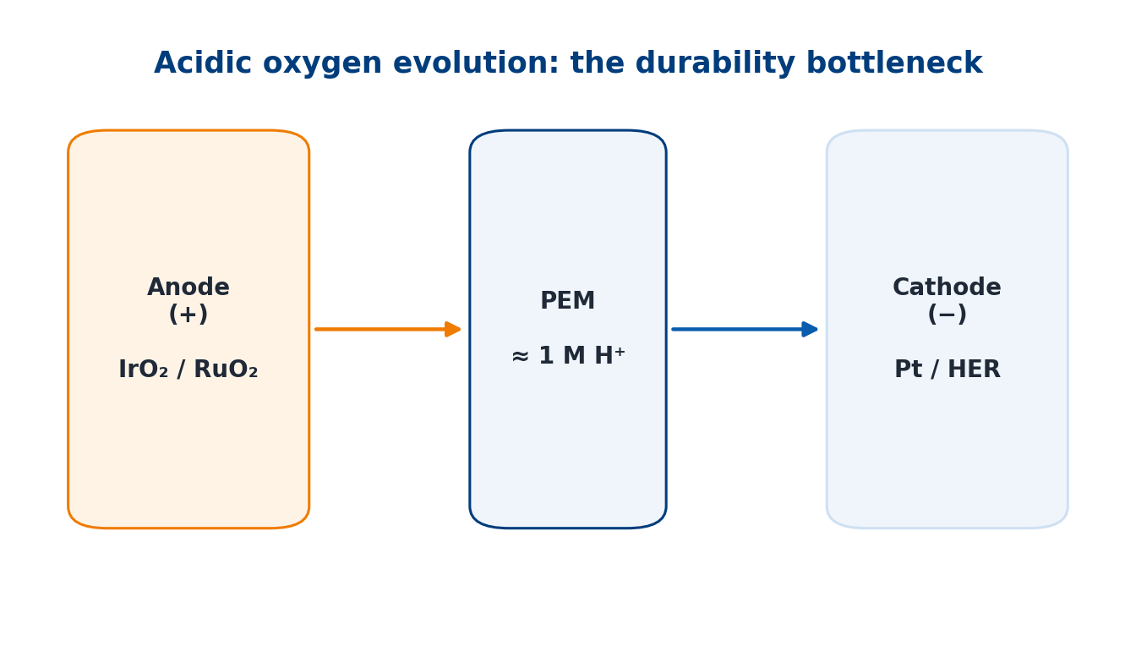
BACKGROUND
Acidic water electrolysis: the bottleneck is durability
3 / 10
In one sentence: we want to make the acidic OER anode cheaper by keeping Ru from dissolving — and we build the Ru–O–Mn interface that does this by electrodeposition, a process we can tune.
PEM electrolysis works at ≈ 1 M proton activity
Almost no transition-metal oxide survives; only Ir and Ru oxides do
Ir is among the scarcest elements; even IrO₂ dissolves as soluble [IrO₄]²⁻
So the constraint is durability at low noble-metal loading
Why it matters for us
– Noble-metal loading, not activity, sets the cost of PEM stacks.
– Our target metal (Ru) is cheaper — but the least stable.
Schematic: PEM electrolyser — only Ir/Ru oxides survive the acidic anode.
Takeaway: acidic OER is limited by durability at low noble-metal loading — not by activity.
Source: CSC-4, Chem. Soc. Rev. 2020, §4.4 (p. 2208).
NUS MSE 311 · Final-Year Project progress review · 24 September 2026
Background
Notes:
Proton exchange membrane electrolysis is the most mature route to green hydrogen, and it works in a strongly acidic environment — the sulfonic-acid membrane is equivalent to roughly one molar proton. In that environment almost no transition-metal oxide survives; only iridium and ruthenium oxides do. Iridium, however, is one of the scarcest elements on earth, and even the benchmark IrO₂ is not immune: it dissolves in both acid and base through formation of soluble IrO₄²⁻. So the bottleneck is not activity — it is durability at low noble-metal loading. That is the problem this project sits in.
【中文对照】【背景】PEM 电解在强酸环境（膜相当于 1 M 质子）中运行，只有铱和钌的氧化物能撑住；铱极稀缺、连基准 IrO₂ 都会溶（生成可溶 IrO₄²⁻）。所以瓶颈不是活性，而是低贵金属载量下的耐久性——这就是本课题的落点。

Slide 4
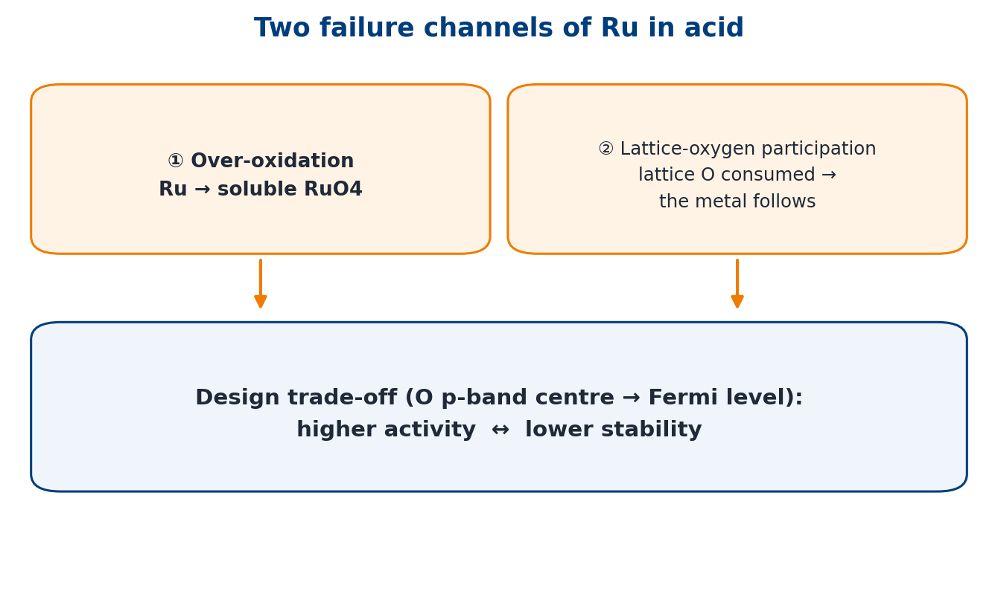
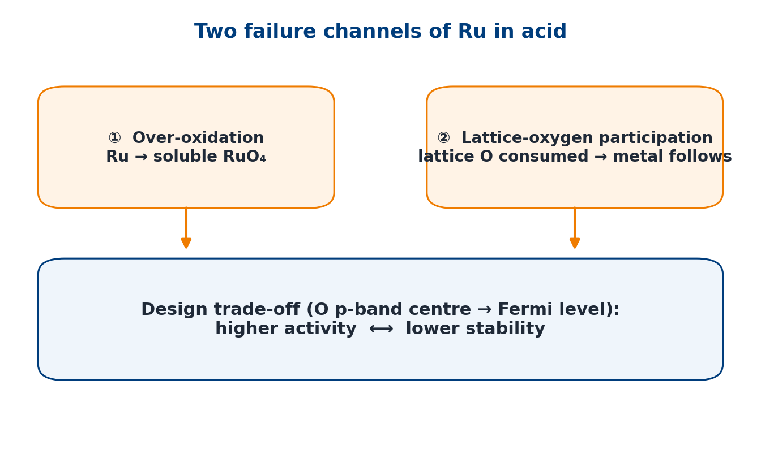
BACKGROUND
The Ru paradox: more active and cheaper — but less stable
4 / 10
RuO₂is more active and far cheaper than IrO₂
Failure channel ①: over-oxidation to soluble RuO₄
Failure channel ②: lattice-oxygen (LOM) participation — the metal follows the oxygen
Design trade-off: O p-band centre closer to E_{F} → higher activity, lower stability
The question is not activity, but how to keep Ru where it is
What this implies
– Stabilisation must reduce Ru dissolution, not just lower the overpotential.
– Any gain must be shown by a dissolution-based metric.
Ru fails through RuO₄ formation and lattice-oxygen participation; activity and stability trade off.
Takeaway: Ru needs a stabilisation strategy, not simply a higher intrinsic activity.
Sources: AEM-5, Adv. Energy Mater. 2023, §6 (p. 15); CSC-4 §2.2–2.3 (p. 2202).
NUS MSE 311 · Final-Year Project progress review · 24 September 2026
Background
Notes:
Ruthenium is the attractive alternative: RuO₂ is more active and far cheaper than IrO₂. But in acid, Ru fails through two channels. First, over-oxidation to soluble RuO₄ — ruthenium can be pushed to a high oxidation state where it leaves the surface. Second, participation of lattice oxygen: when oxygen evolution proceeds through the lattice-oxygen mechanism, lattice oxygen is consumed and the metal follows it into solution. There is also a well-known design trade-off: moving the oxygen p-band centre closer to the Fermi level increases activity but decreases stability. So the question is not "which catalyst is more active", but how do we keep ruthenium where it is.
【中文对照】【背景·钌悖论】RuO₂ 比 IrO₂ 更活泼也更便宜，但在酸里会从两条通道失稳：① 过氧化生成可溶 RuO₄；② 晶格氧参与反应（LOM），金属随氧一起溶。还有一条躲不开的规律：氧 p 带中心越靠近费米能级活性越高、稳定性越低。结论：问题不是更活泼，而是"怎么把钌留在电极上"。

Slide 5
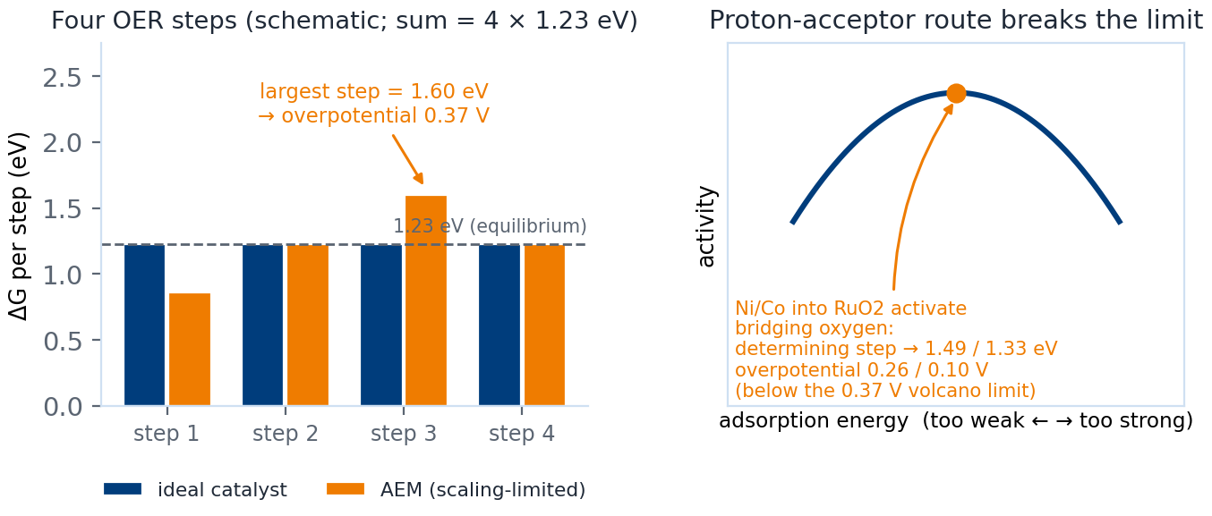
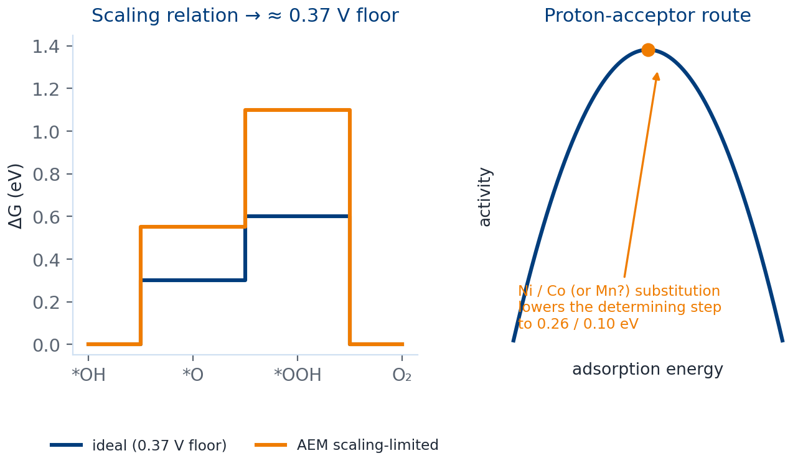
LITERATURE
I — Design principles, and why MnO₂ is allowed
5 / 10
Scaling relation caps AEM at ≈ 0.37 V overpotential
Proton-acceptor route: Ni/Co into RuO₂ activates bridging oxygen (step 0.26 / 0.10 eV)
γ-MnO₂ reported to run 8000 h at pH = 2
Warning: a suitable potential window must be identified
Mn³⁺ provides the optimal eg occupancy (eg = 1)
Two consequences for us
– Mn can play the proton-acceptor / charge-buffer role (Mn³⁺, eg = 1).
– Its usable potential window must be measured first.
Scaling relation, the proton-acceptor route, and the reported acid stability of γ-MnO₂.
Takeaway: design rules exist (proton acceptor) and MnO₂ is allowed in acid — but its potential window must be found.
Sources: CSC-4 §2.1 (p. 2197), §3.2 (pp. 2203–2204), §4.4 (p. 2208), §2.2 (p. 2200).
NUS MSE 311 · Final-Year Project progress review · 24 September 2026
Literature review
Notes:
From the Chem Soc Rev review I take the design frame. First, the scaling relation between the *OH and *OOH intermediates caps the adsorbate-evolution mechanism at roughly 0.37 volts of overpotential; breaking it requires stabilising *OOH independently, introducing a proton acceptor, or switching to the lattice-oxygen mechanism. The proton-acceptor route is the one relevant to us: substituting nickel or cobalt into RuO₂ activates bridging oxygen and lowers the potential-determining step to about 0.26 and 0.10 volts — below the volcano top. Second, and very practical: the same review reports that γ-MnO₂ can operate for 8000 hours at pH 2, and that doping with titanium or germanium stabilises its reaction terminus and creates more coordinatively unsaturated sites. It also warns that a suitable potential window must be identified for any transition-metal oxide — and that warning becomes our first experiment. Third, manganese is not just a bystander: Mn³⁺ provides the optimal e_g occupancy of one.
【中文对照】【文献综述 I · CSC-4】设计原理：标度关系把 AEM 的过电位锁在约 0.37 V；破局路径之一是"质子受体"——把 Ni/Co 掺入 RuO₂ 活化桥位氧，把电位决定步降到 0.26/0.10 eV，低于火山顶。同时该综述记载 γ-MnO₂ 在 pH 2 下 8000 h 不失活、掺 Ti/Ge 可稳定它，但警告"必须先找到合适电位窗口"。Mn³⁺ 还恰好提供最优 eg 占据。

Slide 6
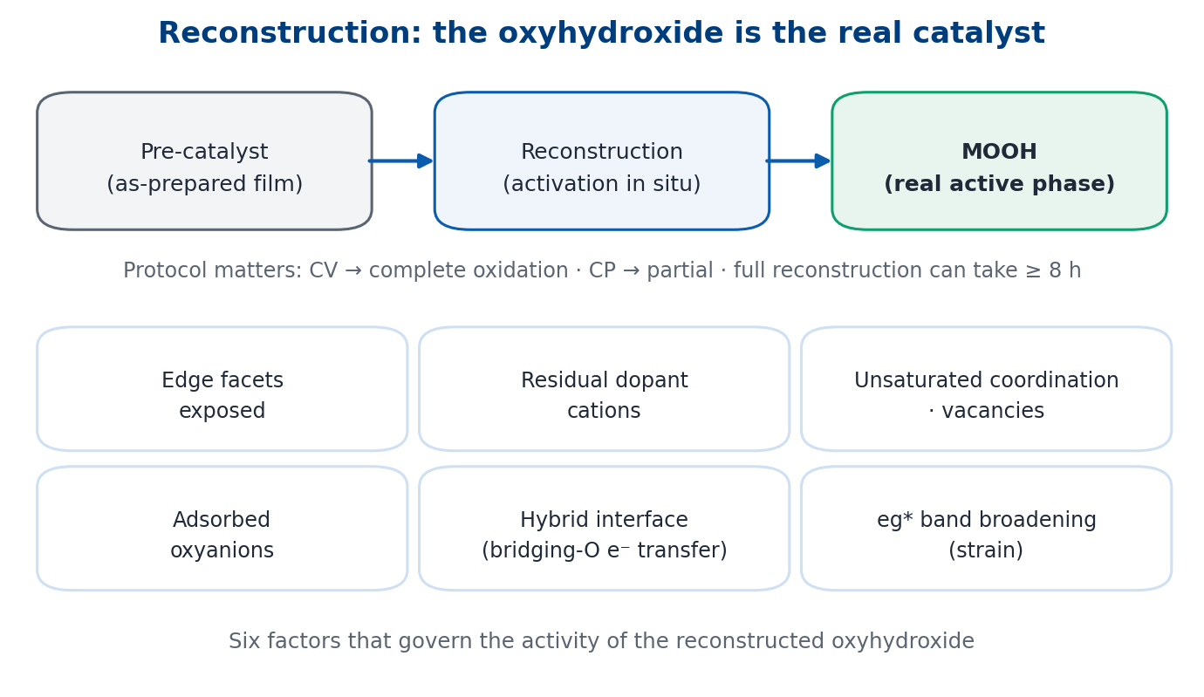
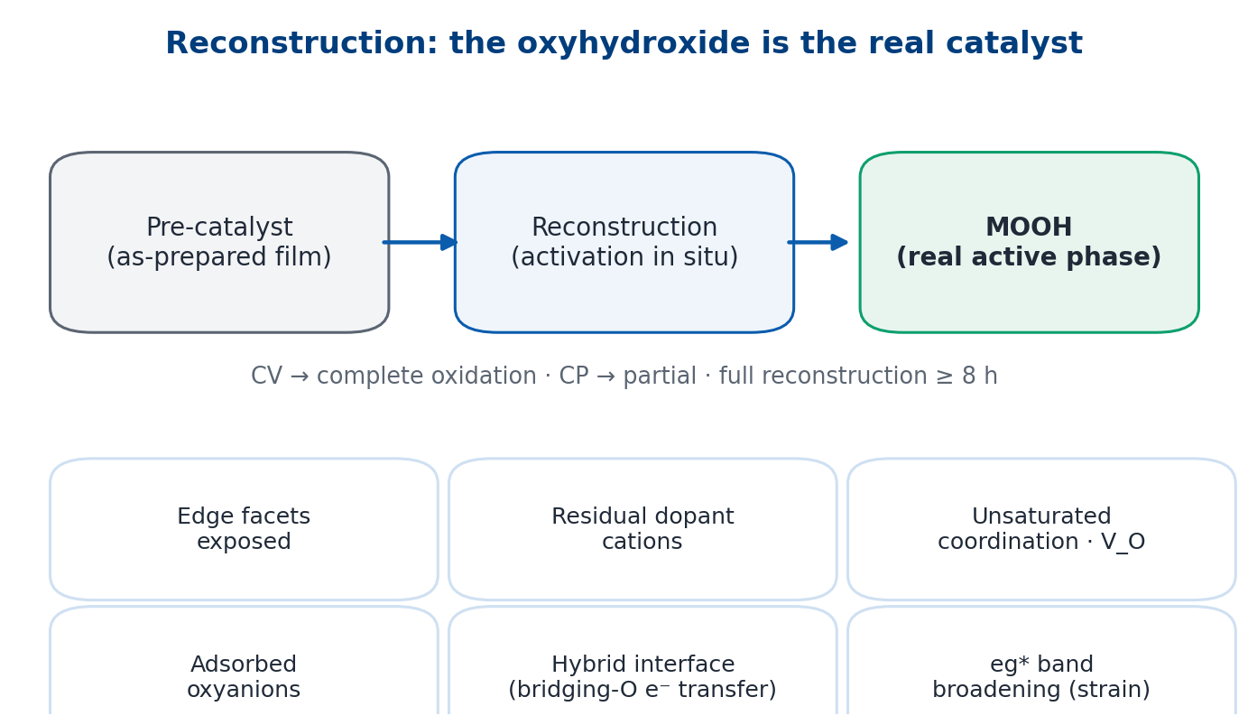
LITERATURE
II — Reconstruction chemistry and Ru stabilisation in acid
6 / 10
The real active phase is the reconstructed oxyhydroxide, not the as-prepared film
Four reconstruction mechanisms; six activity factors (strain → eg* broadening; hybrid interfaces)
Activation protocol matters: CV → complete oxidation, CP → partial; full reconstruction ≥ 8 h
In acid: Ru fails via RuO₄ + LOM; two proven routes — single-atom confinement, higher oxygen-vacancy formation energy
Precedent recorded there: Ru/α-MnO₂ cation exchange — 161 mV, > 200 h
How we use it
– The film we deposit is a pre-catalyst; the interface forms on activation.
– Activation protocol is an experimental variable, not a step.
Pre-catalyst → reconstruction → oxyhydroxide (real active phase); six factors govern its activity.
Takeaway: the real catalyst is the reconstructed oxyhydroxide; in acid, two stabilisation routes are already proven.
Source: AEM-5, Adv. Energy Mater. 2023, §3–§6 (pp. 5–16), incl. p. 6 and p. 13.
NUS MSE 311 · Final-Year Project progress review · 24 September 2026
Literature review
Notes:
From our own group's review I take the reconstruction language. The catalytically real phase is not the as-made solid but the oxyhydroxide formed by irreversible reconstruction, and six factors govern its activity — edge facets, residual dopant cations, coordinatively unsaturated sites and oxygen vacancies, adsorbed oxyanions, hybrid interfaces where a bridging oxygen transfers electrons, and e_g* band broadening caused by lattice strain. Two practical points for us: the activation protocol changes the product — cyclic voltammetry gives complete oxidation, whereas chronopotentiometry gives only partial reconstruction; and complete reconstruction can take more than eight hours. For acid specifically, the review states that Ru fails through RuO₄ formation and lattice-oxygen participation, and that two stabilisation routes are proven: confining the metal as single-atom sites, or raising the oxygen-vacancy formation energy — for example tungsten- or erbium-doped RuO₂ reaches 168 millivolts and 500 hours in acid. The same section records a Ru on α-MnO₂ precedent — cation exchange, in-situ reconstruction into Ru atom arrays, the oxide path mechanism without oxygen vacancies, 161 millivolts and more than 200 hours — as reviewed in that paper.
【中文对照】【文献综述 II · AEM-5（薛组综述）】核心语言是"重构"：真正的活性相不是刚做出来的材料，而是用电过程中不可逆重构出的羟基氧化物（MOOH）；六个因素决定其活性（含应变→eg* 带展宽、桥氧电子转移的杂化界面）。实操两点：CV 造成完全氧化、计时电位只造成部分重构；完全重构可能要 ≥8 h。酸性部分指出钌的两条失稳通道与两条已验证的稳定路线（单原子限域、提高氧空位形成能），并记载了 Ru/α-MnO₂ 阳离子交换先例（161 mV、>200 h，as reviewed in our group's review）。

Slide 7
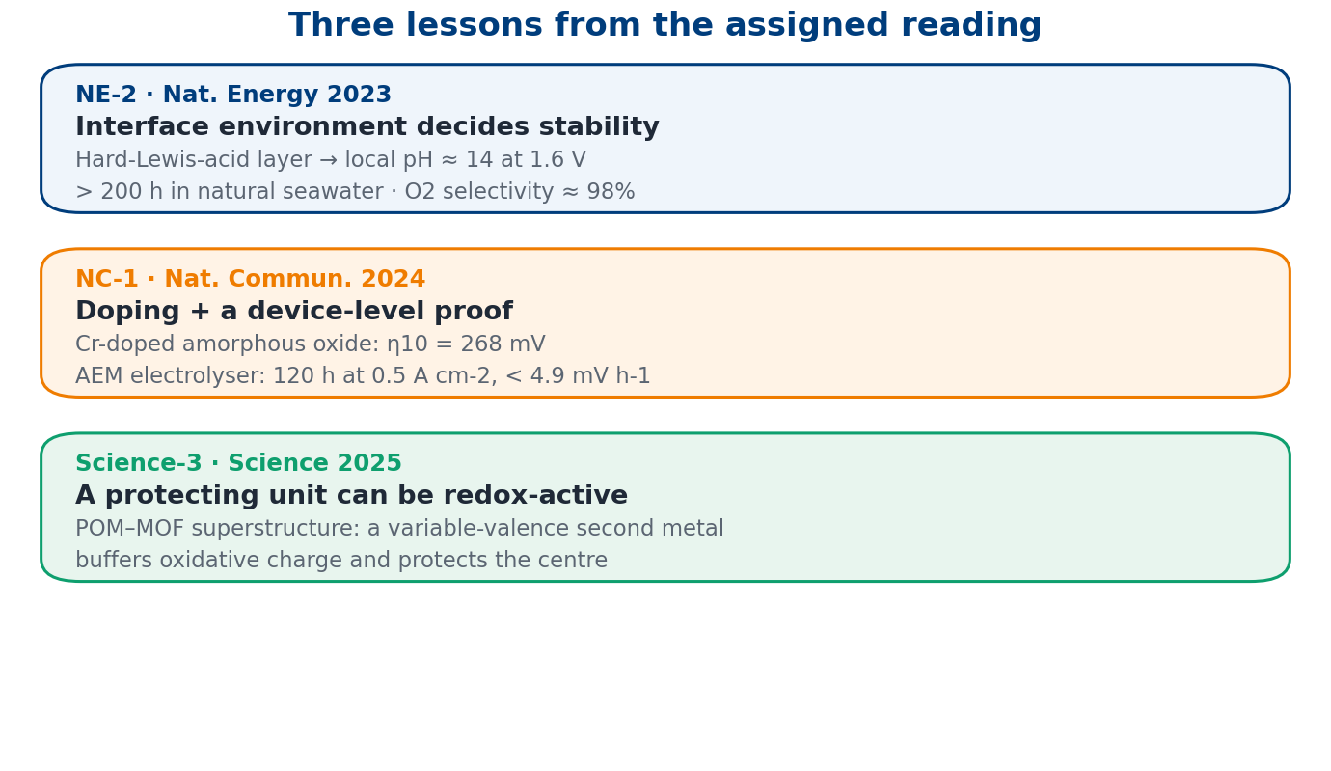
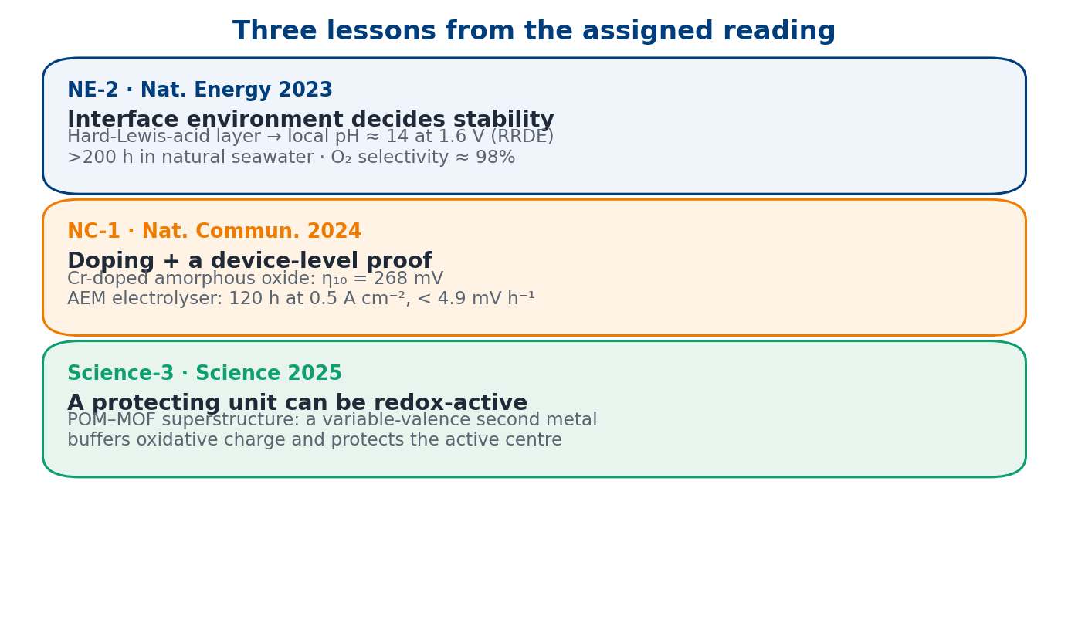
LITERATURE
III — Interface environment, doping practice, device-level proof
7 / 10
NE-2: what happens around the site decides stability (local pH ≈ 14 at 1.6 V)
NC-1: doping stabilises the metal — and always finish with a device test
Science-3: a protecting unit can be redox-active, not inert
Together: principles, chemistry, interface and device practice are established
What is missing: how to BUILD the Ru–MnO₂ interface controllably and scalably
So the gap is
– Chemistry: established. Interface environment: understood.
– Process: how to build Ru–O–Mn controllably — still open.
One lesson per paper: interface environment, doping plus a device test, and redox-active protection.
Takeaway: principles, chemistry, interface and device practice are established — building the interface is not.
Sources: NE-2 pp. 264–267 and Methods p. 270; NC-1; Science-3.
NUS MSE 311 · Final-Year Project progress review · 24 September 2026
Literature review
Notes:
Three more lessons, one per paper. From the Nature Energy seawater work: what happens around the active site matters. A hard-Lewis-acid layer of Cr₂O₃ splits water at the surface and builds local alkalinity — the surface pH reaches about 14 at 1.6 volts, measured with an iridium-oxide ring electrode — and the electrode then survives more than 200 hours in natural seawater with about 98 percent oxygen selectivity; importantly, the authors show the same approach also works on manganese oxide. From the Nature Communications electrolyser paper: chromium doping plus an amorphous structure gives 268 millivolts, and — the part I find most instructive — they finish with a device-level test: an anion-exchange-membrane electrolyser running 120 hours at 0.5 amps per square centimetre with decay below 4.9 millivolts per hour. From the Science paper on polyoxometalate-MOF superstructures: the protecting unit does not have to be inert — a variable-valence second metal can buffer oxidative charge and protect the catalytic centre. Putting the five papers together: the design principles, the reconstruction chemistry, the interface environment and the device practice are all established; what none of them shows is how to build the Ru–MnO₂ interface in a controllable, scalable way.
【中文对照】【文献综述 III · NE-2 / NC-1 / Science-3】三课：① NE-2——"位点周围的环境"决定稳定性（硬 Lewis 酸层把界面 pH 抬到约 14，自然海水 >200 h、O₂ 选择性约 98%，且对 MnOₓ 也有效）；② NC-1——掺杂可稳定主金属，而且**必须做到器件级验证**（Cr 掺杂非晶 η₁₀=268 mV，AEM 电解槽 120 h 衰减 <4.9 mV h⁻¹）；③ Science-3——保护单元不必是惰性的：可变价第二金属做"电荷缓冲"（把稳定电位上限从 1.48 V 提到 1.80 V vs RHE）。合起来：原理、机理、界面、器件都已被证明，**缺的是"可控地造出这个界面"**。

Slide 8
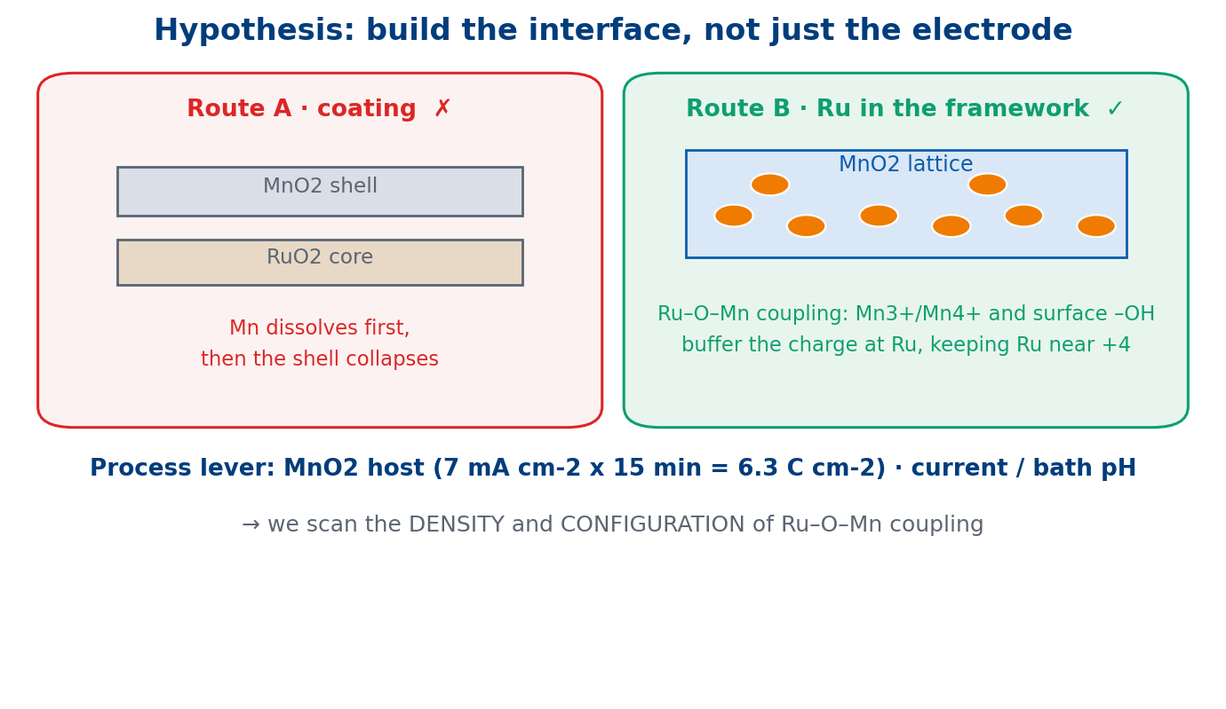
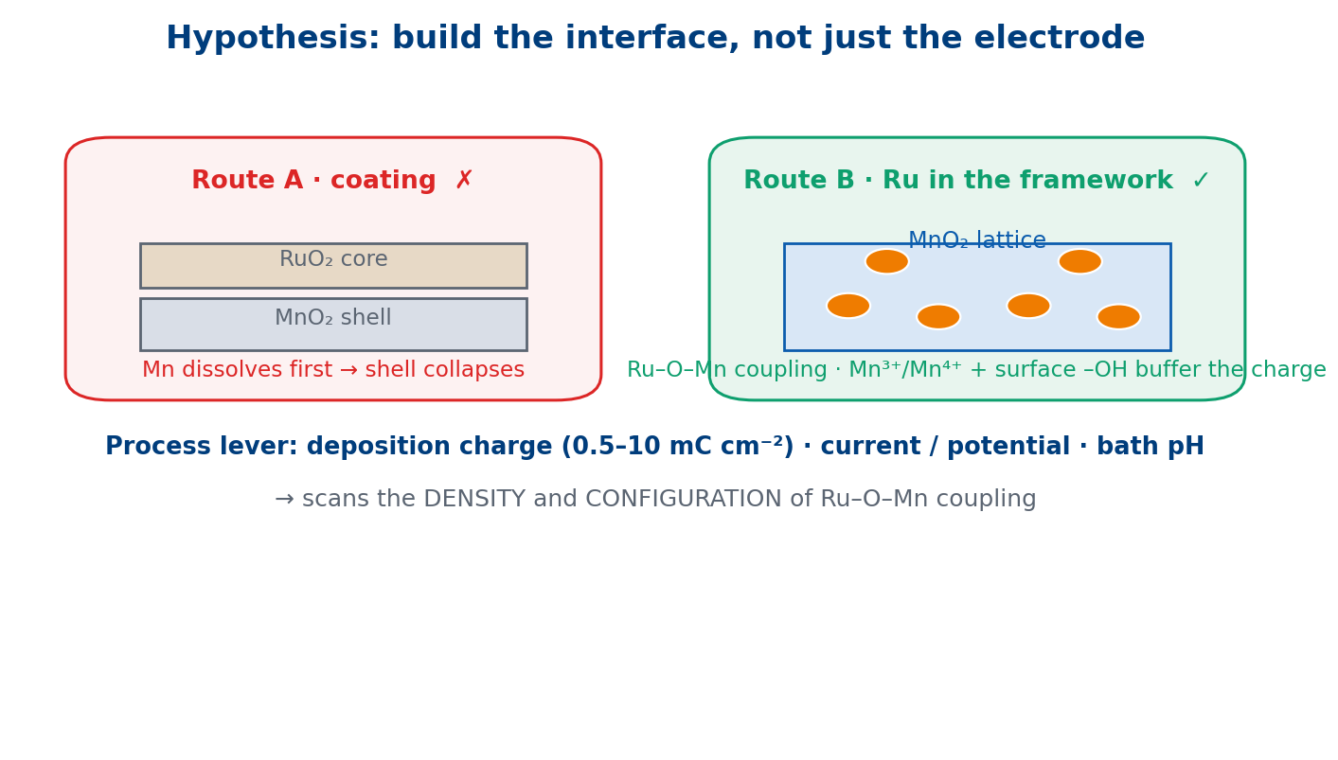
EXPERIMENT PLAN
Gap & hypothesis — electrodeposition as the process lever
8 / 10
Hypothesis (material): electrodeposited MnO₂ as support AND redox mediator
Mn³⁺ /Mn⁴⁺ + surface –OH buffer the oxidative charge at Ru → keep Ru near +4, out of the RuO₄ window
Hypothesis (process): deposition charge / current / bath pH control phase, morphology, edge-site density
→ we can SCAN the density and configuration of Ru–O–Mn coupling
This process control is what the existing literature does not provide
Process variables we will scan
– MnO₂ host: 7 mA cm⁻² × 15 min (≈ 6.3 C cm⁻²), ±2× gradient · current / bath pH.
– Ru route: co-deposition vs impregnation vs cation exchange. (Ru loading: near-single-atom)
A coating dissolves first; putting Ru into the MnO₂ framework is the working hypothesis.
Takeaway: electrodeposition turns the Ru–O–Mn interface into a tunable process variable.
Rationale based on CSC-4 (p. 2200, p. 2208) and AEM-5 (§6, pp. 15–16).
NUS MSE 311 · Final-Year Project progress review · 24 September 2026
Experiment plan
Notes:
That gap defines the project. Our hypothesis has two parts. Material-wise: electrodeposited MnO₂ acts as both the support and a redox mediator. Manganese is redox-active — Mn³⁺/Mn⁴⁺ — and its surface hydroxyls can buffer the oxidative charge arriving at ruthenium, keeping Ru near the +4 state and away from the high oxidation state where RuO₄ forms; in other words, the interface oxygen is pushed out of the dissolution window. Process-wise: electrodeposition makes the interface itself a tunable variable — deposition charge, current or potential, and bath pH control the phase of MnO₂, its morphology, and above all its edge-site density, so we can scan the density and configuration of Ru–O–Mn coupling instead of hoping for it. That process control is what the existing literature does not provide.
【中文对照】【空白与假设】我们的假设有两层：材料层——电沉积的 MnO₂ 既是载体也是"氧化还原缓冲器"，Mn³⁺/Mn⁴⁺ 与表面羟基接住钌周围多余的氧化电荷，把钌保持在 +4 附近、远离会溶掉的高价态；工艺层——电沉积让"界面"变成可调变量（电量 0.5–10 mC cm⁻²、电流/电位、浴液 pH → 相、形貌、边缘位密度），于是可以**扫描** Ru–O–Mn 的密度与构型。这就是文献没提供的部分。

Slide 9
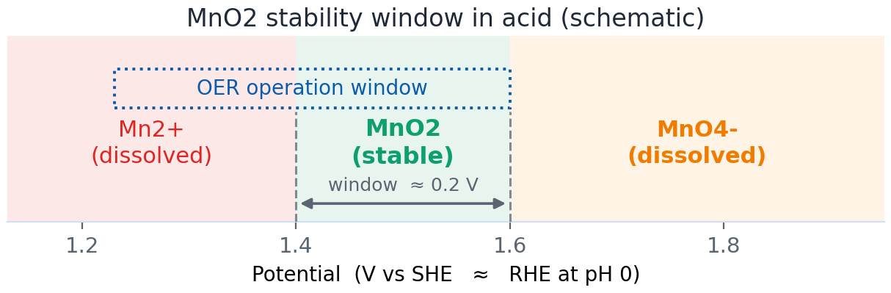
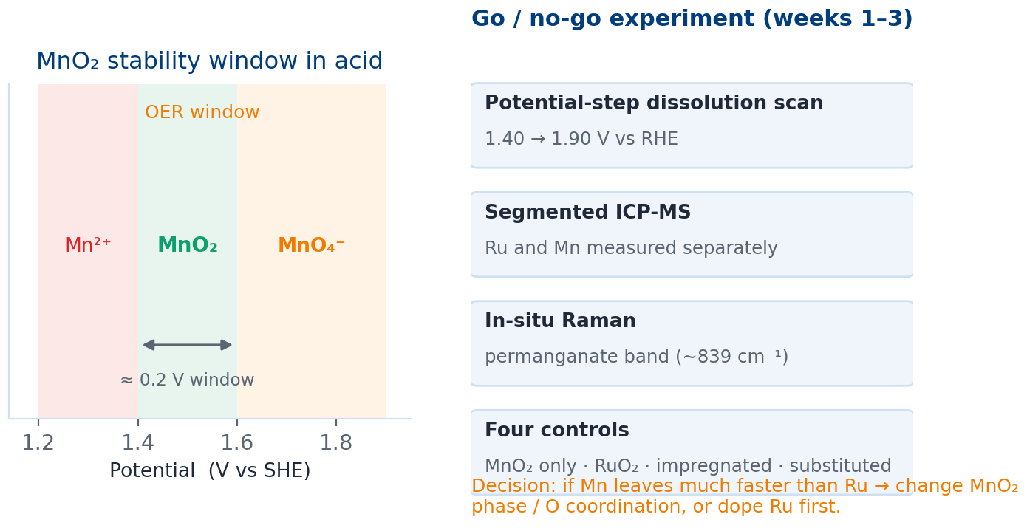
EXPERIMENT PLAN
Main risk, and our go / no-go experiment
9 / 10
The risk is MnO₂ itself, not Ru: MnO₂ only stable in a narrow window (~1.4–1.6 V vs SHE)
A MnO₂ coating would therefore dissolve first
Working answer: put Ru INTO the MnO₂ framework (cf. the cation-exchange precedent)
Go / no-go in weeks 1–3: potential-step scan + segmented ICP-MS for Ru AND Mn + in-situ Raman
Four controls; if Mn leaves first and cannot be suppressed → change phase / oxygen coordination, or dope Ru first
Go / no-go experiment (weeks 1-3)
Potential-step dissolution scan
1.40 → 1.90 V vs RHE
Segmented ICP-MS
Ru and Mn measured separately
Decision rule
In-situ Raman
permanganate band (~839 cm-1)
Four controls
MnO2 only · RuO2 · impregnated · substituted
– If Mn dissolves much faster than Ru and cannot be suppressed → change phase.
– Otherwise → proceed to interface engineering and parameter sweep.
Decision rule: if Mn dissolves much faster than Ru and cannot be suppressed → change phase, or dope Ru first.
Manganese in acid: narrow stability window → possible permanganate formation above ~1.6 V.
Takeaway: first test whether Mn or Ru leaves faster — before optimising anything else.
Sources: CSC-4 §4.4 (p. 2208, "a suitable potential window must be identified"); AEM-5 §6 (pp. 15–16), §8.1 (p. 18).
NUS MSE 311 · Final-Year Project progress review · 24 September 2026
Experiment plan
Notes:
The biggest risk is not ruthenium — it is MnO₂ itself. The thermodynamics of manganese in acid are tight: Mn²⁺ below about 1.4 volts, MnO₂ only in a narrow window around 1.4 to 1.6 volts, and soluble permanganate above that; the Chem Soc Rev review makes exactly this point when it says a suitable potential window must be found. So a MnO₂ coating on ruthenium would probably dissolve first. Our working answer is to put ruthenium into the MnO₂ framework rather than on top of it — which is why the cation-exchange precedent recorded in our review matters. To test this early we will run a go / no-go experiment in the first two to three weeks: a potential-step dissolution scan from 1.40 to 1.90 volts versus RHE, with segmented ICP-MS measuring both ruthenium and manganese, plus in-situ Raman watching for the permanganate band, and four controls — electrodeposited MnO₂ alone, a RuO₂ reference, ruthenium impregnated on the surface, and ruthenium substituted into the framework. If manganese dissolves much faster than ruthenium and cannot be suppressed, we change phase or oxygen coordination, or we reverse the order and dope ruthenium first.
【中文对照】【风险与 go/no-go】最大风险不是钌，而是 **MnO₂ 自己**：酸中 Mn 的稳定区很窄（约 1.4–1.6 V vs SHE，再高生成可溶高锰酸根），所以"包一层 MnO₂"很可能先溶掉——因此工作假设是让 Ru **进入** MnO₂ 骨架（对应 AEM-5 记载的阳离子交换先例）。前 2–3 周先做判定实验：电位阶梯 1.40→1.90 V 溶出扫描 + 分段 ICP-MS 同时测 Ru 与 Mn + 原位拉曼盯高锰酸根峰 + 四组对照。判据：若 Mn 溶出远快于 Ru 且压不住 → 换相/换氧配位，或先掺 Ru 再沉积。

Slide 10
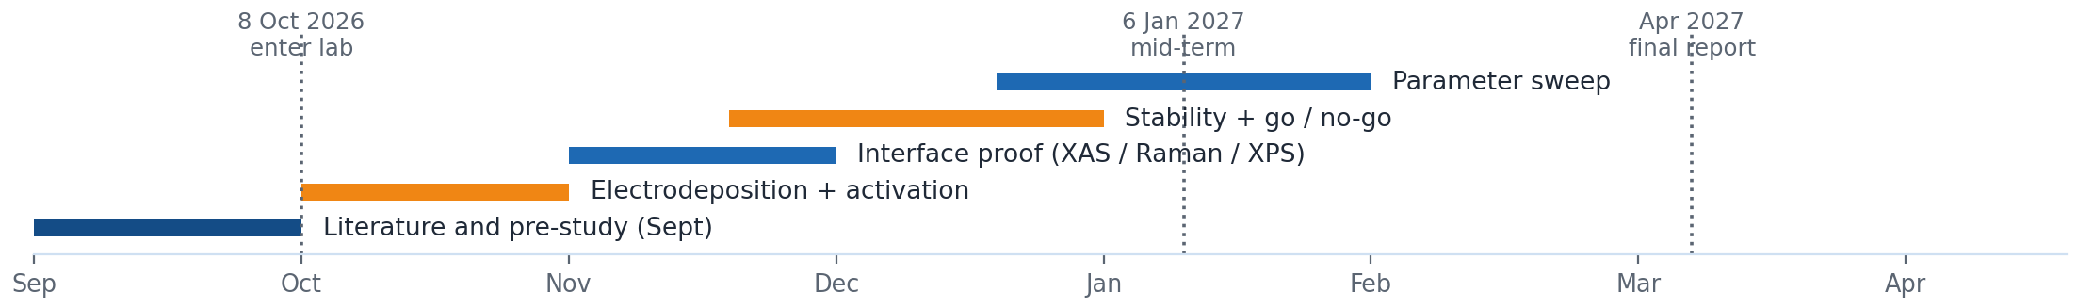
EXPERIMENT PLAN
Synthesis, characterisation, testing and timeline
10 / 10
Synthesis
Electrodeposit MnO₂ on Ti mesh / Ti felt; host: 7 mA cm⁻² x 15 min (≈ 6.3 C cm⁻²), ±2×; current / bath pH as variables; Ru at near-single-atom level; one fixed activation protocol (CV vs CP).
Characterisation
Paired XRD / Raman / XPS / HRTEM-EDS before and after activation; operando XAS at Ru and Mn K-edges (decisive for Ru–O–Mn); EPR for oxygen vacancies.
Testing
iR-corrected LSV with η₁₀ , Tafel, EIS; normalised by mass and ECSA; long-term chronopotentiometry with segmented ICP-MS (Ru + Mn) and a stability number — metrics the assigned reviews report only as decay rates.
Device
Single-cell test reported as current density / duration / retention with Faradaic efficiency (following NE-2 and NC-1).
Milestones: 8 Oct 2026 enter lab · 6 Jan 2027 mid-term · Apr 2027 final report | Sources: AEM-5 §5 (pp. 11–15) and p. 6 · NE-2 pp. 268–270 · NC-1.
NUS MSE 311 · Final-Year Project progress review · 24 September 2026
Experiment plan · slide 10
Notes:
Concretely. Synthesis: electrodeposit MnO₂ on a corrosion-resistant substrate such as titanium felt or carbon paper, scanning deposition charge from 0.5 to 10 millicoulombs per square centimetre together with current, potential and bath pH; then introduce ruthenium by one of three routes — co-deposition, impregnation or cation exchange — and fix one activation protocol, because cyclic voltammetry and chronopotentiometry give different degrees of reconstruction. Characterisation: paired XRD, Raman, XPS and HRTEM-EDS before and after activation, then operando X-ray absorption at both the Ru and Mn K-edges as the decisive evidence for Ru–O–Mn coupling, with EPR for oxygen vacancies and surface-sensitive probes chosen per our group's review. Testing: iR-corrected polarisation with η₁₀, Tafel slope and EIS, normalised by mass and by electrochemically active surface area; then long-term chronopotentiometry with segmented ICP-MS for both Ru and Mn and a stability number — note that the reviews I was given report decay rates but not dissolution metrics, so we will generate them ourselves. Device: a single-cell test reported in the current-density / duration / retention format with Faradaic efficiency, following the two device papers. Timeline: I enter the laboratory on the 8th of October; synthesis and activation in October, interface proof in November, stability and the go / no-go decision in November and December, parameter sweep in December and January, mid-term defence on the 6th of January 2027, and the final report in April. That is my plan — and I have two questions for the group at the end.
【中文对照】【实验计划】合成：在钛毡/碳纸上电沉积 MnO₂，扫描电量 0.5–10 mC cm⁻² 与电流/电位/浴液 pH；Ru 按共沉积、浸渍、阳离子交换三条路线引入；固定一种活化协议（CV 或 CP）。表征：活化前后配对 XRD/Raman/XPS/HRTEM-EDS，再用原位 XAS 双 K 边证明 Ru–O–Mn，EPR 看氧空位。测试：iR 补偿 LSV（η₁₀）、Tafel、EIS，按质量与 ECSA 双归一；长测 + 分段 ICP-MS（Ru 与 Mn）+ S-number（注意：mentor 给的综述没有溶出定量，这部分由我们补）。器件：单电池按"电流密度—时长—保持率 + 法拉第效率"报告。时间线：10.8 进组 → 10 月合成活化 → 11 月界面证据 → 11–12 月稳定性与判据 → 12 月–1 月参数扫描 → 2027.1.6 中期 → 4 月结题。

Slide 11
APPENDIX — BACKUP
Key numbers at a glance (all from the assigned five)
CSC-4
Volcano-top limit ≈ 0.37 V · proton acceptor lowers the step to 0.26 / 0.10 eV · γ-MnO₂ : 8000 h at pH 2 · Mn³⁺ : eg = 1
AEM-5
Ru fails via RuO₄ + LOM · W/Er-doped RuO₂ : 168 mV, 500 h · Ru/α-MnO₂ precedent: 161 mV, > 200 h, OPM, no V_{O}
NE-2
Surface pH ≈ 14 at 1.6 V (RRDE, N_{D} = 0.37) · O₂ selectivity ≈ 98% · > 200 h · 60 °C: 1.87 V at 1.0 A cm⁻²
NC-1
Cr-doped amorphous oxide: η₁₀ = 268 mV · AEM electrolyser 2.1 V at 1.5 A cm⁻² · 120 h at 0.5 A cm⁻², < 4.9 mV h⁻¹
Science-3
POM–MOF superstructure · variable-valence second metal buffers oxidative charge · protects the active centre
Discipline: every number on this slide is traceable to a page of the five assigned papers; the assigned reviews do not report dissolution-based metrics (S-number, ICP-MS rates), so those we will generate ourselves.
NUS MSE 311 · Final-Year Project progress review · 24 September 2026
Appendix
Notes:
Backup slide for numbers. Use only if a specific figure is questioned.
【中文对照】【附录（数字备查）】五篇指定文献的关键数字速查（0.37 V 火山顶 / 0.26 与 0.10 eV / γ-MnO₂ 8000 h / 168 mV、500 h / 161 mV、>200 h / 界面 pH≈14、选择性 98% / η₁₀=268 mV、120 h 衰减<4.9 mV h⁻¹ / 1.48→1.80 V）。所有数字都能回溯到具体页码。

