Slide 1

Transforming and Analysing Data with SQL
Oliver Amirmansour – October 4th, 2023

Slide 2
Project Steps - pt.1
Familiarising with the Ecommerce dataset – 5 tables
Sales_report, sales_by_sku, products, analytics, all_sessions
Creating tables with SQL – naming columns and setting data types
Importing the data via SQL queries

Slide 3
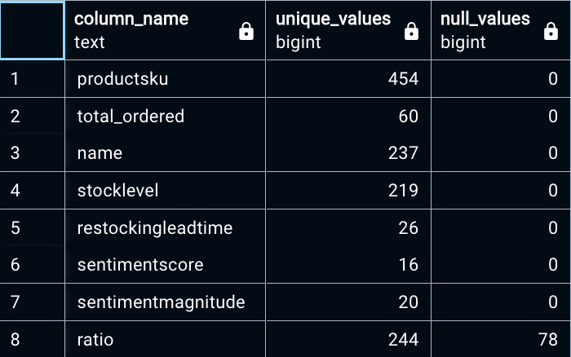
Project Steps - pt.2
Quality assurance (QA) – identifying NULLS, missing values, duplicates, outliers….
Cleaning & transformation – informed on by QA
Removing several NULL columns from ’all_sessions’ and ‘analytics’ tables, adjusting price-related columns, reformatting date columns, replacing values in city/country columns…
Rather than establishing new tables, instead created SQL Views (virtual table) detailing the necessary changes for both the ‘analytics’ and ‘all_sessions’ table.

Slide 4
Questions & Discovery…
What I discovered..
The United States holds the biggest market share for the website, holding the largest transaction revenue (~$13.5m) – exact city unknown as missing from data…
Of the sites total revenue of ~$50m, $26.5m comes from the US and cities.
The highest average number of products ordered are from Czech Republic and Saudi Arabia with 319 products ordered and in third place is the United States with ~250 products. (Buying more expensive products?)
Product categories’ ‘Youtube’ and ‘Men’s t-shirts’ are purchased predominately by US customers..

Slide 5
Questions & Discovery - Pt.2
What I discovered..
Despite the U.S. generating the most revenue, countries like Peru (~14 minutes), Nigeria and Tunisia see visitors spend the most time on the website, while the U.S. spends ~3-4 minutes - Why??
Need data on internet connectivity, cursor heatmaps etc..
Does that inform on U.S. shoppers and their spending habits? NEED MORE DATA!
Discrepancy between two price columns – ‘unit_price’ & ‘productprice’, why is unit_price higher??

Slide 6
Conclusion: Need.. More.. Time.. ☹
Soak in the dataset more, learn new things…
More context behind the tables/data
Questions lead to more questions, which lead to more questions…
Better clean the data – fill in those missing blanks

