Slide 1



Statistical Modelling Project
cityBikes – Foursquare - Yelp
Oliver Amirmansour

Slide 2


Project Goal
- To gather and compare data on rental bike stations in Toronto
- Gather data on Bars and Libraries from the Foursquare and the Yelp API
- Perform a regression using the gathered data so as to predict rental bike availability

Slide 3
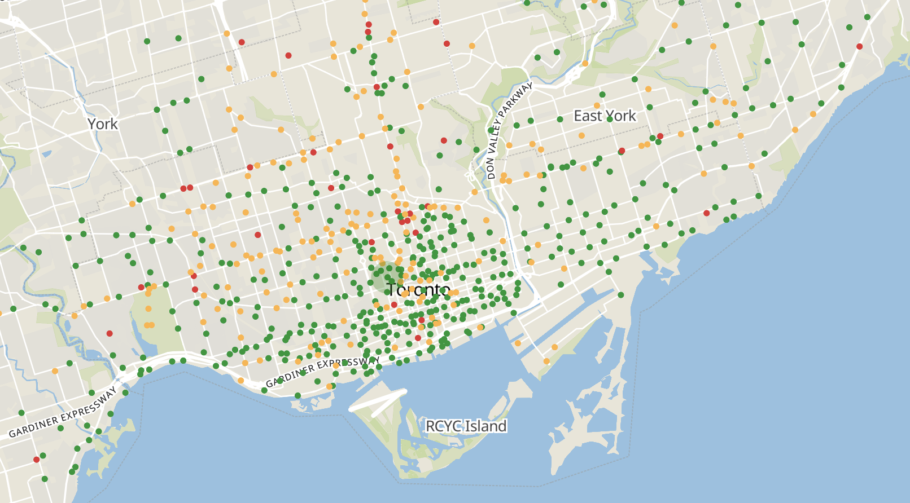
Project Flow – cityBikes API
- Querying rental bikes for Toronto

Slide 4
Project Flow – cityBikes API
- Querying rental bikes for Toronto
- Making sense of the JSON and extracting what I need!

Slide 5
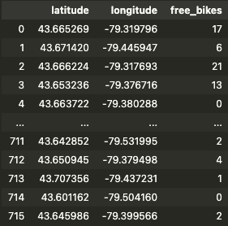
Project Flow – cityBikes API
- Querying rental bikes for Toronto
- Making sense of the JSON and extracting what I need!
- Creating the final product…ish

Slide 6
Project Flow – Foursquare & Yelp
- Connecting to the Foursquare and Yelp

Slide 7
Project Flow – Foursquare & Yelp
- Connecting to the Foursquare and Yelp
- Extracting data on Bars and Libraries

Slide 8
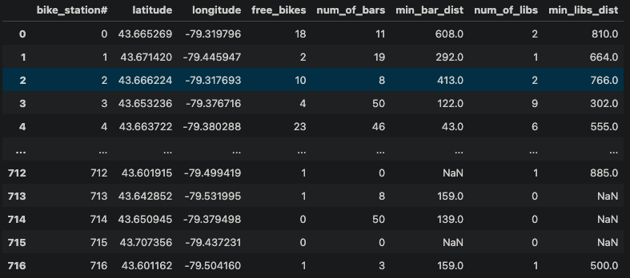
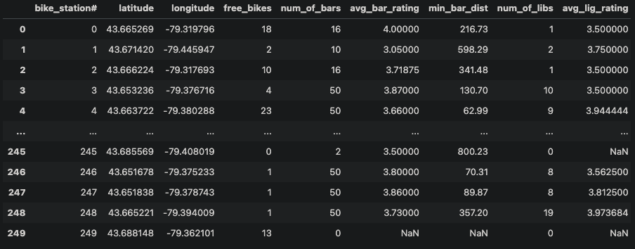
Project Flow – Foursquare & Yelp
- Connecting to the Foursquare and Yelp
- Extracting data on Bars and Libraries
- The ACTUAL final product…ish

Slide 9
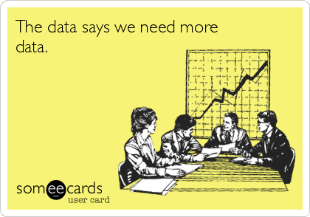
Project Flow – EDA & Comparing
- Foursquare four the win

Slide 10
Project Flow – EDA & Comparing
- Foursquare four the win
- Easy comparison as bike stations were in same order.

Slide 11
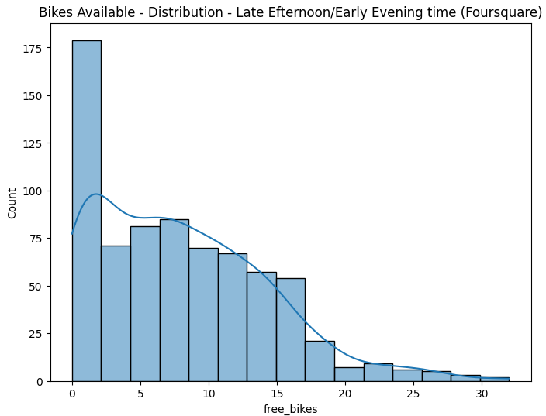
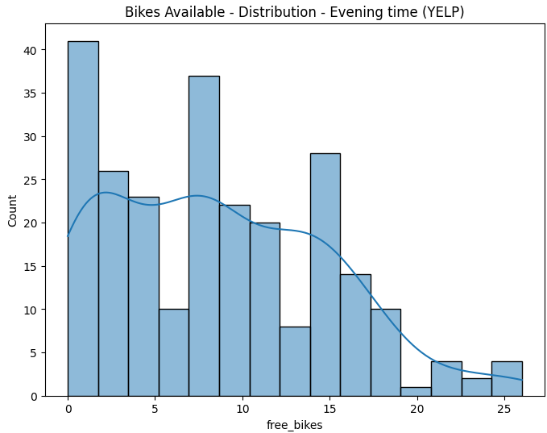
Project Flow – EDA & Comparing
- Foursquare four the win
- Easy comparison as bike stations were in same order.
- Differences in visualisations (Sampling)

Slide 12
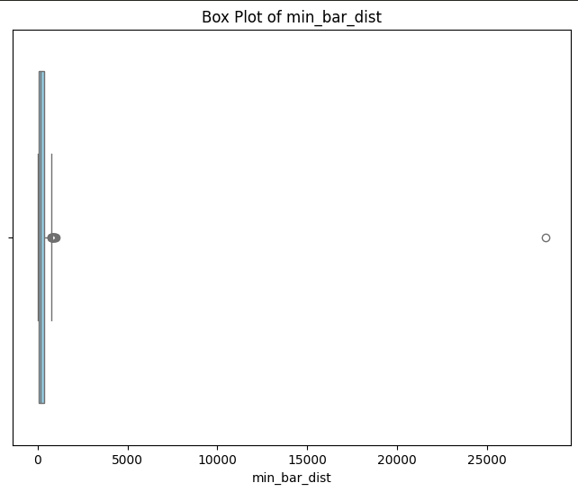
Project Flow – Modelling & results
- Cleaning data before modelling

Slide 13
Project Flow – Modelling & results
- Cleaning data before modelling
- Multiple Linear Regression (MLR) – Least Squares

Slide 14

Project Flow – Modelling & results
- Cleaning data before modelling
- Multiple Linear Regression (MLR) – Least Squares
- Low explainability of variation in data ($adj R^{2}=0.116)$ with significant variables (and expected directions)
Feature | Effect on Y | Signif
Num_of_bars | 14.65% increase | 1, 5 and 10%
Num_of_libs | 47.74% decrease | 1, 5 and 10%
Min_bar_dist | 0.037% increase | 5 and 10%

Slide 15
Challenges – If I Had More Time
- Query Yelp over 3 days to extract all data

Slide 16
Challenges – If I Had More Time
- Query Yelp over 3 days to extract all data
- Improve model explainability with more features

Slide 17
The End ☺

