Slide 1
SITL模式（单一PX4_instance)
MAVLink
Communication
QGroundControl
PX4 on SITL
MultiVehicleManager
MAVLink
port 18570
MAVLink
UI(qml)
Vehicle
FirmwarePlugin
UDP
port 14550
UDP
MissionManager
Commaders & Navigator
Actuator
Mixer
uORB
(Message Bus)
Desired state
AirSim
port 14540
UDP
simulator APIs
Rending Engine
port 14580
Estimated state
Sensor data
Sensor
Estimator
Controller
MAVLink
Sensor data
TCP 4560
TCP
Sensor Models
Physisc Engine
TCP
Simulator_MAVLink
Environment Models
random port
Vehicle Model
Actuator control

Slide 2



SITL模式（多PX4 instances）
第1个
port 14580
UDP
UDP
port 14550
port 18570
random port
port 14540
…
TCP
第i个
TCP 4560
port 14580+i-1
port 14550
UDP
UDP
port 14540+i-1
port 18570+i-1
TCP
TCP 4560+i-1
random port
port 14540+n-1
AirSim+UE4
port 14550
UDP
…
UDP
第n个
port 14580+n-1
TCP 4560+n-1
TCP
port 18570+n-1
random port

Slide 3
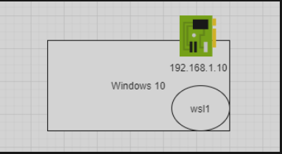
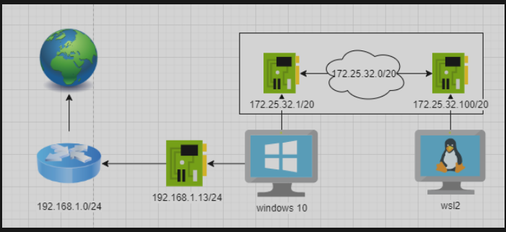
wsl1 、wsl2与宿主机网络拓扑图
wsl1
wsl2

