Slide 1

Retrieval Augmented Generation (RAG) project
Oliver BELLIARD & Naël BRIAND
10h

Slide 2
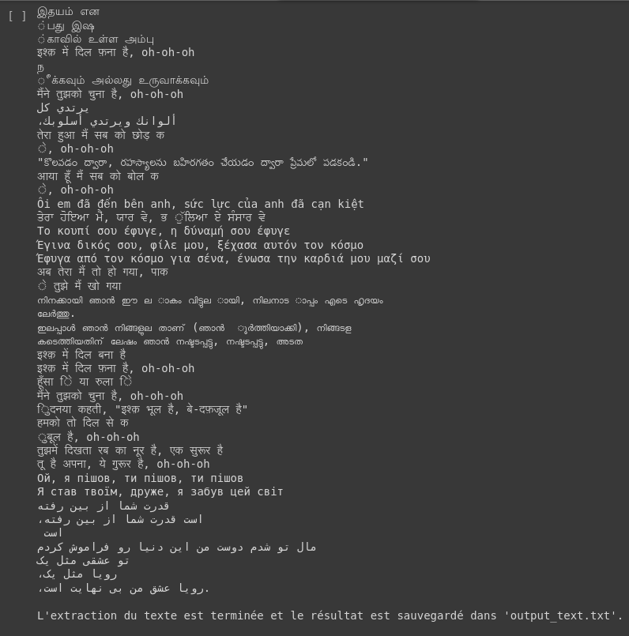
I - Extracting and structuring
CHOOSING A DATASET : GoodLuck.pdf
Extracting text from a PDF file and save in text file
extract_text_from_pdf(pdf_path)
Dividing text into paragraphs using line breaks
structure_data(text)
Oliver BELLIARD & Naël BRIAND

Slide 3


II - Indexing
Import the class to charge pretrain model which generate embeddings
We chose this model for embedding paragraphs
Better Performance Semantic Search
transformer_model = "multi-qa-mpnet-base-dot-v1"
FAISS : a library developed by Facebook AI Research
Oliver BELLIARD & Naël BRIAND

Slide 4

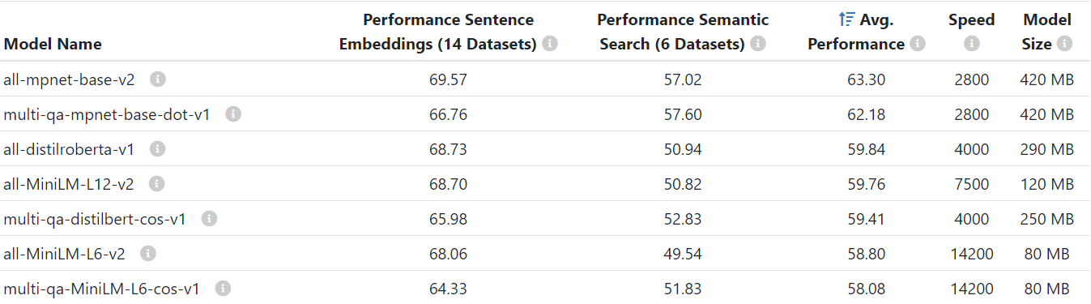
source: https://www.sbert.net/docs/pretrained_models.html
Oliver BELLIARD & Naël BRIAND

Slide 5


II - MODULE CREATION
Sentence Transformer and Large Language Model (LLM) from Hugging Face
LLM running on Hugging Face
We made sure to run the script on Colab
Oliver BELLIARD & Naël BRIAND

Slide 6
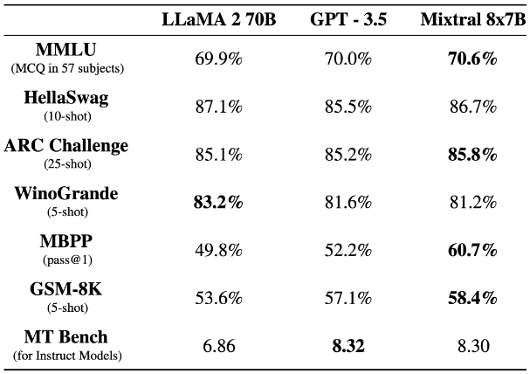
II - MODULE CREATION: LLM
source: https://mistral.ai/fr/news/mixtral-of-experts/
We chose: mistralai/Mixtral-8x7B-Instruct-v0.1
We wanted to taxe as much advantage of the cloud as possible so we choose a model larger than a 7b parameters model (zephyr-7b-beta, llama2)
Local: around 60s per token
Google Colab: 6s per Answer
Oliver BELLIARD & Naël BRIAND

Slide 7
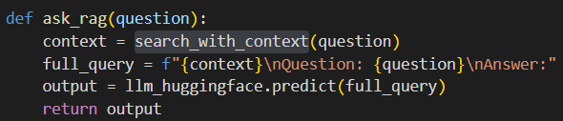
II - MODULE CREATION: Queries
Query building with 3 main tags: Context, Question and Answer
Context:
content of the document
Question:
user question
Answer:
Oliver BELLIARD & Naël BRIAND

Slide 8

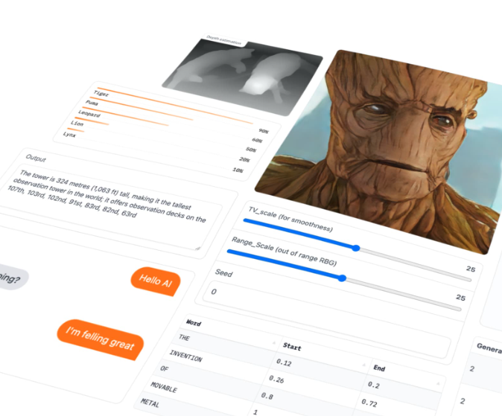
III - Model Serving
Deployment of the model
Gradio API
Function: query maker
source: https://www.gradio.app
Oliver BELLIARD & Naël BRIAND

Slide 9
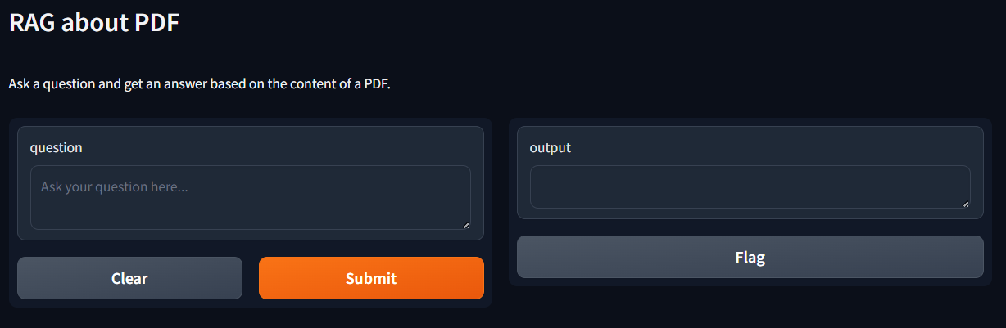
II - MODULE CREATION: Deployment
We deployed our RAG using the same method seen in previous labs
Oliver BELLIARD & Naël BRIAND

Slide 10

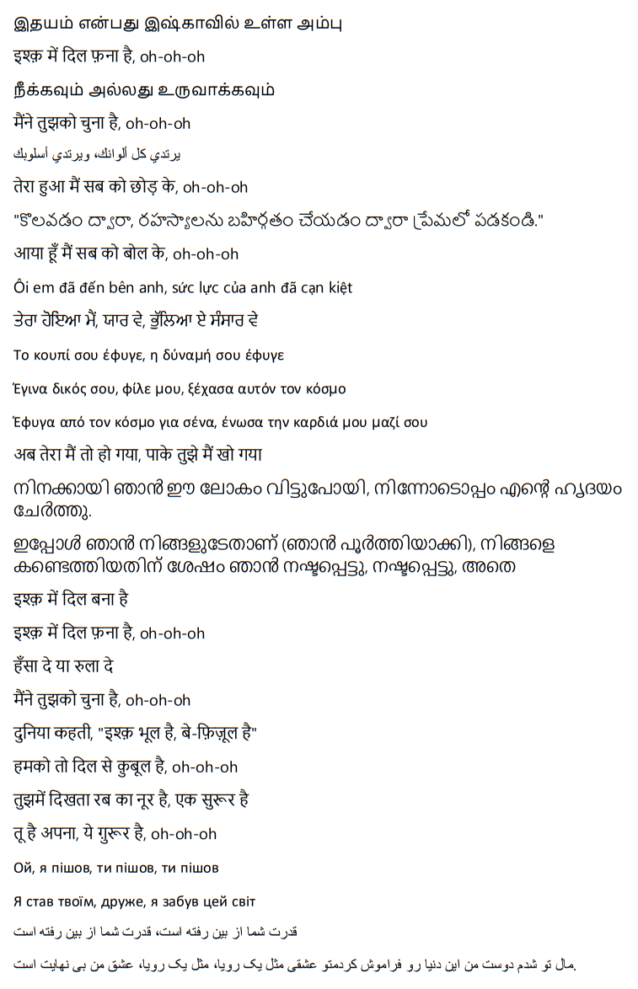
Try our RAG
It will answer questions about the test document: GoodLuck.pdf

Slide 11
Thank you for your attention

Slide 12
Sources
Mixtral-8x7b benchmark and documentation: https://mistral.ai/fr/news/mixtral-of-experts/
Available sentence transformers models: https://www.sbert.net/docs/pretrained_models.html
Oliver BELLIARD & Naël BRIAND

