Slide 1
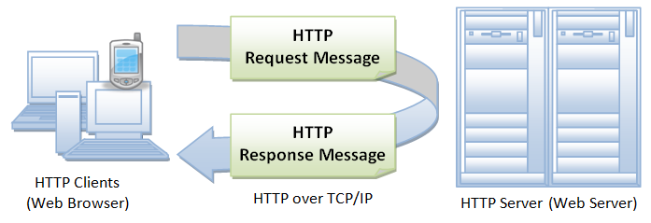
Aplicações WEB – Cliente/servidor
Browser / app
http client
Apache
http server
Software
Cliente
Request
Software
Servidor
Response
PC
Datacenter
PC/notebook/laptop
Smartphone/tablet/smart watch
IOT (Internet of things)
Hiper-text Transfer Protocol

Slide 2
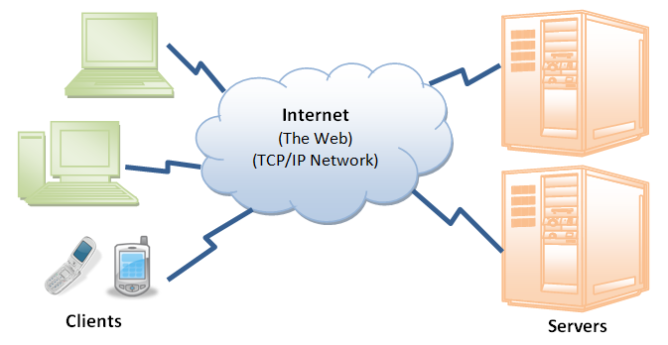
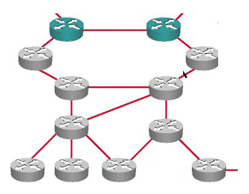

Slide 3
Front-end
HTML (Hyper-text markup language) não é WYSIWYG
What you see is what you got
CSS (Cascade style sheet)
Javascript
Back-end
Php
Angular
Servlet/JSP/JSF (JAVA SE)
Banco de Dados
Mysql (relacional) – oracle – ms sql server (SQL-Structured Query Language)
mondoDB (documento)
Neo4j(grafo/rede)
DEV-OPS
Git / Github

