Slide 1
Coursework Introduction
COMP 3222/6246 Machine Learning Technologies
Dr Indu Bodala
Email: i.p.bodala@soton.ac.uk
13 November 2023

Slide 2
Today’s lecture
Coursework Submission – what and when?
Task and Data
Design and Implementation
Evaluation
Frequently Asked Questions (FAQ)
Marking Scheme
Q&A

Slide 3
Coursework Submission – What and When?
Deliverables and Deadlines
Machine learning pipeline implementation
Jupyter notebook
Submit as source_code.ipynb + requirements.txt
Week 12 Fri 4pm (timetable week 15)
Marking weight 15%
Final report
Week 12 Fri 4pm (timetable week 15)
Submit as report.pdf
Marking weight 35%
Total coursework mark is worth 50%
Turnitin checked >> Code and PDF reports must be your own work
Feedback
4 weeks after submission

Slide 4
Task and Data
Task
Design/build algorithm(s) to classify social media posts with imagesp as 'real' or 'fake'
Background
AI verifying multimedia content automatically can help tackle viral fake news
New algorithms support journalists and platform providers offering news content (e.g. Google, Facebook)
This was a real MediaEval challenge task for international researchers!
Definition of a fake post
Reposting of real multimedia, such as real photos from the past re-posted as being associated with a current event
Digitally manipulated multimedia
Synthetic multimedia, such as artworks or snapshots presented as real imagery

Slide 5
Task and Data
Dataset - Zip on module page
MediaEval 2015 dataset of social media posts
Test set posts 3,781
Training set posts 14,483
Unique images/videos referenced 399
News events 11
Each post contains text & mentions of a linked or embedded image/video
MediaEval 2015 image features will NOT used to keep task simple
Format - tab delimited UTF-8 CSV
TweetId, tweetText, userId, imageId(s), username, timestamp, label
263259176497737728
'New York "attacked" by Sandy. #NewYork #statueofliberty #hurricane #Sandy #dark #attack #sky #picoftheday # http://t.co/6PSNTCj9'
458337011
sandyA_fake_48
DimPhil1
Tue Oct 30 12:40:53 +0000 2012
fake

Slide 6
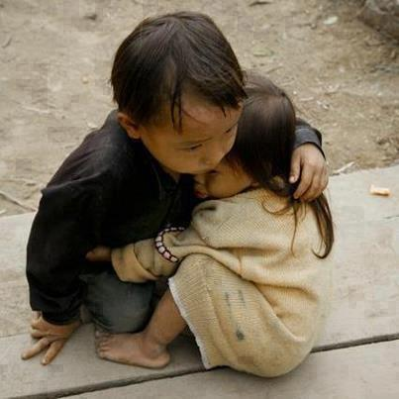
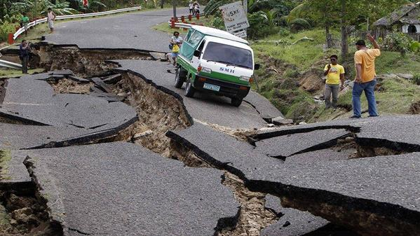
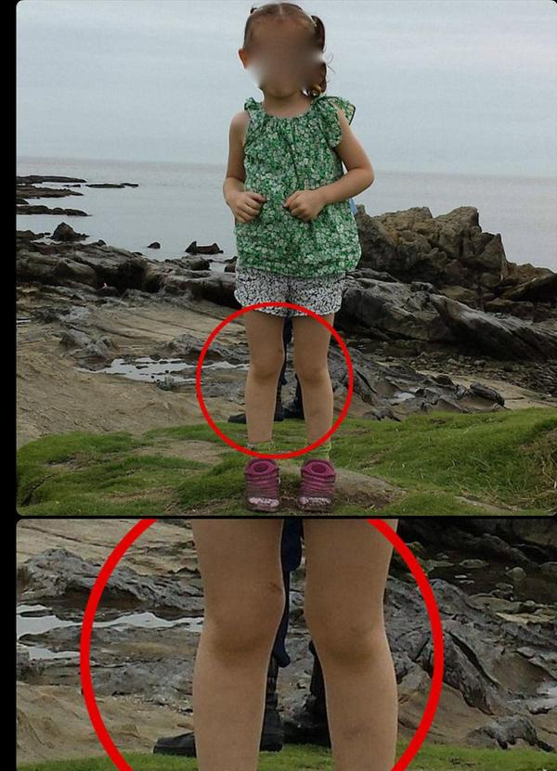
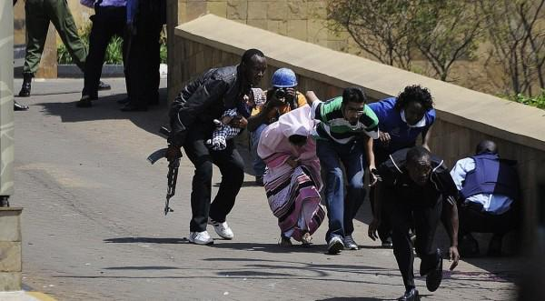

Nepal earthquake (fake)
Nepal earthquake (real)
Dataset contains text and metadata only
You should NOT process any images
Garissa Attack (real)
Samurai Ghost (fake)
Solar eclipse (fake)

Slide 7
Design and Implementation
Algorithm Design and Implementation (COMP 3222 - UG)
Problem characterization
Data characterization
Data analysis & hypothesis formulation
Algorithm choice (2 algorithms) with justifications
Pipeline Implementation
Evaluation – F1 Score
Iterative improvement of the chosen algorithms
Algorithm Design and Analysis (COMP 6246 - MSc)
Problem characterization
Data characterization
Data analysis & hypothesis formulation
Algorithm choice (3 algorithms) with justifications
Pipeline Implementation
Evaluation – F1 Score and other evaluation metrics
Critical review - 3 strengths and 3 weaknesses + ranking

Slide 8
Design and Implementation
Refer to Coursework Specification

Slide 9
Evaluation
Evaluation (COMP 3222 - UG)
Metric - F1 score (but you might want to report P, R, ROC ...)
Binary class labels == 'fake' (positive) or 'real' (negative)
TP >> Classified fake + Ground truth fake
FP >> Classified fake + Ground truth real
TN >> Classified real (or unknown) + Ground truth real
FN >> Classified real (or unknown) + Ground truth fake
Label might be unknown if you choose to filter out results below a certain confidence threshold

Slide 10
Evaluation
Evaluation (COMP 6246 - MSc)
F1 Score and other evaluation metrics to be used for ranking
Critical review of 3 algorithms, for each identifying 3 strengths and 3 weaknesses
Compare all 3 algorithm designs against each other
Rank algorithm designs in order of suitability to the task with justifications

Slide 11
Final Report
Final report 5 to 10 pages long
Mandatory final report sections
Introduction and data analysis
Algorithm design
Evaluation
Conclusion
References
Refer to coursework specification

Slide 12
Frequently Asked Questions (FAQ) - see assignment PDF
Justify all your choices
Marks are awarded for the method you used and evidence-driven justifications for your design decisions
There is no 'correct' final design or F1 score

Slide 13
Frequently Asked Questions (FAQ) - see assignment PDF
Consider enriching the data
You cannot use external task-specific data
MediaEval image features, list of task-specific faker usernames
You can use external generic data
NLTK stopwords, lists of common first names, lists of respected news organizations, sentiment word lists
You can pre-process your data and make new features
n-grams, TF-IDF, Stanford POS and NER taggers, VADER sentiment analysis
What is the humour label?
Humour label should be treated as a Fake label for eval. It might be helpful for training (or it might not!)
You cannot edit the test dataset to make it easier
F1 scores must be run on full test dataset to allow a fair comparison of results

Slide 14
Marking Scheme
Refer to Marking Scheme document
Things to note:
Show us things like graphs, histograms, confusion matrix,
ranked lists of top features, skew in data segments, gap analysis ...
The lab on "Data analysis and visualization" will help here
Show us evidence of iteration, such as how you fine-tuned or
optimised your design/parameters during the evaluation process
Show us how each design choice compares to each other, rank choices, discuss why you rejected other choices, cite results for algorithms in published papers

Slide 15
Thank you… Q&A

Slide 16
Next Lecture Use Case 1 by Dr Luis-Daniel Ibáñez See you again during weeks 9 and 10

