Slide 1
Stationary Iterative Methods
Iterative methods are optimal for solving Ax=b when A is very large
Two types of Iterative methods are Stationary and Krylov Subspace
Explored two types of Stationary methods as discussed in class:
Jacobi
Gauss-Seidel

Slide 2
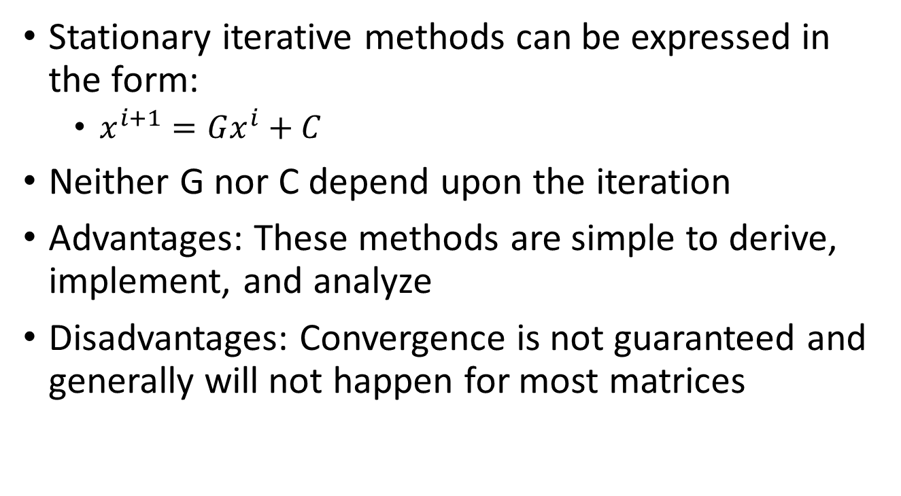
Stationary Iterative Methods
Stationary iterative methods can be expressed in the form:
$x^{i+1}=Gx^{i}+C$
Neither G nor C depend upon the iteration
Advantages: These methods are simple to derive, implement, and analyze
Disadvantages: Convergence is not guaranteed and generally will not happen for most matrices

Slide 3
Stationary Iterative Methods
Code developed to implement both the Jacobi and Gauss-Seidel methods
However, since some of these matrices are particularly large, it would be helpful and time-saving to know in advance whether they would be expected to converge
As discussed, only limited matrices will be guaranteed to converge.
Diagonally dominant systems will converge, but that is not a necessary condition

Slide 4
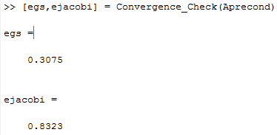
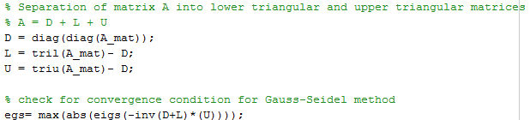
Stationary Iterative Methods
How do we determine whether these methods will converge?
If the eigenvalues of G all lie within the unit circle, then the error converges to zero and it can be known in advance whether a solution will be obtained
Code was developed to first check for this condition to determine what combinations might succeed with these iterative methods
As an example, this runs approximately 10x faster than attempting to directly run four iterations of the Jacobi iterative method to determine whether there is divergence.

Slide 5
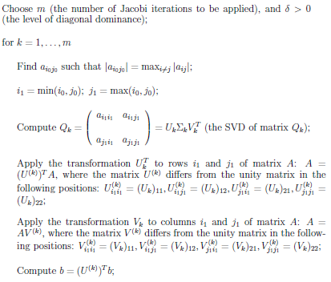
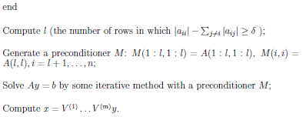
Stationary Iterative Methods
Attempted to develop code to run an algorithm to create diagonal dominance through Jacobi iterations
Unfortunately, the initial systems were found to be fairly far from diagonally dominant and this method was actually slower than running a direct SVD

Slide 6


Stationary Iterative Methods
Results:
Gauss-Seidel ran to within a set tolerance of 0.001 in 8 iterations taking 0.65 seconds
For the same matrix and tolerance, the Jacobi method took 37 iterations and 3.13 seconds.
Gauss-Seidel
Jacobi

Slide 7
Stationary Iterative Methods
These results show that these methods can be efficient in producing useful results
The biggest negative comes when the matrices are not convergent by nature through these methods
The process to precondition these matrices to be diagonally dominant turned out to be quite expensive
I.e. the iterative methods might take on the order of a couple of seconds, while the process to get a diagonally dominant matrix would take on the order of tens of minutes or even hours
Conditioning the matrix for Jacobi required additional iterations of the preconditioning method when compared to getting a matrix to converge for Gauss-Seidel

Slide 8
Sources:
Yuan, Jin Yun and Plamen Y. Yalamov. A Method for Contructing Diagonally Dominant Preconditioners based on Jacobi Rotations.
https://en.wikipedia.org/wiki/Iterative_method
http://mathworld.wolfram.com/StationaryIterativeMethod.html
http://www.codewithc.com/gauss-seidel-method-matlab-program/
https://www.mathworks.com/matlabcentral/fileexchange/32051-gauss-seidel-method?focused=5193371&tab=function
http://www.mathworks.com/matlabcentral/fileexchange/2182-numerical-methods-using-matlab--3e?focused=5042682&tab=function

