Slide 1
Stationary Iterative Methods
Iterative methods are optimal for solving Ax=b when A is very large
Two types of Iterative methods are Stationary and Krylov Subspace
Explored two types of Stationary
Jacobi
Gauss-Seidel

Slide 2
Stationary Iterative Methods
Code developed for both methods
However, they are not guaranteed to solve for all systems
Since some of these matrices are particularly large, it would be helpful to know in advance whether they would be expected to converge
Diagonally dominant systems will converge, but that is not a necessary condition

Slide 3
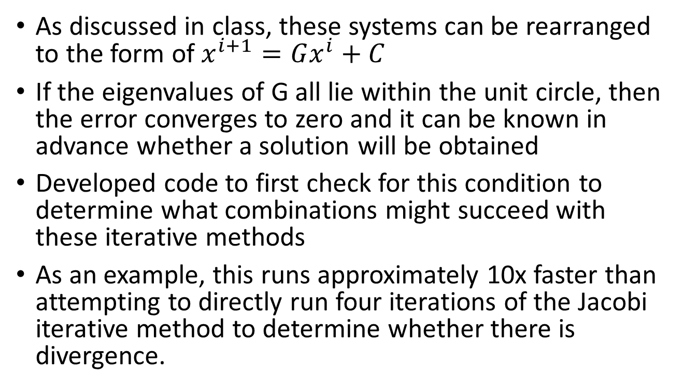
Stationary Iterative Methods
As discussed in class, these systems can be rearranged to the form of $x^{i+1}=Gx^{i}+C$
If the eigenvalues of G all lie within the unit circle, then the error converges to zero and it can be known in advance whether a solution will be obtained
Developed code to first check for this condition to determine what combinations might succeed with these iterative methods
As an example, this runs approximately 10x faster than attempting to directly run four iterations of the Jacobi iterative method to determine whether there is divergence.

Slide 4
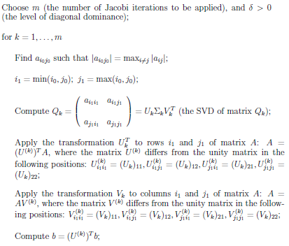
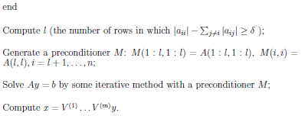
Stationary Iterative Methods
Attempted to develop code to run an algorithm to create diagonal dominance through Jacobi iterations
Unfortunately, the initial systems were found to be fairly far from diagonally dominant and this method was actually slower than running a direct SVD

