Slide 1
Stationary Iterative Methods
Iterative methods are another method for solving linear systems of equations
Optimal for solving Ax=b when A is very large by successively improving approximate solutions
Two types of Iterative methods are Stationary and Krylov Subspace
Explored two types of Stationary methods as discussed in class:
Jacobi
Gauss-Seidel

Slide 2
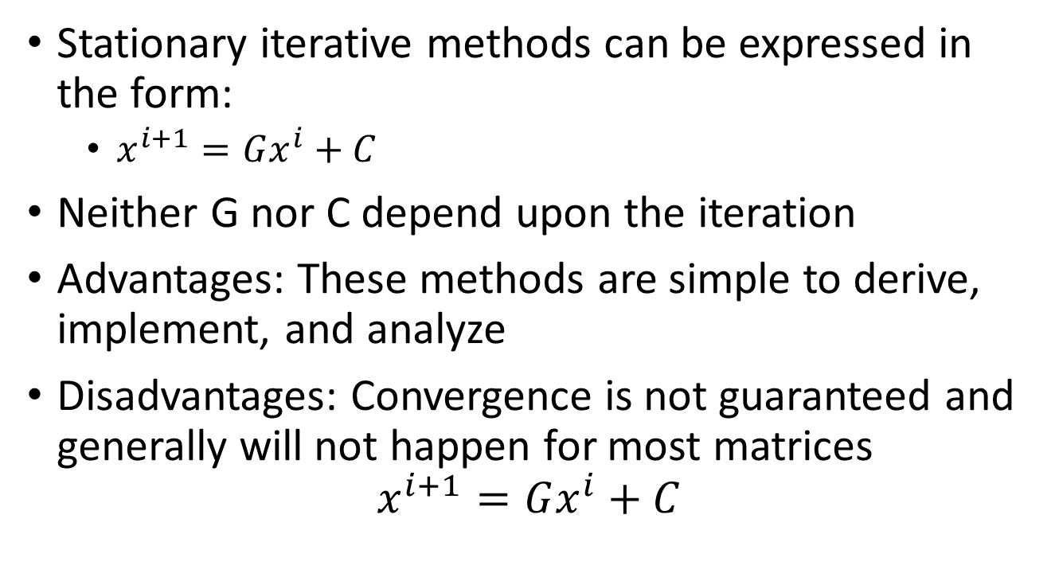
Stationary Iterative Methods
Stationary iterative methods can be expressed in the form:
$x^{i+1}=Gx^{i}+C$
Neither G nor C depend upon the iteration
Advantages: These methods are simple to derive, implement, and analyze
Disadvantages: Convergence is not guaranteed and generally will not happen for most matrices
$$x^{i+1}=Gx^{i}+C$$

Slide 3
Stationary Iterative Methods
Code developed to implement both the Jacobi and Gauss-Seidel methods
However, since some of these matrices are particularly large, it would be helpful and time-saving to know in advance whether they would be expected to converge
As discussed, only limited matrices will be guaranteed to converge.
Diagonally dominant systems will converge, but that is not a necessary condition

Slide 4
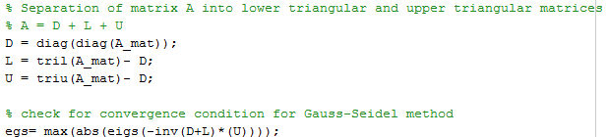
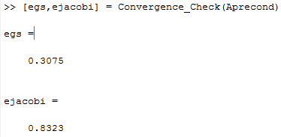
Stationary Iterative Methods
How do we determine whether these methods will converge?
If the eigenvalues of G all lie within the unit circle, then the error converges to zero and it can be known in advance whether a solution will be obtained
Code was developed to first check for this condition to determine what combinations might succeed with these iterative methods
This runs approximately 10x faster than attempting to directly run four iterations of the Jacobi iterative method to determine whether there is divergence.
It was found that none of the initial matrices would converge through these methods

Slide 5
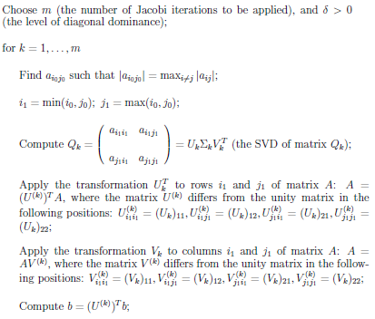
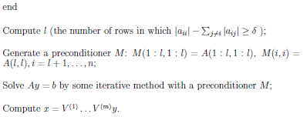
Stationary Iterative Methods
With none of the matrices being capable of directly producing results using
SVD will produce useful matrices but is expensive and can be used itself to solve the system
Found an algorithm to precondition our system to be diagonally dominant and developed code to implement this process

Slide 6
Stationary Iterative Methods
The code was proven to work and did allow for solving via the Jacobi and Gauss-Seidel methods
Unfortunately, the initial systems were found to be fairly far from diagonally dominant and this method was actually slower than running a direct SVD

Slide 7
Stationary Iterative Methods
Results:
Gauss-Seidel ran to within a set tolerance of 0.001 in 8 iterations taking 0.75 seconds
For the same system and tolerance, the Jacobi method took 47 iterations and 3.85 seconds.

Slide 10
Stationary Iterative Methods
These results show that these methods can be efficient in producing useful results
The biggest negative comes when the matrices are not naturally structured to be convergent through these methods
The process to precondition these matrices to be diagonally dominant turned out to be quite expensive
I.e. the iterative methods might take on the order of a couple of seconds, while the process to get a diagonally dominant matrix would take on the order of tens of minutes or even hours
Conditioning the matrix for Jacobi required additional iterations of the preconditioning method when compared to getting a matrix to converge for Gauss-Seidel

Slide 11
Sources:
Yuan, Jin Yun and Plamen Y. Yalamov. A Method for Contructing Diagonally Dominant Preconditioners based on Jacobi Rotations.
https://en.wikipedia.org/wiki/Iterative_method
http://mathworld.wolfram.com/StationaryIterativeMethod.html
http://www.codewithc.com/gauss-seidel-method-matlab-program/
https://www.mathworks.com/matlabcentral/fileexchange/32051-gauss-seidel-method?focused=5193371&tab=function
http://www.mathworks.com/matlabcentral/fileexchange/2182-numerical-methods-using-matlab--3e?focused=5042682&tab=function

