Slide 1
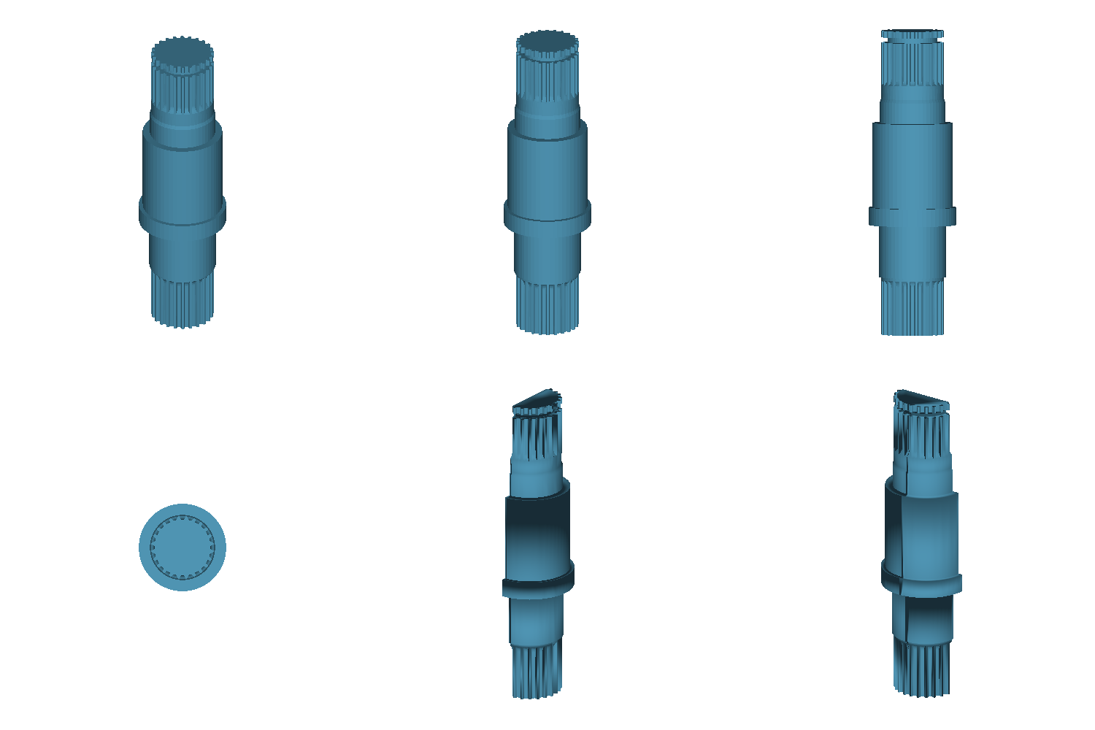
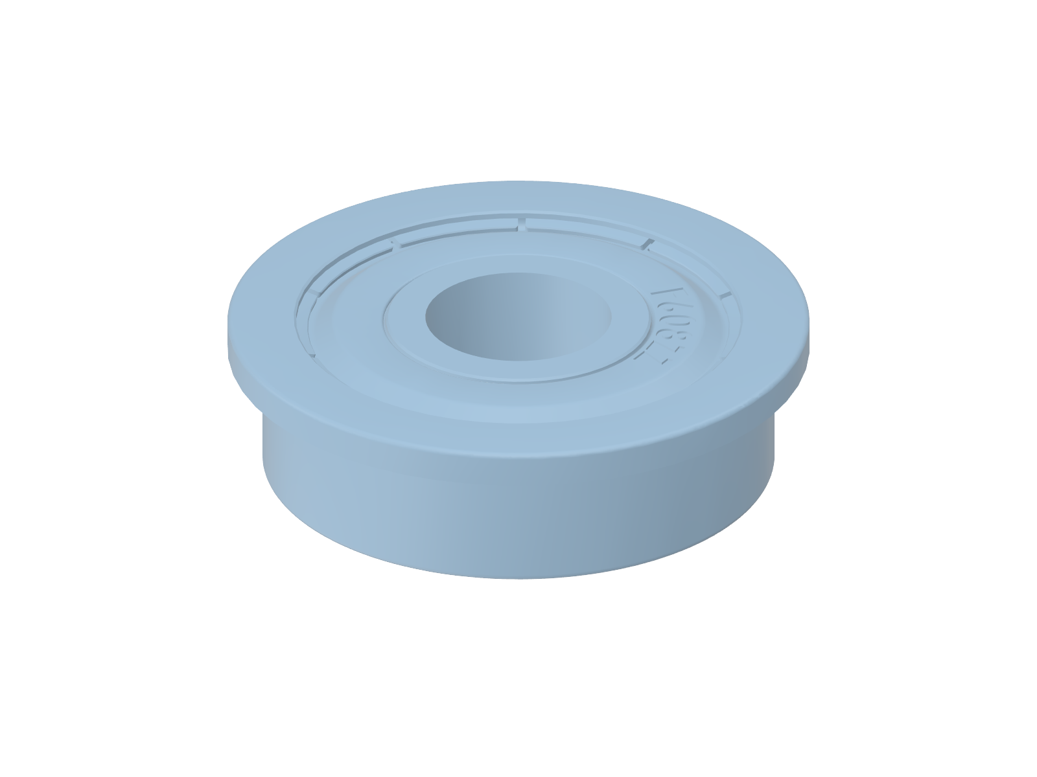
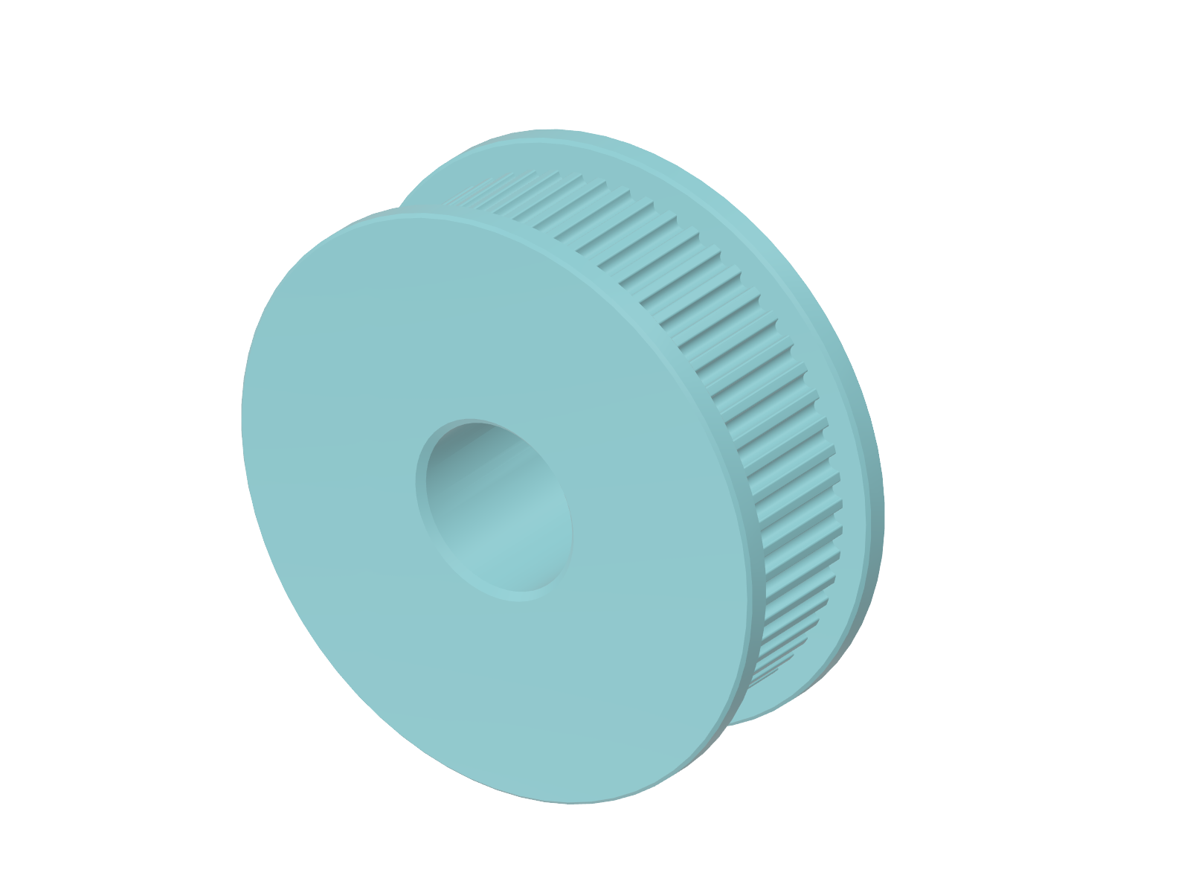
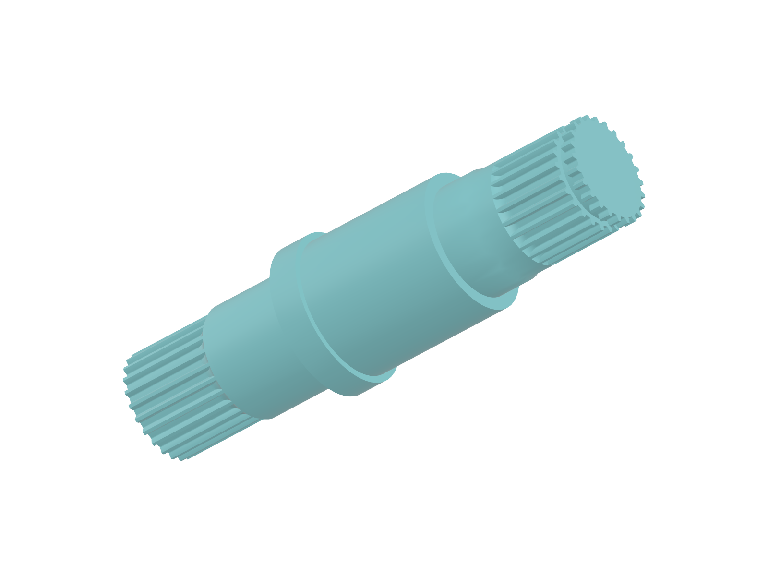
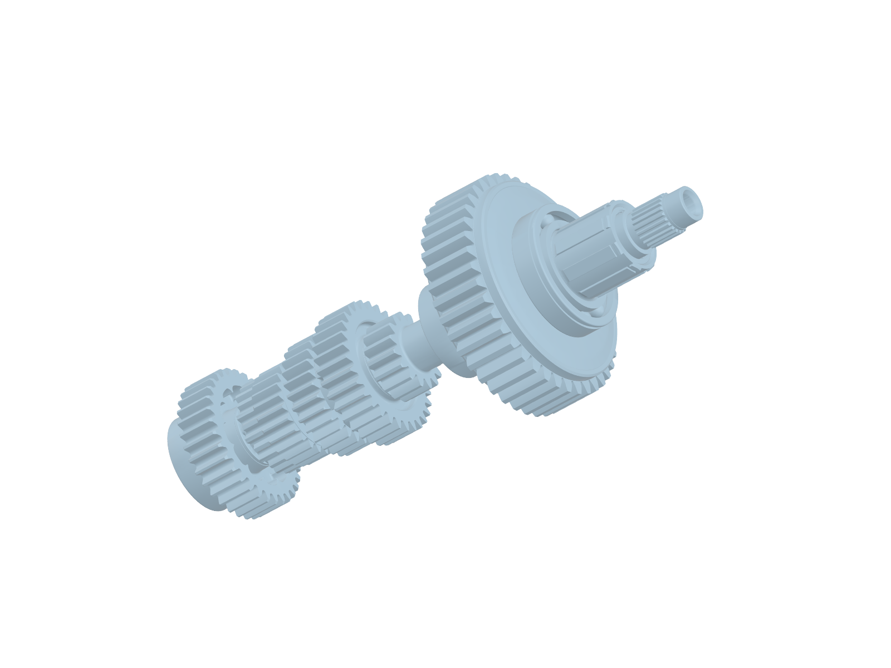
CAD gallery
Measurement
Engineering knowledge graph
Six CAD views
4 clauses
L
same-part bindings
predicted
supports
requires
Part
Class
Role f
Predicate
observes
Observation
CAD exemplar r
zᵢ, pᵢ
F
Candidate geometry
Requested role f
Initial score
Size screen
Fixed pool
Visual LLM
Coverage
Ranked CAD
Extent bound b
s = (G + A + F)/3
L ≤ b
Eligible candidates
yes / no / unknown
H = ¼ Σ v(o)
(3s + H)/4
cited source views
v = 1 / 0 / ½
+ linked evidence
Notes:
Method: manuscript/cirp_draft/main.tex, Equations1–7; frozen Luna outputs/llm_geometry_matched_v1. KG requirements and bindings are authored. Visual observations are model-assessed; H and dimensions use deterministic arithmetic and stored kernel measurements respectively. Six-view image is byte-identical to API input for part9e159dd21fd267ccf103/Z0972. Beauty pictures use actual source triangle meshes; ceramic shaders and independent scales are illustrative. Fixed pool is union of top10 eligible Base Full, G+F+C and G+C. Only views and predicates enter LLM. Diagram adapted from built-in image-generation concept v2; final labels, nodes, connections and formulas rebuilt as native PowerPoint objects, CAD images from source renderer. Icons: Lucide1.8.0, ISC, https://lucide.dev/license; license and original SVG assets accompany this deck.

