Slide 1
Sharing OSM Test Dummies
The OpenChain reference tooling work group 2023

Slide 2
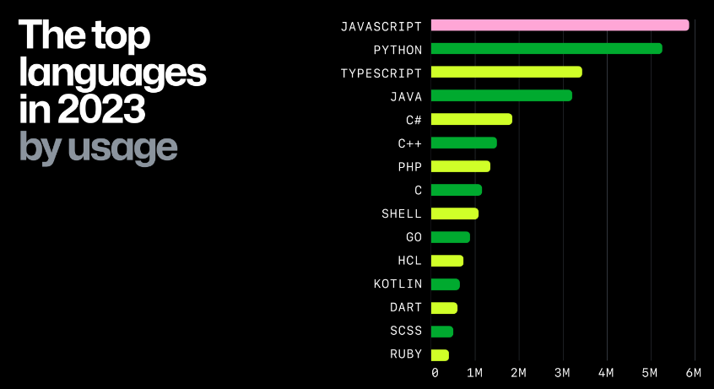
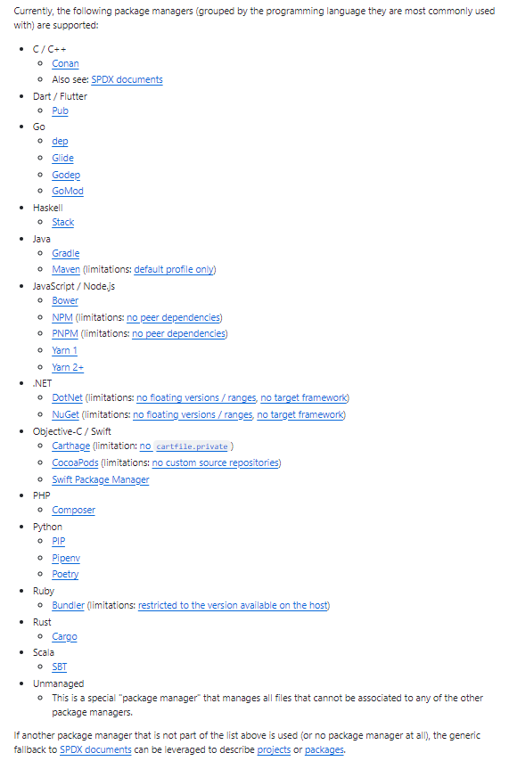
Current Situation
Heterogonous environment with a multitude of programming languages and package managers (and their versions)
From Octoverse report; Source: https://github.blog/2023-11-08-the-state-of-open-source-and-ai/
Source: https://github.com/oss-review-toolkit/ort#analyzer

Slide 3
Need and idea
Need
A reproducible quality for the Software Composition Analysis and the handling of findings needs to be ensured.
In order to be able to test different infrastructure setups (with different tools) „test-sets“ are necessary
Idea / Proposal
Identify „Hello World+“ (+ = using dependencies) example repositories in the respective communities (ideally maintained by the stewards of the respective technology, e.g. maven-example by the Maven-community etc.)
e.g. https://github.com/golang/example
Fork the example repository to Sharing_creates_value as a „dummy“
E.g. tbd
Establish branches to enrich the „dummy“ with test-cases of interest and provide a description of the „expected behaviour“ if analyzed by an Open Source Management tool (e.g. ORT, Fossology,…)
Adding a vulnerably go-component from https://pkg.go.dev/vuln/ in Cargo.lock => expect security vulnerability alert
Use the dummies for testing and share test-cases as new branches in the respective repositories
E.g. run ORT with vulnerableCode integration via Advisor on the dummy repository
Benefit
Tool communities could use the Dummies to test against them => „golden repositories“ (in relation to „golden files“ e.g. https://medium.com/@jarifibrahim/golden-files-why-you-should-use-them-47087ec994bf )
Establish standardized processing independent from the technology

Slide 4
Some potential sources for forking
C - https://github.com/mrsarm/helloworld-c , https://github.com/jithin-renji/Nuke
GO - https://github.com/golang/example , https://github.com/go-training/helloworld
Python - https://github.com/dbarnett/python-helloworld
Java - https://github.com/DEV3L/java-mvn-hello-world-web-app
C# - https://github.com/richk1/HelloWorldRUI
JavaScript - https://github.com/richk1/HelloWorldRUI
Rust - https://github.com/aalmiray/helloworld-rust , https://github.com/rust-lang/rust
SPDX - https://github.com/david-a-wheeler/spdx-tutorial , https://github.com/spdx/spdx-examples
Ideally the upstream is maintained by the „stewards“ of the respective language (e.g. https://github.com/rust-lang/rust; https://github.com/golang/example ) to ensure that the „raw“ dummies (w/o modification) are in line with the build standards and avoid discussions/irritations.

Slide 5
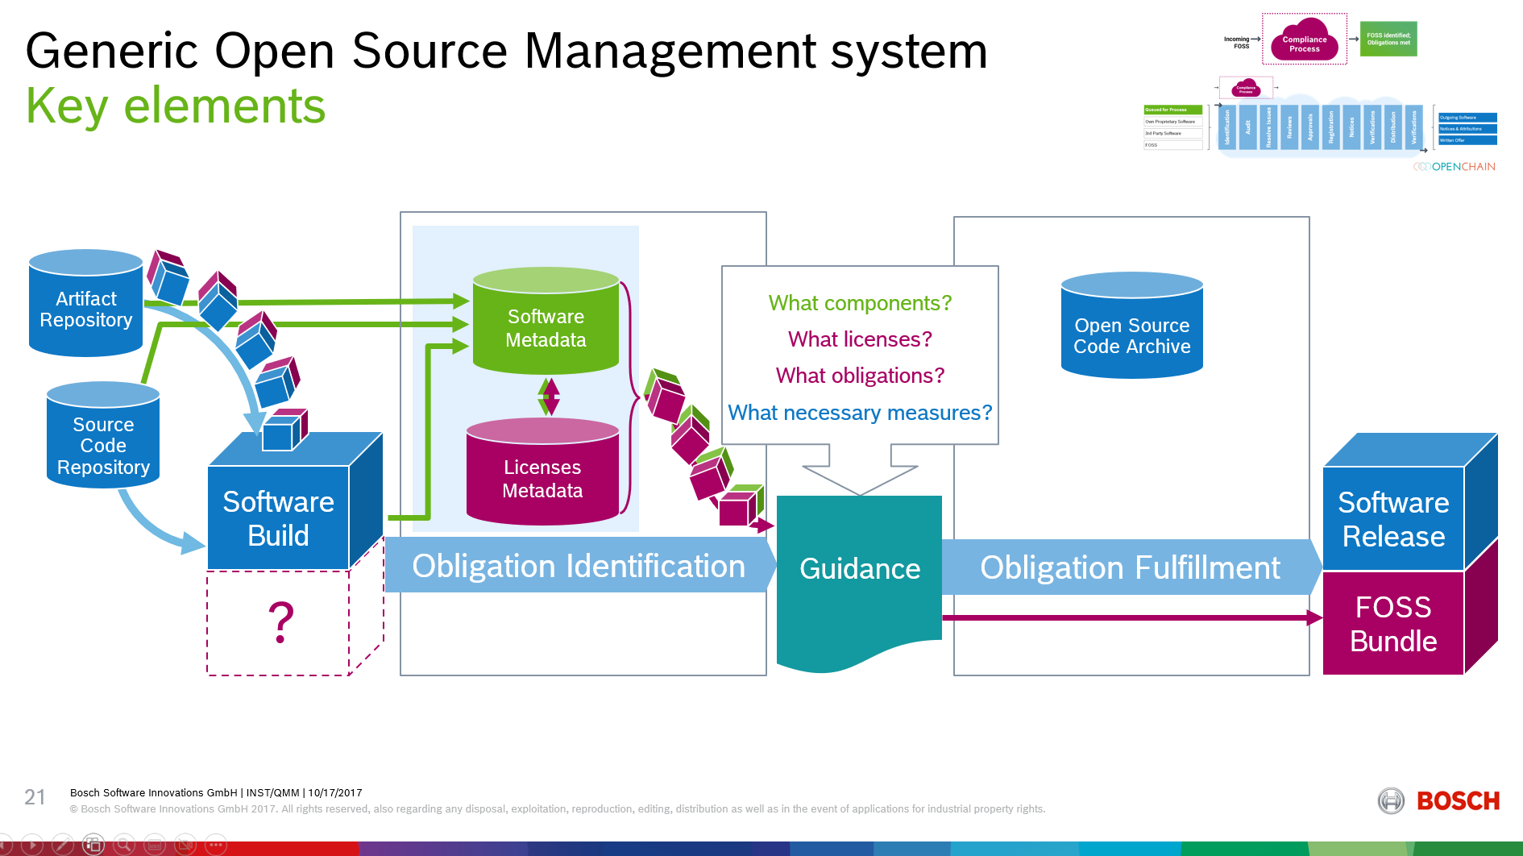
Principle
Dummy-repository
Expected Output 2
(depending on distribution context)
e.g. Branch1/log4j-Dependency
Identify Component
Identify License (Metadata)
Identify Obligation
Expected Output 1
e.g. for Branch 1: security vulnerabily

Slide 6
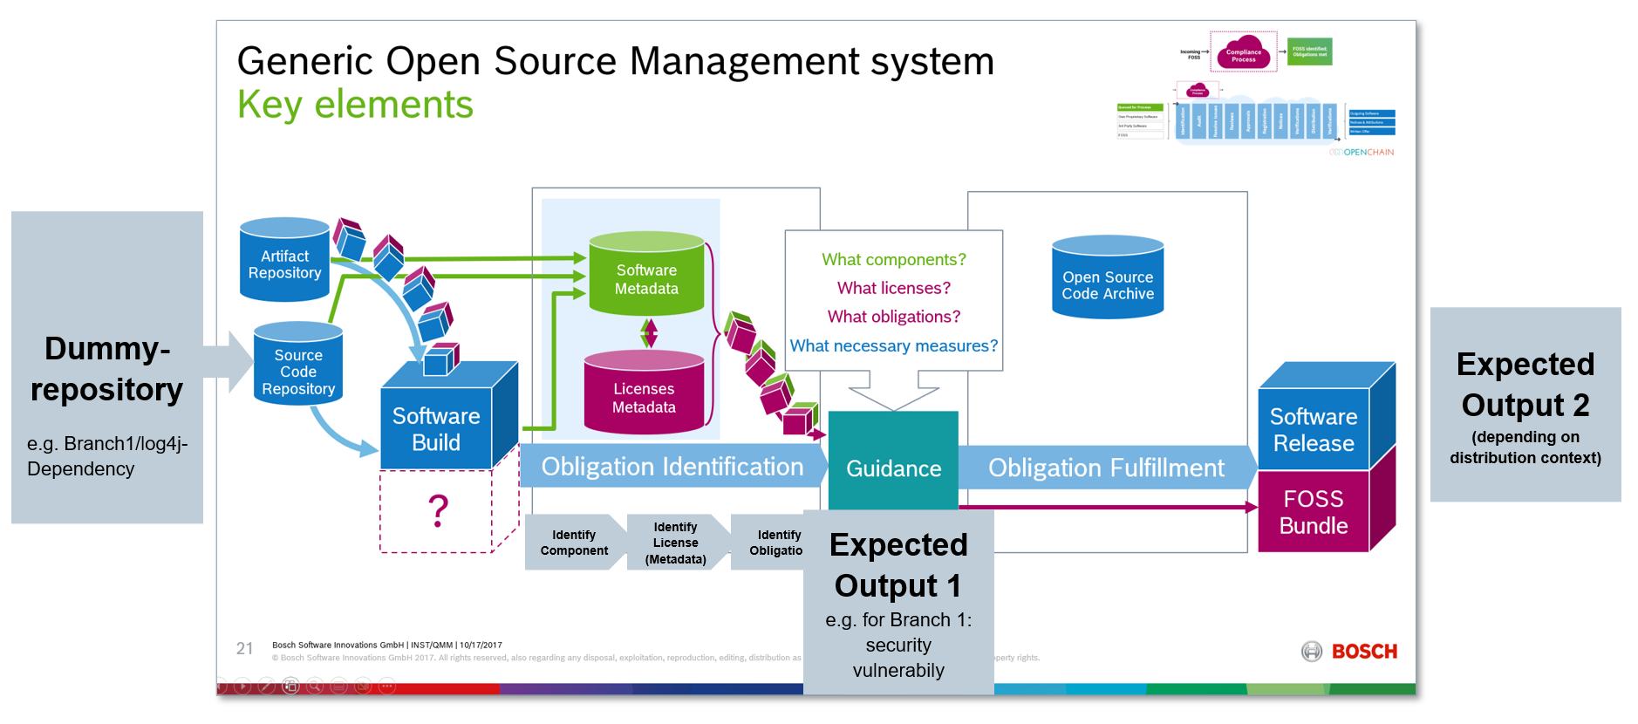
Showcase
Showcase focuses on first part

Slide 7
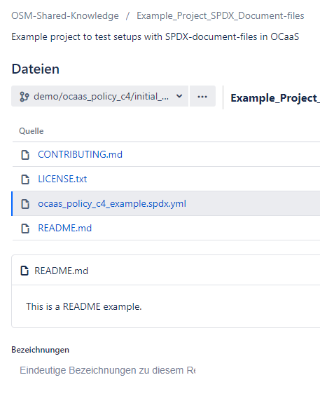
Showcase
Demo Repository (initial case)
Synthetic example based on ORTs
generic fallback*:
project.spdx.yml-file
(*details see https://github.com/oss-review-toolkit/ort/blob/main/plugins/package-managers/spdx/src/funTest/assets/projects/synthetic/inline-packages/project-xyz.spdx.yml )

Slide 8
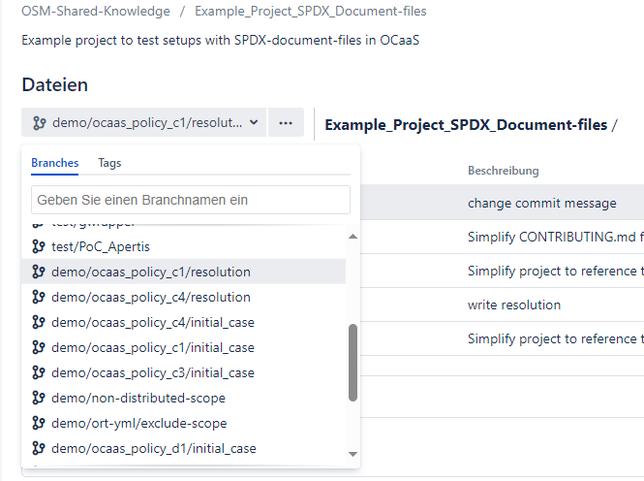
Showcase
Different branches for showcasing
For each show-case two branches:
Branch with the initial situation w/o fix
Branch with resolution
In this case e.g. we declared a commercial
license and thus provoqued a policy violation.
For results several possibilities:
- Either extra repository or another branch

Slide 9
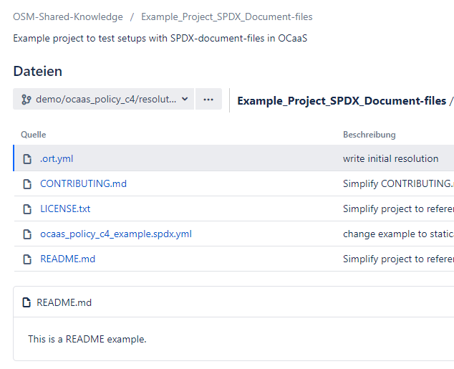
Showcase
Demo repository (resolution branch)
This is the same case with the
declared commercial license, but
we simulate that the license was acquired.
Thus the violation may be waived in
the .ort.yml-file and the violation is
gone.

Slide 10
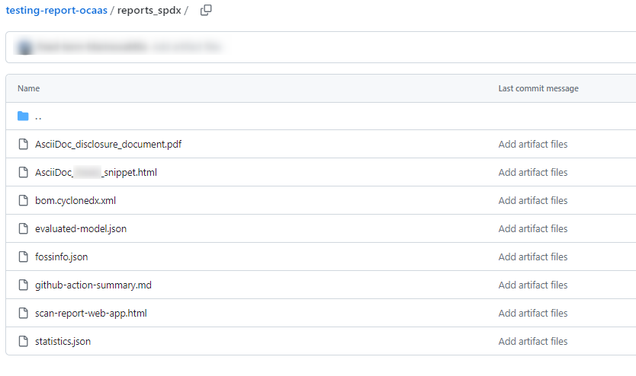
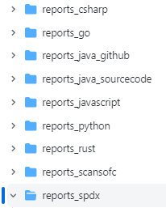
Showcase
Result repository
(scans are schedule nightly)

Slide 11
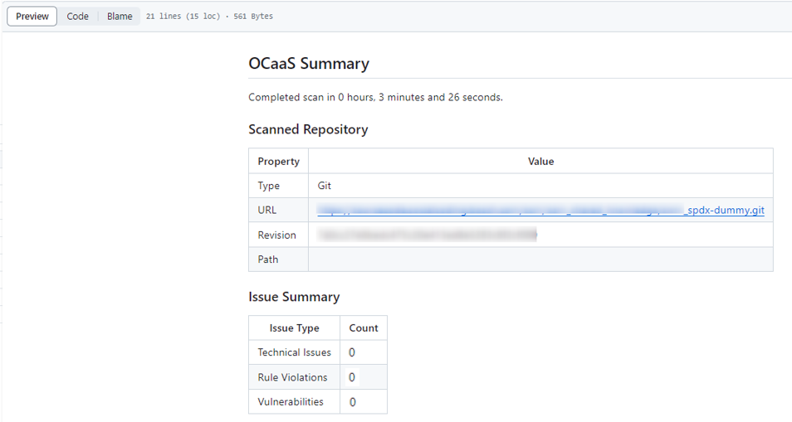
Showcase
Result repository

Slide 12

Showcase
Result repository
Extension with Test-Automation
Results may be check e.g. with RobotFramework.
Expected value for Rule Violation:
= 0
= 1

Slide 13
Next steps
…

