Slide 1
Big Picture – Integrated Compliance Toolchain
Inbound software
Dependency resolver
Container content resolver
Binary analyzer
Source package downloader
Component & application metadata repository
License Obligations Database
Integration layer (API/Data)
Integration layer (API/Data)
Integration layer (API/Data)
Integration layer (API/Data)
Integration layer (API/Data)
Integration layer (API/Data)
Outbound software
&
Compliance artifacts
Artifact Repository
Continuous Integration
Contributions
CI / CD Infrastructure
Public compliance artifact repos
Build Tools
Issue Tracker
Source Code Repo
Integration layer (API/Data)
Integration layer (API/Data)
Integration layer (API/Data)
Integration layer (API/Data)
Integration layer (API/Data)
Integration layer (API/Data)
License & Copyright Scanner
Forensic Code Analysis Service
Policy checker (Compliance Checker)
Obligation fulfillment
FOSS Compliance Bundle generator
Compliance artifact consistency

Slide 2









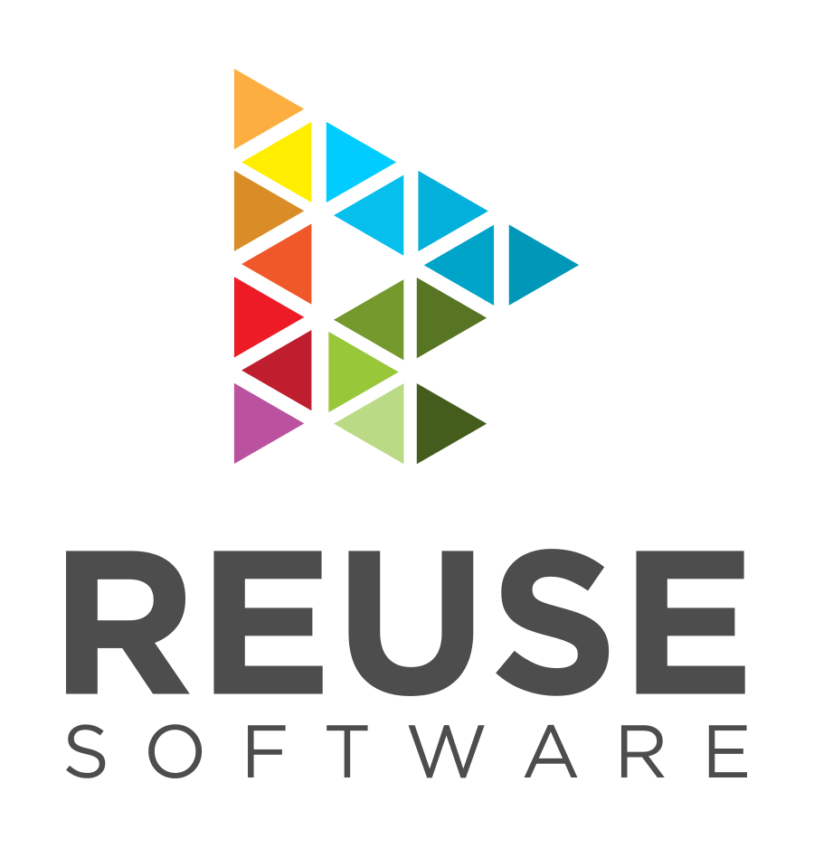



Example Automation Implementation Using Open Source Tools
Dependency resolver
Container content resolver
Binary analyzer
Source package downloader
Component & application metadata repository
License metadata repository
Inbound software
Bang
Integration layer (API/Data)
Integration layer (API/Data)
Integration layer (API/Data)
Integration layer (API/Data)
Integration layer (API/Data)
Integration layer (API/Data)
Outbound software
&
Compliance artifacts
Artifact Repository
Continuous Integration
Contributions
CI / CD Infrastructure
Build Tools
Issue Tracker
Source Code Repo
Integration layer (API/Data)
Integration layer (API/Data)
Integration layer (API/Data)
Integration layer (API/Data)
Integration layer (API/Data)
Integration layer (API/Data)
License Classifier
Compliance artifact consistency
ScanCode
Public compliance artifact repos
License & Copyright Scanner
Forensic Code Analysis Service
FOSS Compliance Bundle generator

Slide 3
Dependency resolver
Container content resolver
Binary analyzer
Source package downloader
Component & application metadata repository
License metadata repository
Inbound software
Bang
Integration layer (API/Data)
Integration layer (API/Data)
Integration layer (API/Data)
Integration layer (API/Data)
Integration layer (API/Data)
Integration layer (API/Data)
Outbound software
&
Compliance artifacts
Artifact Repository
Continuous Integration
Contributions
CI / CD Infrastructure
Build Tools
Issue Tracker
Source Code Repo
Integration layer (API/Data)
Integration layer (API/Data)
Integration layer (API/Data)
Integration layer (API/Data)
Integration layer (API/Data)
Integration layer (API/Data)
License Classifier
Compliance artifact consistency
ScanCode
Public compliance artifact repos
License & Copyright Scanner
Forensic Code Analysis Service
FOSS Compliance Bundle generator

