Slide 1
Sharing FOSS License Management Data
The OpenChain reference tooling work group 2023

Slide 2
Current Situation
Different Linux Distros and Ecosystems along the supply chain, every party needs to do Open Source Management (OSM)
upstream
downstream
Open Source
Image Creation in Proprietary Context
Consumer
Linux Kernel
Debian
Apertis
OSM
Device
Linux Images
Linux Images
Yocto +
bitbake
Oniro
Libraries
OSM
OSM
Leda
OSM
Ubuntu
…
…
OSM
Apps
OSM
…
OSADL
OSM

Slide 3
Overview
ID | Approach | Community | Linux Distro | Link
 | Yocto Bitbake + ORT (replacing meta-doubleopen/do-convert) | Double Open, OpenEmbedded | Yocto | https://www.youtube.com/watch?v=Q5UQUM6zxVU ; https://github.com/oss-review-toolkit/ort/issues/722
 | Aliens4Friends | Eclipse Oniro, Eclipse Leda | Yocto | https://gitlab.eclipse.org/eclipse/oniro-compliancetoolchain/toolchain/pipelines/-/raw/master/img/aliens4friends-schema-2021-12-17.png ; https://gitlab.eclipse.org/eclipse/oniro-compliancetoolchain/toolchain/docs/-/blob/main/audit_workflow/oniro_ip_audit_guidelines.md
 | OSADL Base images; FOSSology; OSSelot | OSADL | Alpine, Ubuntu, Debian | https://hub.docker.com/u/osadl ; https://www.osselot.org
 | Apertis + “ort-analyzer” + ORT | Apertis | Apertis(Debian) | https://gitlab.apertis.org/infrastructure/ort-analyzer
 |  |  | CentOS
 |  |  | Debian
 |  |  | Ubuntu
 | …
Plan to have Webinars for all known approaches to get a deeper insight

Slide 4
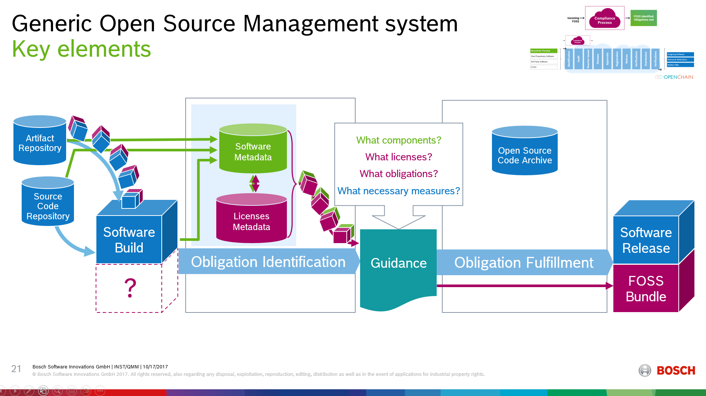
What all have in common…
First Goal:
Align on method to reproducibly identify and document the component specific metadata
Identify Component
Identify License (Metadata)
Identify Obligation

Slide 5
Next steps
…

